Slide 1
Laconic Function Evaluation and Applications
Willy Quach Hoeteck Wee Daniel Wichs
Northeastern University CNRS and ENS Northeastern University

Slide 2
Outline
Introduce “Laconic Function Evaluation” (LFE).
New primitive, dual to Fully Homomorphic Encryption.
Applications of LFE
Construction from Learning With Errors (LWE)

Slide 3
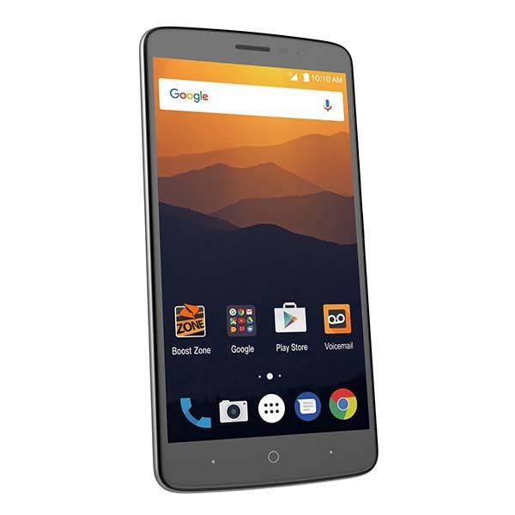





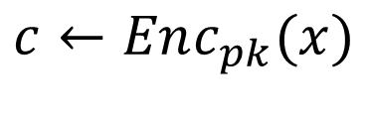

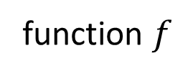
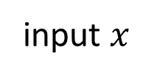
Fully Homomorphic Encryption (FHE)
Alice
Bob
input $x$
function $f$
$$c←Enc_{pk}(x)$$
$$c^{∗}=Eval (f,c)$$
$$Dec_{sk}\left(c^{∗} \right)=$$
$$f(x)$$
Security: Ciphertext $c$ hides all information about $x$.
Optional: Function hiding
Efficiency: “Bob does all the work.”

Slide 4
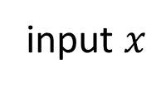
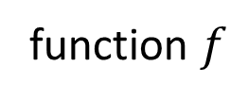
Let’s switch it up!
Alice
Bob
function $f$
input $x$
$$f(x)$$

Slide 5
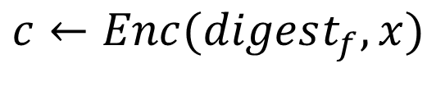


Laconic Function Evaluation (LFE)
Alice
Bob
function $f$
input $x$
$$digest_{f}=Compress(f)$$
$$c←Enc(digest_{f},x)$$
$$Dec\left(f,c \right)=$$
$$f(x)$$
Security: Ciphertext $c$ hides all information about $x$ except for $f(x)$.
Efficiency: Alice does all the work.

Slide 6

Laconic Function Evaluation (LFE)
Alice
Bob
function $f$
input $x$
$$digest_{f}=Compress(f)$$
$$c←Enc(digest_{f},x)$$
$$Dec\left(f,c \right)=$$
$$f(x)$$
Non-interactive view: Digest is a public encryption key.
Anyone can encrypt inputs $x$, Alice only recovers $f(x)$.
Feature!
The “decryption key” is the function $f$.
Feature or bug?

Slide 7
Laconic Function Evaluation (LFE)
Alice
Bob
function $f$
input $x$
$$digest_{f}=Compress(f)$$
$$c←Enc(digest_{f},x)$$
$$Dec\left(f,c \right)=$$
$$f(x)$$
Default: compression deterministic, digest does not fully hide $f$.

Slide 8

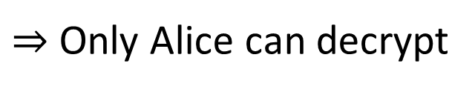

Function-Hiding LFE
Alice
Bob
function $f$
input $x$
$$digest_{f}=Compress(f;r)$$
$$c←Enc(digest_{f},x)$$
$$Dec\left(r,f,c \right)=$$
$$f(x)$$
Also consider (randomized) function-hiding LFE. Digest hides function $f$.
$⇒$ Only Alice can decrypt

Slide 9
Common Reference String
Alice
Bob
function $f$
input $x$
$$digest_{f}=Compress(f)$$
$$c←Enc(digest_{f},x)$$
$$Dec\left(f,c \right)=$$
$$f(x)$$
Compresssion needs to be collision resistant.

Slide 10
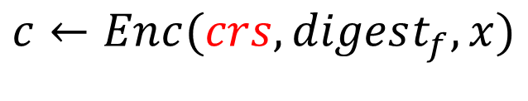



Common Reference String
$$crs$$
Alice
Bob
function $f$
input $x$
$$digest_{f}=Compress(crs, f)$$
$$c←Enc(crs, digest_{f},x)$$
$$Dec\left(crs,f,c \right)=$$
$$f(x)$$
Will ignore this throughout talk
Compresssion needs to be collision resistant.
Requires a “common reference (random) string”.

Slide 11











Security of LFE
$$Challenger\{Real,Ideal\}$$
$$crs$$
$$crs←Setup$$
$$x, f$$
$$dig_{f}←Compress(crs,f)$$
$$ct$$
$$ct^{Real} ←Enc(crs, dig_{f},x)$$
$$ct^{Ideal}←Sim(crs, dig_{f}, f\left(x\right))$$
$$Real≈Ideal$$
Notes:
Challenger Adversary

Slide 12


Security of LFE (selective)
$$Challenger\{Real,Ideal\}$$
$$x$$
$$crs$$
$$crs←Setup$$
$$f$$
$$dig_{f}←Compress(crs,f)$$
$$ct$$
$$ct^{Real} ←Enc(crs, dig_{f},x)$$
$$ct^{Ideal}←Sim(crs, dig_{f}, f\left(x\right))$$
$$Real≈Ideal$$
Notes:
Challenger Adversary

Slide 13
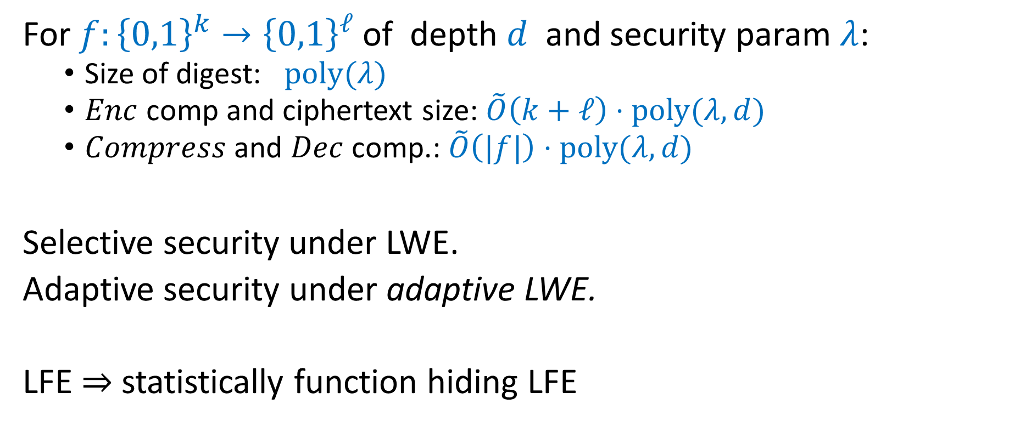
Our Results: LFE from LWE
For $f:{\left\{0,1\right\}}^{k}→{\left\{0,1\right\}}^{ℓ}$ of depth $d$ and security param $λ$:
  Size of digest: $poly(λ)$
  $Enc$ comp and ciphertext size: $\tilde{O}\left(k+ℓ\right)⋅poly(λ,d)$
  $Compress$ and $Dec$ comp.: $\tilde{O}\left(|f|\right)⋅poly(λ,d)$
Selective security under LWE.
Adaptive security under adaptive LWE.
LFE $⇒$ statistically function hiding LFE
Notes:
Comment on the +?

Slide 14
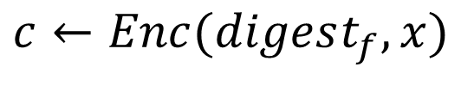


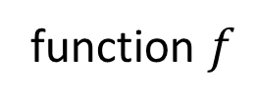

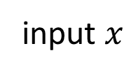
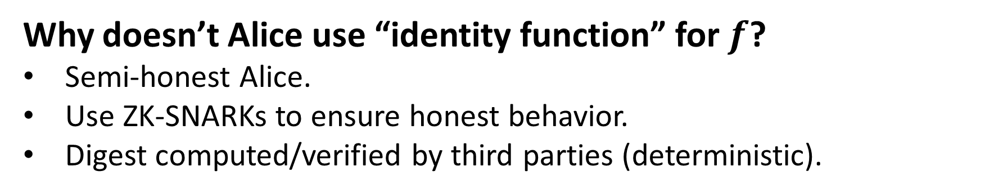
Security Meaningful?
Alice
Bob
function $f$
input $x$
$$digest_{f}=Compress(f)$$
$$c←Enc(digest_{f},x)$$
$$Dec\left(f,c \right)=$$
$$f(x)$$
Malicious digest?
Why doesn’t Alice use “identity function” for $f$?
Semi-honest Alice.
Use ZK-SNARKs to ensure honest behavior.
Digest computed/verified by third parties (deterministic).

Slide 15




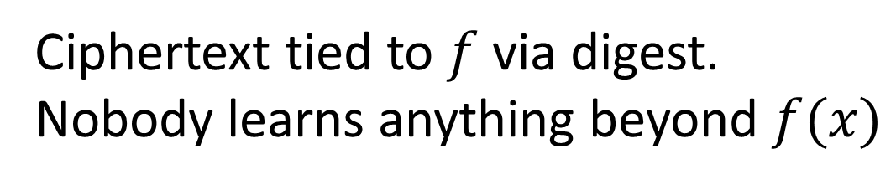


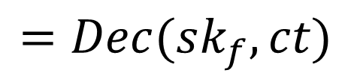





LFE vs Succinct Functional Encryption (FE)
$$msk$$
$$mpk$$
$$sk_{f}$$
$$f$$
$$x$$
$$ct$$
$$f\left(x\right)$$
$$=Dec(sk_{f},ct)$$
$$ct=Enc(mpk, x)$$
Succinct FE
LFE
Ciphertext tied to $f$ via digest.
Nobody learns anything beyond $f(x)$
Trusted third party learns $x$.
Give keys for different functions.

Slide 16
Outline
Introduce “Laconic Function Evaluation” (LFE).
New primitive, dual to Fully Homomorphic Encryption.
Applications of LFE
Construction from Learning With Errors (LWE)

Slide 17




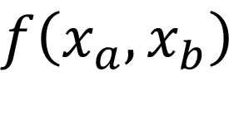
Application 1: Succinct Two-Party Computation
Security: Alice learns nothing more than $f(x_{a},x_{b})$
Bob does not learn anything
$$f$$
$$x_{a}$$
$$x_{b}$$
$$f\left(x_{a},x_{b}\right)$$
Notes:
2 rounds, Alice starts and gets output

Slide 18




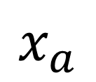
Alice-Optimized Protocol (insecure)
$$f$$
$$x_{a}$$
$$x_{b}$$
$$x_{a}$$
Compute
$$f\left(x_{a},x_{b}\right)$$
$$y=f\left(x_{a},x_{b}\right)$$
Efficiency: - Communication O(|x_{a}| +|y|)
- Bob does all the computation

Slide 19
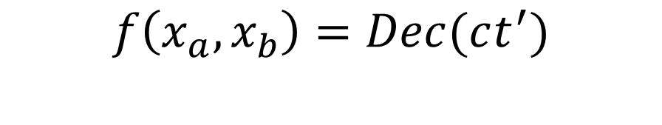



Alice-Optimized Protocol (secure via FHE)
$$f$$
$$x_{a}$$
$$x_{b}$$
$$ct←Enc(x_{a})$$
$$ct^{′}←Eval(f_{b}, ct)$$
$$ct′$$
$$f\left(x_{a},x_{b}\right)=Dec(ct^{′})$$
Function Hiding
Efficiency: - Communication O(|x_{a}| +|y|)
- Bob does all the computation

Slide 20


Bob-optimized protocol (insecure)
$$f$$
$$x_{a}$$
$$x_{b}$$
$$x_{b}$$
$$f\left(x_{a},x_{b}\right)$$
Efficiency: - Communication O(|x_{b}|)
- Alice does all the computation

Slide 21

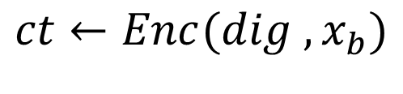

Bob-optimized protocol (secure via LFE)
$$f$$
$$x_{a}$$
$$x_{b}$$
Function Hiding
$$dig←Compress(f_{a};r)$$
$$ct←Enc(dig ,x_{b})$$
$$f\left(x_{a},x_{b}\right)=Dec(r, f_{a},ct)$$
Efficiency: - Communication O(|x_{b}|+|y|)poly(depth)
- Alice does all the computation

Slide 22
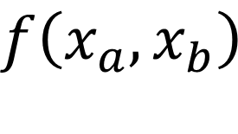
Succinct 2-Party Computation
$$f$$
$$x_{a}$$
$$x_{b}$$
$$f\left(x_{a},x_{b}\right)$$
Two solutions: Alice-optimized via FHE, Bob-optimized via LFE
Both only achieve semi-honest (semi-malicious) security.
Upgrade to fully malicious via ZK-SNARKs.
Notes:
2 rounds, Alice starts and gets output

Slide 23



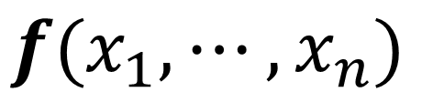

Application 2: MPC with Low Online Computation
$$x_{2}$$
$$f(x_{1},⋯,x_{n})$$
Fast protocol execution, less complex than computing $f$.
Allow pre-processing and post-procesing.
$$x_{1}$$
$$x_{3}$$

Slide 24

Application 2: MPC with Low Online Computation
$$x_{2}$$
$$f(x_{1},⋯,x_{n})$$
1. Compute $dig_{f}=Compress(f)$; Offline
2. Run MPC to compute $ct=Enc\left(dig_{f}, \left(x_{1},⋯,x_{n}\right)\right);$ Online ☺
3. Decrypt $f\left(x_{1},⋯, x_{n}\right)=Dec\left(f,ct\right).$ Offline
$$x_{1}$$
$$x_{3}$$
If inner MPC is maliciously secure so is final protocol.

Slide 25
Outline
Introduce “Laconic Function Evaluation” (LFE).
New primitive, dual to Fully Homomorphic Encryption.
Applications of LFE
Construction from Learning With Errors (LWE)
  Attribute-Based LFE (AB-LFE)
  Construct AB-LFE from LWE : adaptation of [BGGHNSVV’13]
  AB-LFE to LFE via FHE : adaptation of [GKP+13]

Slide 26




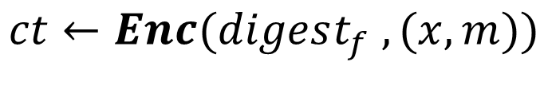


Attribute-Based LFE (AB-LFE)
public
$$f$$
$$x, m$$
$$digest_{f}=Compress(f)$$
$$ct←Enc(digest_{f} ,(x,m))$$
$$ct$$
$$Dec\left(f,ct\right)=m if f\left(x\right)=0$$
authorized
$$m hidden if f\left(x\right)=1$$
unauthorized

Slide 27




Learning with Errors (LWE) [Regev 05]
$$m$$
$$A$$
$$n$$
$$A∈_{R}ℤ_{q}^{n×m }$$
Notes:
In box: decisional LWE?

Slide 28













Learning with Errors (LWE) [Regev 05]
$$m$$
$$n$$
$$m$$
$$A$$
$$,$$
$$s$$
$$A$$
$$+$$
$$e$$
$$A$$
$$,$$
$$u$$
$$≈_{c}$$
small
$$A∈_{R}ℤ_{q}^{n×m }, s∈_{R}ℤ_{q}^{n }, e←χ^{m}$$
$u$ $∈_{R}ℤ_{q}^{m }$
Notes:
In box: decisional LWE?

Slide 29








Gadget Matrix [Micciancio-Peikert12]
$$G$$
$$G^{−1}(Y)$$
$$Y$$
$G$ gadget matrix
$G$ is a powers-of-two matrix
$G^{−1}(X)$ is the Bit-Decomposition of $X$.
$$=$$
$$ℤ_{q}^{n×m }$$
$$ℤ_{q}^{n×m }$$
$${\left\{0,1\right\}}^{m×m}$$

Slide 30








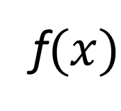



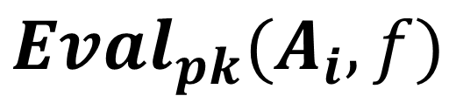




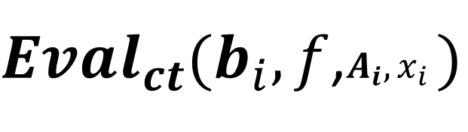




Lattice Homomorphism [BGGHNSVV’13]
$$∈\{0,1\}$$
$$A_{i}$$
$$b_{i}=$$
$$s$$
$$A_{i}$$
$$G$$
$$+$$
$$e_{i}$$
$$−$$
$$x_{i}$$
small
$$Eval_{pk}(A_{i},f)$$
$Eval_{ct}(b_{i},f$,$A_{i}, x_{i}$ $)$
$$A_{f}$$
$$b_{f}=$$
$$s$$
$$A_{f}$$
$$G$$
$$+$$
$$e_{C}$$
$$−$$
f$(x)$
« small »
$$∈\{0,1\}$$
Notes:
No rectangles

Slide 31





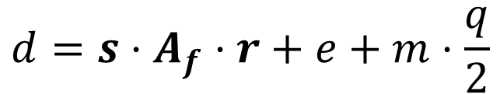

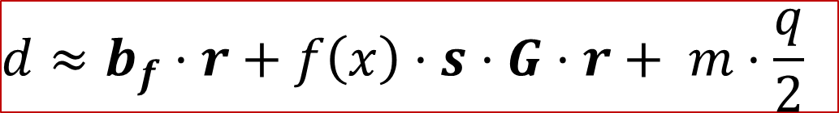





Building AB-LFE
$$A_{i} b_{i}=s\left(A_{i}−x_{i}G\right)+e_{i}$$
$$Eval_{pk}$$
$$Eval_{ct}$$
$$A_{f} b_{f}=s\left(A_{f}−f(x)G\right)+e_{f}$$
$$crs=A_{1},⋯,A_{k}$$
$$f$$
$$x, m$$
$$A_{f}$$
$$A_{f}=Eval_{pk}(A_{i},f)$$
$$b_{i}=s\left(A_{i}−x_{i}⋅G\right)+e_{i}$$
$${(x,\{b}_{i}\}, d,r)$$
$$r←{\left\{0,1\right\}}^{m}$$
$$b_{f}=Eval_{ct}(b_{i},f)$$
$$d=s⋅A_{f}⋅r+e+m⋅\frac{q}{2}$$
$$Output 1 if d−b_{f}⋅r large$$
$$d≈b_{f}⋅r+f\left(x\right)⋅s⋅G⋅r+ m⋅\frac{q}{2}$$

Slide 32
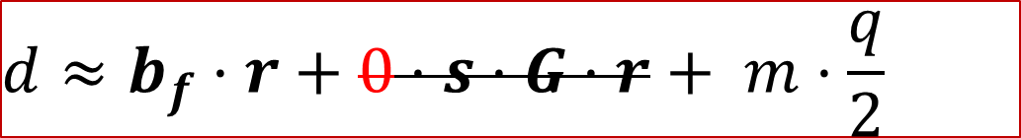

Building AB-LFE
$$A_{i} b_{i}=s\left(A_{i}−x_{i}G\right)+e_{i}$$
$$Eval_{pk}$$
$$Eval_{ct}$$
$$A_{f} b_{f}=s\left(A_{f}−f(x)G\right)+e_{f}$$
$$crs=A_{1},⋯,A_{k}$$
$$f$$
$$x, m$$
$$A_{f}$$
$$A_{f}=Eval_{pk}(A_{i},f)$$
$$b_{i}=s\left(A_{i}−x_{i}⋅G\right)+e_{i}$$
$${(x,\{b}_{i}\}, d,r)$$
$$r←{\left\{0,1\right\}}^{m}$$
$$b_{f}=Eval_{ct}(b_{i},f)$$
$$d=s⋅A_{f}⋅r+e+m⋅\frac{q}{2}$$
$$Output 1 if d−b_{f}⋅r large$$
Correctness:
$$f(x)=0$$
$$d≈b_{f}⋅r+0⋅s⋅G⋅r+ m⋅\frac{q}{2}$$

Slide 33
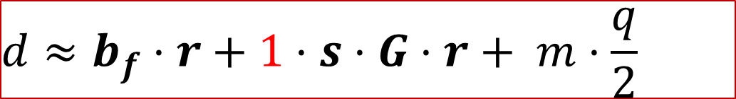

Building AB-LFE
$$A_{i} b_{i}=s\left(A_{i}−x_{i}G\right)+e_{i}$$
$$Eval_{pk}$$
$$Eval_{ct}$$
$$A_{f} b_{f}=s\left(A_{f}−f(x)G\right)+e_{f}$$
$$crs=A_{1},⋯,A_{k}$$
$$f$$
$$x, m$$
$$A_{f}$$
$$A_{f}=Eval_{pk}(A_{i},f)$$
$$b_{i}=s\left(A_{i}−x_{i}⋅G\right)+e_{i}$$
$${(x,\{b}_{i}\}, d,r)$$
$$r←{\left\{0,1\right\}}^{m}$$
$$b_{f}=Eval_{ct}(b_{i},f)$$
$$d=s⋅A_{f}⋅r+e+m⋅\frac{q}{2}$$
$$Output 1 if d−b_{f}⋅r large$$
Security:
$$f(x)=1$$
$$d≈b_{f}⋅r+1⋅s⋅G⋅r+ m⋅\frac{q}{2}$$

Slide 34

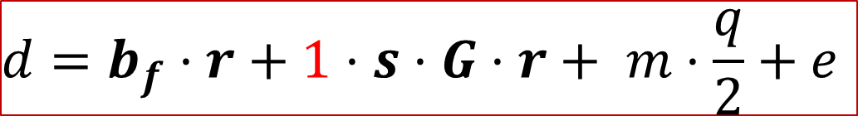
Building AB-LFE
$$A_{i} b_{i}=s\left(A_{i}−x_{i}G\right)+e_{i}$$
$$Eval_{pk}$$
$$Eval_{ct}$$
$$A_{f} b_{f}=s\left(A_{f}−f(x)G\right)+e_{f}$$
$$crs=A_{1},⋯,A_{k}$$
$$f$$
$$x, m$$
$$A_{f}$$
$$A_{f}=Eval_{pk}(A_{i},f)$$
$$b_{i}=s\left(A_{i}−x_{i}⋅G\right)+e_{i}$$
$${(x,\{b}_{i}\}, d,r)$$
$$r←{\left\{0,1\right\}}^{m}$$
$$b_{f}=Eval_{ct}(b_{i},f)$$
$$Output 1 if d−b_{f}⋅r large$$
$$a$$
Security:
$$f(x)=1$$
$$d=b_{f}⋅r+1⋅s⋅G⋅r+ m⋅\frac{q}{2}+e$$

Slide 35
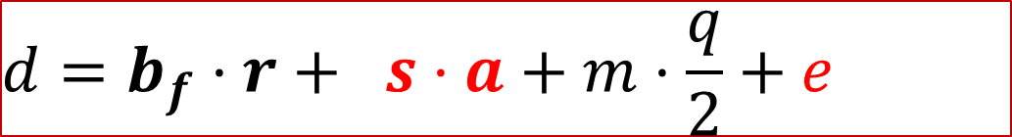


Building AB-LFE
$$A_{i} b_{i}=s\left(A_{i}−x_{i}G\right)+e_{i}$$
$$Eval_{pk}$$
$$Eval_{ct}$$
$$A_{f} b_{f}=s\left(A_{f}−f(x)G\right)+e_{f}$$
$$crs=A_{1},⋯,A_{k}$$
$$f$$
$$x, m$$
$$A_{f}$$
$$A_{f}=Eval_{pk}(A_{i},f)$$
$$b_{i}=s\left(A_{i}−x_{i}⋅G\right)+e_{i}$$
$${(x,\{b}_{i}\}, d,r)$$
$$a←ℤ_{q}^{n}$$
$$b_{f}=Eval_{ct}(b_{i},f)$$
$$r=G^{−1}(a)$$
$$Output 1 if d−b_{f}⋅r large$$
Security:
$$f(x)=1$$
$$d=b_{f}⋅r+ s⋅a+m⋅\frac{q}{2}+e$$

Slide 36
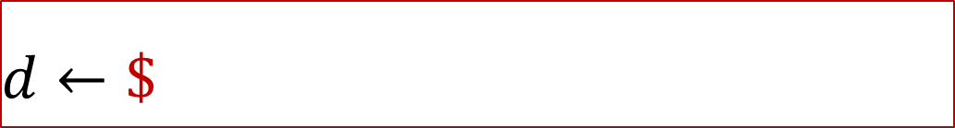



Building AB-LFE
$$A_{i} b_{i}=s\left(A_{i}−x_{i}G\right)+e_{i}$$
$$Eval_{pk}$$
$$Eval_{ct}$$
$$A_{f} b_{f}=s\left(A_{f}−f(x)G\right)+e_{f}$$
$$crs=A_{1},⋯,A_{k}$$
$$f$$
$$x, m$$
$$A_{f}$$
$$A_{f}=Eval_{pk}(A_{i},f)$$
$$b_{i}←\$$$
$${(x,\{b}_{i}\}, d,r)$$
$$a←ℤ_{q}^{n}$$
$$b_{f}=Eval_{ct}(b_{i},f)$$
$$r=G^{−1}(a)$$
$$Output 1 if d−b_{f}⋅r large$$
Security:
$$f(x)=1$$
$d←\$$

Slide 37
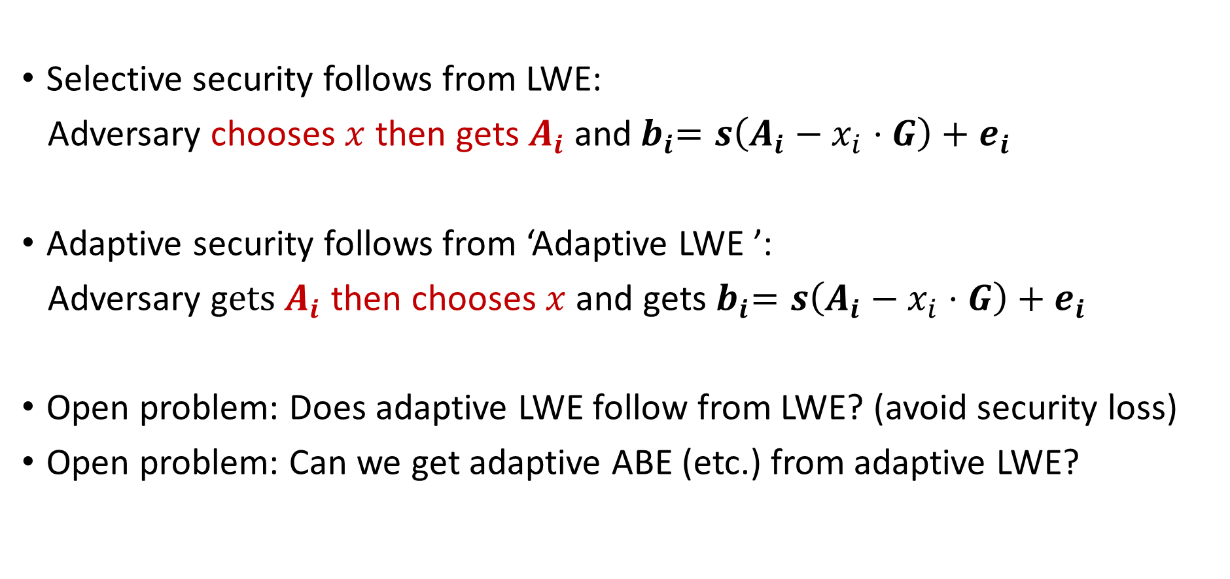
Selective vs. Adaptive AB-LFE?
Selective security follows from LWE:
Adversary chooses $x$ then gets $A_{i}$and${ b}_{i}=s\left(A_{i}−x_{i}⋅G\right)+e_{i}$
Adaptive security follows from ‘Adaptive LWE ’:
Adversary g$ets A_{i}$ then chooses $x$ and gets${ b}_{i}=s\left(A_{i}−x_{i}⋅G\right)+e_{i}$
Open problem: Does adaptive LWE follow from LWE? (avoid security loss)
Open problem: Can we get adaptive ABE (etc.) from adaptive LWE?
Notes:
X vector

Slide 38

AB-LFE + FHE ⇒ LFE [GKPVZ’13]
Bob wants to encrypt $x$so that Alice only learns $f(x)$.
But in AB-LFE attribute $x$ is public.
Encrypt $x$ under FHE! New attribute is ${\hat{x}=Enc}_{pk}(x)$.
Garble the FHE decryption circuit with secret-key hard-coded.
Use AB-LFE to ensure that Alice only learns garbled labels for ${Enc}_{pk}(f(x))$.
Notes:
Encrypt homomorphically attribute

Slide 39



LFE Implies (Statistical) Function Hiding LFE
Use 2-round 2PC to get function hiding:
LFE implies OT (with statistical receiver security)
implies 2-round 2PC (with statistical security for Alice)
implies (statistical) function-hiding LFE
$$digest_{f}$$
$$x$$
new digest
new encryption
$$Enc(digest_{f},x)$$

Slide 40
Conclusions and Open Problems
Define new primitive: “laconic function evaluation”. Construction from LWE.
Showed two applications to MPC. More applications?
Depth-dependent efficiency. Can we get rid of this? Analogue of bootstrapping? This problem shows up in many places.
Understand adaptive LWE.
Security with maliciously generated digests?

