Slide 1
On the Implausibility of
Differing-Inputs Obfuscation
(and Extractable Witness Encryption) with Auxiliary Input
Daniel Wichs (Northeastern U)
with: Sanjam Garg, Craig Gentry, Shai Halevi

Slide 2
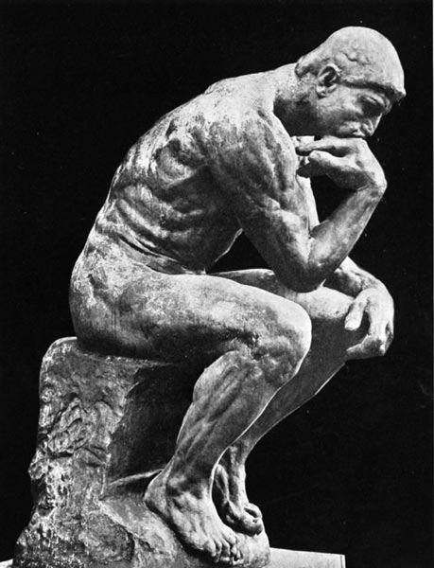
Overview of Result
Differing-inputs obfuscation cannot exist
  assuming another form of obfuscation does exist.
science
philosophy / hand-waving
+
Theorems, Proofs
What does it all mean?

Slide 3
Ancient History of Obfuscation ‘00-’13
First formally studied by [Hada 00] and [Barak et al. 01].
Defined strong notion of “virtual black-box obfuscation” (VBB).
  Obfuscated code only as good as black-box access to program.
Negative Result: VBB obfuscation is impossible for many “pathological functions” (contrived).
  Cannot have general VBB obfuscation.
  Don’t have a general class that excludes all “pathological functions”.
Positive Results: Can obfuscate some very simple functions like “point functions” [Canetti ‘97, Wee ‘05,…].

Slide 4
Our Knowledge of VBB Obfuscation
unobfusctable
obfusctable
unknown

Slide 5
Interpretation of VBB before ‘13
unobfusctable
obfusctable

Slide 6
Candidate Obfuscator
The first general candidate obfuscator [Garg-Gentry-Halevi-Raykova-Sahai-Waters 13]
  Can be applied to any poly-time program.
  Fails to be VBB for some “pathological functions”, but does not seem to have any other weakness.

Slide 7
Interpretation of VBB after ‘13
unobfusctable
obfusctable
Green or red?

Slide 8
General Obfuscation Assumption
Can we have a general, simple-to-state, useful assumption about an obfuscator?
Two such candidates proposed by [Barak et al. 01]:
  Indistinguishability Obfuscation (iO)
  Differing-Inputs Obfuscation (diO)

Slide 9
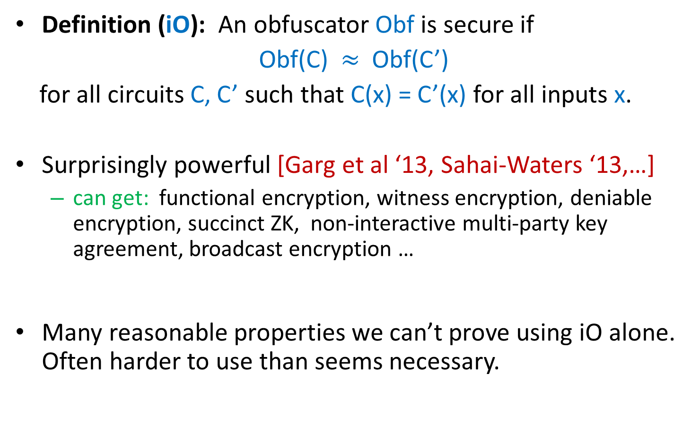
Indistinguishability Obfuscation
Definition (iO): An obfuscator Obf is secure if
Obf(C) $≈$ Obf(C’)
for all circuits C, C’ such that C(x) = C’(x) for all inputs x.
Surprisingly powerful [Garg et al ‘13, Sahai-Waters ‘13,…]
  can get: functional encryption, witness encryption, deniable encryption, succinct ZK, non-interactive multi-party key agreement, broadcast encryption …
Many reasonable properties we can’t prove using iO alone. Often harder to use than seems necessary.

Slide 10

Differing-Inputs Obfuscation
Definition (diO): An obfuscator Obf is secure if
Obf(C) $≈$ Obf(C’)
for all “differing-inputs distributions” (C,C’) $←$ D
s.t. given C, C’ hard to find x : C(x) $≠$ C’(x)

Slide 11
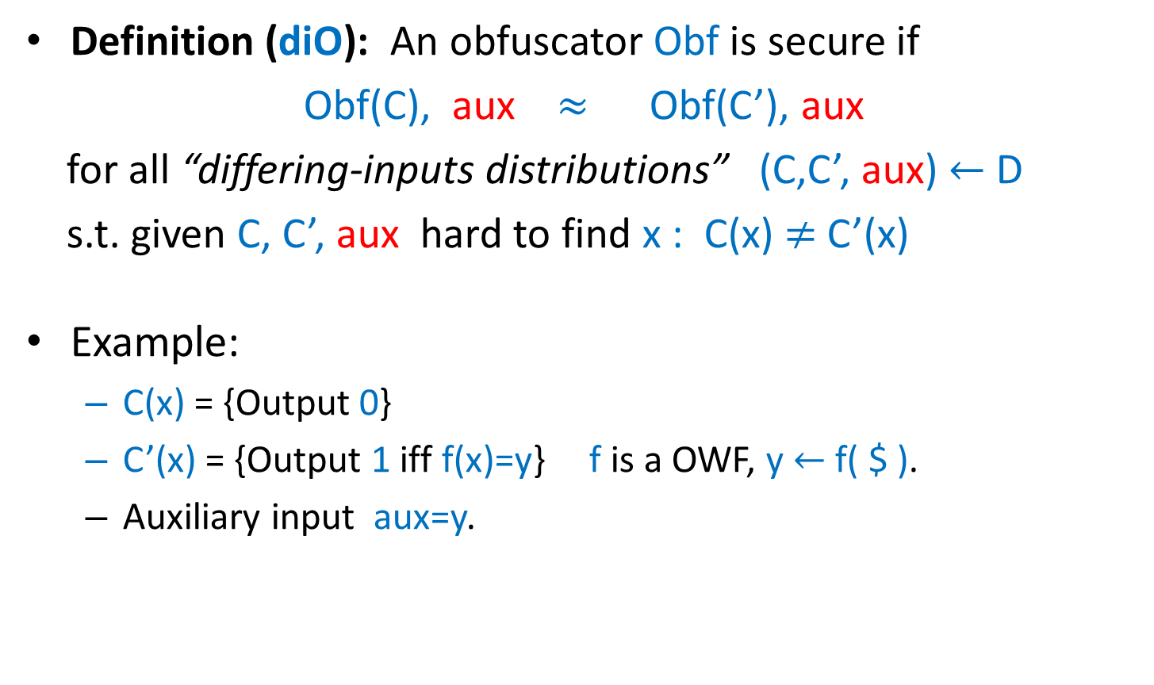
Differing-Inputs Obfuscation
Definition (diO): An obfuscator Obf is secure if
Obf(C), aux $≈$ Obf(C’), aux
for all “differing-inputs distributions” (C,C’, aux) $←$ D
s.t. given C, C’, aux hard to find x : C(x) $≠$ C’(x)
Example:
  C(x) = {Output 0}
  C’(x) = {Output 1 iff f(x)=y} f is a OWF, y $←$ f( $ ).
  Auxiliary input aux=y.

Slide 12
Differing-Inputs Obfuscation
Recently explored by Ananth et al. [ABG+13] and Boyle et al. [BCP14] who showed many applications:
  obfuscation for TMs
  adaptively secure functional encryption for TMs.
  extractable witness encryption
Many results using iO can be simplified if we use diO.

Slide 13
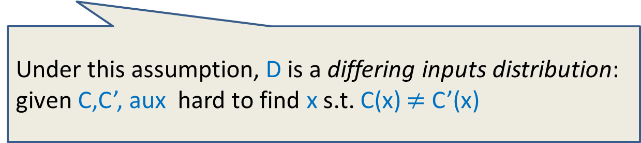
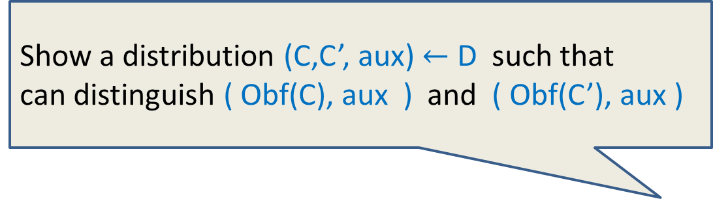
Our Results
Show a distribution (C,C’, aux) $←$ D such that
can distinguish ( Obf(C), aux ) and ( Obf(C’), aux )
General differing-inputs obfuscation cannot exist
assuming that
a “special-purpose obfuscation assumption” holds
(a specific function can be obfuscated to hide specific info)
(extractable witness encryption)
Under this assumption, D is a differing inputs distribution:
given C,C’, aux hard to find x s.t. C(x) $≠$ C’(x)

Slide 14
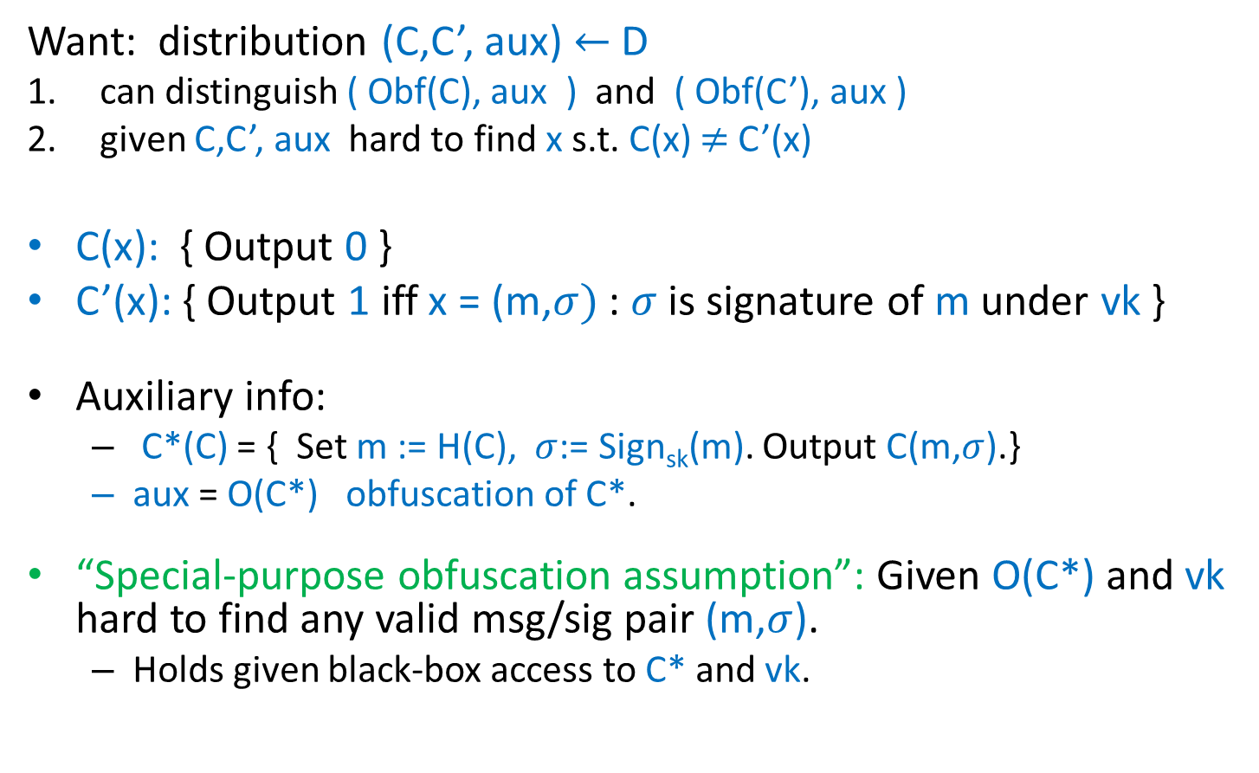

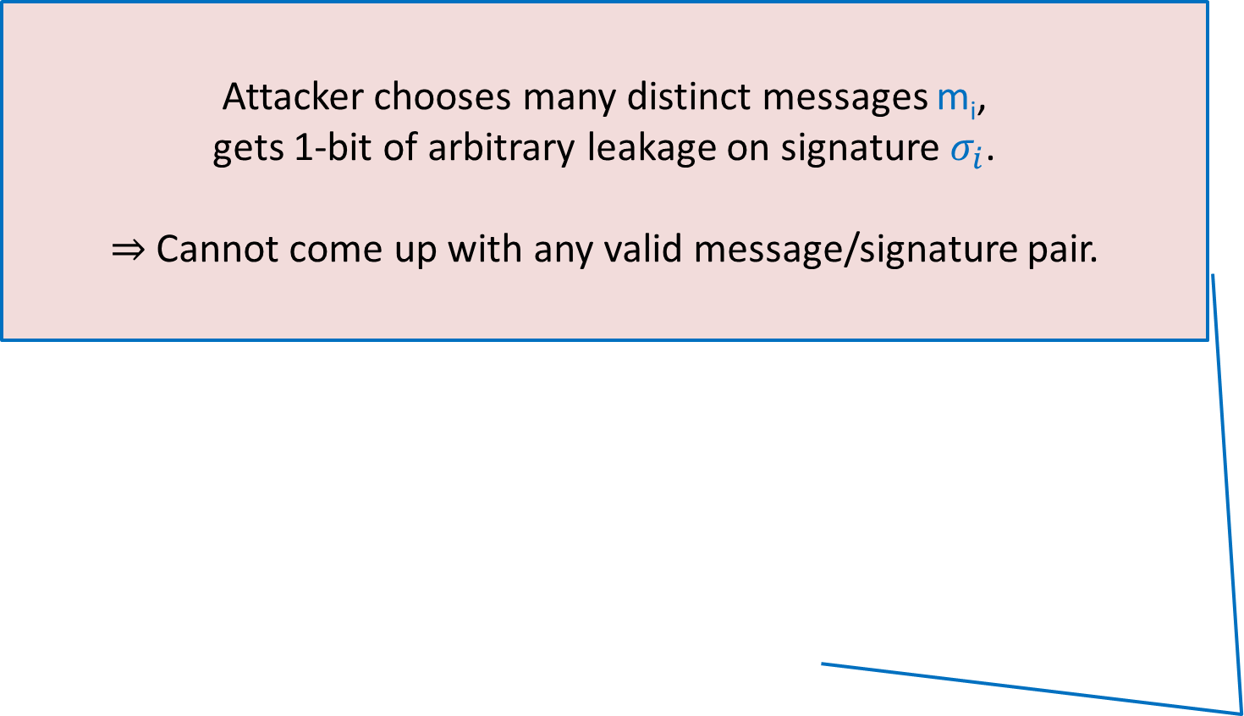
Counter-Example
Attacker chooses many distinct messages m_{i},
gets 1-bit of arbitrary leakage on signature $σ_{i}$.
$⇒$ Cannot come up with any valid message/signature pair.
Want: distribution (C,C’, aux) $←$ D
can distinguish ( Obf(C), aux ) and ( Obf(C’), aux )
given C,C’, aux hard to find x s.t. C(x) $≠$ C’(x)
C(x): { Output 0 }
C’(x): { Output 1 iff x = (m,$σ)$ : $σ$ is signature of m under vk }
Auxiliary info:
  C*(C) = { Set m := H(C), $σ$:= Sign_{sk}(m). Output C(m,$σ$).}
  aux = O(C*) obfuscation of C*.
“Special-purpose obfuscation assumption”: Given O(C*) and vk hard to find any valid msg/sig pair (m,$σ$).
  Holds given black-box access to C* and vk.

Slide 15
At most one can survive!
General differing-inputs obfuscation
for all “differing-inputs distributions”
[indistinguishability property] holds
vs.
Special-purpose obfuscation assumption
given obfuscation of specific C* hard to recover a valid signature
Not “falsifiable”
[Naor 03 ]
implies existence of efficient algorithm
without having a candidate
falsifiable

Slide 16
What to think of diO?
General diO for all “differing-inputs families” is implausible.
But diO and even VBB obfuscation can plausibly hold for most natural candidates that we’d like to obfuscate.
  Better to rely on diO vs. VBB. Clarifies which property you really need.
The search continues for a useful, plausible, general obfuscation assumption.
Obfuscation is the new random oracle model ?

Slide 17
Thank you!

