Slide 1
Effective Competition Organization to Obtain Effective Algorithmic Solutions from a Motivated Community
Karl Lieberherr, Northeastern University,
College of Computer and Information Science, PRL
joint work with
Ahmed Abdelmeged (PhD Dissertation)
Ruiyang Xu

Slide 2

Solving Complex Problems using the Crowd
We want Incentive
Compatibility.
Some are better
than others: we want
a fair, peer-based
meritocracy.
Some want to
game the system
by colluding/lying.

Slide 3
Complex behavior of the crowd!
The correct solution is not known.
Correct solutions are refuted.
Incorrect solutions are defended.
Players may change their mind about which solution is correct.
Players may lie about their strength and intentionally help a friend to become more meritorious (collusion).
How can we get a useful signal out of this complex behavior?
  a data mining problem.
  wrong approach: accumulate information about solutions.
  better approach: accumulate information about players.

Slide 4
Contributions
We offer
  A new kind of game: called a side-choosing game for modeling formal science communities (Algorithms is a good Example).
  A theoretical study of side-choosing games
    2 Theorems:
      A Representation Theorem that provides a family of desirable ranking algorithms satisfying three axioms, including the collusion-resistance axiom.
      Incentive-Compatibility Theorem: shows that collusion-resistance is essential for incentive compatibility.
  A practical application of side-choosing games
    Reports about how we use side-choosing games for course home works to take advantage of peer teaching.

Slide 5
What we want: an incentive compatible mechanism
Best player as determined by the motivated players. Not the best player as determined by some fixed benchmark or an often unknown perfect solution.
Players make choices about game positions (claims) and they have to defend those choices by winning a game.
Want to find the best players that are most consistent in supporting their choices.
We do this search in the presence of collusion: players who lie about their strength to artificially boost the consistency of another player.
We guarantee that the best players will be top-ranked for any set of games.

Slide 6
Contributions: Side-Choosing Games
Side-choosing Games provide a useful foundation to organize computational problem solving communities.
We introduce an elegant ranking theory, based on Social Choice ideas, for side-choosing games which is based on collusion-resistance and which guarantees to find the most meritorious players as determined by the motivated community (and not by some fixed benchmark or an often unknown perfect solution).
  We have a guaranteed fair peer evaluation which works for any set of side-choosing games (not just full round-robin tournaments).
  The ranking theory is based on a representation theorem which shows that any ranking function satisfying three axioms must have an efficiently checkable property.

Slide 7
Effective Organization of a Motivated Community to Obtain Effective Algorithmic Solutions
In economics, when a person must rely on others to solve a problem there are two important constraints
  Participation Constraint
    ensures that people want to participate.
  Incentive Compatibility Constraint
    ensures that people are motivated to behave in a manner consistent with the best solution.
Our solution for both constraints: Side-Choosing Games with the right Ranking Mechanism

Slide 8
Abstract
We introduce a new game, called “side-choosing game” that helps to organize computational problem solving communities and more generally constructive formal scientific communities. We study the social choice theory of side-choosing games, including appropriate axioms, a representation theorem and a meritocracy theorem. While traditional social-choice theory studies game-theoretic models of political institutions we study game-theoretic models of formal scientific communities.
Side-choosing games offer the benefit of fair, collusion-resistant peer evaluation without a central authority, thereby lowering the effort of organizing competitions similar to the ones held on TopCoder.com. Side-choosing games are educational for players, giving them targeted feedback on their choices and their defense, offering many learning opportunities. We report on our experience in building computational problem solving communities in algorithm and software development courses as a first application of our theory.

Slide 9
Introduction
Theory
Methods
Applications/Results
Conclusion
In 2011, researchers from the Harvard Catalyst Project were investigating the potential of crowdsourcing genome-sequencing algorithms.

Slide 10
So, they collected a few million sequencing problems and developed an electronic judge that evaluates sequencing algorithms by how well they solve these problems.

Slide 11
And, they set up a two-week open online competition on TopCoder with a total prize pocket of $6000.

Slide 12
The results were astounding!

Slide 13
-- Nature Biotechnology, 31(2):pp. 108–111, 2013.
“... A two-week online contest ... produced over 600 submissions ... . Thirty submissions exceeded the benchmark performance of the US National Institutes of Health’s MegaBLAST. The best achieved both greater accuracy and speed (1,000 times greater).”

Slide 14
Introduction
Theory
Methods
Applications/Results
Conclusion
We want to lower the barrier to entry for organizing such competitions by having “meaningful” competitions where participants assist the administrator in evaluating their peers.
  Administrator: WHAT
  Players = Participants: HOW

Slide 15
Motivating Example for Side-Choosing Game
Choose a combinatorial game: Chess.
Take a chess position P.
Claim:
  There exists a k so that Black, moving first from P, will check-mate White after k moves and
  k is minimum.
Abbreviated claim: Black mates White in at most k moves.

Slide 16
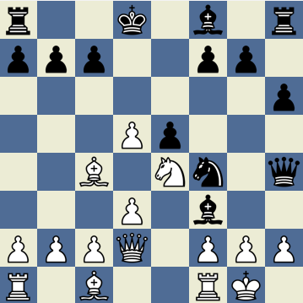
Organization is based on side-choosing games.
What is a side-choosing game (SCG)?
Black mates White in at most k moves.
A claim about a
combinatorial game G, e.g., Chess.
We ask 2 players x and !x:
x is a Proponent
!x is an Opponent
There is always a winner
and a loser. No ties.
x and !x must defend their side-choice
by winning the game.

Slide 17
What is a claim?
How is collaboration working?
A claim is a prediction about one’s performance interacting with an opponent in a given context.
Opponent tries to find an interaction which contradicts prediction. Claim is refuted but not necessarily false.

Slide 18
Organization is based on side-choosing games.
What is a side-choosing game (SCG)?
Black moves first and mates in 2 moves
We ask 2 players x and !x:
x is a Proponent
!x is an Opponent
x and !x must defend their side-choice
by winning the game.

Slide 19
What is a side-choosing game?
Black mates White in at most k moves.
We ask 2 players x and !x:
x is a Proponent
!x is a Proponent
We have one of them play
as devil’s advocate. Say x is
devil’s advocate. If x wins,
!x was not a serious Proponent.
Devil’s Advocate = Forced.

Slide 20
Side-Choosing Game (SCG) Cases
Sx (Side(x)) | S!x (Side(!x)) | P (Proponent) | W (Winner)
P | O | x | x
P | O | x | !x
P | P | x | x
P | P | x | !x
P | P | !x | x
P | P | !x | !x
…
How should we rank players? Player with the most wins? But there are cheap wins: when the other is forced.
Should we rank based on wins where other is not forced???

Slide 21
To play this SCG
Introduction
Theory
Methods
Applications/Results
Conclusion
Claim:
  There exists a k so that Black, moving first, will check-mate White after k moves and
  k is minimum.
8
7
6
5
4
3
2
1
Proponents?
Opponents?
W L F
? ? ?
W: Winner
L: Loser
F: Forced
a b c d e f g h

Slide 22
Another Issue: Distributing the Evaluation Work.
Administrator: Defines claim/game; checks that rules are followed; determines who wins and loses and keeps track of results.
Does Administrator have to solve the problems = develop winning strategies for claims?
No! We want the administrator to be a referee who is interested in problem solutions but who wants to get them from the players.
How can we make sure that the peer evaluation is fair?

Slide 23
Voting with Justification
You cannot just say: I am a Proponent.
You must justify your choice by game play.
As Proponent: you must win.
As Opponent: you must prevent the other from winning, i.e., you must win.

Slide 24
Another Motivating Example: Software Development: specifying a function
Pre and Post conditions for requirements
Exists gcd in Function(Nat,Nat -> Nat) ForAll x,y in Nat Exists d in Nat:
  d=gcd(x,y) Λ
  divides(d,x) Λ divides(d,y) Λ
  ! Exists s in Nat ((s>d) Λ divides(s,x) and divides(s,y)) Λ
  if x,y < C then Runtime(gcd,(x,y)) < RC
E.g., C = 10¹⁰, RC = 10 milliseconds.
We are hoping for Euclid’s or Schoenhage’s algorithm.

Slide 25
Gamification of Software Development for Computational Problems
Introduction
Theory
Methods
Applications/Results
Conclusion
Want reliable software to solve a computational problem? Design an SCG lab where the winning team will create the software you want.
A lab consists of Game/logical sentence interpreted in some structure.

Slide 26
Formal Science Claims: Saddle Point / Silver Ratio
claim
G(c) = ForAll x in [0,1] Exists y in [0,1]: x*y + (1-x)*(1-y^2) >= c
Strategy chosen depends on c.
  G(0.5)
  G(0.615)
  G(0.616)

Slide 27
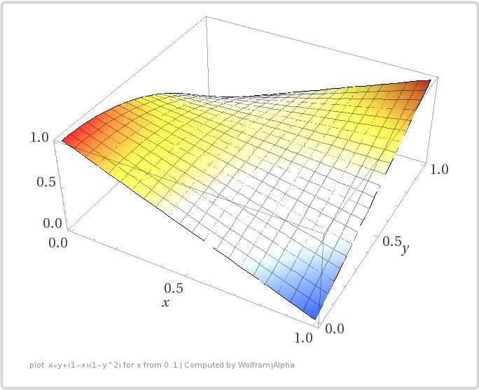

Slide 28
What is common to
Chess Puzzle claim
Software Development claim
Formal Science claim
  Two views
    Combinatorial Game G
      Claim: Start position is winning.
    Logical formula φ interpreted in structure A

Slide 29
Combinatorial Game
From Wikipedia: Combinatorial game theory (CGT) is a branch of applied mathematics and theoretical computer science that studies
  sequential games with
  perfect information, that is, two-player games which have a position. The players choose well-defined moves to achieve a defined winning condition.
We consider non-loopy games without draw: there is a winner and a loser.
  Equivalent definition: two-person game in extensive-form with perfect information.
The problem is purely strategic: how to best play the game against an ideal opponent.

Slide 30
Combinatorial Game Definition
There are two players. Sequential (turn-based). Perfect-Information, no chance or hidden information. (But players may hide their winning strategies.)
There is a finite set of possible positions of the game.
The rules of the game specify for both players and each position which moves to other positions are legal moves.
The game ends when a position is reached from which no moves are possible. A predicate on the final position determines who has won. There is an absolute winner: the first player to fulfill the winning condition. No ties or draws.
The game ends in a finite number of moves.

Slide 31
Logical Formula Claim⟨φ, A⟩
Claim⟨φ, A⟩
  φ is a well-formed formula.
  A is a structure, often consisting of several substructures. Think of A as a collection of data types that are needed to define the claim.
    φ refers to the functions defined in those data types.
What goes into φ, what goes into A? Into φ: what is better done by humans; into A: what is better done by machines.

Slide 32
Which view is better?
Combinatorial game view is simpler.
For evaluating games: combinatorial game view is sufficient.
For expressiveness: logical formula view is useful.
  There is a standard way of translating an interpreted logical formula into a combinatorial game, a so-called semantic game.

Slide 33
Outline for the Talk
Introduction
Theory
Methods
Applications/Results
Conclusion
Theory: Develop ranking theory for side-choosing games to find the most meritorious player.
  Novelties:
    Side-Choosing games.
    Meritocracy Management for Side-Choosing Games: Ranking functions for side-choosing games. Map game results to a ranking of players.
  Axiomatic approach:
    Formulate desirable axioms for ranking functions.
    Find representation theorem for ranking functions satisfying axioms.
Applications/Results:
  Lower barrier of entry for competition designers and participants
    Simplify work of administrator
    Make participation fun (collaborative, learning component)
  Organize communities for experience-based learning
  Software Development

Slide 34
Yaron Singer’s Course: CS 284r:
Incentives and Information in Networks
Premise: Human Interactions follow mathematical patterns that can be leveraged by algorithms for acquiring, disseminating, and learning information.

Slide 35
Connection to Yaron’s Premise
We study engineered networks where participants need to follow a protocol of interaction about claims.
We study algorithms that take the results of those constrained interactions as input and produce
  information about the participants and, indirectly through the participants,
  information about the claims.
We study techniques to engineer networks that disseminate specific knowledge through a network.

Slide 36
Connection to Yaron’s Work
So while Yaron gathers information from networks "in the wild" we gather information from networks we have constrained by rules. Our rules are motivated by observing how formal scientific communities work.

Slide 37
Definition: Side-Choosing Game
A side-choosing game is a triple (G,SC,AA), where G is a two-person, draw-free, combinatorial game, SC is a side-choice configuration and AA is an agreement algorithm.
G, SC and AA are defined separately. The important component is the combinatorial game G; SC and AA offer variation possibilities to define the side-choosing games. We will use simple instances of SC and AA for our side-choosing games.

Slide 38
Combinatorial Game Definition
There are two players. Sequential (turn-based). Perfect-Information, no chance or hidden information. (But players may hide their winning strategies.)
There is a finite set of possible positions of the game.
The rules of the game specify, for both players and each position, which moves to other positions are legal moves.
The game ends when a position is reached from which no moves are possible. A predicate on the final position determines who has won. There is an absolute winner: the first player to fulfill the winning condition. No ties or draws.
The game ends in a finite number of moves.

Slide 39
Terminology
Design-time decision for Proponent/Opponent. This is the design time for the winning strategy.
Run-time decision for Proponent/Opponent. This is the decision used when the defense game executes and might involve forcing at most one participant.
Side-choosing game consists of two parts
  simultaneous design-time decision
  run-time decision (imposed from outside) followed by sequential games defending run-time decision.

Slide 40
Side-Choice Configuration Definition
The side choices are made by the players but the Side-choice Configuration (SC) defines the sequencing of the design-time decisions.
We have two players, x and y, who make a choice dx and dy for the start position of the combinatorial game G. dx, dy are elements of {P,O}. If x chooses dx=P then x claims to win the combinatorial game G from its start position. If x chooses dx=O then x claims to prevent y from winning G from its start position. The players make the side choices but SC specifies the configuration. Examples for SC:
    simultaneous
    sequential
      with probability p for x to be the first player.
      other context-sensitive mechanisms to choose the first player.

Slide 41
Agreement Algorithm Definition
The agreement algorithm maps two players x,y with their design-time side choices dx=dy for combinatorial game G into a set of plays between the two players with, for each play, run-time side choices rx, ry such that at most one player is forced.
  Example: Agreement algorithm CAA (Competitive Agreement Algorithm):
    Randomly choose z, one of the players x,y and force z.
      Play SCG(G, x, y, dz, d!z, !dz, d!z); z is forced
      Play SCG(G, x, y, dz, d!z, dz, !d!z); !z is forced
      Play SCG(G, x, y, dx, dy, rx, ry) is a game between x and y, where x makes design-time choice dx and y makes design-time choice dy. The run-time choices are rx and ry. If x is forced then rx=!dx and ry=dy. If y is forced then rx=dx and ry=!dy. The claim is: in the start position of G the player in the P role (d*=P) has a winning strategy.
      dx,dy,rx,ry have values in {P,O}. z has values in {x,y}. !z =x if z=y. !z = y if z=x. !P=O, !O=P.

Slide 42
Motivation for CAA
For some claims it is a disadvantage to have to move first because you give away a “secret” (e.g., the chess example). Therefore, we choose the forced player randomly to balance the potential disadvantage.
We play two games to give each player a chance to test the other.

Slide 43
Alternative Example for Agreement Algorithm
CAA-1/2 only plays one game choosing the forced player randomly.
CAA-1/2 (Competitive Agreement Algorithm 1/2):
  Randomly choose z, one of the players x,y and force z.
    Play SCG(G, x, y, dz, d!z, !dz, d!z); z is forced

Slide 44
Outline Theory
Combinatorial Games
Why Side-Choosing Games: Benefits
Side-Choosing Game = (CombinatorialGame, AgreementMap)
Side-ChoosingGameResult= Side-ChoiceResult x CombinatorialGameResults
Meritocracy management
  Tables with base and derived fields
  Important table: SCG-Table: (W,L,F)
  How to get to the SCG-Table?
  Axioms for Ranking and Representation Theorem: Surprise

Slide 45
Examples of Combinatorial Games
Truth of sentences in various logics (semantic games: Hintikka)
  First-order predicate logic
  Second-order predicate logic
  etc.
Positions in 2-person extensive-form games with perfect information. Choose a node (position) and ask: is it winning? Example: Chess.
From Combinatorial Game Theory: Go, Checkers, Nim (solved), etc.

Slide 46
Concepts
prerequisite
NEW
Semantic Game
“equivalent"
Winner,
Loser
Meritocracy: Evaluation/Axioms
Proponent, Opponent
collusion-
resistant
Combinatorial Game
NNEW
NPEL
CR
Claim
Local Fault-Based
collusion
AgreementAlgorithm
Side-Choosing Game
Fault
Representation Theorem
Quasi-
Perfect
Incentive Comp. Theorem
Forced
Design-time Decision
Side-Choosing Game Table
Side-Choice Configuration
Run-Time Decision
Player Ranking (total preorder)

Slide 47
Basic
Concepts
prerequisite
NEW
Semantic Game
“equivalent"
Winner,
Loser
Meritocracy: Evaluation/Axioms
Proponent, Opponent
collusion-
resistant
Combinatorial Game
NNEW
NPEL
CR
Claim
Local Fault-Based
collusion
Side-Choosing Game
Fault
Representation Theorem
Quasi-
Perfect
Meritocracy Theorem
Forced
Design-time Decision
Side-Choosing Game Table
Run-Time Decision
Player Ranking (total preorder)

Slide 48
Paper Design
Main focus is on Meritocracy box.
Need definition of Side-Choosing Game.

Slide 49
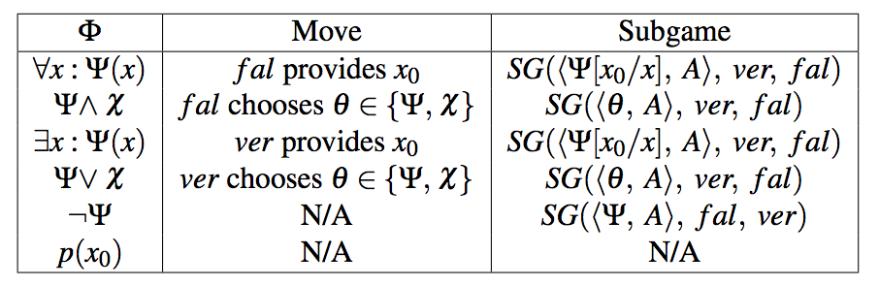
Standard Example: Semantic Game Rules
fal = Opponent
ver = Proponent

Slide 50
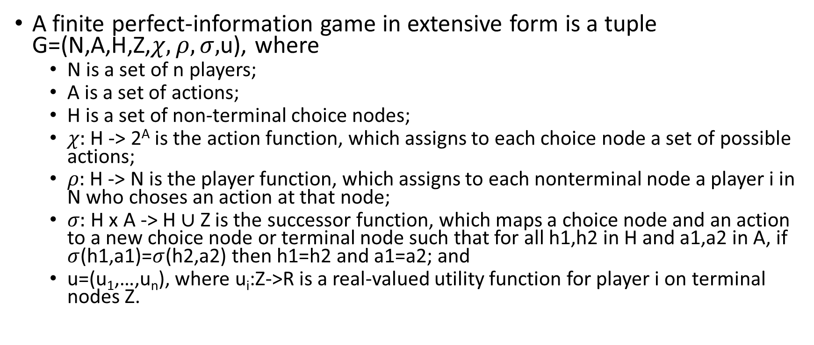
Alt. Comb. Game: Perfect-Information Game in Extensive Form (from Shoham & Leyton-Brown)
A finite perfect-information game in extensive form is a tuple G=(N,A,H,Z,$χ,ρ,σ,$u), where
  N is a set of n players;
  A is a set of actions;
  H is a set of non-terminal choice nodes;
  $χ:$ H -> 2^{A} is the action function, which assigns to each choice node a set of possible actions;
  $ρ:$ H -> N is the player function, which assigns to each nonterminal node a player i in N who choses an action at that node;
  $σ:$ H x A -> H $∪$ Z is the successor function, which maps a choice node and an action to a new choice node or terminal node such that for all h1,h2 in H and a1,a2 in A, if $σ$(h1,a1)=$σ$(h2,a2) then h1=h2 and a1=a2; and
  u=(u₁,…,u_{n}), where u_{i}:Z->R is a real-valued utility function for player i on terminal nodes Z.

Slide 51
Side-Choosing Games
Benefits
Based on Combinatorial Games
Side-Choosing Game = (Combinatorial Game, Agreement Map)
  side-choice followed by sequential game

Slide 52
Benefits of Side-Choosing Games
benefits: Objective, Low Overhead, Correct, Targeted Feedback, Well-Defined Interfaces.
Objective: The result depends on how well the participants solve the computational problems coming from the claim/game.
Low Overhead on Administrator: Prepare claim/game and check that the game rules are followed.
Correct: The winners demonstrate their opponent’s lack of skills for current claim/game.
Targeted Feedback: game plays give losers specific feedback.
Participants interact through well-defined interfaces. Choosing side and following game protocol.

Slide 53
Prominent Example of a Side-Choosing Game
The semantic game for some logic, e.g., predicate logic, is a combinatorial game. The start position is a sentence φ interpreted in some structure A.
Turn it into a side-choosing game by selecting an agreement map.

Slide 54




Toy Example: SCG Trace
Proponent
Opponent
,
)
SCG(∀x ∈ [0,1]: ∃ y ∈ [0,1]: x + y > 1.5,
Provides 1 for x
Weakening (too much!)
SCG(∃ y ∈ [0,1]: 1 + y > 1.5,
,
)
SCG = Side-Choosing Game
SCG = Scientific Community Game
SCG = Specker Challenge Game
SCG = SemantiC Game
all are meaningful
Provides 1 for y
Strengthening
SCG( 1 + 1 > 1.5,
,
)
Wins

Slide 55
Abstraction Barriers/Important Steps
Widen: Semantic Games – Combinatorial Games: Generalize
  Key to side-choosing game definition
  Simplifies Meritocracy Theory for Side-Choosing Games
Minimum Recording: Side-Choosing Game Plays – SCG-Tables: Specialize without information loss
  based on relational table manipulations

Slide 56
What is a Side-Choosing Game Result?
Introduction
Theory
Methods
Applications/Results
Conclusion
Sx (Side(x)) | S!x (Side(!x))
P | O
O | P
P | P
O | O
Combinatorial Game G
  Not known whether there is a winning strategy
  outcome: Proponent/Winner
Side-Choice (P (Proponent) or O (Opponent))
abbreviated: Side-Choice Result x Combinatorial Game Result
P (Proponent) | Winner
x | x
x | !x
!x | x
!x | !x
One P against one O!

Slide 57
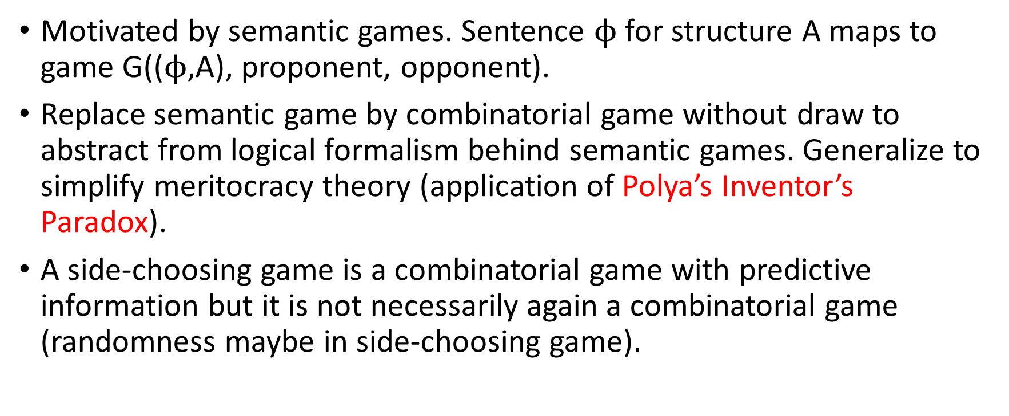
Side-Choosing Games, Overview
Motivated by semantic games. Sentence $ϕ$ for structure A maps to game G(($ϕ$,A), proponent, opponent).
Replace semantic game by combinatorial game without draw to abstract from logical formalism behind semantic games. Generalize to simplify meritocracy theory (application of Polya’s Inventor’s Paradox).
A side-choosing game is a combinatorial game with predictive information but it is not necessarily again a combinatorial game (randomness maybe in side-choosing game).

Slide 58
Terminology
Design-time decision for Proponent/Opponent. This is the design time for the winning strategy.
Run-time decision for Proponent/Opponent. This is the decision used when the defense game executes and might involve forcing at most one participant.
Side-choosing game consists of two parts
  simultaneous design-time decision
  run-time decision (imposed from outside) followed by sequential games defending run-time decision.

Slide 59
Agreement Map
The agreement function maps two players x,y with their design-time side choices dx=dy for combinatorial game G into a set of plays between the two players with run-time side choices rx, ry such that at most one player is forced.
We choose the following agreement function CAG (Competitive Agreement Game):
  Randomly choose z, one of the players x,y and force z.
    Play SCG(G, x, y, z, dx, dy, rx, ry)
    Play SCG(G, x, y, !z, dx, dy,!rx, !ry)
  Play SCG(G, x, y, z, dx, dy, rx, ry) is a game between x and y, where z is forced. If x is forced then rx=!dx and ry=dy. If y is forced then rx=dx and ry=!dy. The claim is: in the start position of G the player in the P role (d*=P) has a winning strategy.
  dx,dy,rx,ry have values in {P,O}. z has values in {x,y}. !z =x if z=y. !z = y if z=x. !P=O, !O=P.

Slide 60
Motivation for CAG
For some claims it is a disadvantage to have to move first because you give away a “secret” (e.g., the chess example Mate-in-2). Therefore, we choose the forced player randomly to balance the potential disadvantage.
We play two games to give each player a chance to test the other.

Slide 61
Alternative for CAG
CAG-1/2 only plays one game choosing the forced player randomly.
We choose the following agreement function CAG-1/2 (Competitive Agreement Game 1/2):
  Randomly choose one of the players x,y and force it.
    Play SCG(G, x, y, dx, dy, rx, ry)
    Play SCG(G, x, y, dx, dy, rx, ry) is a game between x and y. If rx=!dx and ry=dy then x is forced. If rx=dx and ry=!dy then y is forced.

Slide 62
What is a Side-Choosing Game (G,AM) for a Combinatorial Game G and an Agreement Map AM?
(G,AM) is played by x and y.
Game
  Choose a design-time side: P or O: dx, dy for G. P means: The start position of G is a winning position for player in P role. O means: The start position is not a winning position for player in P role.
  If dx!=dy: play game SCG(G, x, y, dx, dy, dx, dy)
  Else: Use agreement map AM to determine games to be played. Each game is of the form SCG(G, x, y, dx, dy, rx, ry) for run-time side-choices rx, ry determined by the agreement map AM.
  Each game result is recorded as a triple: W,L,F.

Slide 63
From Combinatorial to Side-Choosing Game
CG = Combinatorial Game, no notion of proponent, opponent.
SCG = Side-Choosing Game, notion of proponent/opponent at design-time and run-time.
  design-time proponent/opponent (choice by players)
    Proponent claims: start position of CG G is winning position for player who is run-time proponent.
  run-time proponent/opponent (influenced from outside, AM)
result (W,L,F). W,L,F have values in {x,y}.
A side-choosing game is a combinatorial game with predictive information but is not necessarily again a combinatorial game (randomness in AM).
A side-choosing game is a generalization of a semantic game. Semantic games also use the notion of proponent/opponent but are tied to a logical formalism which is irrelevant for studying meritocracy management in side-choosing games.

Slide 64
Result of a Side-Choosing Game Play
A game that produces an SCG-Row in an SCG-table. First move is simultaneous: choose a side: Proponent (P) or Opponent (O).
What is a row in an SCG-table?
  Presents one game result between two distinct participants x and y.
  Columns are: W,L,F (for Winner, Loser, Forced) (SCG-Table Rule 0).
  W,L contain either x or y. W≠L. There are no ties (SCG-Table Rule 1).
  F contains “none” or W or L (SCG-Table Rule 2).
    A participant is Forced if it has to take the opposite side than it has chosen. Synonym: Devil’s Advocate.

Slide 65
Result of several Side-Choosing Game Plays (continued)
What is an SCG-Table?
  Given a set of Players.
  A table of SCG rows satisfying rules 0-2 involving participants in Players.
  Multiple rows may involve the same two players (SCG-Table Rule 3).
To determine who wins the side war requires the execution of some protocol between the two participants. The SCG-Table definition does not specify the protocol: separation of concerns.

Slide 66
SCG-Tables
Introduction
Theory
Methods
Applications/Results
Conclusion
columns Concrete SCG-Table:
x: player
!x: other player
Sx: side of player x
S!x: side of player !x
P: Proponent
2/4
2/4
what we want
SideChoiceCases
core: Sx, S!x
SemanticGameCases
core: W,P
Abstract SCG-Table
core: W, L, F
derived: Fault, Control
core columns abstract SCG-Table:
W: Winner
L: Loser
F: Forced
3(5)/6
direct product
is-a
drop: Sx, S!x, P
derived columns SCG-Table:
Fault: Loser is not forced
Control: Loser in control
filter
Concrete SCG-Table
core: Sx, S!x, W, P
derived: F, L
number of columns (with derived)/number of rows
4(6)/12

Slide 67
Concepts
prerequisite
NEW
Semantic Game
“equivalent"
Winner,
Loser
Meritocracy: Evaluation/Axioms
Proponent, Opponent
collusion-
resistant
Combinatorial Game
NNEW
NPEL
CR
Claim
AgreementMap
Local Fault-Based
collusion
Side-Choosing Game
Fault
Forced
Representation Theorem
Design-time Decision
Side-Choosing Game Table
Run-Time Decision
Player Ranking (total preorder)

Slide 68
Problem we solve next: Meritocracy Finding
Given a tournament of side-choosing games among a set of Players, how can we find the most meritorious players?
Note: There is a lot of noise produced by the tournament:
  We don’t know whether claim is true.
  true claim might be refuted.
  false claim might be defended.
  players switch their sides between different games.
  players may lie about their strength and lose intentionally to help a friend become more meritorious (collusion among players).
  The more weak players or the more collusion, the more noise.
HOW CAN WE FIND ORDER IN THIS COMPLEXITY?

Slide 69
Informal Reasoning
Case Abbreviation | Winner/Loser | Forced/Unforced
WF | Win | Forced
WU | Win | Unforced
LF | Lose | Forced
LU | Lose | Unforced
Which of the four statistics is a reliable indicator
of strength or weakness?
WF: strength: no (because of possible collusion)
WU: strength: no (because of possible collusion)
LF: weakness: no (because of forcing)
LU (Fault): weakness: YES. Player is contradictory!
Loser is Proponent: should have won
Loser is Opponent: should have prevented the other
from winning.
Informal argument why counting Faults is interesting.

Slide 70
Fair Peer-Based Evaluation for n participants
Builds on Two-Participant Evaluation
Ranking systems for side-choosing games
Axiomatic treatment: collusion-resistant
  Introduce 3 axioms

Slide 71
Non-Negative Effect For Wins (Axiom 1: NNEW)
Introduction
Theory
Methods
Applications/Results
Conclusion
Px
Additional wins
cannot worsen Px’s
rank w.r.t. other participants.
Wins
Faults
undisputed: Wins don’t lower rank.

Slide 72
Non-Positive Effect For Losses (Axiom 2: NPEL)
Px
Implies:
Wins
Additional losses
cannot improve Px’s
rank w.r.t. other participants.
Faults
undisputed: Losses don’t increase rank.

Slide 73
Ranking Functions (Anonymity)
Output ranking is independent of participants’ identities.
Ranking function ignores participants’ identities.
Participants also ignore their opponents’ identities.

Slide 74
Collusion-Resistance
Slightly weaker notion than anonymity.
What you want in practice.
A participant Py can choose to lose on purpose against another participant Px, but that won’t make Px get ahead of any other participant Pz.

Slide 75
Collusion-Resistance (Axiom 3: CR)
Px
Games outside Px’s
control cannot worsen
Px’s rank w.r.t. other participants.
Wins
Faults
  Px is in control if (Px in W(inner)) or (not(Px in F(orced)))

Slide 76
Collusion-Resistant Axiom: Explanation
Your rank cannot come down when additional rows are added to table T
  where you did not participate.
  where you won.
  where you were forced.

Slide 77
Preparing for the Discovery/Surprise:
Locally Fault Based (LFB)
Px
Py
Relative rank of Px
and Py depends
only on faults made
by either Px or Py.
Wins
Faults
Faults
Wins
“Locally” is used to exclude faults made by some third player z when ranking x versus y.

Slide 78
Discovery: Property of SCG-Tables
Introduction
Theory
Methods
Applications/Results
Conclusion
A useful design principle for ranking functions.
Under NNEW, NPEL : CR = LFB
LFB is quite unusual.
LFB lends itself to implementation.
Not only is fault counting important; it is fundamental.
NNEW Λ CR => LFB
NPEL Λ LFB => CR
Representation Theorem: NNEW Λ NPEL => (CR ⬄ LFB)

Slide 79
Proof
Venn Diagram for Game Kinds involving x,y
≥ monotonically non-decreasing
≤ monotonically non-increasing
WF(x), WF(y),LF(x),LF(y) shown in diagram
1ᴜ3-WF(x)=WU(x); 4ᴜ6-WF(y)=WU(y); 2ᴜ4:LU(x); 3ᴜ5:LU(y)
LFB: d_{W}U = 0, d_{LF}U = 0
All games
2, 3, 4, 5: LFB
x wins and y at fault
1 [!fl y] [w x] = [!c y] [w x]
2 [!w y] [fl x] = [!c y] [fl x]
3 [fl y] [w x] = [c y] [w x]
4 [w y] [fl x] = [c y] [fl x]
5 [!w x] [fl y] = [!c x] [fl y]
6 [!fl x] [w y] = [!c x] [w y]
7 [!c x] [!c y]
games that cannot
improve rank of
x wrt. y:
6 by NNEW
1,7 by CR
games that cannot
worsen rank of
x wrt. y:
6,7 by CR
1 by NNEW
Proves:
NNEW and CR => LFB
LF(y)
c(x)
c(y)
x wins:
W(x)
1
WF(x)
5
y at fault:
LU(y)
3
2
4
6
WF(y)
y wins:
W(y)
x at fault:
LU(x)
LF(x)
7
c(z) = z in control (full circle)
= (z wins) or (z not forced)
x at fault and y wins
NNEW: d_{W}U ≤ 0, NPEL: d_{L}U ≥ 0, CR: d_{W}U ≥ 0, d_{LF}U = 0, d_{LU}U ≥ 0

Slide 80
Ranking Axioms Imply
≥ monotonically non-decreasing
≤ monotonically non-increasing
Monotonicity Constraints
  NNEW: d_{WF}U ≤ 0 Λ d_{WU}U ≤ 0
  NPEL: d_{LF}U ≥ 0 Λ d_{LU}U ≥ 0
  CR: d_{WF}U ≥ 0 Λ d_{WU}U ≥ 0 Λ d_{LF}U = 0 Λ d_{LU}U ≥ 0
  LFB: d_{WF}U = 0 Λ d_{WU}U = 0 Λ d_{LF}U = 0
Above implies:
NNEW Λ CR => LFB
NPEL Λ LFB => CR
NNEW Λ NPEL => (CR ⬄ LFB)

Slide 81
Finding a concrete LFB function.
One example of an infinite family.

Slide 82
Fault-Counting Scoring Function
Provide a concrete example of a ranking function which is NNEW, NPEL and LFB and therefore CR.
  Players are ranked according to their score: the number of faults they make. The fewer the number of faults the higher the rank.
Satisfies the NNEW and NPEL
  Clearly, Fault Counting is LFB and therefore CR (by previous theorem).
Note: There is an infinite family of ranking functions that are LFB.

Slide 83
Side-Choosing Game Tournament Design
Full Round-Robin with adaptation: For every pair of players:
  If choosing different sides, play a single SG.
  If choosing same sides, play combinatorial game plays according to the chosen AM, i.e., CAG (two combinatorial games where they switch sides).

Slide 84
Neutrality with CAG
Each player plays n_{P}+ n_{O} - 1 combinatorial games in their chosen side, those are the only games in which it may make faults.
P = Proponent, O = Opponent
n_{O}
n_{P}
2 games; one player in chosen side
n_{O}
1 game; both players in chosen side
n_{P}

Slide 85
Incentive Compatibility Theorem
We call it “Incentive Compatibility Theorem” (for side-choosing games)
  it shows that without collusion-resistance (CR) incentive compatibility is not guaranteed.
Incentive compatibility means
  the best players will be top ranked.
  “best” means: quasi-perfect. Might be wrong but nobody can illustrate through game play.

Slide 86
Incentive Compatibility Theorem
A quasi-perfect player is a player who never makes a fault.
(A perfect player always chooses the correct side and always wins the defense and therefore is quasi-perfect).
Meritocracy Theorem
  Part 1: [CR is necessary]: If ranking function is not collusion-resistant (CR) but NNEW and NPEL, there exists a set of games where a quasi-perfect player is not top-ranked.
  Part 2: [CR is sufficient] NNEW and NPEL and CR imply that quasi-perfect player is top-ranked.

Slide 87
Quasi-Perfect Player
The concept of a quasi-perfect player is an important one. It indicates that the outcome of side-choosing games depends on the quality of the players.
It is possible that a false claim is regularly defended. But the other players don’t have the skill to refute the claim.
Being a quasi-perfect player is already an accomplishment, even if the claim is false. It shows superior skill with respect to the other players.

Slide 88
Summary Theory
Introduction
Theory
Methods
Applications/Results
Conclusion
Side-choosing games require a side-choice at the beginning and then resort to forcing if both choose same side. A side-choosing game finishes with one or more combinatorial games.
The axiomatic ranking theory producing the representation theorem: NNEW Λ NPEL => (CR ⬄ LFB), only depends of SCG-Tables satisfying rules 0-3 and not on the details of combinatorial games. The 4 rules provide an abstraction barrier from the details of protocols.
CR is crucial for incentive compatibility.

Slide 89
Solving Problems using the Crowd
USE SAFE SIDE-CHOOSING GAMES!
They look at the
administrator who
only acts as referee.
We use the crowd for
fair peer evaluation!
They want to be
heard.
We want to
extract a
provably
reliable signal
(“best”,
collusion-
resistant
solution)
from the
complex
behavior of
the crowd.
Some are better
than others:
meritocracy.
Some want to
game the system
by colluding/lying.

Slide 90
Application Concepts
Lab = (Side-Choosing Game, Participants)
Avatar/
Software Agent
Competition System we built
Baby Avatar automatically generated from Side-Choosing Game
Participant
Human
Tools like Piazza are sufficient but could be improved

Slide 91
Methods
Use piazza.com
  Use JSON for scientific discourse (objects sent back and forth during combinatorial game).
  Divide class into teams of 3.
For strategies in software
  We developed
    a generator for baby strategies
    administrator automated
Also used simulation (synthetic strategies) to help invent the theory.

Slide 92
Lower barrier of entry for competition designers
Introduction
Theory
Methods
Applications/Results
Conclusion
What can be done with SCGs?
  LFB ranking mechanisms, e.g., fault-counting.
  Shifting evaluation from administrator to players!
  Tournaments that fairly evaluate players!
    collusion-resistance is guaranteed.

Slide 93
Applications of SCG (1)
Introduction
Theory
Methods
Applications/Results
Conclusion
Teaching Software Development
  Students get Baby-Strategy to start (automatically generated from claim).
  Students add intelligence to their strategy to outperform the strategies of their peers.
  A strategy consists of a function for side choice and a function for each quantifier (we use simplified semantic games).
  Strategy with fewest losses wins. Strategies use web for fight!
  Weekly tournaments with slightly modified claim: encourage well-modularized software that is easy to change.

Slide 94
Applications of SCG (2)
Bring order to literature on solving computational problems.
  Authors are required to provide a strategy to defend the claim.
  Knowledge becomes active on the web.
  A newcomer might beat all current strategies. Easily verified by a tournament.
  Develop a Wikipedia for computational problems.

Slide 95
Applications of SCG (3)
Teaching Formal Sciences (e.g., Algorithms).
  Use a platform like Piazza to execute the protocol.
  Avoid claims where the semantic game gives away the solution.
  Divide class into groups of size 3. Balance skills in each group. Play tournaments within groups to prevent information overload for class.
  Students came up with solutions that were about 10 years behind the state-of-the-art.

Slide 96
Price for peer evaluation
Given: A side-choosing game s.
  Find winning strategy (or an approximation to it) for
    winning the game s and
    exposing weaknesses (if they exist) in any strategy for defending the claim.
      For second bullet: You play in devils advocate role and still try to win against a non-perfect player.
The symmetric requirement has three benefits
  fair peer evaluation
  “dynamic benchmark” instead of a static benchmark.
  requires the players to think about the difficult cases.

Slide 97
Results
Introduction
Theory
Methods
Applications/Results
Conclusion
SCG usage for teaching using forum
  Innovation Success with Undergraduates using SCG on piazza.com: Qualitative Data Sources & Analysis
  Perfect for creating interaction between students (peer teaching)
Strategy competitions are useful for teaching (and good for competitive innovation).
  Some students stayed up to see their strategy succeed in the tournament.

Slide 98
Related Work
Semantic Games
Rating and Ranking Functions
Tournament Scheduling
Match-Level Neutrality

Slide 99
Rating and Ranking Functions (I)
Dominated by heuristic approaches
  Elo ratings.
  Who’s #1?
There are axiomatizations of rating functions in the field of Paired Comparison Analysis.
  CR not on radar

Slide 100
Rating and Ranking Functions (II)
Rubinstein[1980]:
  points system (winner gets a point) characterized as:
    Anonymity : ranks are independent of the names of participants.
    Positive responsiveness to the winning relation which means that changing the results of a participant p from a loss to a win, guarantees that p’s rank would improve.
    IIM: relative ranking of two participants is independent of matches in which neither is involved.
  “beating functions” are restricted to complete, asymmetric relations.

Slide 101
Tournament Scheduling
Neutrality is off radar.
  Maximizing winning chances for certain players.
  Delayed confrontation.

Slide 102
Match-Level Neutrality
Dominated by heuristic approaches
  Compensation points.
  Pie rule.

Slide 103
Future Work
Problem decomposition labs.
Social Computing.
Evaluating Thoroughness.

Slide 104
Financial Support
Novartis

Slide 105
Conclusions
Introduction
Theory
Methods
Applications/Results
Conclusion
Side-choosing games provide a useful foundation to organize computational problem solving and formal science communities for research and experience-based learning.
We found a solution to the problem of lowering the barrier of entry for competition organizers by shifting evaluation tasks from the administrator to the players.
We show the fundamental nature of locally fault-based evaluation in the presence of collusion-resistance.
Simple result: 3 axioms, representation theorem, adapted full round-robin tournament with fault-counting gives fair, collusion-resistant evaluation of SCGs.

Slide 106

CCIS
45 faculty + 9 researchers
  7 new faculty in 2012
  6 new faculty in 2013
634 undergrads, 606 MS, 97 PhDs
$7.6 million in grant funding in 2012
PhD Programs in:
  Computer Science
  Information Assurance
  Health Informatics
  Network Science

Slide 107
Research at CCIS
Formal Methods
  10 papers in FMSD, FMCAD, TOPLAS, and CAV since ’08
  NSF CAREER for building dependable concurrent software
Robotics and Computer Vision
  NSF CAREER for building robots that handle uncertainty
  New hire for 2013: Rob Platt
Network Science
  Founders of the field: Laszlo Barabasi and Alex Vespignani
  20+ papers in Nature, Science, and PNAS since ‘08
Security
  19+ papers at NDSS, CSS, S&P, and Usenix Security since ‘08
  Funding from DARPA, Symantec, and Verisign
Programming Languages
  19 papers in POPL, OOPSLA, and ICFP since ‘08
  Active in the ECMA Javascript standards body
DB, IR, and ML
  Papers in SIGIR, CIKM, KDD, SIGMOD, VLDB, ICDM
  New research center for digital humanities

Slide 108

Questions?
Karl Lieberherr
lieber@ccs.neu.edu

Slide 109
Thank You!

Slide 110
For Hansruedi
Proper tournament evaluation for side-choosing games.
Games with winners and losers, no draws.
Evaluation must satisfy 3 axioms.
Collusion-resistant axiom: Games outside a player’s control cannot lower that player’s rank with respect to other players.

Slide 111
Collusion-Resistance (Axiom 3: CR)
  Px is not in control if not (Px in W(inner)) and (Px in F(orced))
  Px is not in control if Px does not participate or (Px in L(oser) and (Px in F(orced))
Px
Games outside Px’s
control cannot worsen
Px’s rank w.r.t. other participants.
Wins
Faults
  Px is in control if (Px in W(inner)) or (not(Px in F(orced)))
  Fault: Loser is not forced.

Slide 112
Side-Choosing Game
Combinatorial game G
Proponent: start position is a winning position.
Opponent: start position is not a winning position.
Choose side.
Need for forcing.
Faults.

Slide 113
end Hansruedi

Slide 114
Combinatorial Games

Slide 115
Examples of Combinatorial Games
Truth of sentences in various logics
  First-order predicate logic
  Second-order predicate logic
  etc.
Positions in 2-person extensive-form games with perfect information. Choose a node (position) and ask: is it winning? Example: Mate in 2.
From Combinatorial Game Theory: chess, checkers, Nim (solved), etc.

Slide 116
Standard Example: SCG Rules
fal = Opponent
ver = Proponent

Slide 117
Alt. Comb. Game: Perfect-Information Game in Extensive Form (from Shoham & Leyton-Brown)
A finite perfect-information game in extensive form is a tuple G=(N,A,H,Z,$χ,ρ,σ,$u), where
  N is a set of n players;
  A is a set of actions;
  H is a set of non-terminal choice nodes;
  $χ:$ H -> 2^{A} is the action function, which assigns to each choice node a set of possible actions;
  $ρ:$ H -> N is the player function, which assigns to each nonterminal node a player i in N who choses an action at that node;
  $σ:$ H x A -> H $∪$ Z is the successor function, which maps a choice node and an action to a new choice node or terminal node such that for all h1,h2 in H and a1,a2 in A, if $σ$(h1,a1)=$σ$(h2,a2) then h1=h2 and a1=a2; and
  u=(u₁,…,u_{n}), where u_{i}:Z->R is a real-valued utility function for player i on terminal nodes Z.

Slide 118
Side-Choosing Games
Benefits
Based on Combinatorial Games
Side-Choosing Game = (Combinatorial Game, Agreement Map)
  side-choice followed by sequential game

Slide 119
Benefits of Side-Choosing Games
benefits: Objective, Low Overhead, Correct, Targeted Feedback, Well-Defined Interfaces.
Objective: The result depends on how well the participants solve the computational problems coming from the claim/game.
Low Overhead on Administrator: Prepare claim/game and check that the game rules are followed.
Correct: The winners demonstrate their opponent’s lack of skills for current claim/game.
Targeted Feedback: game plays give losers specific feedback.
Participants interact through well-defined interfaces. Choosing side and following game protocol.

Slide 120
Prominent Example of a Side-Choosing Game
The semantic game for some logic, e.g., predicate logic, is a combinatorial game. The start position is a sentence φ interpreted in some structure A.
Turn it into a side-choosing game by selecting an agreement map.

Slide 121
Toy Example: SCG Trace
Proponent
Opponent
,
,
)
SCG(∀x ∈ [0,1]: ∃ y ∈ [0,1]: x + y > 1.5
Provides 1 for x
Weakening (too much!)
,
,
)
SCG(∃ y ∈ [0,1]: 1 + y > 1.5
SCG = Side-Choosing Game
SCG = Scientific Community Game
SCG = Specker Challenge Game
SCG = SemantiC Game
all make are meaningful
Provides 1 for y
Strengthening
,
,
)
Wins
SCG( 1 + 1 > 1.5

Slide 122
Toy Example: SCG Trace
Proponent
Opponent
,
)
SCG(∀x ∈ [0,1]: ∃ y ∈ [0,1]: x + y > 1.5,
Provides 1 for x
Weakening (too much!)
SCG(∃ y ∈ [0,1]: 1 + y > 1.5,
,
)
SCG = Side-Choosing Game
SCG = Scientific Community Game
SCG = Specker Challenge Game
SCG = SemantiC Game
all make are meaningful
Provides 1 for y
Strengthening
SCG( 1 + 1 > 1.5,
,
)
Wins

Slide 123
Abstraction Barriers/Important Steps
Widen: Semantic Games – Combinatorial Games: Generalize
  Simplifies Meritocracy Theory for Side-Choosing Games
Minimum Recording: Side-Choosing Game Plays – SCG-Tables: Specialize without information loss
  based on relational table manipulations
Meritocracy: SCG-Tables – Player Ranking: Specialize
  based on axioms

Slide 124
What is a Side-Choosing Game Result?
Introduction
Theory
Methods
Applications/Results
Conclusion
Sx (Side(x)) | S!x (Side(!x))
P | O
O | P
P | P
O | O
Combinatorial Game G
  Not known whether there is a winning strategy
  outcome: Proponent/Winner
Side-Choice (P (Proponent) or O (Opponent))
abbreviated: Side-Choice Result x Combinatorial Game Result
P (Proponent) | Winner
x | x
x | !x
!x | x
!x | !x
One P against one O!

Slide 125
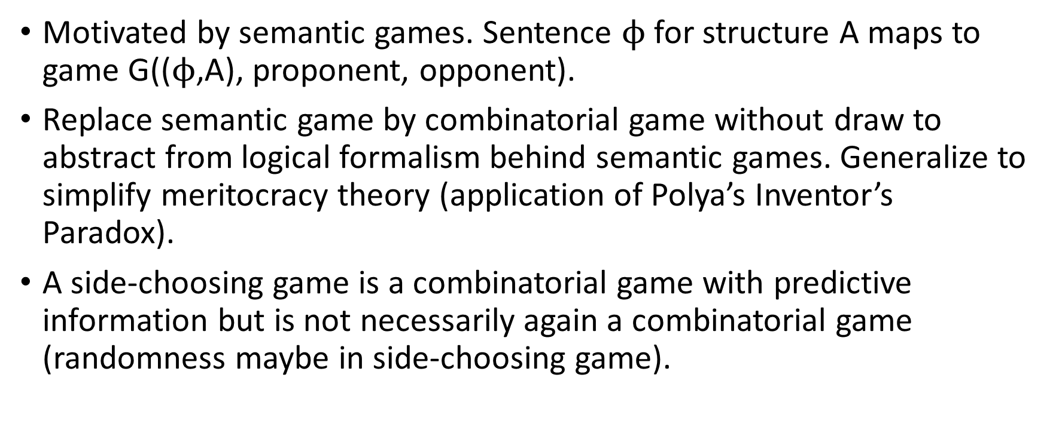
Side-Choosing Games, Overview
Motivated by semantic games. Sentence $ϕ$ for structure A maps to game G(($ϕ$,A), proponent, opponent).
Replace semantic game by combinatorial game without draw to abstract from logical formalism behind semantic games. Generalize to simplify meritocracy theory (application of Polya’s Inventor’s Paradox).
A side-choosing game is a combinatorial game with predictive information but is not necessarily again a combinatorial game (randomness maybe in side-choosing game).

Slide 126
Agreement Map
The agreement function maps two players x,y with their design-time side choices dx=dy for combinatorial game G into a set of plays between the two players with run-time side choices rx, ry such that at most one player is forced.
We choose the following agreement function CAG (Competitive Agreement Game):
  Randomly choose z, one of the players x,y and force z.
    Play SCG(G, x, y, z, dx, dy, rx, ry)
    Play SCG(G, x, y, !z, dx, dy,!rx, !ry)
  Play SCG(G, x, y, z, dx, dy, rx, ry) is a game between x and y, where z is forced. If x is forced then rx=!dx and ry=dy. If y is forced then rx=dx and ry=!dy. The claim is: in the start position of G the player in the P role (d*=P) has a winning strategy.
  dx,dy,rx,ry have values in {P,O}. z has values in {x,y}. !z =x if z=y. !z = y if z=x. !P=O, !O=P.

Slide 127
Motivation for CAG
For some claims it is a disadvantage to have to move first because you give away a “secret” (e.g., the chess example Mate-in-2). Therefore, we choose the forced player randomly to balance the potential disadvantage.
We play two games to give each player a chance to test the other.

Slide 128
Alternative for CAG
CAG-1/2 only plays one game choosing the forced player randomly.
We choose the following agreement function CAG-1/2 (Competitive Agreement Game 1/2):
  Randomly choose z, one of the players x,y and force z.
    Play SCG(G, x, y, z, dx, dy, rx, ry)
    Play SCG(G, x, y, z, rx, ry) is a game between x and y, where z is forced. If x is forced then rx=!dx and ry=dy. If y is forced then rx=dx and ry=!dy.

Slide 129
What is a Side-Choosing Game (G,AM) for a Combinatorial Game G and an Agreement Map AM?
(G,AM) is played by x and y.
Game
  Choose a design-time side: P or O: dx, dy for G. P means: The start position of G is a winning position for player in P role. O means: The start position is not a winning position for player in P role.
  If dx!=dy: play game SCG(G, x, y, dx, dy, dx, dy)
  Else: Use agreement map AM to determine games to be played. Each game is of the form SCG(G, x, y, dx, dy, rx, ry) for run-time side-choices rx, ry determined by the agreement map AM.
  Each game result is recorded as a triple: W,L,F.

Slide 130
From Combinatorial to Side-Choosing Game
CG = Combinatorial Game, no notion of proponent, opponent.
SCG = Side-Choosing Game, notion of proponent/opponent at design-time and run-time.
  design-time proponent/opponent (choice by players)
    Proponent claims: start position of CG G is winning position for player who is run-time proponent.
  run-time proponent/opponent (influenced from outside, AM)
Same Information
  CG(G, x, y, dx, dy, rx, ry)
  CG(G, x, y, z, rx, ry), z is forced player.
result (W,L,F). W,L,F have values in {x,y}.
A side-choosing game is a combinatorial game with predictive information but is not necessarily again a combinatorial game (randomness in AM).
A side-choosing game is a generalization of a semantic game. Semantic games also use the notion of proponent/opponent but are tied to a logical formalism which is irrelevant for studying meritocracy management in side-choosing games.

Slide 131
Side-Choosing Game between two players x and y for a combinatorial game g
Given: Combinatorial Game g and an Agreement Map AM, e.g., CAG.
Game
  Both players x and y choose simultaneously a design-time side: P or O: dx, dy for g. P means: The starting position of g is a winning position for player P. O means: the starting position of g is not a winning position for player P.
  If dx!=dy: play game CG(g, x, y, dx, dy, dx, dy)
  Else: Use agreement map AM to determine games to be played. Each game is of the form CG(g, x, y, dx, dy, rx, ry) for run-time side-choices rx, ry determined by the agreement map AM.
  Each game result is recorded as a triple: W,L,F.

Slide 132
Result of a Side-Choosing Game Play
A game that produces an SCG-Row in an SCG-table. First move is simultaneous: choose a side: Proponent (P) or Opponent (O).
What is a row in an SCG-table?
  Presents one game result between two distinct participants p and q.
  Columns are: W,L,F (for Winner, Loser, Forced) (SCG-Table Rule 0).
  W,L contain either p or q. W≠L. There are no ties (SCG-Table Rule 1).
  F contains “none” or W or L (SCG-Table Rule 2).
    A participant is Forced if it has to take the opposite side than it has chosen. Synonym: Devil’s Advocate.

Slide 133
Result of several Side-Choosing Game Plays (continued)
What is an SCG-Table?
  Given a set of Players.
  A table of SCG rows satisfying rules 0-2 involving participants in Players.
  Multiple rows may involve the same two players (SCG-Table Rule 3).
To determine who wins the side war requires the execution of some protocol between the two participants. The SCG-Table definition does not specify the protocol: separation of concerns.

Slide 134
SCG-Tables
Introduction
Theory
Methods
Applications/Results
Conclusion
columns Concrete SCG-Table:
x: player
!x: other player
Sx: side of player x
S!x: side of player !x
P: Proponent
2/4
2/4
what we want
SideChoiceCases
core: Sx, S!x
SemanticGameCases
core: W,P
Abstract SCG-Table
core: W, L, F
derived: Fault, Control
core columns abstract SCG-Table:
W: Winner
L: Loser
F: Forced
3(5)/6
direct product
is-a
drop: Sx, S!x, P
derived columns SCG-Table:
Fault: Loser is not forced
Control: Loser in control
filter
Concrete SCG-Table
core: Sx, S!x, W, P
derived: F, L
number of columns (with derived)/number of rows
4(6)/12

Slide 135

Core sets, Dan Feldman
Given data D and Algorithm A with A(D) intractable, can we efficiently reduce D to C so that A(C) fast and A(C) $\sim$ A(D)?

Slide 136
Illustrate that collusion-resistance is essential
best player not on top if wins against non-forced are counted.
A,B,C,D players. D perfect, B,C colluding, A higher ranked than D.
  all non-forced losses?
  A-B 1:0 collusion: x game plays
  A-C 1:0 collusion
  A-D 0:1
  B-C 0:1
  B-D 0:1
  A x+1 wins, B 0 wins, C 1 win, D 1 win: A overall winner
  A 1 fault, B x+2 faults, C 2 faults, D 0 faults: D overall winner
  engage D again: C-D 0:1: still A winner for win counts

Slide 137
Claim: In full round-robin tournament
can count wins and still have perfect on top?
Would contradict the representation theorem!
when is the perfect on top?
connection to collusion-resistance?
perfect has 0 faults.
in full-round robin tournament for n players:
  perfect wins all n-1 games, 0 faults
  others can artificially play more games and win more than n-1 but no longer full-round-robin tournament.

Slide 138
Table extension
axioms are about table extensions
full round-robin has a fixed number of games, axioms not applicable

Slide 140
Incentive Compatibility Theorem
We call it “Incentive Compatibility Theorem” (for side-choosing games)
  it shows that without collusion-resistance (CR) incentive compatibility is not guaranteed.
  with CR, incentive compatibility is guaranteed.
Incentive compatibility means
  the best players will be top ranked.
  “best” means: quasi-perfect. Might be wrong but nobody can illustrate through game play.

Slide 141
Incentive Compatibility Theorem
A quasi-perfect player is a player who never makes a fault.
(A perfect player always chooses the correct side and always wins the defense and therefore is quasi-perfect).
Meritocracy Theorem
  Part 1: [CR is necessary]: If ranking function is not collusion-resistant (CR) but NNEW and NPEL, there exists a set of games where a quasi-perfect player is not top-ranked.
  Part 2: [CR is sufficient] NNEW and NPEL and CR imply that quasi-perfect player is top-ranked.

Slide 142
Quasi-Perfect Player
The concept of a quasi-perfect player is an important one. It indicates that the outcome of side-choosing games depends on the quality of the players.
It is possible that a false claim is regularly defended. But the other players don’t have the skill to refute the claim.
Being a quasi-perfect player is already an accomplishment, even if the claim is false. It shows superior skill with respect to the other players.

Slide 144
A semi-perfect player is a player who never makes a fault.
A perfect player is a player who always chooses the correct side and properly defends it.
Fact: A perfect player is semi-perfect.
A semi-perfect player looks like a perfect player but the claim it defends could actually be refuted. (either claim is false or defense is not optimal)
A player is top-ranked if it never makes a fault.
Theorem: If collusion-resistance is violated, a perfect or semi-perfect player may not be top-ranked.

Slide 145
better: collusion-resistance is essential
A quasi-perfect proponent is a player who never makes a fault after choosing the proponent role.
A quasi-perfect opponent is a player who never makes a fault after choosing the opponent role.
A quasi-perfect player is a player who never makes a fault.
A perfect player is a player who always chooses the correct side and properly defends it.
Fact: A perfect player is quasi-perfect.
A quasi-perfect player looks like a perfect player but the claim it defends could actually be refuted. (either claim is false or defense is not optimal)
Theorem [CR is essential]: If ranking function is not collusion-resistant (CR) but NNEW and NPEL, there exists a set of games where a quasi-perfect player is not top-ranked.
The theorem means that the optimal solution might not win. This would be an absolute show stopper. The truth would be distorted!
Proof: Give an example of a tournament where a semi-perfect player is not top ranked.
What is the best example of a tournament to prove the theorem?
Theorem: If ranking function is NNEW, NPEL and CR then for all sets of games all quasi-perfect players are top-ranked.

Slide 146
Robust Ranking Functions for Side-Choosing Games
player is never lower ranked than its final rank
  corollary: quasi-perfect player will stay among top-ranked
If NNEW, NPEL and CR then ranking function is robust.
Definition: A ranking function is robust if for all sub tournaments S of a tournament T all players are ranked higher or equal for S than for T.
f: table -> ranking (total preorder)

Slide 147
Theorems to present in paper/talks
Representation Theorem: NNEW and NPEL => (CR⬄LFB)
“CR is essential”: without CR, quasi-perfect player may not be top-ranked.
  Meritocracy Theorem: NNEW and NPEL and CR imply that quasi-perfect player is top-ranked.
  NNEW and NPEL and CR imply that the ranking function is robust.
Definition: A ranking function is robust if for all sub games S of a set of games T all players are ranked higher or equal for S than for T.
Meritocracy Theorem
  Part 1: [CR is necessary]: If ranking function is not collusion-resistant (CR) but NNEW and NPEL, there exists a set of games where a quasi-perfect player is not top-ranked.
  Part 2: [CR is sufficient] NNEW and NPEL and CR imply that quasi-perfect player is top-ranked.

Slide 148
Quasi-Perfect Player
The concept of a quasi-perfect player is an important one. It indicates that the outcome of side-choosing games depends on the quality of the players.
It is possible that a false claim is regularly defended. But the other players don’t have the skill to refute the claim.
Being a quasi-perfect player is already an accomplishment, even if the claim is false. It shows superior skill with respect to the other players.

Slide 149
Equilibrium
When 2 players x and y always win when they are not forced, then the game is in an equilibrium. This can be viewed as a tie or draw between x and y.

Slide 150
Interpreted logical formulas
The structure A must be completely specified and might satisfy a certain set of axioms.
The logical formula must be complete and might involve a set of axioms that must hold.

Slide 151
Agreement Algorithm
The agreement algorithm maps two players x,y with their design-time side choices dx=dy for combinatorial game G into a set of plays between the two players with run-time side choices rx, ry such that at most one player is forced.
We choose the following agreement algorithm CAA (Competitive Agreement Algorithm):
  Randomly choose z, one of the players x,y and force z.
    Play SCG(G, x, y, z, dx, dy, rx, ry)
    Play SCG(G, x, y, !z, dx, dy,!rx, !ry)
  Play SCG(G, x, y, z, dx, dy, rx, ry) is a game between x and y, where z is forced. If x is forced then rx=!dx and ry=dy. If y is forced then rx=dx and ry=!dy. The claim is: in the start position of G the player in the P role (d*=P) has a winning strategy.
  dx,dy,rx,ry have values in {P,O}. z has values in {x,y}. !z =x if z=y. !z = y if z=x. !P=O, !O=P.

Slide 152
Alternative for CAG
CAG-1/2 only plays one game choosing the forced player randomly.
We choose the following agreement function CAG-1/2 (Competitive Agreement Game 1/2):
  Randomly choose z, one of the players x,y and force it.
    Play SCG(G, x, y, z, dx, dy, rx, ry)
    Play SCG(G, x, y, z, dx, dy, rx, ry) is a game between x and y where z is forced. If rx=!dx and ry=dy then x is forced. If rx=dx and ry=!dy then y is forced.

Slide 153
Side-choosing games using social choice theory terminology
From SEP
Aggregation rule
  set of individuals N = {1,2, ... ,n}, n>=2.
  combinatorial game with starting position p(i,j).
choose two alternatives di,dj
design-time choices
di = proponent: starting position p(i,j) winning for i
dj = opponent: starting position p(i,j) not winning for i

Slide 154
Definition: Side-Choosing Game
A side-choosing game is a triple (G,SC,AA), where G is a two-person, draw-free, combinatorial game, SC is a side-choice configuration and AA is an agreement algorithm.
  SC: We have two players, x and y, who make a choice dx and dy for the start position of G. dx, dy are elements of {P,O}. If x chooses dx=P then x claims to win the combinatorial game G from its start position. If x chooses dx=O then x claims to prevent y from winning G from its start position. The players make the side choices but SC specifies the configuration. Examples for SC:
    simultaneous
    sequential
      with probability p for x to be the first player.
      other context-sensitive mechanisms to choose the first player.
  AA:

Slide 155
Side-choosing Game (continued)

Slide 156
Meritocracy Theorem (old)
  Meritocracy Theorem: NNEW and NPEL and CR imply that quasi-perfect player is top-ranked.
CR is essential if we don’t have control about the games played.
A full round-robin tournament also guarantees that a quasi-perfect player is top-ranked.
The meritocracy theorem guarantees the property for any set of games.
A quasi-perfect player can be labeled as a good player. It defends its side-choice each time.

Slide 158
Definition: Side-Choosing Game
A side-choosing game is a triple (G,SC,AA), where G is a two-person, draw-free, combinatorial game, SC is a side-choice configuration and AA is an agreement algorithm.
G, SC and AA are defined separately. The important component is the combinatorial game G; SC and AA offer variation possibilities to define the side-choosing games. We will use simple instances of SC and AA for our side-choosing games.

Slide 159
Combinatorial Game Definition
There are two players. Sequential (turn-based). Perfect-Information, no chance or hidden information. (But players may hide their winning strategies.)
There is a finite set of possible positions of the game.
The rules of the game specify for both players and each position which moves to other positions are legal moves.
The game ends when a position is reached from which no moves are possible. A predicate on the final position determines who has won. There is an absolute winner: the first player to fulfill the winning condition. No ties or draws.
The game ends in a finite number of moves.

Slide 160
Side-Choice Configuration Definition
The side choices are made by the players but the Side-choice Configuration (SC) defines the sequencing of the design-time decisions.
We have two players, x and y, who make a choice dx and dy for the start position of the combinatorial game G. dx, dy are elements of {P,O}. If x chooses dx=P then x claims to win the combinatorial game G from its start position. If x chooses dx=O then x claims to prevent y from winning G from its start position. The players make the side choices but SC specifies the configuration. Examples for SC:
    simultaneous
    sequential
      with probability p for x to be the first player.
      other context-sensitive mechanisms to choose the first player.

Slide 161
Agreement Algorithm Definition
The agreement algorithm maps two players x,y with their design-time side choices dx=dy for combinatorial game G into a set of plays between the two players with, for each play, run-time side choices rx, ry such that at most one player is forced.
  Example: Agreement algorithm CAA (Competitive Agreement Algorithm):
    Randomly choose z, one of the players x,y and force z.
      Play SCG(G, x, y, dz, d!z, !dz, d!z); z is forced
      Play SCG(G, x, y, dz, d!z, dz, !d!z); !z is forced
      Play SCG(G, x, y, dx, dy, rx, ry) is a game between x and y, where x makes design-time choice dx and y makes design-time choice dy. The run-time choices are rx and ry. If x is forced then rx=!dx and ry=dy. If y is forced then rx=dx and ry=!dy. The claim is: in the start position of G the player in the P role (d*=P) has a winning strategy.
      dx,dy,rx,ry have values in {P,O}. z has values in {x,y}. !z =x if z=y. !z = y if z=x. !P=O, !O=P.

Slide 162
Motivation for CAA
For some claims it is a disadvantage to have to move first because you give away a “secret” (e.g., the chess example Mate-in-2). Therefore, we choose the forced player randomly to balance the potential disadvantage.
We play two games to give each player a chance to test the other.

Slide 163
Alternative Example for Agreement Algorithm
CAA-1/2 only plays one game choosing the forced player randomly.
CAA-1/2 (Competitive Agreement Algorithm 1/2):
  Randomly choose z, one of the players x,y and force z.
    Play SCG(G, x, y, dz, d!z, !dz, d!z); z is forced

Slide 164
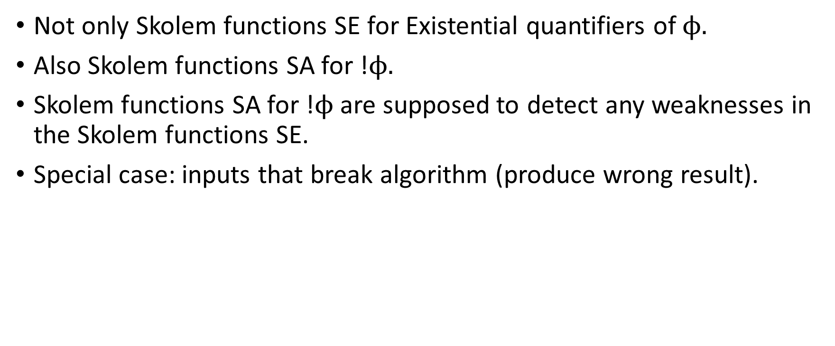
Difference: Balanced Approach
Not only Skolem functions SE for Existential quantifiers of $ϕ.$
Also Skolem functions SA for !$ϕ.$
Skolem functions SA for !$ϕ$are supposed to detect any weaknesses in the Skolem functions SE.
Special case: inputs that break algorithm (produce wrong result).

Slide 165
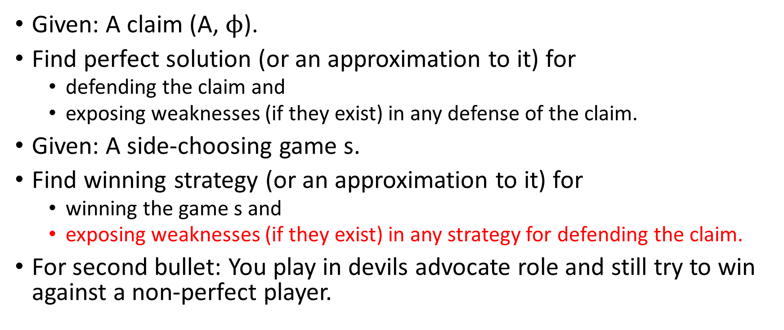
Price for peer evaluation
Given: A claim (A, $ϕ$).
Find perfect solution (or an approximation to it) for
  defending the claim and
  exposing weaknesses (if they exist) in any defense of the claim.
Given: A side-choosing game s.
Find winning strategy (or an approximation to it) for
  winning the game s and
  exposing weaknesses (if they exist) in any strategy for defending the claim.
For second bullet: You play in devils advocate role and still try to win against a non-perfect player.

Slide 166
Yaron Singer’s Course: CS 284r:
Incentives and Information in Networks
Premise: Human Interactions follow mathematical patterns that can be leveraged by algorithms for acquiring. disseminating, and learning information.

Slide 167
Connection to Yaron’s Premise
We study engineered networks where participants need to follow a protocol of interaction about claims.
We study algorithms that take the results of those constrained interactions as input and produce
  information about the participants and, indirectly through the participants,
  information about the claims.
We study techniques to engineer networks that disseminate specific knowledge through a network.

Slide 168
Connection to Yaron’s Work
So while Yaron gathers information from networks "in the wild" we gather information from networks we have constrained by rules. Our rules are motivated by observing how formal scientific communities work.

Slide 169
How does Merlin convince Arthur that the Claim C is true
Merlin gives a proof of C in a proof system. Arthur checks.
Merlin provides a winning strategy for the semantic game associated with the claim C and proves it correct in a proof system. Arthur checks.
Merlin consistently wins the semantic game associated with the claim C against Arthur. Arthur agrees with Merlin after failing to refute the claim after multiple attempts.
  Now Arthur orders Merlin to give out his strategy and Arthur can defend the claim against other Kings, without having a proof that it works.

Slide 170
Truth is secondary to construction
It could be that Arthur cannot find the hole in the reasoning of Merlin but actually, the claim is false.

Slide 171
From Semantic Games to SCG

