Slide 1

CS3000: Algorithms & Data
Jonathan Ullman
Lecture 15:
Ford-Fulkerson: choosing good paths
Mar 16, 2020

Slide 2
Things to Review
Flow networks:
  Definitions
  Flows and cuts
  The max-flow and min-cut problems
The Ford-Fulkerson Algorithm
  Augmenting paths
  Residual graphs
  Proof of correctness via the max-flow-min-cut theorem

Slide 3
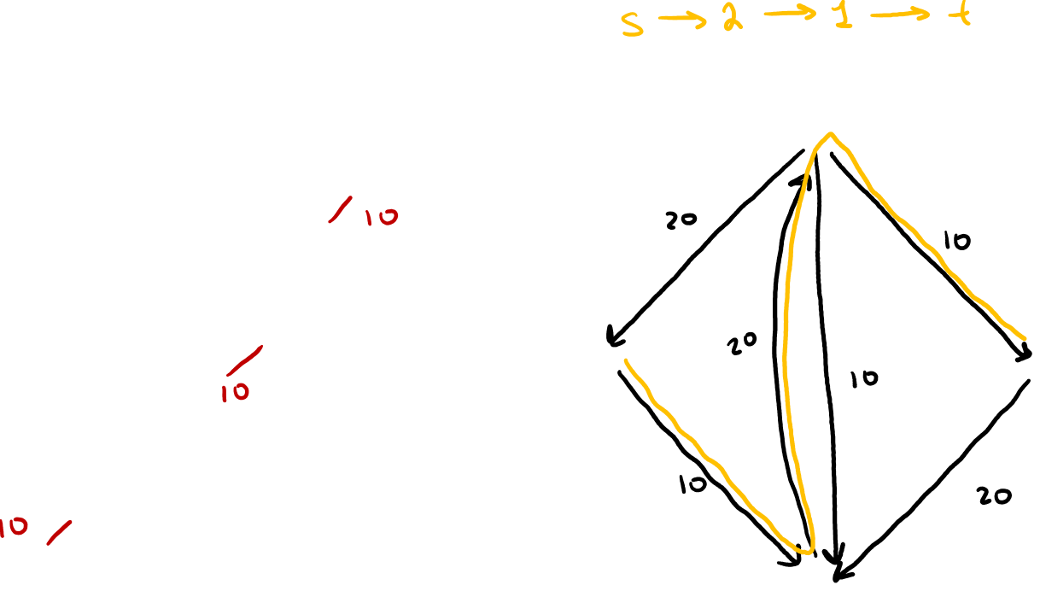

Ford-Fulkerson Algorithm
Start with $f\left(e\right)=0$ for all edges $e∈E$
Find an augmenting path $P$ in the residual graph $G_{f}$
Repeat until you get stuck
1
1
20
0
20
10
s
30
20
t
s
t
10
20
0
20
2
2

Slide 4
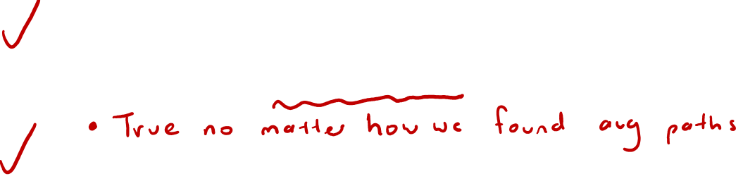
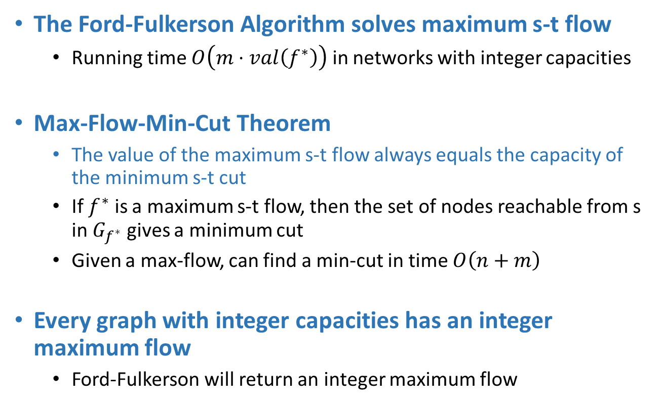
Ford-Fulkerson Summary
The Ford-Fulkerson Algorithm solves maximum s-t flow
  Running time $O\left(m⋅val\left(f^{∗}\right)\right)$ in networks with integer capacities
Max-Flow-Min-Cut Theorem
  The value of the maximum s-t flow always equals the capacity of the minimum s-t cut
  If $f^{∗}$ is a maximum s-t flow, then the set of nodes reachable from s in $G_{f^{∗}}$ gives a minimum cut
  Given a max-flow, can find a min-cut in time $O\left(n+m\right)$
Every graph with integer capacities has an integer maximum flow
  Ford-Fulkerson will return an integer maximum flow

Slide 5
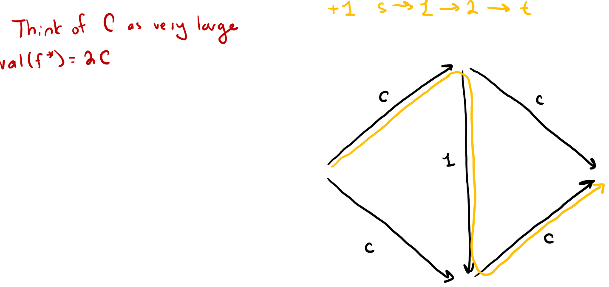
Ford-Fulkerson Algorithm
Start with $f\left(e\right)=0$ for all edges $e∈E$
Find an augmenting path $P$ in the residual graph $G_{f}$
Repeat until you get stuck
1
1
C
C
s
1
t
s
t
C
C
2
2

Slide 6
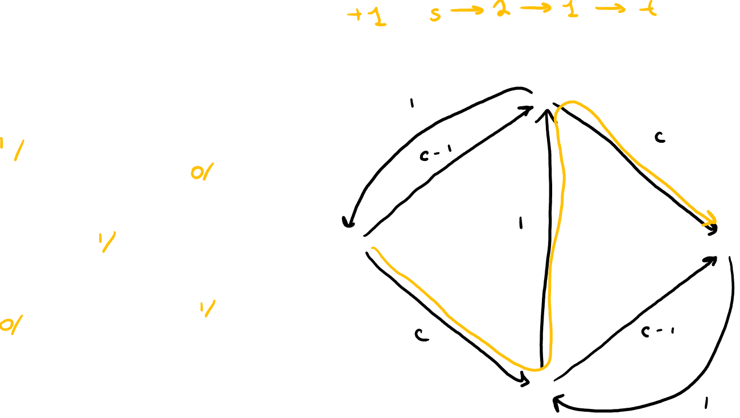
Ford-Fulkerson Algorithm
Start with $f\left(e\right)=0$ for all edges $e∈E$
Find an augmenting path $P$ in the residual graph $G_{f}$
Repeat until you get stuck
1
1
C
C
s
1
t
s
t
C
C
2
2

Slide 7
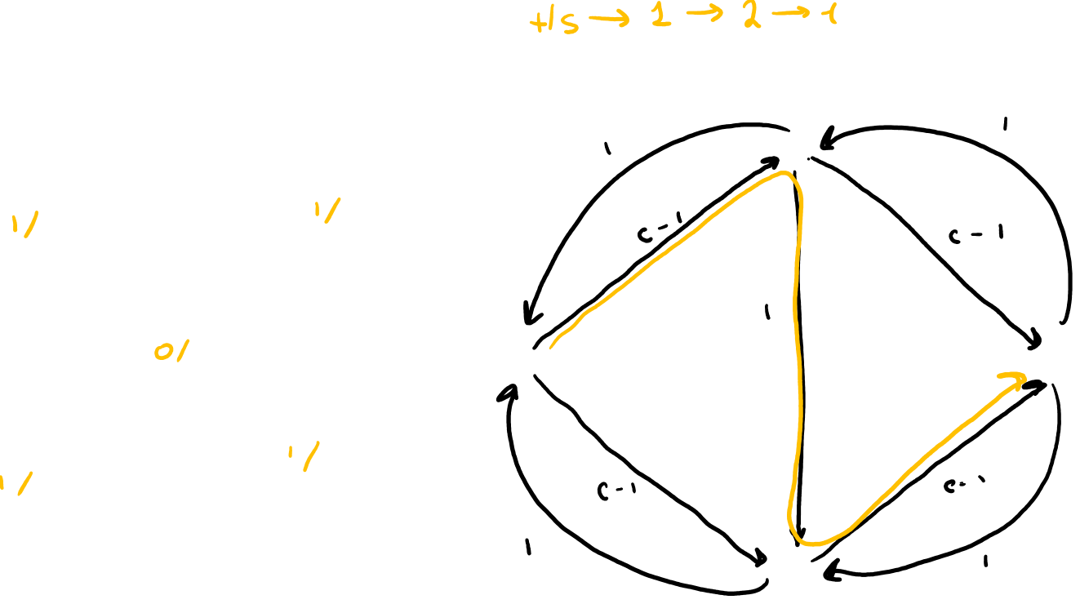
Ford-Fulkerson Algorithm
Start with $f\left(e\right)=0$ for all edges $e∈E$
Find an augmenting path $P$ in the residual graph $G_{f}$
Repeat until you get stuck
1
1
C
C
s
1
t
s
t
C
C
2
2

Slide 8
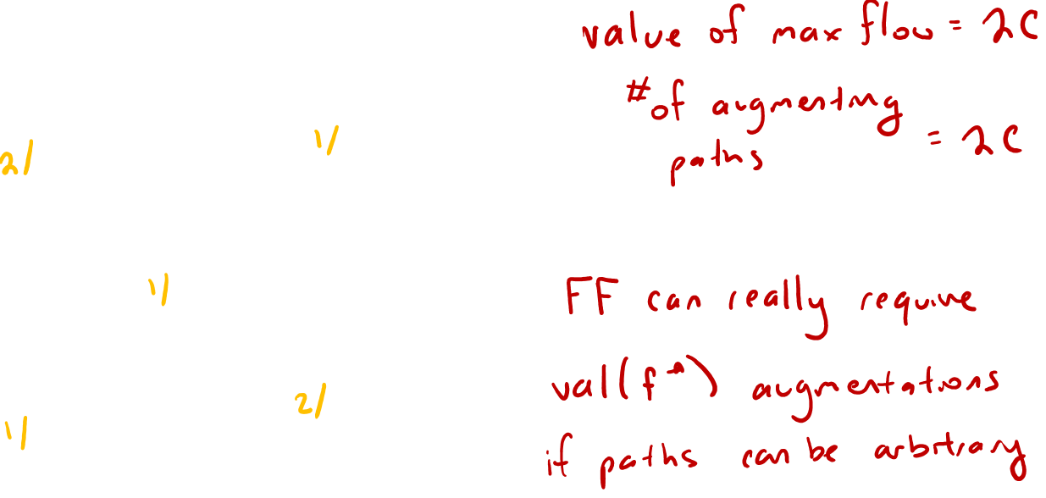
Ford-Fulkerson Algorithm
Start with $f\left(e\right)=0$ for all edges $e∈E$
Find an augmenting path $P$ in the residual graph $G_{f}$
Repeat until you get stuck
1
C
C
s
1
t
C
C
2

Slide 9
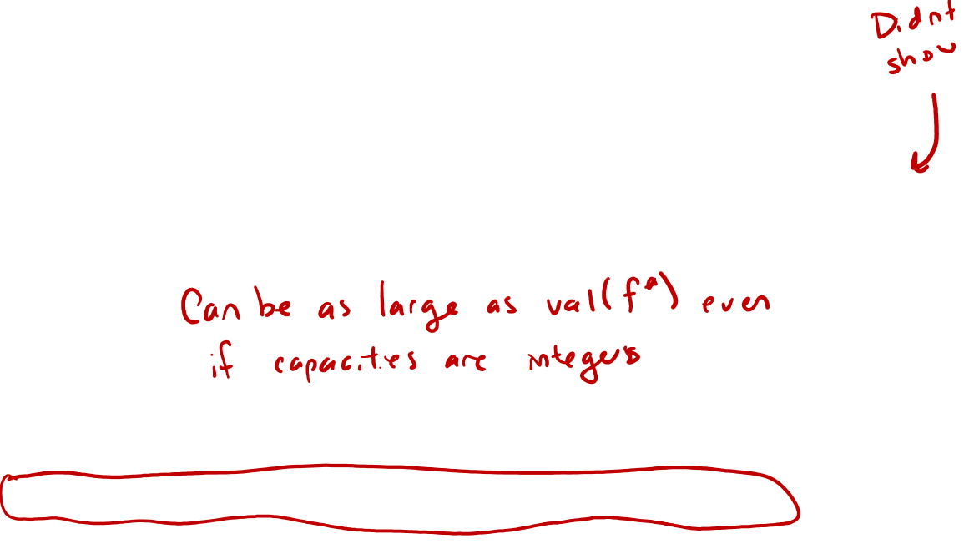
Choosing Good Augmenting Paths
Last time: arbitrary augmenting paths
  If Ford-Fulkerson terminates, then we have found a max flow
  Can construct capacities where the algorithm never terminates
  Can require many augmenting paths to terminate
Today: clever augmenting paths
  Maximum-capacity augmenting path (“fattest path”)
  Shortest augmenting paths (“shortest path”)

Slide 10
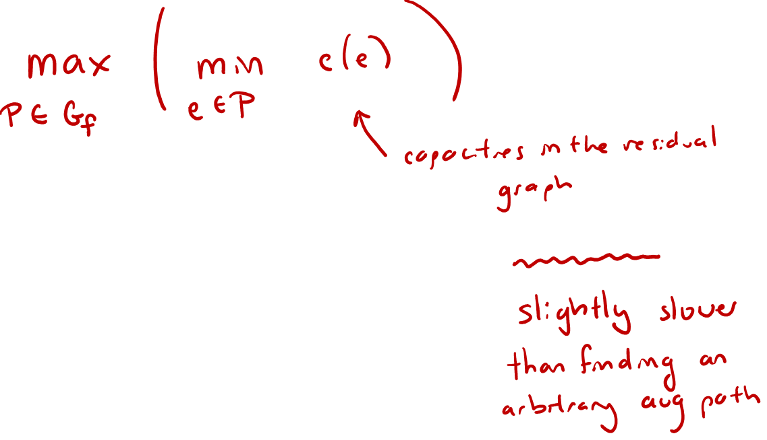
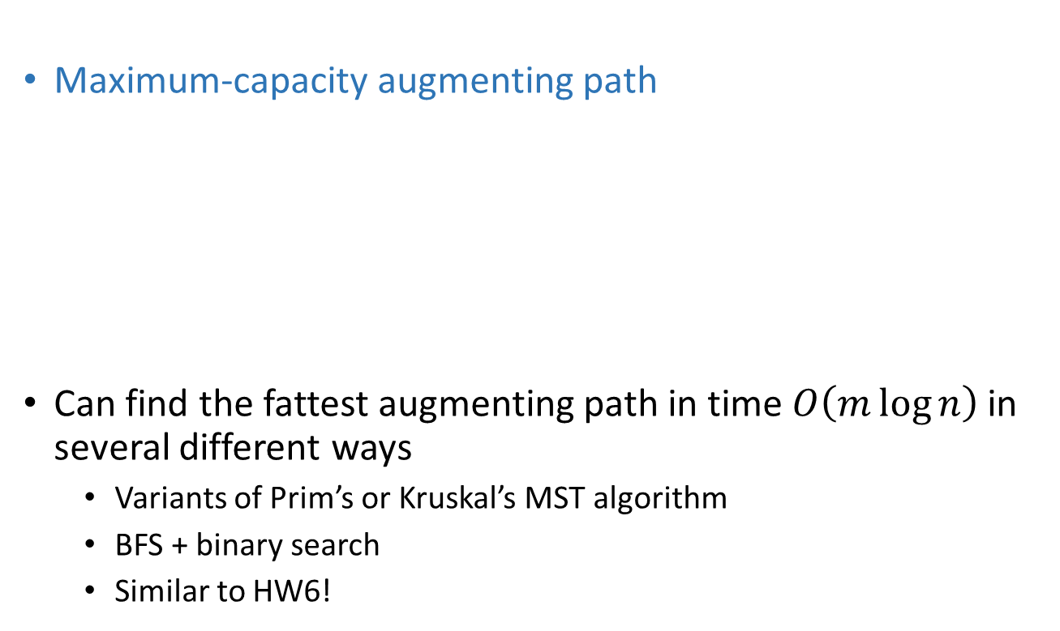
Fattest Augmenting Path
Maximum-capacity augmenting path
Can find the fattest augmenting path in time $O\left(m\log{n}\right)$ in several different ways
  Variants of Prim’s or Kruskal’s MST algorithm
  BFS + binary search
  Similar to HW6!

Slide 11
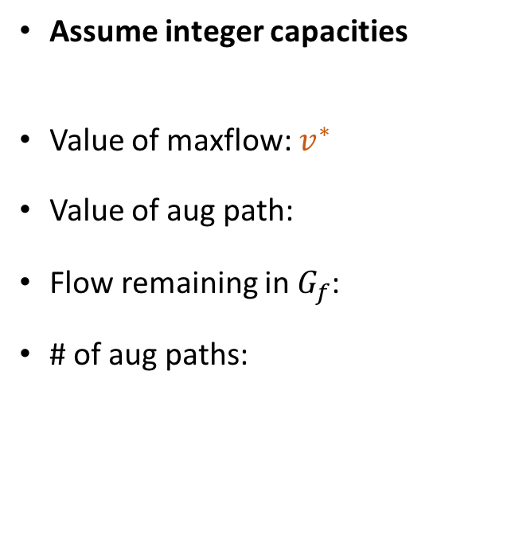
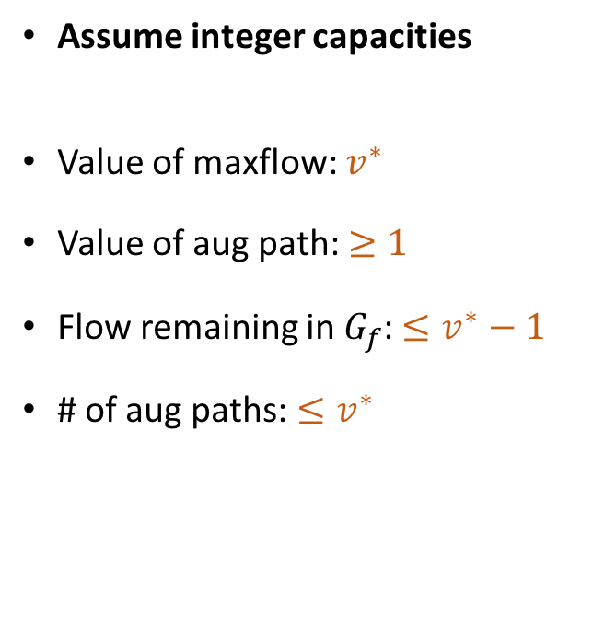
Fattest Augmenting Path
Arbitrary Paths
Maximum-Capacity Path
Assume integer capacities
Value of maxflow: $v^{∗}$
Value of aug path: $≥1$
Flow remaining in $G_{f}$: $≤v^{∗}−1$
# of aug paths: $≤v^{∗}$
Assume integer capacities
Value of maxflow: $v^{∗}$
Value of aug path:
Flow remaining in $G_{f}$:
# of aug paths:

Slide 12
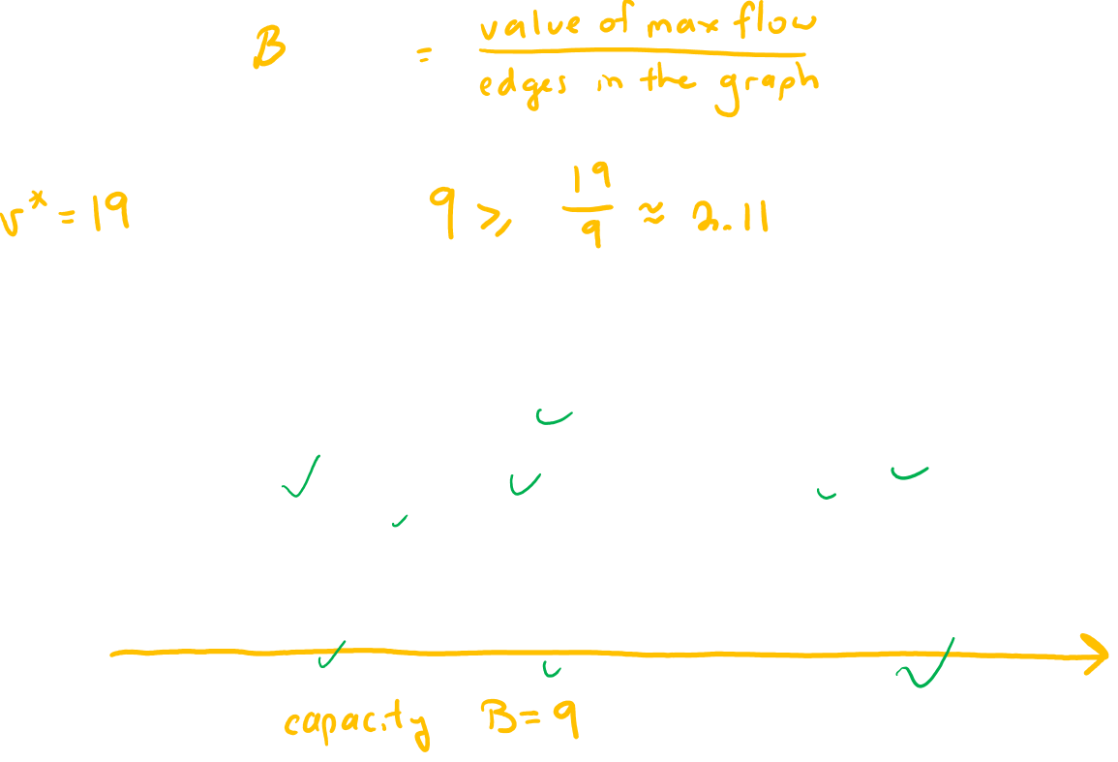
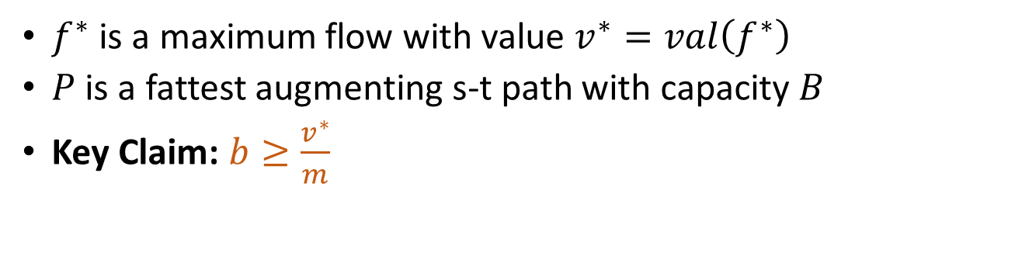
Fattest Augmenting Path
$f^{∗}$ is a maximum flow with value $v^{∗}=val\left(f^{∗}\right)$
$P$ is a fattest augmenting s-t path with capacity $B$
Key Claim: $b≥\frac{v^{∗}}{m}$
2
4
4
10
2
8
6
10
s
10
3
9
5
9
t

Slide 13
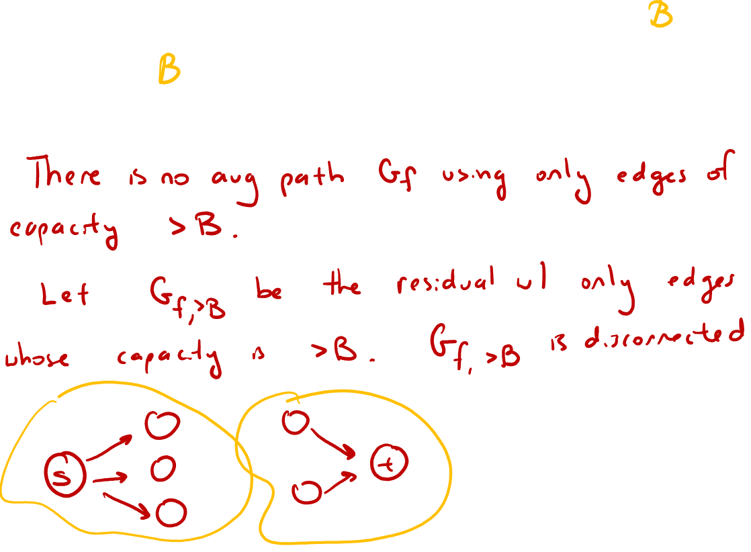
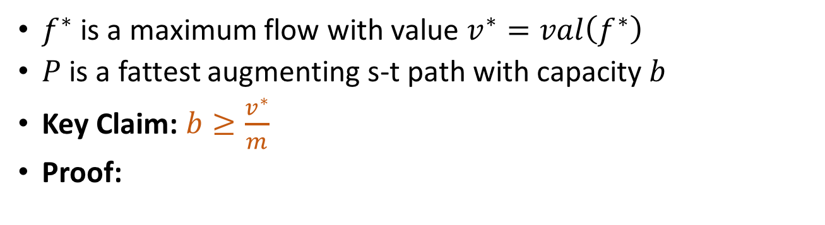
Fattest Augmenting Path
$f^{∗}$ is a maximum flow with value $v^{∗}=val\left(f^{∗}\right)$
$P$ is a fattest augmenting s-t path with capacity $b$
Key Claim: $b≥\frac{v^{∗}}{m}$
Proof:

Slide 14
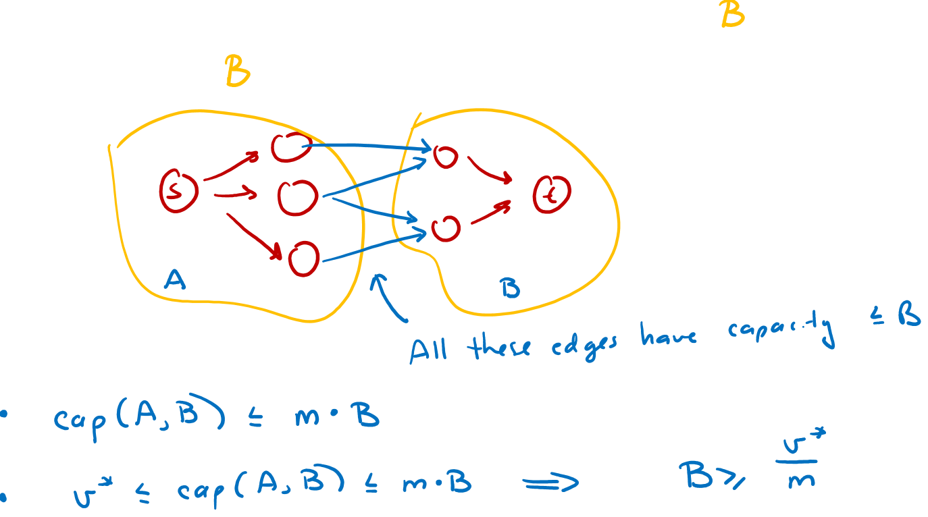

Fattest Augmenting Path
$f^{∗}$ is a maximum flow with value $v^{∗}=val\left(f^{∗}\right)$
$P$ is a fattest augmenting s-t path with capacity $b$
Key Claim: $b≥\frac{v^{∗}}{m}$

Slide 15
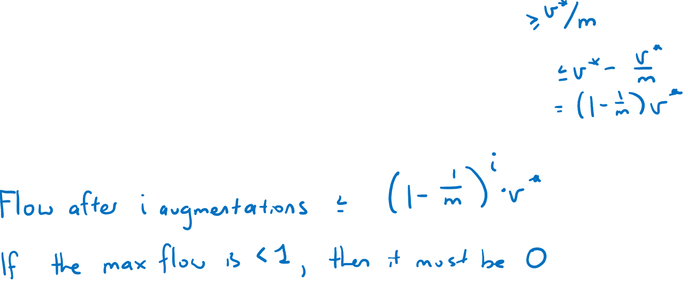
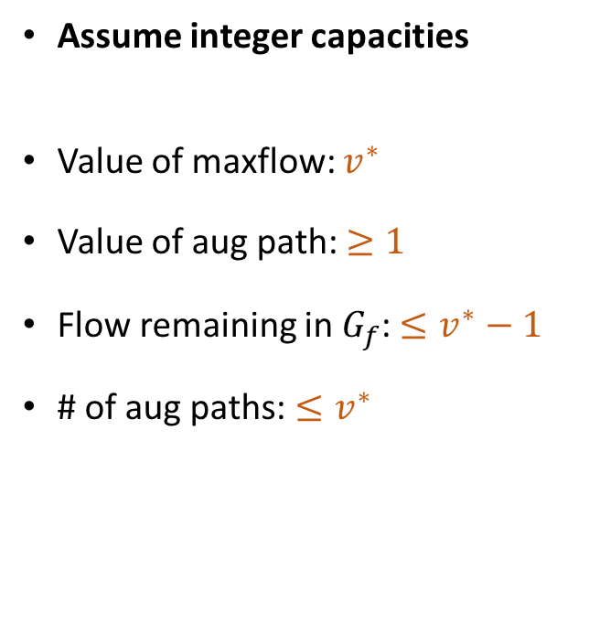
Fattest Augmenting Path
Arbitrary Paths
Maximum-Capacity Path
Assume integer capacities
Value of maxflow: $v^{∗}$
Value of aug path: $≥1$
Flow remaining in $G_{f}$: $≤v^{∗}−1$
# of aug paths: $≤v^{∗}$
Assume integer capacities
Value of maxflow: $v^{∗}$
Value of aug path:
Flow remaining in $G_{f}$:
# of aug paths:

Slide 16
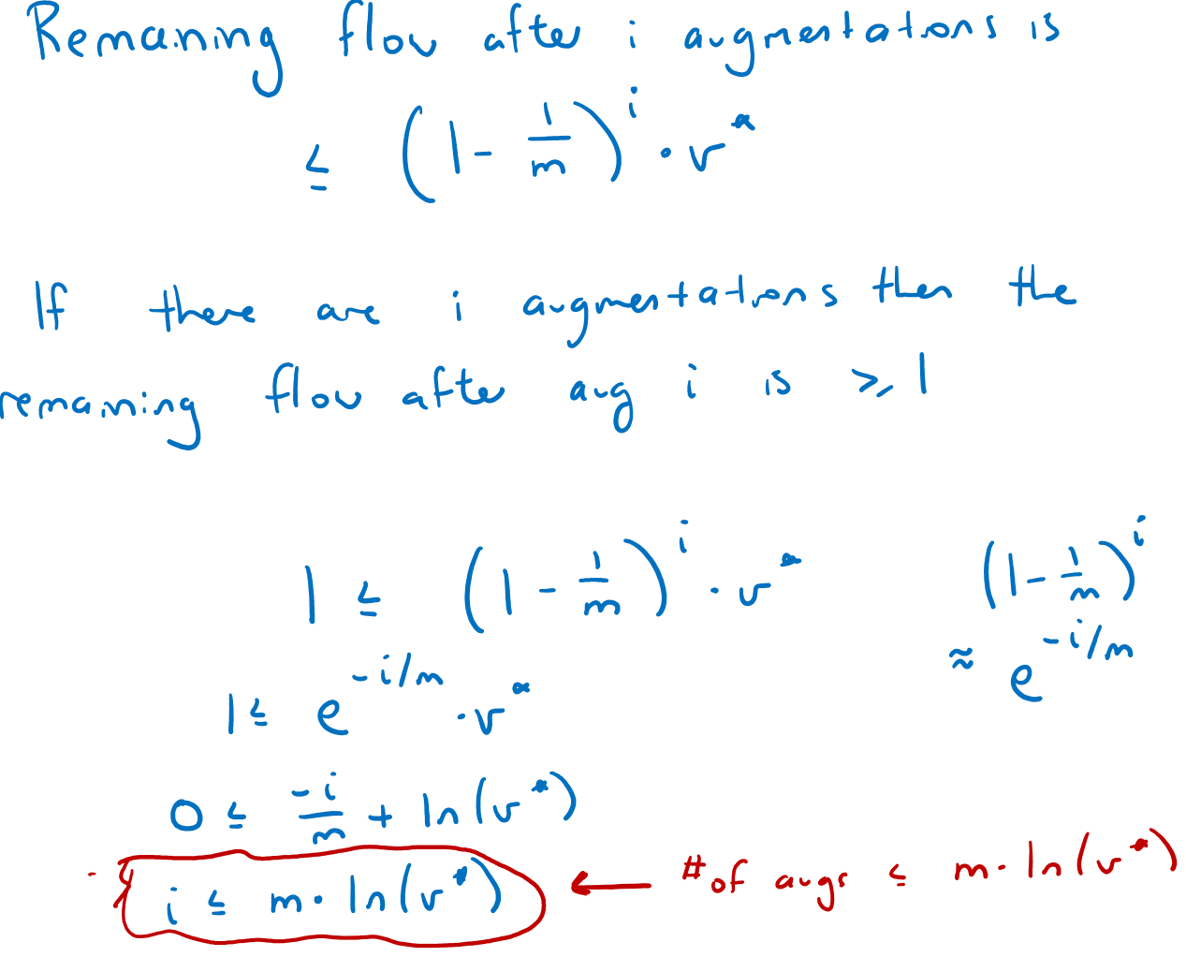

Slide 17
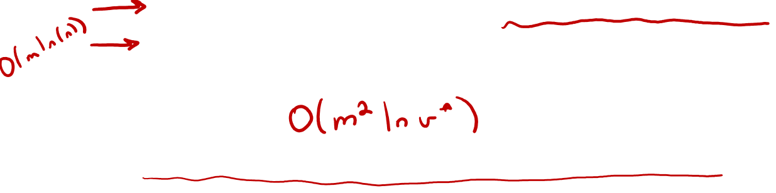
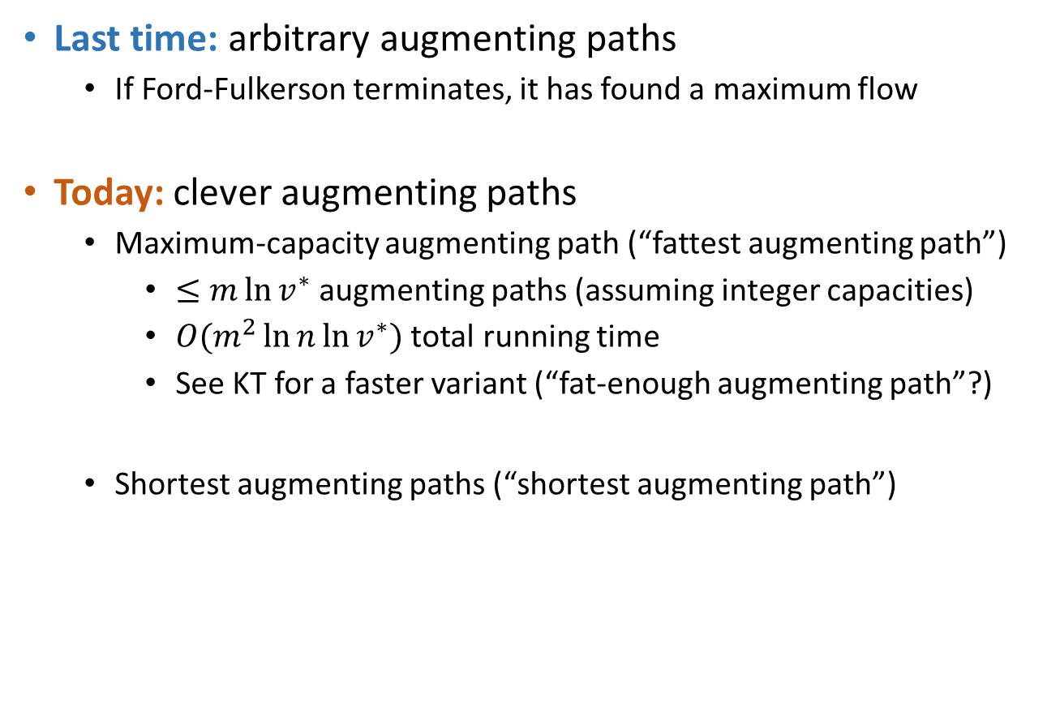
Choosing Good Paths
Last time: arbitrary augmenting paths
  If Ford-Fulkerson terminates, it has found a maximum flow
Today: clever augmenting paths
  Maximum-capacity augmenting path (“fattest augmenting path”)
    $≤m\ln{v^{∗}}$ augmenting paths (assuming integer capacities)
    $O(m^{2}\ln{n}\ln{v^{∗}})$ total running time
    See KT for a faster variant (“fat-enough augmenting path”?)
  Shortest augmenting paths (“shortest augmenting path”)

Slide 18
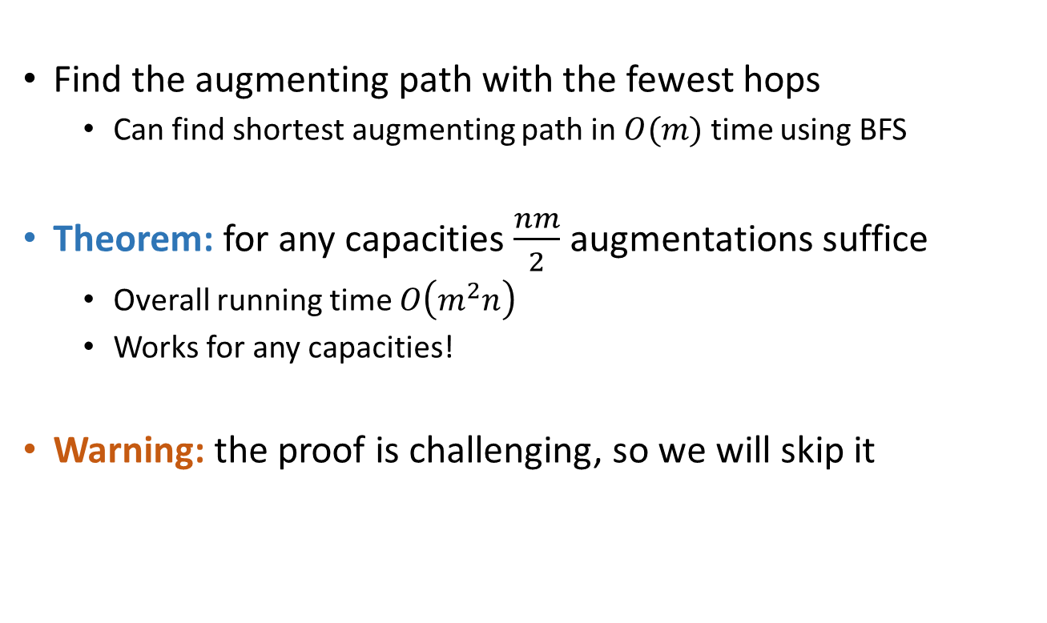
Shortest Augmenting Path
Find the augmenting path with the fewest hops
    Can find shortest augmenting path in $O(m)$ time using BFS
Theorem: for any capacities $\frac{nm}{2}$ augmentations suffice
  Overall running time $O\left(m^{2}n\right)$
  Works for any capacities!
Warning: the proof is challenging, so we will skip it

Slide 19
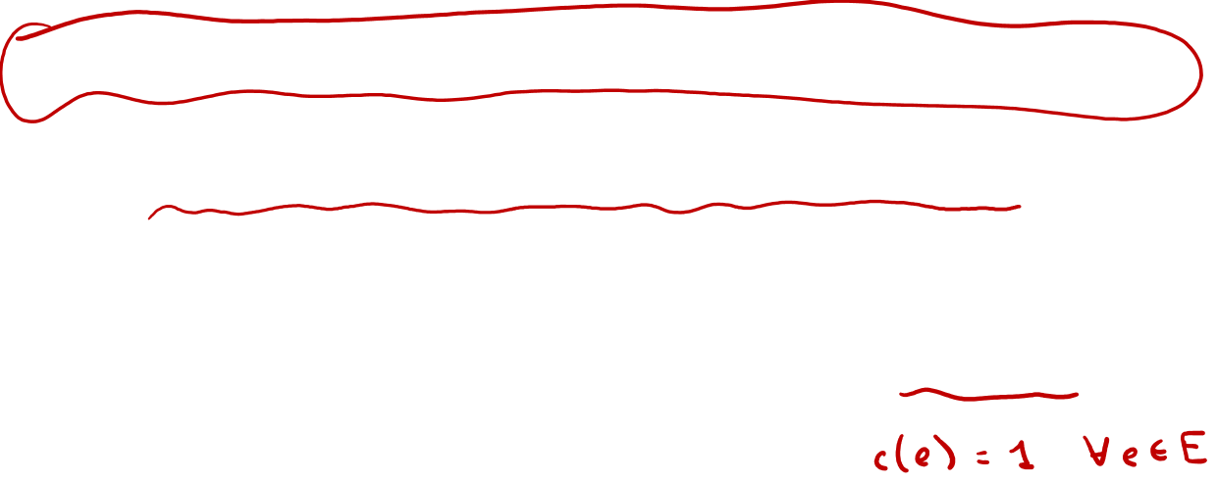
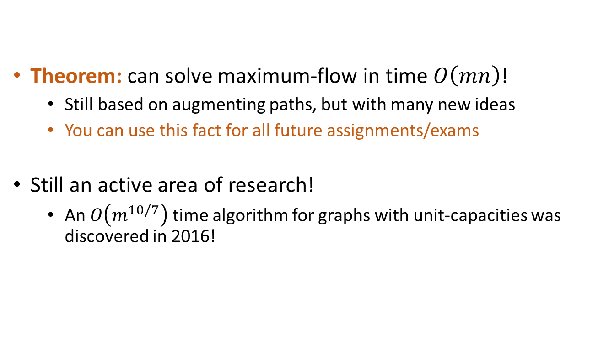
Shortest Augmenting Path
Theorem: can solve maximum-flow in time $O\left(mn\right)$!
  Still based on augmenting paths, but with many new ideas
  You can use this fact for all future assignments/exams
Still an active area of research!
  An $O\left(m^{10/7}\right)$ time algorithm for graphs with unit-capacities was discovered in 2016!

