Slide 1
Models of Coordination in Multiagent Decision Making
Chris Amato
Many slides from a larger tutorial with Matthijs Spaan and Shlomo Zilberstein
Some other slides courtesy of: Dan Bernstein, Frans Oliehoek and Alan Carlin

Slide 2
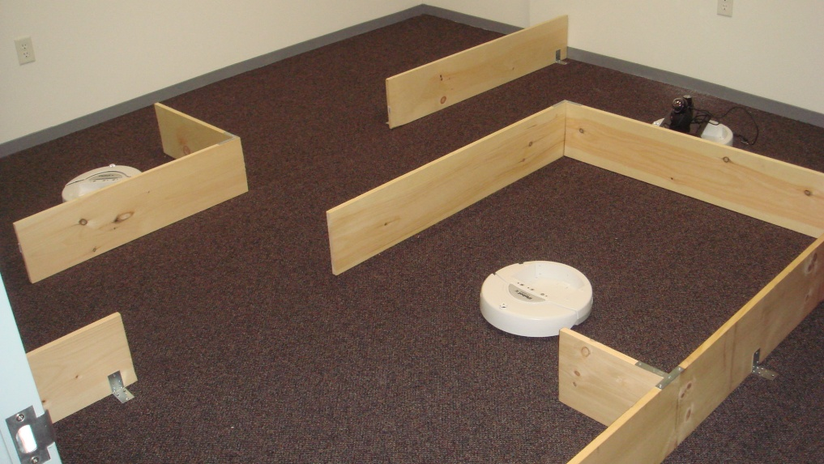
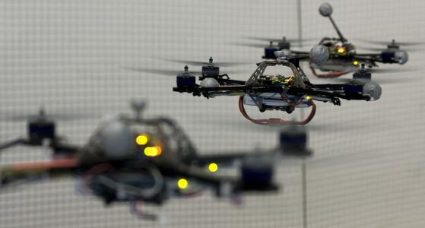
General overview
Agents situated in a world, receiving information and choosing actions
  Uncertainty about outcomes and sensors
  Sequential domains
  Cooperative multi-agent
  Decision-theoretic approach
Developing approaches to scale to real-world domains
Notes:
Noisy: see walls, but could be any wall or shadow
Unobservable: see resulting widget, but not machine components
sequential (one decision affects the next), uncertainty (some inaccuracy in movement, passing/shooting, location, unknown info), objective (maximize collection speed and quality)

Slide 3
Outline
Background on decision-theoretic planning
Models for cooperative sequential decision-making
  Dec-POMDPs and MTDPs
  Notable subclasses (Dec-MDPs, ND-POMDPs)
  Related competitive models (POSGs, I-POMDPs)
Optimal algorithms
  Finite and infinite horizon
  Top down and bottom up
Approximate algorithms
  Finite and infinite horizon
Communication
Applications being targeted
Conclusion

Slide 4
Decision-theoretic planning
Tackles uncertainty in sensing and acting in a principled way
Popular for single-agent planning under uncertainty (MDPs, POMDPs)
We need to model:
  Each agent's actions
  Their sensors
  Their environment
  Their task

Slide 5
Modeling assumptions
Sequential decisions: problems are formulated as a sequence of discrete “independent” decisions
Markovian environment: the state at time t depends only on the events at time t-1
Stochastic models: the uncertainty about the outcome of actions and sensing can be accurately captured
Objective encoding: the overall objective can be encoded using cumulative (discounted) rewards over time steps

Slide 6
Problem aspects
On-line vs. off-line
Centralized vs. distributed
  Planning
  Execution
Cooperative vs. self-interested
Observability
Communication

Slide 7
A toy example (decentralized tiger)
2 agents with 2 doors
A tiger is behind one and a treasure is behind the other
Can listen for a noisy signal about the location of the tiger
If either agent opens the door with the tiger, they both get mauled
If the door with treasure is opened, they share the reward
Don’t know each other’s actions and observations

Slide 8
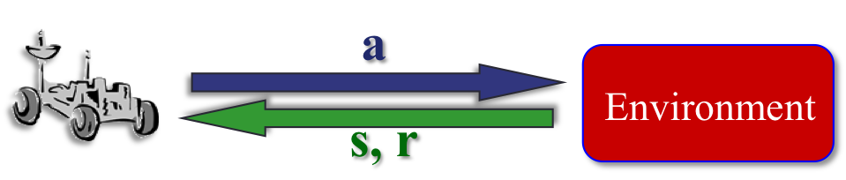
Single agent/centralized models
Markov decision processes (MDPs)
  Stochastic actions, but fully observe state at each step
  P complexity
Maximize value
Can be multiagent, but centralized execution (and large size)

Slide 9
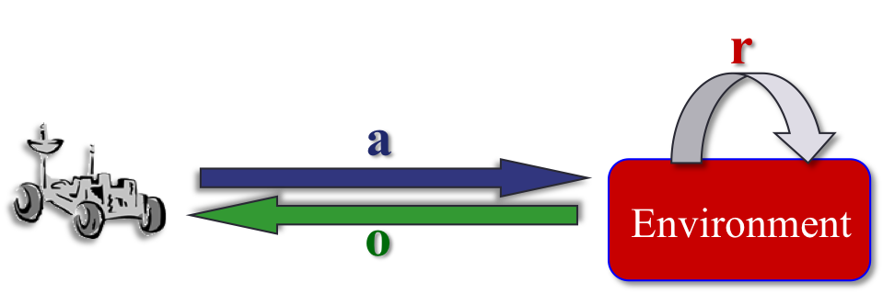
Single agent/centralized models
Partially observable Markov decision processes (POMDPs)
  Receive an observation rather than true state
  PSPACE complexity (for finite horizons)
Maximize value in a similar way (but over distributions over states or beliefs)
Can also be (centralized) multiagent

Slide 10
Decentralized domains
Cooperative multiagent problems
Each agent’s choice affects all others, but must be made using only local information
Properties
  Often a decentralized solution is required
  Multiple agents making choices independently of the others
  Does not require communication on each step (may be impossible or too costly)
  But now agents must also reason about the previous and future choices of the others (more difficult)

Slide 11
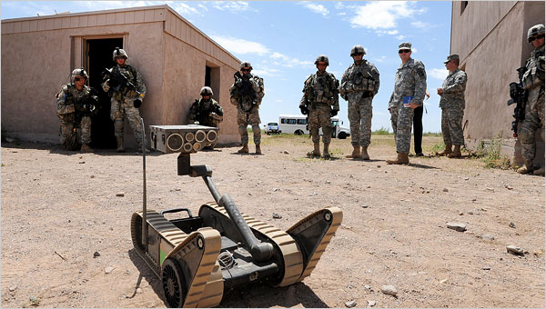
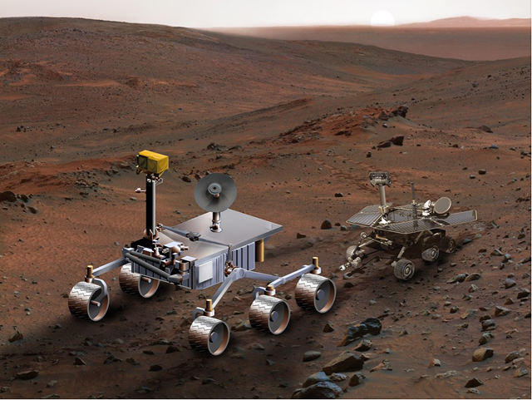
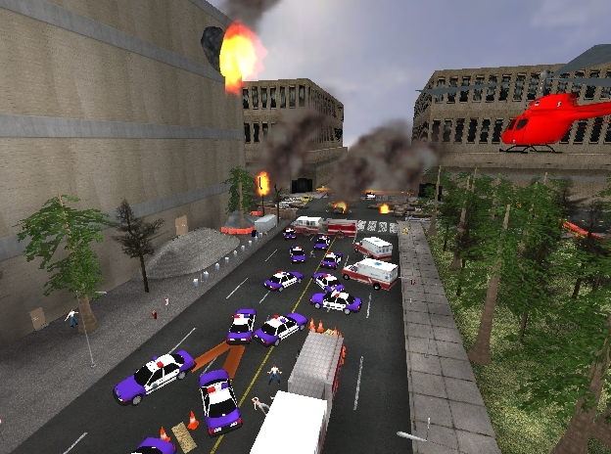
Example cooperative multiagent problems
Multi-agent planning (examples below, reconnaissance, etc.)
Human-robot coordination (combat, industry, etc.)
Sensor networks (e.g. target tracking from multiple viewpoints)
E-commerce (e.g. decentralized web agents, stock markets)
Notes:
Multi-agent (single mission to complete, but multiple agents cooperating to get it done)

Slide 12
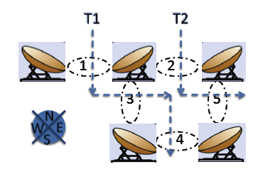
Sensor network problems
Sensor networks for
  Target tracking (Nair et al., 05, Kumar and Zilberstein 09-AAMAS)
  Weather phenomena (Kumar and Zilberstein 09-IJCAI)
Two or more cooperating sensors

Slide 13
Other possible application domains
Multi-robot coordination
  Space exploration rovers (Zilberstein et al., 02)
  Helicopter flights (Pynadath and Tambe, 02)
  Navigation (Emery-Montemerlo et al., 05; Spaan and Melo 08)
Load balancing for decentralized queues (Cogill et al., 04)
Multi-access broadcast channels (Ooi and Wornell, 96)
Network routing (Peshkin and Savova, 02)
Sensor network management (Nair et al., 05)

Slide 14

Multiple cooperating agents
Decentralized partially observable Markov decision process (Dec-POMDP) also called multiagent team decision problem (MTDP)
Extension of the single agent POMDP
Multiagent sequential decision-making under uncertainty
  At each stage, each agent takes an action and receives:
    A local observation
    A joint immediate reward
a₁
r
o₁
a_{n}
Environment
o_{n}

Slide 15
Dec-POMDP definition
A Dec-POMDP can be defined with the tuple:
M = <I, S, {A_{i}}, P, R, {Ω_{i}}, O>
  I, a finite set of agents
  S, a finite set of states with designated initial state distribution b₀
  A_{i}, each agent’s finite set of actions
  P, the state transition model:
  R, the reward model:
  Ω_{i}, each agent’s finite set of observations
  O, the observation model:
Note: Functions depend on all agents

Slide 16
Dec-POMDP solutions
A local policy for each agent is a mapping from its observation sequences to actions, Ω*  A
  State is unknown, so beneficial to remember history
A joint policy is a local policy for each agent
Goal is to maximize expected cumulative reward over a finite or infinite horizon
  For infinite-horizon cannot remember the full observation history
  In infinite case, a discount factor, γ, is used

Slide 17
Example: 2-Agent Navigation
States: grid cell pairs
Actions: move , , , , stay
Transitions: noisy
Observations: red lines
Rewards: negative unless sharing the same square
Notes:
Note the differences from POMDPs – no shared information (belief state), so need to deal with own uncertainty as well as consider what the other agents may or may not do

Slide 18
Challenges in solving Dec-POMDPs
Partial observability makes the problem difficult to solve
No common state estimate (centralized belief state)
  Each agent depends on the others
  This requires a belief over the possible policies of the other agents
  Can’t transform Dec-POMDPs into a continuous state MDP (how POMDPs are typically solved)
Therefore, Dec-POMDPs cannot be solved by centralized (POMDP) algorithms

Slide 19
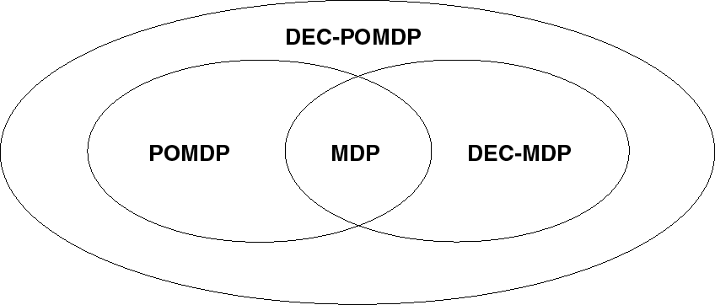
General complexity results
NEXP
PSPACE
P
NEXP
subclasses and finite horizon complexity results

Slide 20
Relationship with other models
Ovals represent complexity, while colors represent number of agents and cooperative or competitive models

Slide 21
POSGs
A partially observable stochastic game (POSG) is a tuple M = <I, S, {A_{i}}, P, {R_{i}}, {Ω_{i}}, O> where
  All the components except the reward function are the same as in a DEC-POMDP
  Each agent has an individual reward function:
    R_{i}(s,a_{i}) denotes the reward obtained after action a_{i} was taken by agent i and a state transition to s’ occurred
This is the self-interested version of the DEC-POMDP model

Slide 22
I-POMDPs
Interactive POMDPs (I-POMDPs) extend state space with behavioral models of other agents (Gmytrasiewicz and Doshi 05)
Agents maintain beliefs over physical and models of others
Recursive modeling
When assuming a finite nesting, beliefs and value functions can be computed (approximately).
Finitely nested I-POMDPs can be solved as a set of POMDPs

Slide 23
Dec-MDPs
Joint full observability = collective observability
A Dec-POMDP is jointly fully observable if the n-tuple of observations made by all the agents uniquely determine the current global state.
  That is, if then
A decentralized Markov decision process (Dec-MDP) is a Dec-POMDP with joint full observability.
A stronger result: The problem is NEXP-hard even when the state is jointly observed!
  That is, two-agent finite-horizon DEC-MDPs are NEXP-hard.

Slide 24
Classes of Dec-POMDPs
A factored n-agent Dec-MDP is a Dec-MDP for which the world state can be factored into n+1 components, S= S₀ ×S₁ ×…× S_{n}
A factored, n-agent Dec-MDP is said to be locally fully observable if each agent observes its own state component
Local state/observation/action is referred to as the local state, as the local action, and as the local observation for agent I
Full observability = individual observability
A Dec-POMDP is fully observable if there exists a mapping for each agent i, such that whenever is non-zero then

Slide 25
Classes of Dec-POMDPs
A multi-agent Markov decision process (MMDP) is a Dec-POMDP with full observability (Boutilier, 96)
A factored, n-agent Dec-MDP is said to be transition independent if there exists P₀ through P_{n} such that
A factored, n-agent Dec-MDP is said to be observation independent if there exists O₁ through O_{n} such that:

Slide 26
Classes of Dec-POMDPs
A factored, n-agent Dec-MDP is said to be reward independent if there exist ƒ and R₁ through R_{n} such that
and
For example, additive rewards
If a Dec-MDP has independent observations and transitions, then the Dec-MDP is locally fully observable.

Slide 27
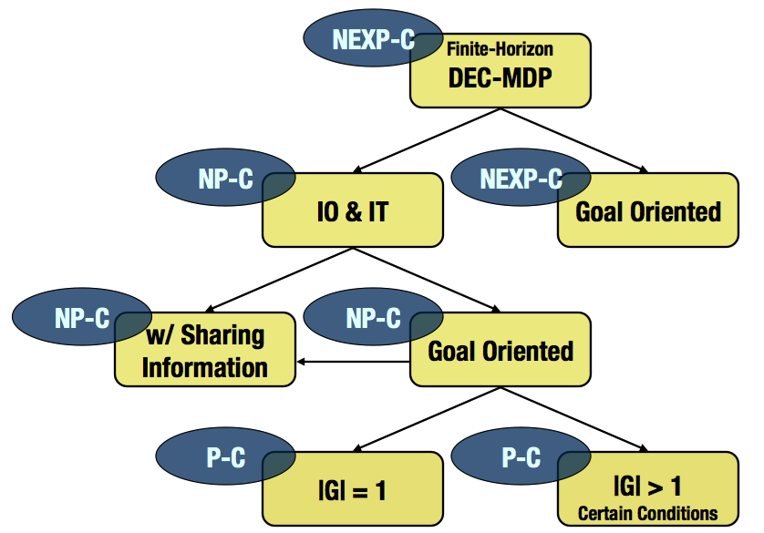
Some complexity results
Observability | General communication | Free communication
Full | MMDP (P-complete) | MMDP (P-complete)
Joint full | Dec-MDP (NEXP) | MMDP (P-complete)
Partial | Dec-POMDP (NEXP) | MPOMDP (PSPACE)

Slide 28
ND-POMDPs (Nair et al., 05)
A network distributed POMDP (ND-POMDP) is a factored n-agent Dec-POMDP with independent transitions and observations as well as a decomposable reward function
That is,
Where l is the subgroup of agents of size k
  Model locality of interaction
  Doesn’t make joint full observability assumption of Dec-MDPs
  Complexity depends on k (but still NEXP in worst case)
Ag1
Ag2
Ag3
Ag5
Ag4

Slide 29
Factored Dec-POMDPs (Oliehoek et al., 08)
Motivation: exploit locality of interaction, but no strict independence assumptions
More general and powerful than ND-POMDPs
Less scalable (non-stationary interaction graph)

Slide 30
Algorithms
How do we produce a solution for these models?
Will discuss
  Solution representations
  Optimal methods
  Approximate methods
  Subclasses
  Communication

Slide 31
Policy representations – finite horizon
Policy trees, one for each agent
Nodes define actions, links define observations
One leaf for each history for the given horizon
Evaluation:
  Starting from a node q, taking the associated action and transition

Slide 32
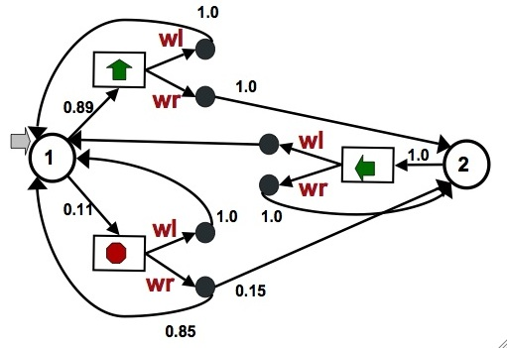
Policy representations – infinite horizon
  Designated initial node
  Nodes define actions
  Transitions based on
    observations seen
  Inherently infinite-horizon
  With fixed memory,
    randomness can help
  One controller for each agent
  Value for node and state s:
Actions: move in direction or stop
Observations: wall left, wall right
  Action selection, P(a|q): Q  ΔA
  Transitions, P(q’|q,o): Q × O  ΔQ

Slide 33
Optimal methods
Want to produce the optimal solution for a problem
That is, optimal horizon h tree or ε-optimal controller
Do this in a bottom up or a top down manner

Slide 34
Bottom up methods
Build the policies up for each agent simultaneously
Begin on the last step (single action) and continue until the first
When done, choose highest value set of trees for any initial state

Slide 35
Exhaustive search
Construct all possible policies for the set of agents
Do this in a bottom up fashion
Stop when the desired horizon is reached
Trivially includes an optimal set of trees when finished
Choose the set of policies with the highest value at the initial belief

Slide 36
Exhaustive search example (2 agents)
a₁
a₂
a₁
a₂

Slide 37
Exhaustive search continued
a₁
a₂
a₁
a₂
o₁
o₂
o₁
o₂
o₁
o₂
o₁
o₂
a₁
a₁
a₁
a₁
a₁
a₁
a₁
a₁
a₁
a₂
a₁
a₁
a₂
a₁
o₁
o₂
o₁
o₂
o₁
o₂
o₁
o₂
o₁
o₂
o₁
o₂
a₁
a₂
a₁
a₂
a₂
a₁
a₁
a₂
a₁
a₂
a₂
a₁
a₂
a₁
a₂
a₂
a₁
a₂
o₁
o₂
o₁
o₂
o₁
o₂
o₁
o₂
o₁
o₂
o₁
o₂
a₂
a₁
a₂
a₂
a₂
a₂
a₂
a₁
a₂
a₂
a₂
a₂

Slide 38
Exhaustive search continued

Slide 39
Exhaustive search summary
Can find an optimal set of trees
Number of each agent's trees grows exponentially at each step
Many trees will not contribute to an optimal solution
Can we reduce the number of trees we consider?

Slide 40
Finite horizon dynamic programming (DP)
(Hansen et al. 2004)
Build policy tree sets simultaneously
Returns optimal policy for any initial state
Prune using a generalized belief space (with linear program)
This becomes iterative elimination of dominated strategies in POSGs
For two agents:
a₃
a₂
s₁
a₂
a₃
q₁
o₁
o₂
o₁
o₂
q₂
×
×
o₁
o₂
o₁
o₂
p₁
p₂
q₁
q₂
a₁
a₁
a₃
a₁
s₂
a₂
a₂
a₁
a₂
agent 2 state space
agent 1 state space
agent 1 value (4D)

Slide 41
DP for DEC-POMDPs example (2 agents)
a₁
a₂
a₁
a₂

Slide 42
DP for DEC-POMDPs continued
a₁
a₂
a₁
a₂
o₁
o₂
o₁
o₂
o₁
o₂
o₁
o₂
a₁
a₁
a₁
a₁
a₁
a₁
a₁
a₁
a₁
a₂
a₁
a₁
a₂
a₁
o₁
o₂
o₁
o₂
o₁
o₂
o₁
o₂
o₁
o₂
o₁
o₂
a₁
a₂
a₁
a₂
a₂
a₁
a₁
a₂
a₁
a₂
a₂
a₁
a₂
a₁
a₂
a₂
a₁
a₂
o₁
o₂
o₁
o₂
o₁
o₂
o₁
o₂
o₁
o₂
o₁
o₂
a₂
a₁
a₂
a₂
a₂
a₂
a₂
a₁
a₂
a₂
a₂
a₂

Slide 43
DP for DEC-POMDPs continued
a₁
a₁
a₂
o₁
o₂
o₁
o₂
o₁
o₂
a₁
a₁
a₁
a₁
a₁
a₁
a₁
a₁
a₁
a₂
a₁
o₁
o₂
o₁
o₂
o₁
o₂
o₁
o₂
o₁
o₂
a₁
a₂
a₂
a₁
a₁
a₂
a₁
a₂
a₂
a₁
a₂
a₁
a₂
a₂
a₁
a₂
o₁
o₂
o₁
o₂
o₁
o₂
o₁
o₂
o₁
o₂
o₁
o₂
a₂
a₁
a₂
a₂
a₂
a₂
a₂
a₁
a₂
a₂
a₂
a₂

Slide 44
DP for DEC-POMDPs continued
a₁
o₁
o₂
a₁
a₁
a₁
a₁
a₁
a₂
a₁
o₁
o₂
o₁
o₂
o₁
o₂
o₁
o₂
o₁
o₂
a₁
a₂
a₂
a₁
a₁
a₂
a₁
a₂
a₂
a₁
a₂
a₁
a₂
a₂
a₂
o₁
o₂
o₁
o₂
o₁
o₂
o₁
o₂
o₁
o₂
a₂
a₁
a₂
a₂
a₂
a₂
a₂
a₁
a₂
a₂

Slide 45
DP for DEC-POMDPs continued
a₁
o₁
o₂
a₁
a₁
a₁
a₁
a₂
a₁
o₁
o₂
o₁
o₂
o₁
o₂
o₁
o₂
a₂
a₁
a₁
a₂
a₁
a₂
a₂
a₁
a₂
a₂
a₂
a₂
o₁
o₂
o₁
o₂
o₁
o₂
o₁
o₂
a₂
a₁
a₂
a₂
a₂
a₁
a₂
a₂

Slide 46
DP for DEC-POMDPs continued
a₁
o₁
o₂
a₁
a₁
a₁
a₁
a₁
o₁
o₂
o₁
o₂
o₁
o₂
a₂
a₁
a₁
a₂
a₂
a₁
a₂
a₂
a₂
a₂
o₁
o₂
o₁
o₂
o₁
o₂
o₁
o₂
a₂
a₁
a₂
a₂
a₂
a₁
a₂
a₂

Slide 47
DP for DEC-POMDPs continued

Slide 48
Infinite horizon version (Bernstein et al., 09)
Remember we need to define a controller for each agent
How many nodes do you need and what should the parameter values be for an optimal infinite-horizon policy?
This may be infinite!
First ε-optimal algorithm for infinite-horizon Dec-POMDPs: Policy Iteration

Slide 49

Optimal DP: Policy Iteration
Start with a given controller
Exhaustive backup (for all agents): generate all next step policies
Evaluate: determine value of starting at each node at each state and for each policy for the other agents
Prune: remove those that always have lower value (merge as needed)
Continue with backups and pruning until error is below ε
o₂
a₁
a₂
= Initial controller
for agent 1
o₁
o₁
o₂
a₁
o₁
o₂
o₂
a₁
a₁
a₁
a₂
o₁,o₂
o₁
o₁,o₂
o₁
a₁
o₂
o₂
o₁
s₁
s₂
(backup for action 1)
Notes:
Evaluate over states of the system and policies of the other agents

Slide 50
Optimal DP: Policy Iteration
Start with a given controller
Exhaustive backup (for all agents): generate all next step policies
Evaluate: determine value of starting at each node at each state and for each policy for the other agents
Prune: remove those that always have lower value (merge as needed)
Continue with backups and pruning until error is below ε
Key: Prune over not just states, but possible policies of the other agents!
o₂
a₁
a₂
= Initial controller
for agent 1
o₁
o₁
o₂
a₁
o₁
o₂
o₂
a₁
a₁
a₂
o₁,o₂
o₁
o₁
o₂
s₁
s₂
(backup for action 1)
Notes:
Need to backup for all agents before you can prune
Nodes merged in pruning when dominated by a distribution
Prune for each agent until no more changes can be made

Slide 51
DP for for Dec-POMDPs
What happens in infinite or large horizons?
  Number of trees is doubly exponential in the horizon
  Doesn’t consider start state
  Full backup wasteful (many trees pruned)
Need more efficient backups
Or approximate approaches to increase scalability

Slide 52
Incremental policy generation (Amato et al., 09)
Optimal dynamic programming for Dec-POMDPs requires a large amount of time and space
In POMDPs, methods have been developed to make optimal DP more efficient (e.g., incremental pruning)
These cannot be extended to Dec-POMDPs (due to the lack of a shared viewpoint by the agents)
Makes the optimal approaches for both finite and infinite-horizon more efficient

Slide 53
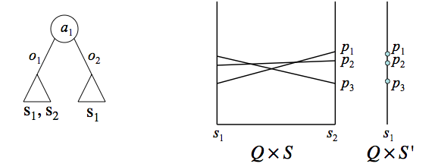
Incremental policy generation (cont.)
Can avoid exhaustively generating policies (backups)
Can limit the number of states considered based on action and observation (see a wall, other agent, etc.)
This allows policies for an agent to be built up incrementally
Add only subtrees (or subcontrollers) that are not dominated
Key: Prune only over reachable subspaces

Slide 54
Benefits of IPG and results
State-of-the-art in bottom up and infinite-horizon
Solve larger problems optimally
Can make use of start state information as well
Can be used in other dynamic programming algorithms
  Optimal: Finite-, infinite- and indefinite horizon
  Approximate: PBDP, MBDP, IMBDP, MBDP-OC and PBIP
Increases horizon in optimal DP (finite or infinite-hor)
Notes:
The important thing to note is that original DP runs out of researches after a small horizon while IPG and IPG with start state can scale to larger horizons (and thus produce higher quality solution in infinite-horizon as well)

Slide 55
Top down approaches
Perform a search starting from a known initial (belief) state
Continue until the desired horizon is reached

Slide 56
Multiagent A* (Szer et al., 05)
Can build up policies for agents from the first step
Use heuristic search over joint policies
  Actions: and , observations: and
  History: and joint policies for a single step:
  Heuristic value for remaining steps (e.g., MDP or POMDP)

Slide 57
Multiagent A* continued
Requires an admissible heuristic function
A*-like search over partially specified joint policies:
Heuristic value:
If is admissible (overestimation), so is

Slide 58
Multiagent A* continued
Expand children by growing policy to the next horizon
Choose nodes with the highest F value
Continue until node with highest F is a full horizon policy

Slide 59
Heuristic functions
Defined by solving simplified problem settings
Q_{MDP}: assume the underlying state is fully observable by the agents from that step on
  Cheap to compute (solve an MDP)
  Often loose (strong assumptions: centralized and fully observable)
Q_{POMDP}: assume the observations of all agents are shared from that step on
  More difficult to solve (exponential in h to solve POMDP)
Q_{BG}: assume the observations of all agents are shared on the next step on
  Still harder to solve
Hierarchy of upper bounds
Q*≤Q_{BG}≤Q_{PODP}≤Q_{MDP}

Slide 60
Heuristic functions: example tiger problem

Slide 61
Generalized MAA* (Oliehoek et al., 08)
Represent Dec-POMDPs as a series of Bayesian games
Also allowed different heuristic functions and solvers to be used

Slide 62
Dec-POMDPs as a series of Bayesian games

Slide 63
Lossless clustering of histories (Oliehoek et al, 09)
Idea: if two individual histories induce the same distribution over states and over other agents' histories, they are equivalent and can be clustered
Lossless clustering, independent of heuristic, but problem dependent
Clustering is bootstrapped: algorithms only deal with clustered Bayesian games
Large increase in scalability of optimal solvers

Slide 64
Incremental expansion (Spaan et al., 11)
Number of children expanded is doubly exponential in t
Many of these not useful for optimal policy
Use incremental expansion
  Find next step policies as a cooperative Bayesian game (CBG)
  Keep pointer to unexpanded nodes in open list

Slide 65
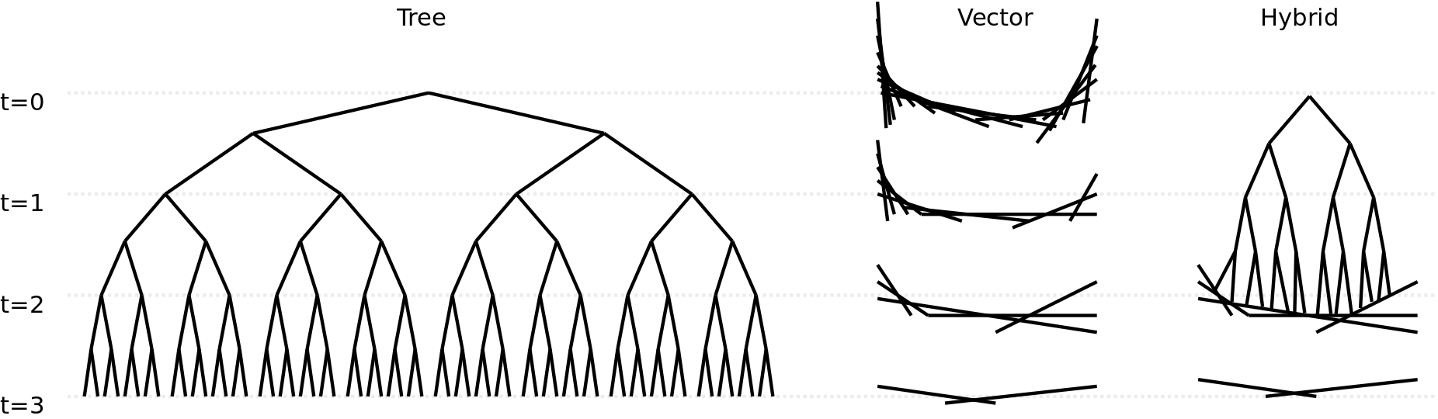
Hybrid heuristic
Two standard representations for heuristics
  Tree: values for all joint action-observation histories
  Vector: a potentially exponential number of vectors
Key insight: exponential growth of these representations is in opposite directions

Slide 66
Optimal results
State-of-the-art in top down and finite-horizon
Problem size (all 2 agent)
  Broadcast Channel S=4 A=2 Ω=2
  Box Pushing S=100 A=4 Ω=5
  Fire Fighting S=432 A=3 Ω=2
Performance a combination of better search and better heuristics

Slide 67
Approximate methods
Optimal methods are intractable for many problems
Want to produce the best solution possible with given resources
Quality bounds are usually not possible, but these approaches often perform well

Slide 68
Joint equilibrium search for policies (JESP)
(Nair et al., 03)
Instead of exhaustive search, find best response
Algorithm:
Start with (full) policy for each agent
while not converged do
for i=1 to n
Fix other agent policies
Find a best response policy for agent i

Slide 69
JESP summary
Finds a locally optimal set of policies
Worst case complexity is the same as exhaustive search, but in practice is much faster
Can also incorporate dynamic programming to speed up finding best responses
  Fix policies of other agents
  Create a (augmented) POMDP using the fixed policies of others
  Generate reachable belief states from initial state b₀
  Build up policies from last step to first
  At each step, choose subtrees that maximize value at reachable belief states

Slide 70
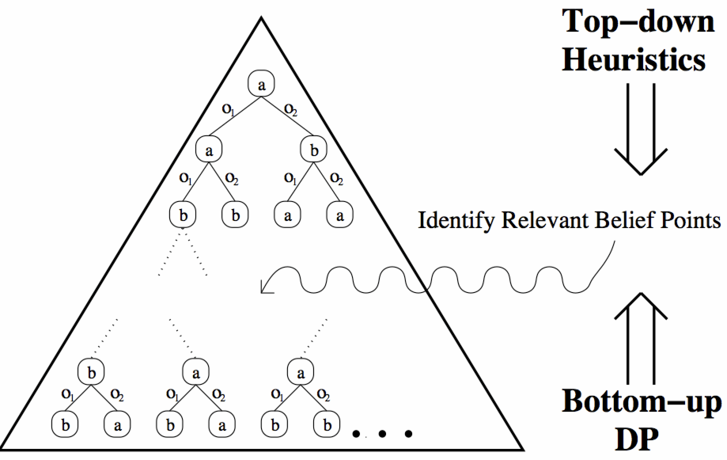
Memory bounded dynamic programming (MBDP)
(Seuken and Zilberstein., 07)
Do not keep all policies at each step of dynamic programming
Keep a fixed number for each agent: maxTrees
Select these by using heuristic solutions from initial state
Combines top down and bottom up approaches

Slide 71
MBDP algorithm
start with a one-step policy for each agent
for t=h to 1 do
backup each agent's policy
for k=1 to maxTrees do
compute heuristic policy and resulting belief state b
choose best set of trees starting at b
select best set of trees for initial state b₀

Slide 72
MBDP summary
Linear complexity in problem horizon
Exponential in the number of observations
Performs well in practice (often with very small maxTrees)
Can be difficult to choose correct maxTrees

Slide 73
Extensions to MBDP
IMBDP: Limit the number of observations used based on
probability at each belief (Seuken and Zilberstein 07)
MBDP-OC: compress observations based on the value produced (Carlin and Zilberstein 08)
PBIP: heuristic search to find best trees rather than exhaustive (Dibangoye et al., 09)
Current state-of-the-art
  PBIP-IPG: extends PBIP by limiting the possible states (Amato et al., 09-AAMAS)
  CBPB: uses constraint satisfaction solver for subtree selection (Kumar and Zilberstein, 10)
  PBPG: approximate, linear programming method for subtree selection (Wu et al, 10) – solves a problem with 3843 states and 11 obs to hor 20

Slide 74
Other finite-horizon approaches
Mixed integer linear programming (MILP) (Aras et al., 07)
  Represent each agent's policy in sequence form (instead of as a tree)
  Solve as a combinatorial optimization problem (MILP)
Sampling methods
  Direct Cross-Entropy policy search (DICE) (Oliehoek et al., 08)
    Randomized algorithm using combinatorial optimization
    Applies Cross-Entropy method to Dec-POMDPs
    Scales well wrt number of agents
  Goal-directed sampling (Amato and Zilberstein, 09)
    Discussed later

Slide 75
Approximate infinite-horizon approaches
A large enough horizon can be used to approximate an infinite-horizon solution, but this is neither efficient nor compact
Specialized infinite-horizon solutions have also been developed:
  Best-First Search (BFS)
  Bounded Policy Iteration for Dec-POMDPs (Dec-BPI)
  Nonlinear Programming (NLP)

Slide 76
Memory-bounded solutions
Optimal approaches may be intractable
Can use fixed-size finite-state controllers as policies for Dec-POMDPs
How do we set the parameters of these controllers to maximize their value?
  Deterministic controllers - discrete methods such as branch and bound and best-first search
  Stochastic controllers - continuous optimization
o₁
q?
q
a?
o₂
q?
(deterministically) choosing an action and transitioning to the next node

Slide 77
Best-first search (Szer and Charpillet 05)
Search through space of deterministic action selection and node transition parameters
Produces optimal fixed-size deterministic controllers
High search time limits this to very small controllers (< 3 nodes)

Slide 78
Bounded policy iteration (BPI) (Bernstein et al., 05)
Improve the controller over a series of steps until value converges
Alternate between improvement and evaluation
Improvement
  Use a linear program to determine if a node's parameters can be changed, while fixing the rest of the controller and other agent policies
  Improved nodes must have better value for all states and nodes of the other agents (multiagent belief space)
Evaluation: Update the value of all nodes in the agent's controller
Can solve much larger controller than BFS, but value is low due to lack of start state info and LP

Slide 79
Nonlinear programming approach (Amato et al., 07, 09b)
Use a nonlinear program (NLP) to represent an optimal fixed-size set of controllers for Dec-POMDPs
Consider node value as well as action and transition parameters as variables
Maximize the value using a known start state
Constraints maintain valid values and probabilities

Slide 80
NLP formulation
Variables:
Objective: Maximize
Value Constraints:
Probability constraints ensure all probabilities must sum to 1 and be greater than 0
Notes:
Nonlinearity due to x and y

Slide 81
Mealy controllers (Amato et al, 10)
Controllers currently used are Moore controllers
Mealy controllers are more powerful than Moore controllers (can represent higher quality solutions with the same number of nodes)
Key difference: action depends on node and observation
o₁
o₁
,a₂
a₂
o₁
o₁
Moore=
o₂
,a₂
o₂
Mealy=
,a₁
Q A
a₁
Q×O A
o₂
o₂
,a₁

Slide 82
Mealy controllers continued
More powerful
Provides extra structure that algorithms can use
  Can automatically simplify representation based on informative observations
  Can be done in controller or solution method
Can be used in place of Moore controllers in all controller-based algorithms for POMDPs and DEC-POMDPs (not just NLP)
  Optimal infinite-horizon DP
  Approximate algorithms
o₁
,a₂
o₁
,a₂
o₂
,a₁
o₂
,a₁

Slide 83
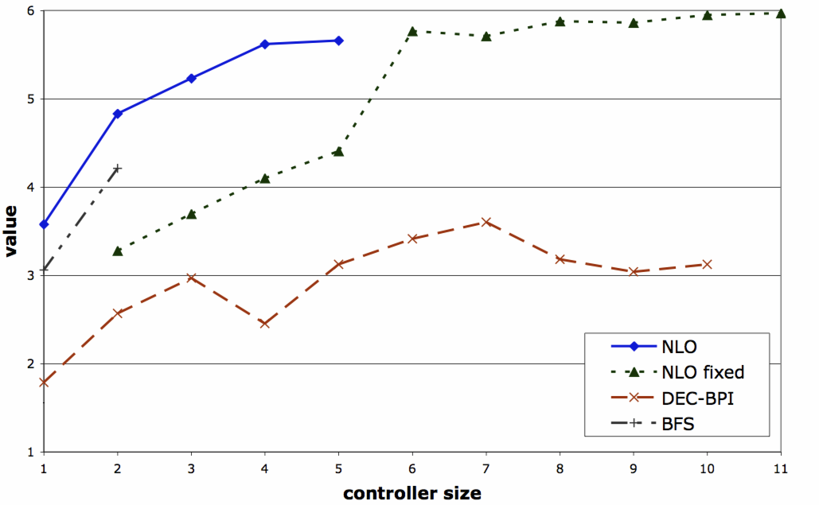
Some infinite-horizon results
Optimal algorithm can only solve very small problems
Approximate algorithms are more scalable
GridSmall: 16 states, 4 actions, 2 obs
Policy Iteration: 3.7 with 80 nodes in 821s before out of memory

Slide 84
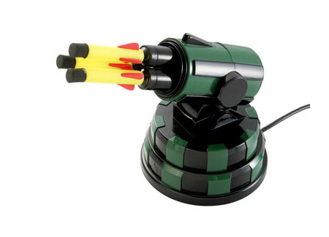
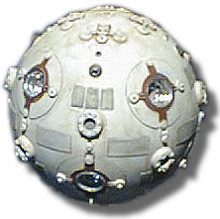
Indefinite-horizon
Unclear how many steps are needed until termination
Many natural problems terminate after a goal is reached
  Meeting or catching a target
  Cooperatively completing a task

Slide 85
Indefinite-horizon Dec-POMDPs (Amato et al, 09a)
Extends indefinite-horizon POMDPs Patek 01 and Hansen 07
Our assumptions
  Each agent possesses a set of terminal actions
  Negative rewards for non-terminal actions
Can capture uncertainty about reaching goal
Many problems can be modeled this way
An optimal solution to this problem can be found using dynamic programming

Slide 86
Goal-directed Dec-POMDPs
Relax assumptions, but still have goal
Problem terminates when
  A single agent or set of agents reach local or global goal states
  Any combination of actions and observations is taken or seen
More problems fall into this class (can terminate without agent knowledge)
Solve by sampling trajectories
  Produce only action and observation sequences that lead to goal
  This reduces the number of policies to consider
Can bound the number of samples required to approach optimality
b₀
a₁
o₃
a₁
o₃
a₁
g
o₁

Slide 87
Infinite and indefinite-horizon results
State-of-the-art in infinite-horizon approximate
Standard infinite-horizon benchmarks
Approximate solutions
Can provide a very high-quality solution very quickly in each problem
Notes:
Goal-directed and Mealy do well even on the very large Mars Rover problem. A huge DEC-POMDP.

Slide 88
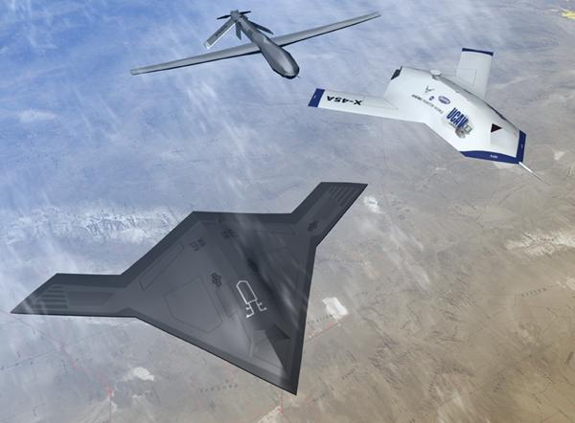
Scalability to larger problems
Dec-MDP
  Collective observations fully determine state
Independent transitions and observations
  P(s’| s, a)=P(s’| s, a₁) P(s’| s, a₂)
  O(o| s’, a) =P(o₁| s’, a₁) P(o₂| s’, a₂)
  Rewards still dependent
Complexity drops to NP (from NEXP)
Policy: nonstationary map from local states to actions s_{i}^{t}  a
Many realistic problems have this type of independence

Slide 89
Sample-based heuristic search under submission
Observation: can share policies before execution
  With Dec-MDP assumptions, can now estimate system state
  Don’t need history, so can use this estimate and single local obs
Use branch and bound to search policy space
  Start from known initial state
Incorporate constraint optimization to more efficiently expand children

Slide 90
Dec-MDP results
State-of-the-art in IT-IO Dec-MDPs
2 agent problems
Scalable to 6 agents for small problems and horizons
Note: ND-POMDP methods can scale to up to 15 agents by making reward decomposability assumptions

Slide 91
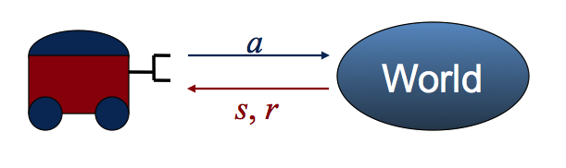
Communication
Communication can be implicitly represented in Dec-POMDP model
Free and instantaneous communication is equivalent to centralization
Otherwise, need to reason about what and when to communicate

Slide 92
Dec-POMDP-COM
A DEC-POMDP-COM can be defined with the tuple:
M = <I, S, {A_{i}}, P, R, {Ω_{i}}, O, Σ,C_{Σ}>
  The first parameters are the same as a Dec-POMDP
  Σ, the alphabet of atomic communication messages for each agent (including a null message)
  C_{Σ}, the cost of transmitting an atomic message:
  R, the reward model integrates this cost for the set of agents sending message σ:
Explicitly models communication
Same complexity as Dec-POMDP

Slide 93
Algorithms using communication
Analysis of possible communication models and complexity (Pynadath et al., 02)
Myopic communication in transition independent Dec-MDPs (Becker et al., 09)
Reasoning about run-time communication decisions (Nair et al., 04; Roth et al., 05)
Stochastically delayed communication (Spaan et al., 08)

Slide 94
Summary
Optimal algorithms for Dec-POMDPs give performance guarantees, but are often intractable
  Top down and bottom up methods provide similar performance
Approximate Dec-POMDP algorithms are much more scalable, but (often) lack quality bounds
  Bounding memory and sampling are dominant approaches
Using subclasses can significantly improve solution scalability (if assumptions hold)
Communication can be helpful, but difficult to decide when and how to communicate

Slide 95
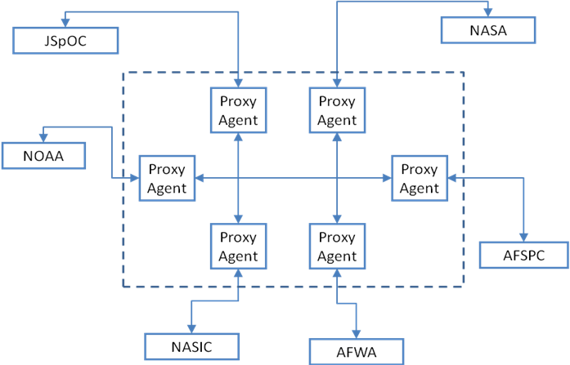

Application: Personal assistant agents (Amato et al.,11)
People connected to many others and sources of info
Use software personal assistant agents to provide support (Dec-MDP, Shared-MDP)
  Agents collaborate on your behalf to find resources, teams, etc.
  Goal: work more efficiently with others and discover helpful info

Slide 96


Application: Unmanned system control
Planning for autonomous vehicles in a simulation
  Single or centralized team: factored POMDP
  Decentralized team: Dec-POMDP
  Team considering adaptive enemy: I-POMDP

Slide 97
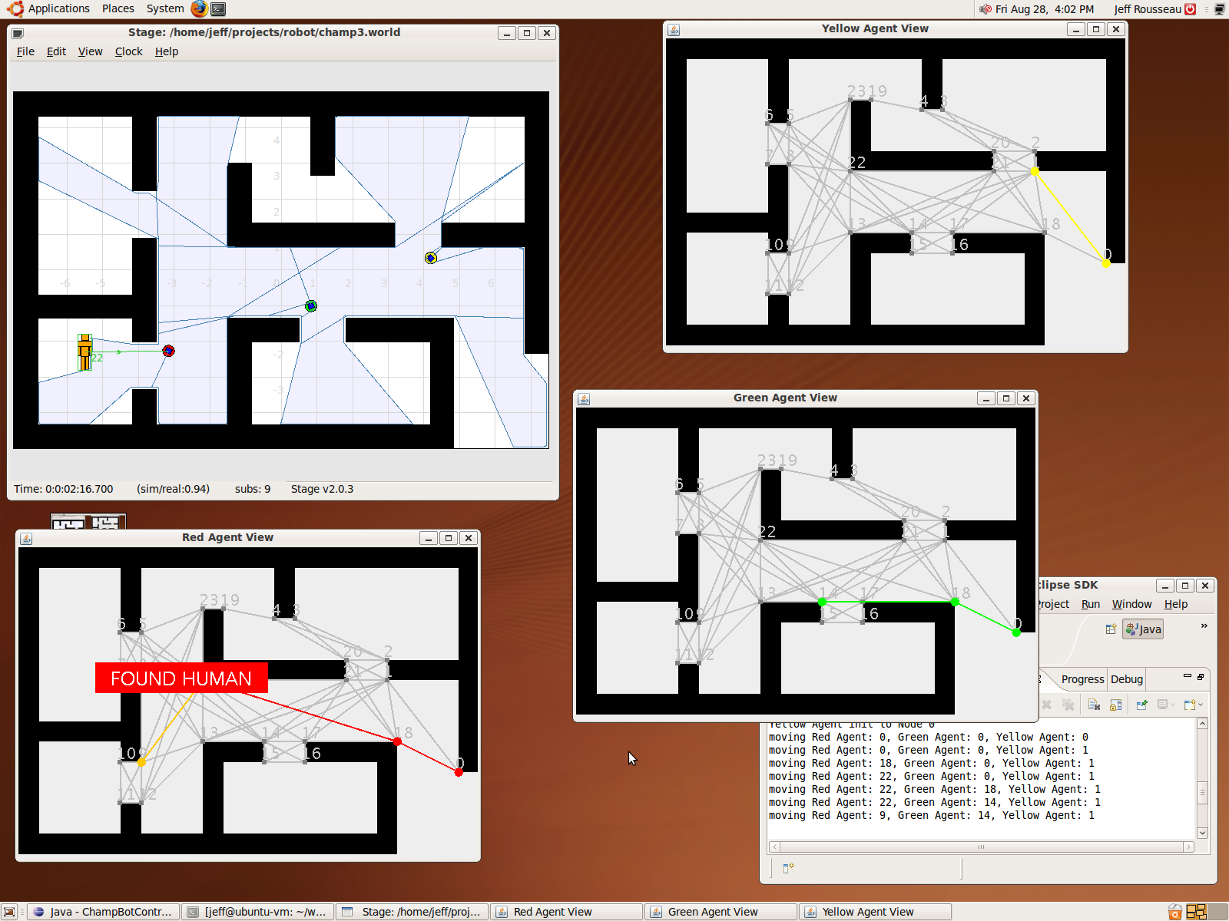
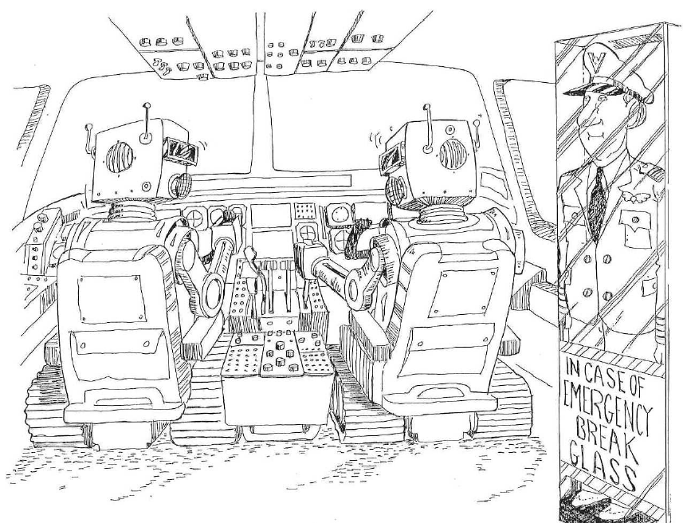
Application: Mixed-initiative robotics
Humans and robots collaborating for search and pursuit
Determine what tasks robots should do (MMDP, Dec-POMDP) and what tasks humans should do
Adjustable autonomy based on preferences and situation

Slide 98
Conclusion
What problems Dec-POMDPs are good for
  Sequential (not “one shot” or greedy)
  Cooperative (not single agent or competitive)
  Decentralized (not centralized execution or free, instantaneous communication)
  Decision-theoretic (probabilities and values)

Slide 99
Resources
My Dec-POMDP webpage
  Papers, talks, domains, code, results
  http://rbr.cs.umass.edu/~camato/decpomdp/
Matthijs Spaan’s Dec-POMDP page
  Domains, code, results
  http://users.isr.ist.utl.pt/~mtjspaan/decpomdp/index_en.html
USC’s Distributed POMDP page
  Papers, some code and datasets
  http://teamcore.usc.edu/projects/dpomdp/
Our full tutorial “Decision Making in Multiagent Systems”
  http://users.isr.ist.utl.pt/~mtjspaan/tutorialDMMS/

Slide 100
References
Scaling Up Optimal Heuristic Search in Dec-POMDPs via Incremental Expansion. Frans A. Oliehoek, Matthijs T. J. Spaan and Christopher Amato. In Proceedings of the Twenty-Second International Joint Conference on Artificial Intelligence (IJCAI-11), Barcelona, Spain, July, 2011
Towards Realistic Decentralized Modelling for Use in a Real-World Personal Assistant Agent Scenario. Christopher Amato, Nathan Schurr and Paul Picciano. In Proceedings of the Workshop on Optimisation in Multi-Agent Systems (OptMAS) at the Tenth International Conference on Autonomous Agents and Multi-Agent Systems (AAMAS-11), Taipei, Taiwan, May 2011.
Finite-state controllers based on Mealy machines for centralized and decentralized POMDPs. Christopher Amato, Blai Bonet and Shlomo Zilberstein. Proceedings of the Twenty-Fourth National Conference on Artificial Intellgence (AAAI-10), Atlanta, GA, July, 2010.
Point-based Backup for Decentralized POMDPs: Complexity and New Algorithms. Akshat Kumar and Shlomo Zilberstein. In Proc. of the International Conference on Autonomous Agents and Multiagent Systems (AAMAS), pages 1315-1322, 2010.
Point-Based Policy Generation for Decentralized POMDPs, Feng Wu, Shlomo Zilberstein, and Xiaoping Chen,
Proceedings of the 9th International Conference on Autonomous Agents and Multi-Agent Systems (AAMAS-10), Page 1307- 1314, Toronto, Canada, May 2010.
Optimizing Fixed-size Stochastic Controllers for POMDPs and Decentralized POMDPs. Christopher Amato, Daniel S. Bernstein and Shlomo Zilberstein. Journal of Autonomous Agents and Multi-Agent Systems (JAAMAS) 2009.
Incremental Policy Generation for Finite-Horizon DEC-POMDPs. Christopher Amato, Jilles Steeve Dibangoye and Shlomo Zilberstein. Proceedings of the Nineteenth International Conference on Automated Planning and Scheduling (ICAPS-09), Thessaloniki, Greece, September, 2009.

Slide 101
References continued
Event-detecting Multi-agent MDPs: Complexity and Constant-Factor Approximation. Akshat Kumar and Shlomo Zilberstein. In Proc. of the International Joint Conference on Artificial Intelligence (IJCAI), pages 201-207, 2009.
Point-based incremental pruning heuristic for solving finite-horizon DEC-POMDPs. Jilles S. Dibangoye, Abdel-Illah Mouaddib, and Brahim Chaib-draa. In Proc. of the Joint International Conference on Autonomous Agents and Multi-Agent Systems , 2009.
Constraint-Based Dynamic Programming for Decentralized POMDPs with Structured Interactions. Akshat Kumar and Shlomo Zilberstein In Proc. of the International Conference on Autonomous Agents and Multiagent Systems (AAMAS), pages 561-568, 2009.
Achieving Goals in Decentralized POMDPs. Christopher Amato and Shlomo Zilberstein. Proceedings of the Eighth International Joint Conference on Autonomous Agents and Multi-Agent Systems (AAMAS-09), Budapest, Hungary, May, 2009.
Policy Iteration for Decentralized Control of Markov Decision Processes. Daniel S. Bernstein, Christopher Amato, Eric A. Hansen and Shlomo Zilberstein. Journal of AI Research (JAIR), vol. 34, pages 89-132, February, 2009.
Analyzing myopic approaches for multi-agent communications. Raphen Becker, Alan Carlin, Victor Lesser, and Shlomo Zilberstein. Computational Intelligence}, 25(1): 31—50, 2009.
Optimal and Approximate Q-value Functions for Decentralized POMDPs. Frans A. Oliehoek, Matthijs T. J Spaan and Nikos Vlassis. Journal of Artificial Intelligence Research, 32:289–353, 2008.

Slide 102
References continued
Formal Models and Algorithms for Decentralized Decision Making Under Uncertainty. Sven Seuken and Shlomo Zilberstein. Journal of Autonomous Agents and Multi-Agent Systems (JAAMAS). 17:2, pages 190-250, 2008.
Interaction-driven Markov games for decentralized multiagent planning under uncertainty. Matthijs T. J. Spaan and Francisco S. Melo. Proceedings of the Joint Conference on Autonomous Agents and Multi Agent Systems, pages 525--532, 2008.
Mixed integer linear programming for exact finite-horizon planning in Decentralized POMDPs. Raghav Aras, Alain Dutech, and Francois Charpillet. In Int. Conf. on Automated Planning and Scheduling, 2007.
Value-based observation compression for DEC-POMDPs. Alan Carlin and Shlomo Zilberstein.In Proceedings of the Joint Conference on Autonomous Agents and Multi Agent Systems, 2008.
Multiagent planning under uncertainty with stochastic communication delays. Matthijs T. J. Spaan, Frans A. Oliehoek, and Nikos Vlassis. In Int. Conf. on Automated Planning and Scheduling, pages 338--345, 2008.
Improved memory-bounded dynamic programming for decentralized POMDPs. Sven Seuken and Shlomo Zilberstein. Proceedings of Uncertainty in Artificial Intelligence, July, 2007
Memory-Bounded Dynamic Programming for DEC-POMDPs. Sven Seuken and Shlomo Zilberstein. Proceedings of the Twentieth International Joint Conference on Artificial Intelligences (IJCAI-07), January 2007
Networked Distributed POMDPs: A Synthesis of Distributed Constraint Optimization and POMDPs. Ranjit Nair, Pradeep Varakantham, Milind Tambe and Makoto Yokoo. Proceedings of the Twentieth National Conference on Artificial Intelligence (AAAI-05), Pittsburgh, PA, July, 2005.

Slide 103
References continued
A framework for sequential planning in multi-agent settings. Piotr J. Gmytrasiewicz and Prashant Doshi. Journal of Artificial Intelligence Research, 24:49--79, 2005.
Bounded policy iteration for decentralized POMDPs. Daniel S. Bernstein, Eric A. Hansen, and Shlomo Zilberstein. In Proc. Int. Joint Conf. on Artificial Intelligence, 2005.
An optimal best-first search algorithm for solving infinite horizon DEC-POMDPs. Daniel Szer and Francois Charpillet. In European Conference on Machine Learning, 2005.
MAA*: A Heuristic Search Algorithm for Solving Decentralized POMDPS. Daniel Szer, Francois Charpillet, Shlomo Zilberstein. Proceedings of the 21st International Conference on Uncertainty in Artificial Intelligence (UAI-05), Edinburgh, Scotland, July 2005
Reasoning about joint beliefs for execution-time communication decisions. Maayan Roth, Reid G. Simmons and Manuela M. Veloso. Proc. of Int. Joint Conference on Autonomous Agents and Multi Agent Systems, 2005
Dynamic Programming for Partially Observable Stochastic Games. Eric A. Hansen, Daniel S. Bernstein, and Shlomo Zilberstein. Proceedings of the 19th National Conference on Artificial Intelligence (AAAI-04), 709-715, San Jose, California, July 2004
Approximate solutions for partially observable stochastic games with common payoffs. Rosemary Emery-Montemerlo, Geoff Gordon, Jeff Schneider, and Sebastian Thrun. In Proceedings of the Joint Conference on Autonomous Agents and Multi Agent Systems, 2004.
An approximate dynamic programming approach to decentralized control of stochastic systems. Randy Cogill, Michael Rotkowitz, Benjamin Van Roy and Sanjay Lall. In Proceedings of the 2004 Allerton Conference on Communication, Control, and Computing, 2004.
Decentralized Control of Cooperative Systems: Categorization and Complexity Analysis. Claudia V. Goldman and Shlomo Zilberstein. Journal of Artificial Intelligence Research Volume 22, pages 143-174, 2004.

Slide 104
References continued
Communication for improving policy computation in distributed POMDPs. Ranjit Nair, Milind Tambe, Maayan Roth, and Makoto Yokoo. Proc. of Int. Joint Conference on Autonomous Agents and Multi Agent Systems, 2004.
Planning, Learning and Coordination in Multiagent Decision Processes. Craig Boutilier Sixth Conference on Theoretical Aspects of Rationality and Knowledge (TARK-96), Amsterdam, pp.195--210 (1996).
Taming Decentralized POMDPs: Towards Efficient Policy Computation for Multiagent Settings. Ranjit Nair, David Pynadath, Makoto Yokoo, Milind Tambe and Stacy Marsella. Proceedings of the Eighteenth International Joint Conference on Artificial Intelligence (IJCAI-03), Acapulco, Mexico, August, 2003.
The Complexity of Decentralized Control of Markov Decision Processes. Daniel S. Bernstein, Robert Givan, Neil Immerman, and Shlomo Zilberstein. Mathematics of Operations Research, 27(4):819-840, November 2002.
The Communicative Multiagent Team Decision Problem: Analyzing Teamwork Theories and Models. David V. Pynadath and Milind Tambe. Journal of Artificial Intelligence Research (JAIR), Volume 16, pp. 389-423. 2002.
Decision-theoretic control of planetary rovers. Shlomo Zilberstein, Richard Washington, Daniels S. Bernstein, and Abdel-Illah Mouaddib. In Plan-Based control of Robotic Agents, volume 2466 of LNAI, pages 270--289. Springer, 2002.
Reinforcement learning for adaptive routing. Leonid Peshkin and Virginia Savova. In Proceedings of the International Joint Conference on Neural Networks, 2002.
Decentralized control of a multiple access broadcast channel: Performance bounds. James M. Ooi and Gregory W. Wornell. In Proceedings of the 35th Conference on Decision and Control, 1996.

