Slide 1

A Concise Introduction to Cooperative
Multi-Agent Reinforcement Learning
(Part 2)
Chris Amato and Frans Oliehoek

Slide 2
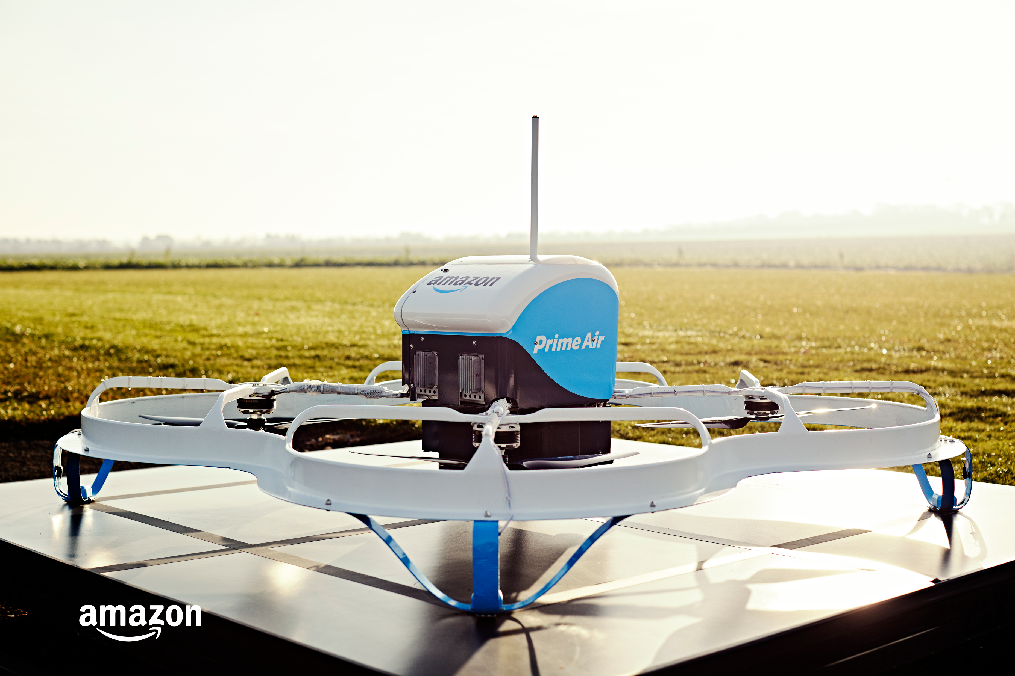
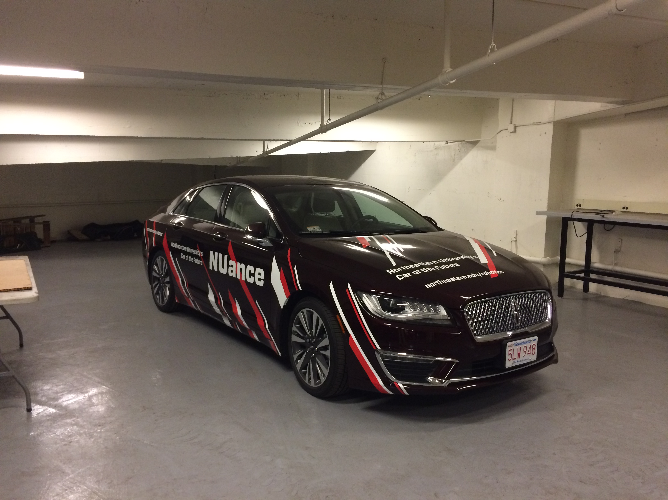



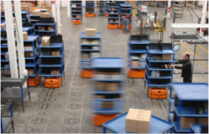
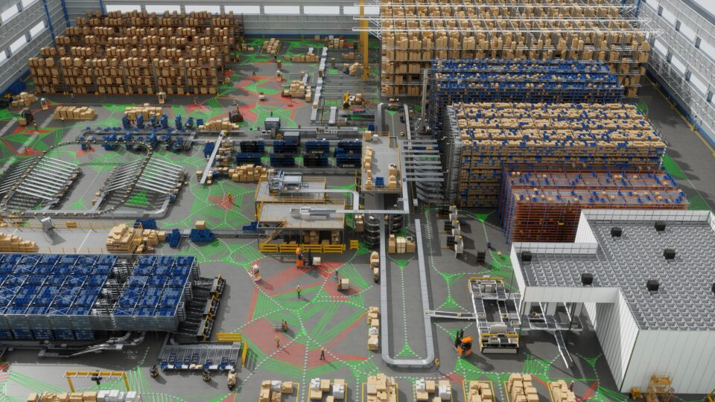
Multi-robot systems are (going to be) everywhere
Drone delivery
LLM agents
Autonomous cars
Amazon
Northeastern
Home robots
Warehouse robots
Factories
iRobot
Amazon
Accenture/nvidia
Notes:
Factories: (humans, robots, other agents) https://blogs.nvidia.com/blog/mega-omniverse-blueprint/

Slide 3
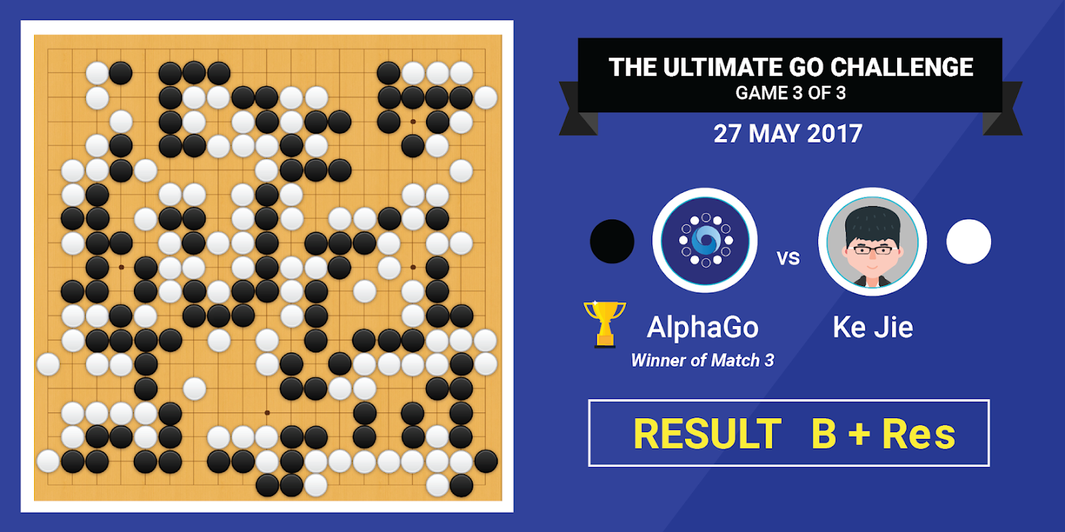
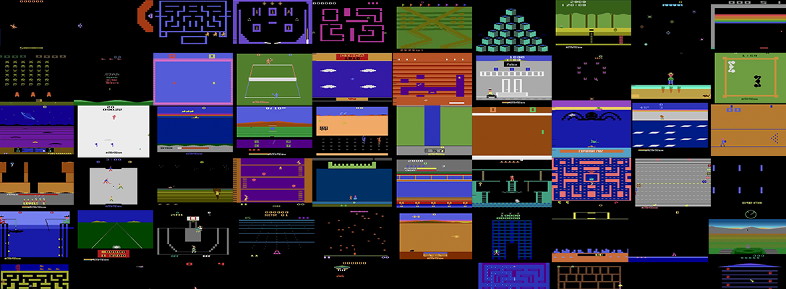
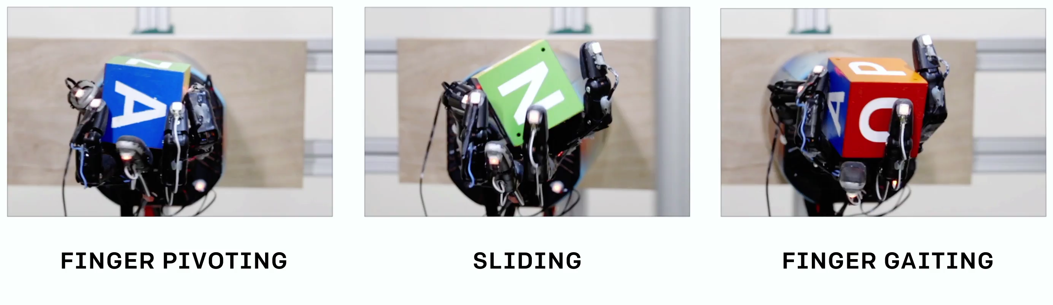
Reinforcement learning has a number of successes
Atari (Google DeepMind)
AlphaGo (Google DeepMind)
Robot manipulation (OpenAI)
ChatGPT (OpenAI)

Slide 4
Reinforcement Learning (RL)
A form of trial-and-error learning
Key characteristics:
Learning from (numeric) feedback
Learning sequential decisions (i.e., control)
Rewards
Environment
Agent
States
Actions

Slide 5
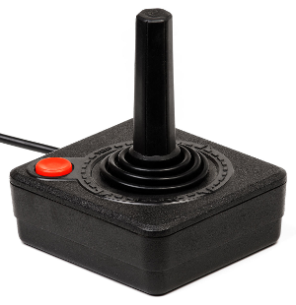
RL agents
Environment
Game score
Agent
Screen pixels
Joystick command
Goal: maximize game score
Notes:
An agent is an AI program that is coupled to an environment. It can read the environment, figure out what to do next, and then do it. Agents behave rationally.

Slide 6
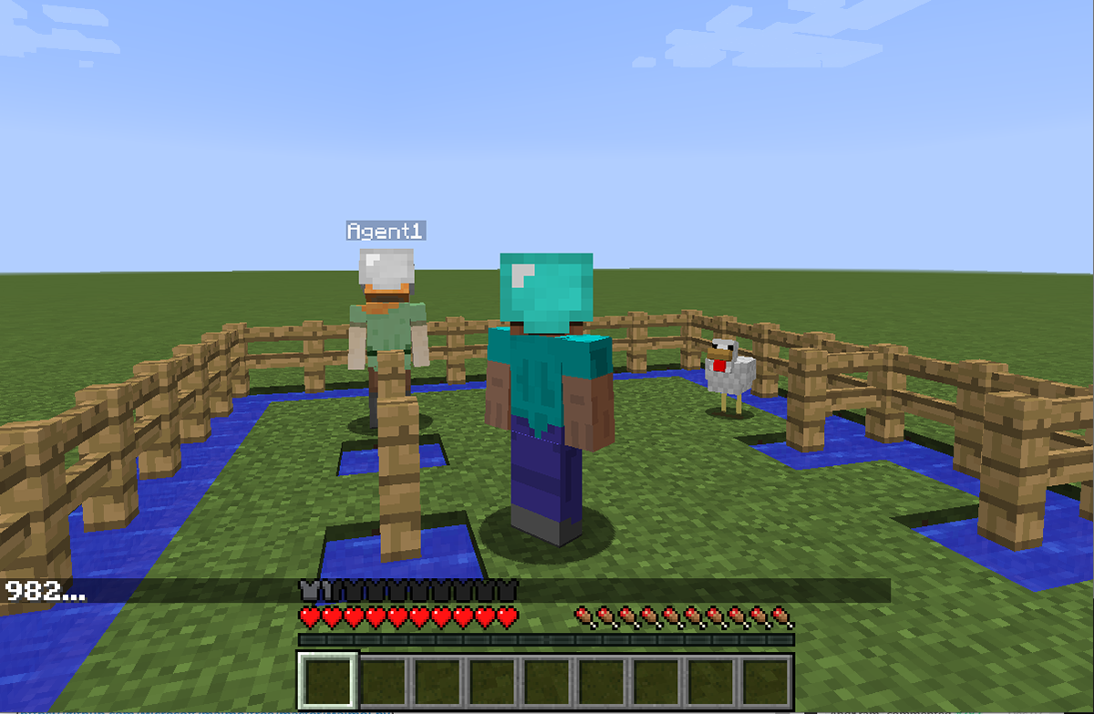
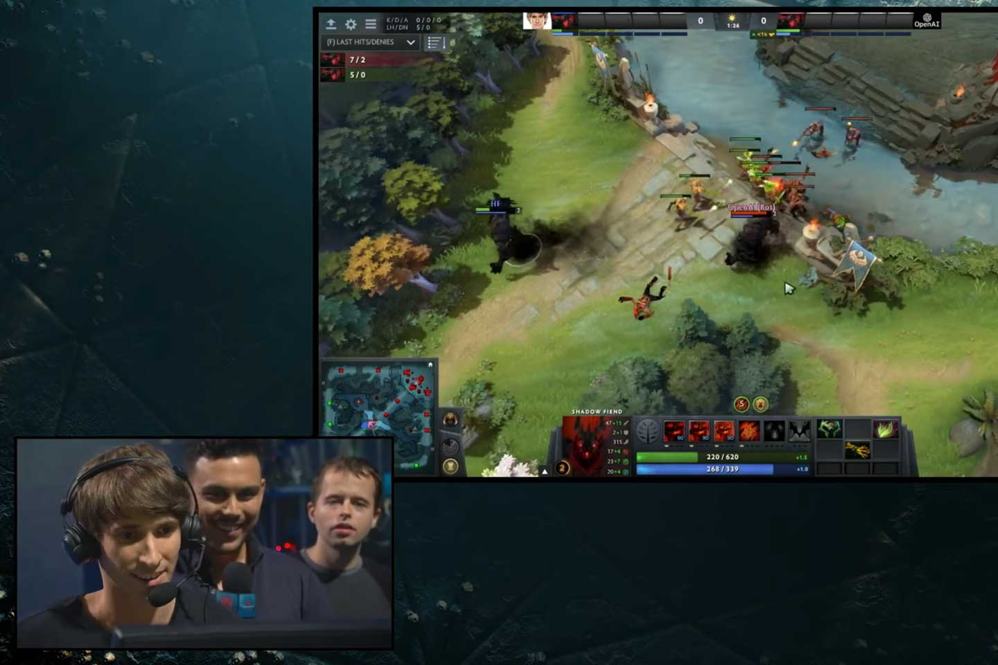
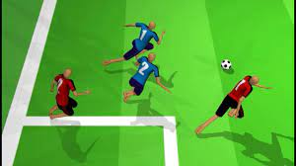
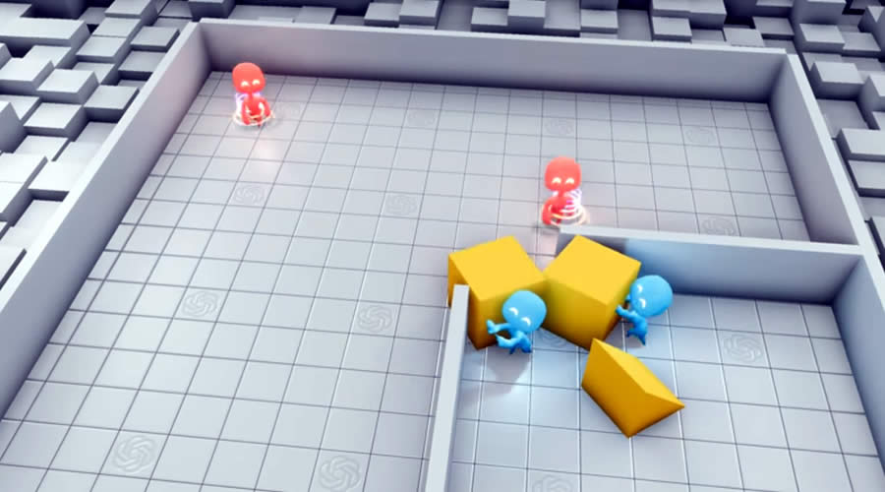
Multi-agent RL has had some successes
Project Malmo (Microsoft Research)
OpenAI Five Dota 2 (OpenAI)
Humanoid Soccer (Google DeepMind)
Emergent tool use (OpenAI)
AlphaStar (Google DeepMind)

Slide 7
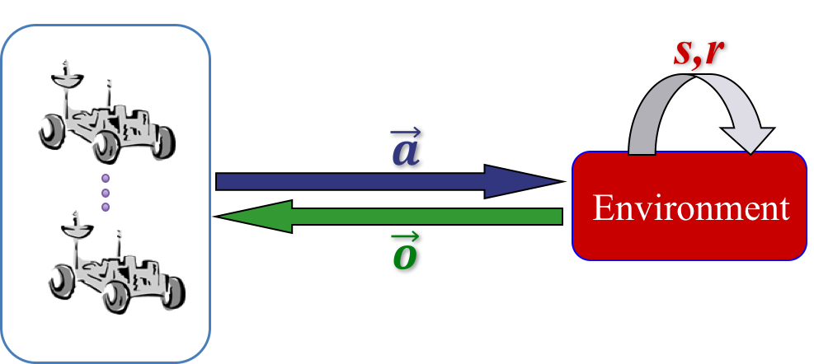
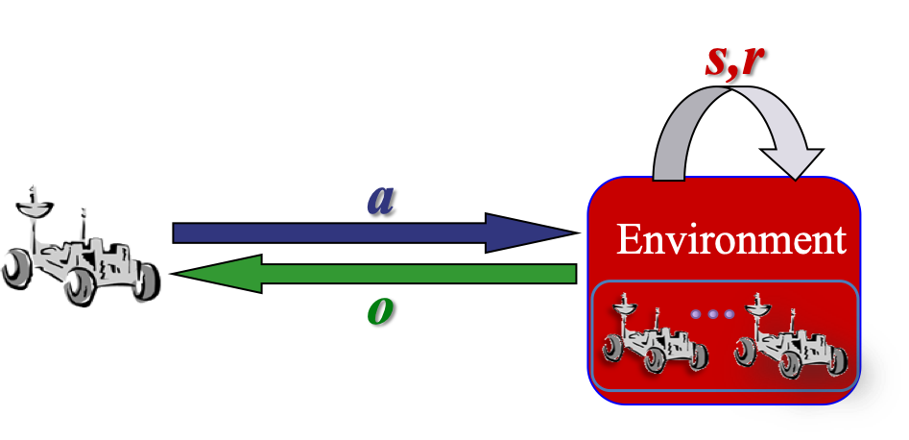
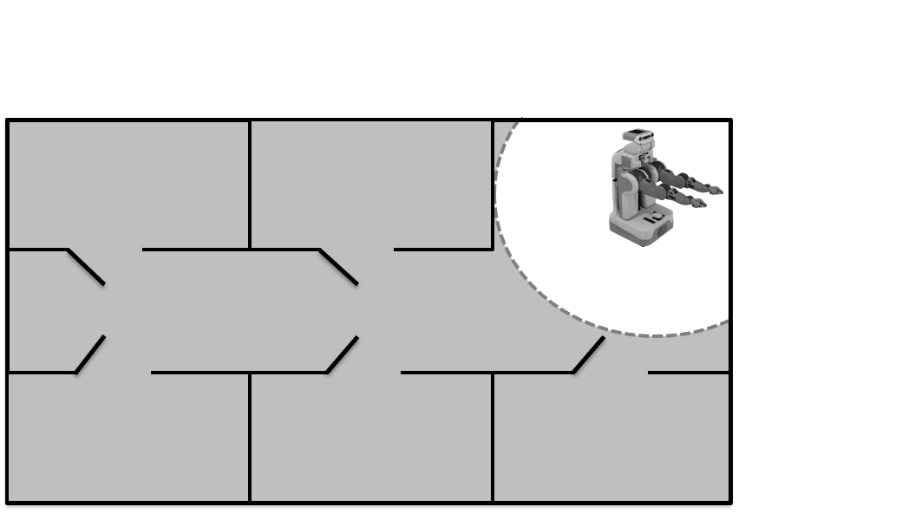
Multi-agent RL is hard
How can we apply RL here?
Centralized learning and control? Need fast, perfect communication (cooperative case)
Decentralized learning and control? Limited knowledge of other agents and environmental nonstationarity
Centralized training for decentralized execution? Use centralized information offline but still execute in a decentralized way
Almost always have partial observability

Slide 8
Overview
Define the cooperative multi-agent RL (MARL) problem
Quickly describe background on deep RL
Discuss the current state-of-the art for the different classes of solutions
Centralized training and execution
Decentralized training and execution: IQL, decentralized REINFORCE, deep extensions
CTDE: VDN, QMIX, QPLEX, MADDPG, MAPPO
Identify misconceptions/issues with current methods
Applications, code, other topics, and the future (LLMs?)

Slide 9
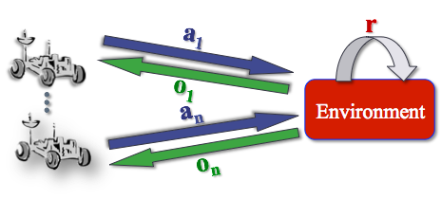
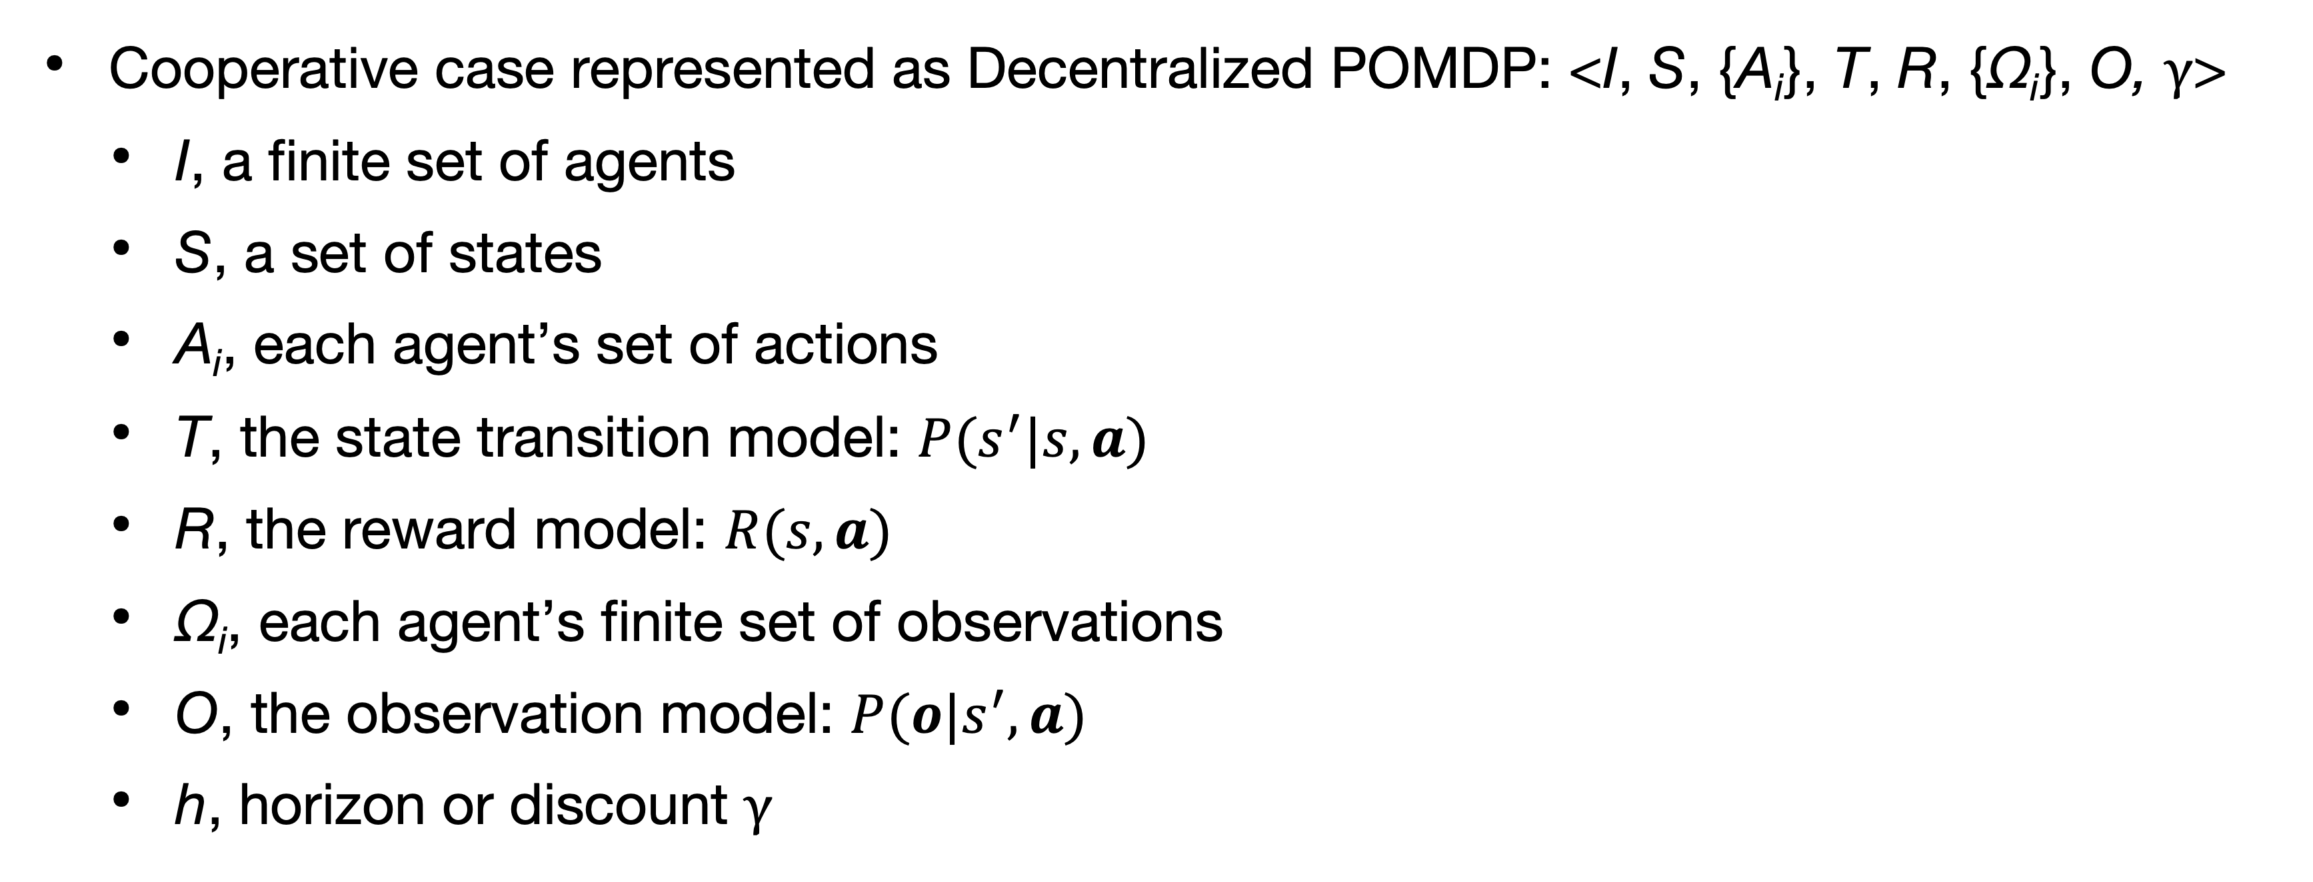
Cooperative MARL
Cooperative case represented as Decentralized POMDP: <I, S, {A_{i}}, T, R, {Ω_{i}}, O, γ>
I, a finite set of agents
S, a set of states
A_{i}, each agent’s set of actions
T, the state transition model: $P(s^{′}|s,a)$
R, the reward model: $R(s,a)$
Ω_{i}, each agent’s finite set of observations
O, the observation model: $P(o|s^{′},a)$
h, horizon or discount γ
Notes:
Much of the work here can also be applied to the POSG case

Slide 10
Cooperative MARL
Cooperative case represented as Decentralized POMDP: <I, S, {A_{i}}, T, R, {Ω_{i}}, O, γ>
I, a finite set of agents
S, a set of states
A_{i}, each agent’s set of actions
T, the state transition model: $P(s^{′}|s,a)$
R, the reward model: $R(s,a)$
Ω_{i}, each agent’s finite set of observations
O, the observation model: $P(o|s^{′},a)$
h, horizon or discount γ
Objective: Maximize the (discounted) sum of future (joint) rewards Cooperative
Notes:
Much of the work here can also be applied to the POSG case

Slide 11
Cooperative MARL
Cooperative case represented as Decentralized POMDP: <I, S, {A_{i}}, T, R, {Ω_{i}}, O, γ>
I, a finite set of agents
S, a set of states
A_{i}, each agent’s set of actions
T, the state transition model: $P(s^{′}|s,a)$
R, the reward model: $R(s,a)$
Ω_{i}, each agent’s finite set of observations
O, the observation model: $P(o|s^{′},a)$
h, horizon or discount γ
Objective: Maximize the (discounted) sum of future (joint) rewards
Calculate a set of optimal policies for each agent π_{i}*: H_{i} → A_{i} that maximize joint objective
Decentralized partially observable execution
Notes:
Much of the work here can also be applied to the POSG case

Slide 12
Deep RL background
D(R)QN and PG/AC

Slide 13
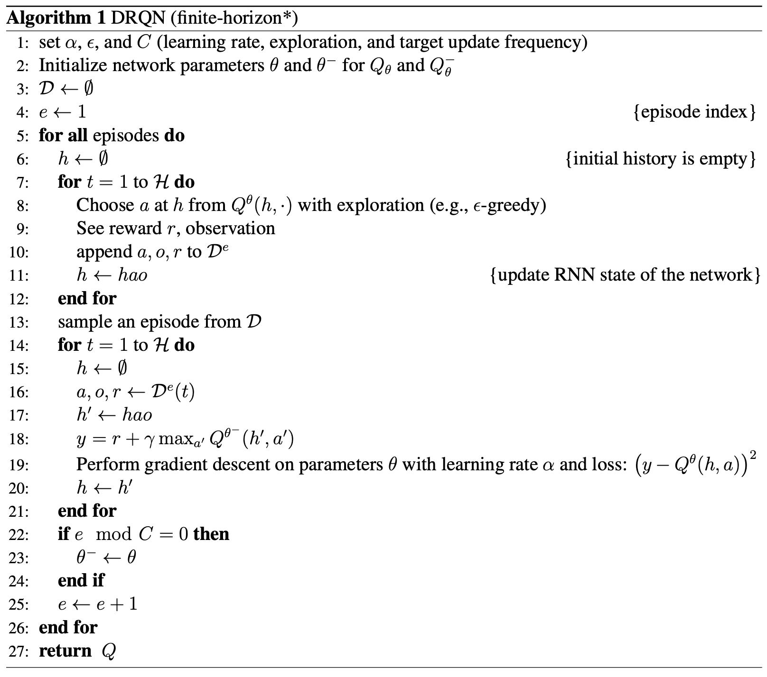
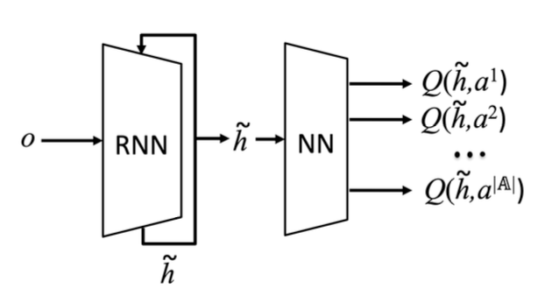

DRQN
Hausknecht and Stone –
AAAI fall symposia 15
Use a neural network to approximate Q(h,a)
Learn a history representation $\tilde{h}$
Output all Q-values for a history to make argmaxing easier
Replay buffer
Target network

Slide 14
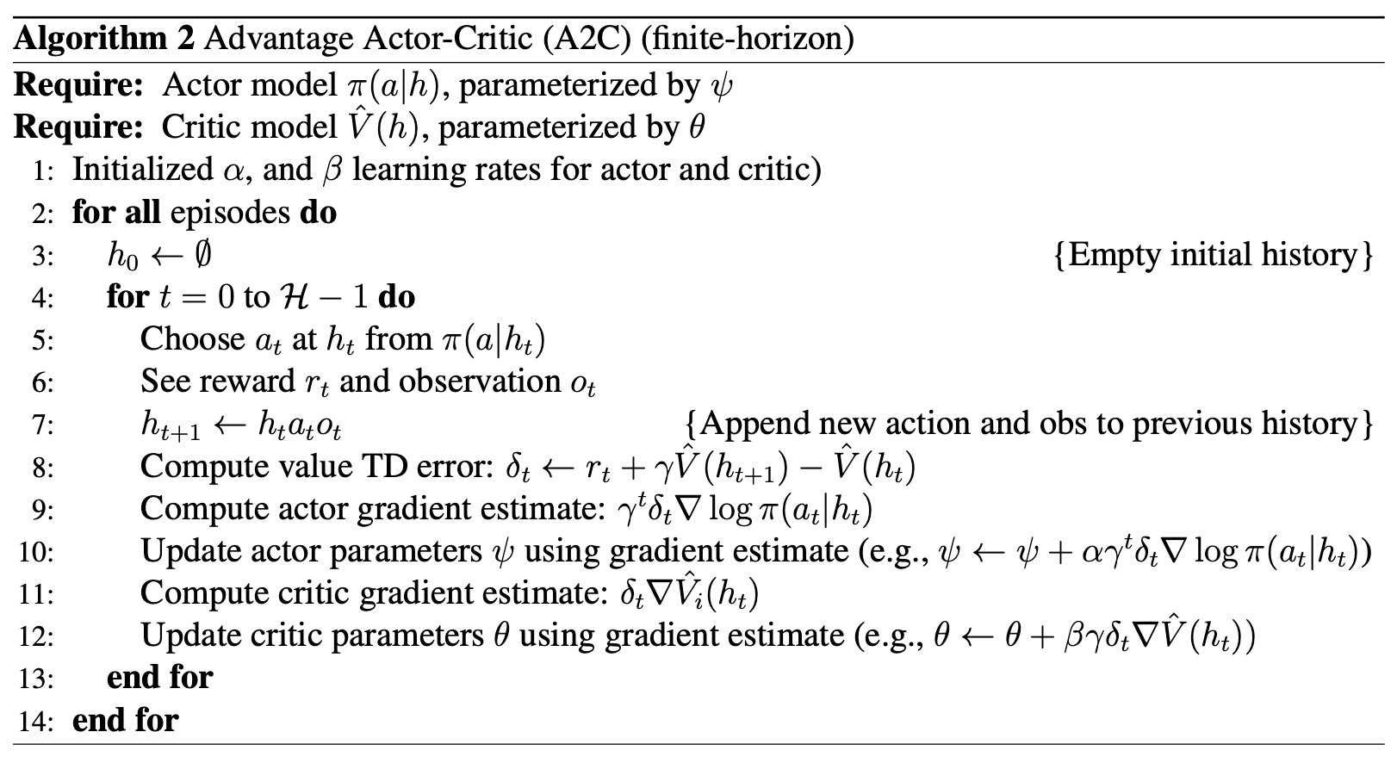
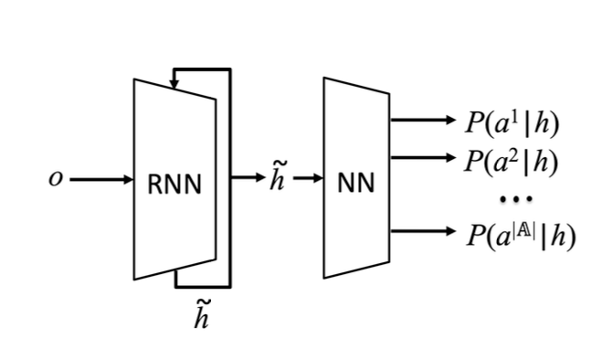

Advantage Actor-Critic (A2C)
Policy gradient with policy and value models
Probabilistic (or continuous) policy
Learn a history representation $\tilde{h}$
On-policy updates

Slide 15
Centralized MARL
Models and methods

Slide 16
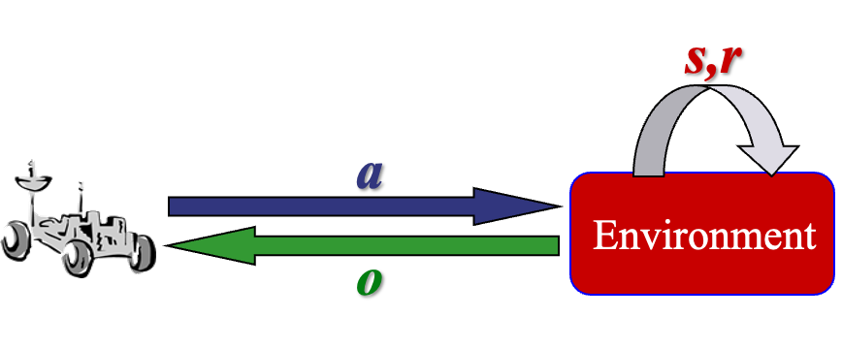
Centralized MARL
Assumptions:
a centralized controller chooses actions for each agent, a
each agent takes the chosen actions a = ⟨a₁,...,a_{n}⟩,
the centralized controller observes the resulting observations o = ⟨o₁,...,o_{n}⟩
the (centralized) algorithm/controller observes o (and a) and the joint reward r
Centralized
Actor
Centralized
Critic
Note: Not a Dec-POMDP (or POSG) anymore since execution is centralized

Slide 17
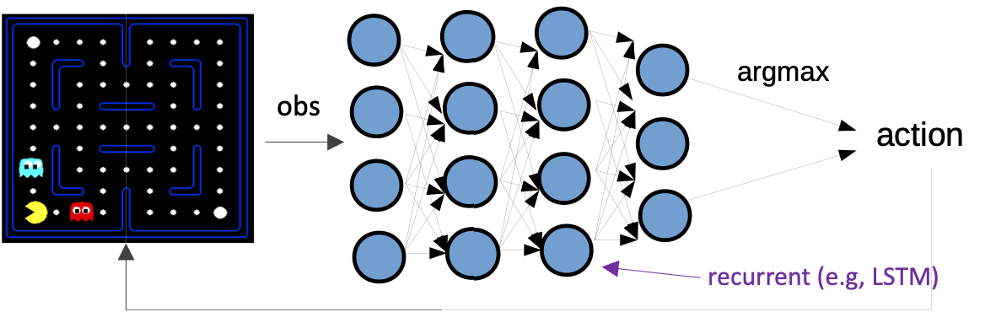
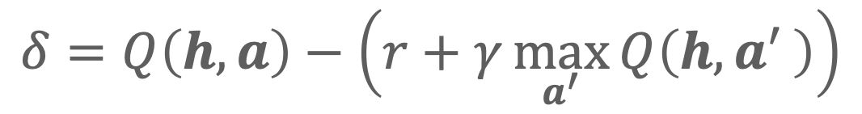
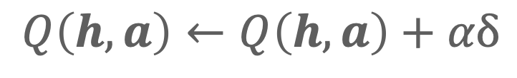
Centralized MARL (DRQN version)
Traditional Q-learning: estimate Q-value with (x can be state, observation or history)
Deep Q-Networks (DQN) (Mnih et al., Nature 15) uses a neural net for function approximation
DRQN (Hausknecht and Stone, arXiv 15) adds a recurrent layer for memory
For learning rate 𝛼
Helps with scalability
Joint history
Helps with partial observability
$$Q\left(h, a\right)←Q\left(h, a\right)+αδ$$
$$δ=Q\left(h, a\right)−\left(r+γ\max_{a^{′}}{Q\left(h,a′ \right)}\right)$$

Slide 18
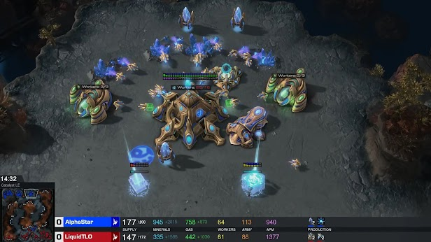
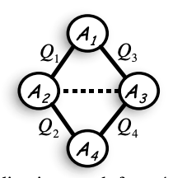
Centralized MARL methods
Now just a (factored) single-agent problem
Multi-agent MDP or POMDP (not Dec-POMDP/POSG)
Can use any single-agent RL method
But it doesn’t scale well
And assumes centralized information and control
Some methods exploit multi-agent factorization but not very active
Coordination graphs [Guestrin et al., 2001]
AlphaStar [Vinyals et al., 2019]

Slide 19
Centralized MARL models
More models: MMDP, MPOMDP

Slide 20
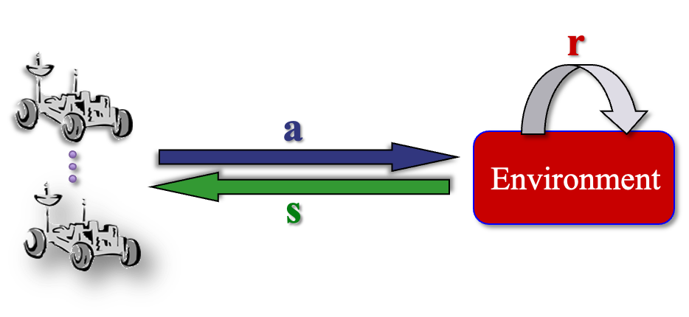
Decentralizing centralized solutions
Easy to ‘decentralize’ in a MMDP or MPOMDP
MMDP
S → A or S → A_{i}
MPOMDP
H → A or H → A_{i}
Hard in a Dec-POMDP
Once you have H → A how do you get H_{i} → A_{i} ?

Slide 21
Decentralized MARL
Models and methods

Slide 22

Decentralized MARL
Assumptions:
each agent, i, observes its current observation, o_{i}, and takes action a_{i} at the resulting history, h_{i},
the (decentralized) algorithm/controller sees the same information (o_{i} and a_{i} ) as well as the joint reward r.
Actor₁
Critic₁
Actor_{n}
Critic_{n}

Slide 23
Decentralized MARL
Agents each learn separately
Assumes training and execution are decentralized (e.g., lack of communication)
Is more scalable
The realistic case for POSGs and online learning in Dec-POMDPs
Each agent i learns a policy that maps from local histories to local actions π_{i}: H_{i} → A_{i}
Can also use any single-agent method here
May be nonstationarity but there are many methods for dealing with that
Many improvements: Distributed Q, ICML-00; Hysteretic Q, IROS-07, ICML-17; Lenient Q JMLR-08, AAMAS-18; Likelihood Q, AAMAS-20; IPPO arxiv-20
Actor₁
Critic₁
Actor_{n}
Critic_{n}

Slide 24
Decentralized Action-Value Methods
IQL, Distributed Q, Hysteretic Q, Lenient Q
Deep extensions
Note: these methods were originally developed for the fully observable case

Slide 25
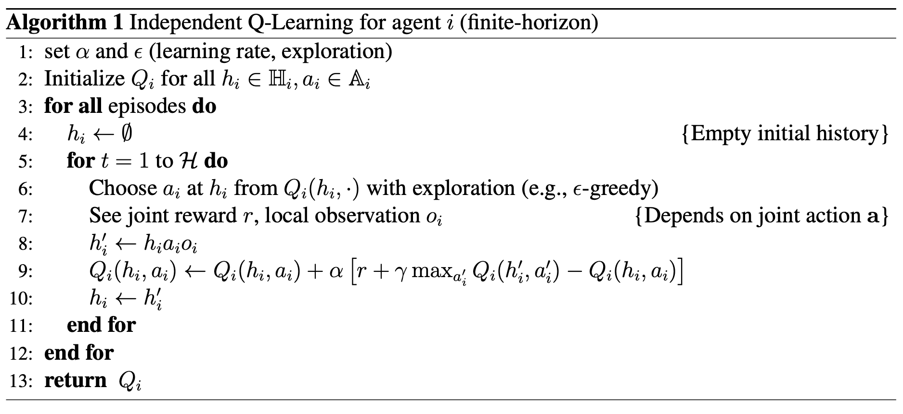
Independent Q-Learning (IQL)
Tan – ICML 93
Just apply Q-learning pretending the other agents don’t exist

Slide 26
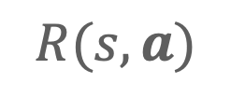
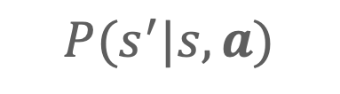
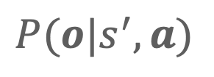
Independent Q-Learning (IQL)
Tan – ICML 93
Just apply Q-learning pretending the other agents don’t exist
Where do the observations and joint rewards come from?
$$P(o|s^{′},a)$$
$P(s^{′}|s,a)$
$R(s,a)$

Slide 27
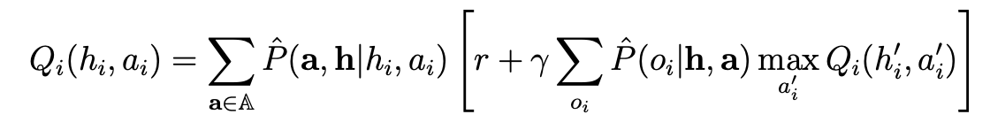
Important hidden information
Agents don’t exist by themselves!
Assumes other agents are acting according to some (fixed) policies
Then learns as if in a POMDP where other agents are part of the environment:
This is where non-stationarity comes from!
Other learning agents change their policies over time
$\hat{P}$s are empirical probabilities from data during training

Slide 28


IQL properties
IQL may not converge (Tan ICML 93)
Convergence properties of Q-learning in Dec-POMDPs is an open question!
Usually performs poorly (often used as a baseline)
Note even with optimal Q-values, agents may not select the optimal action without coordination when multiple actions are optimal (like equilibrium selection)

Slide 29
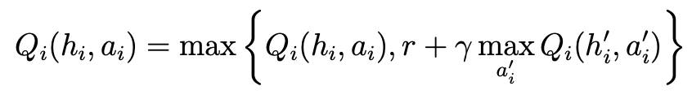
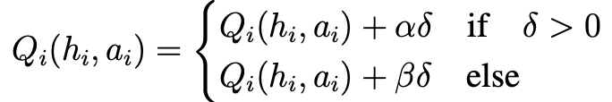

Improving IQL with optimism
Distributed Q-learning (Lauer and Riedmiller ICML 00)
Optimal in deterministic domains but problematic with stochasticity
Hysteretic Q-learning (Matignon et al. IROS 07)
with
Use two learning rates
Can be used in stochastic domains

Slide 30
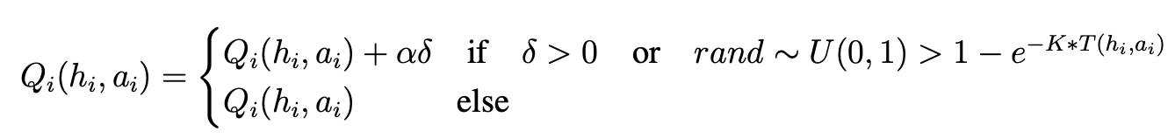
Improving IQL with optimism
Lenient Q-learning (Wei and Luke JMLR 16)
Update on positive TD or randomly based on how many times the history-action pair has been visited
But need to maintain counts for those

Slide 31
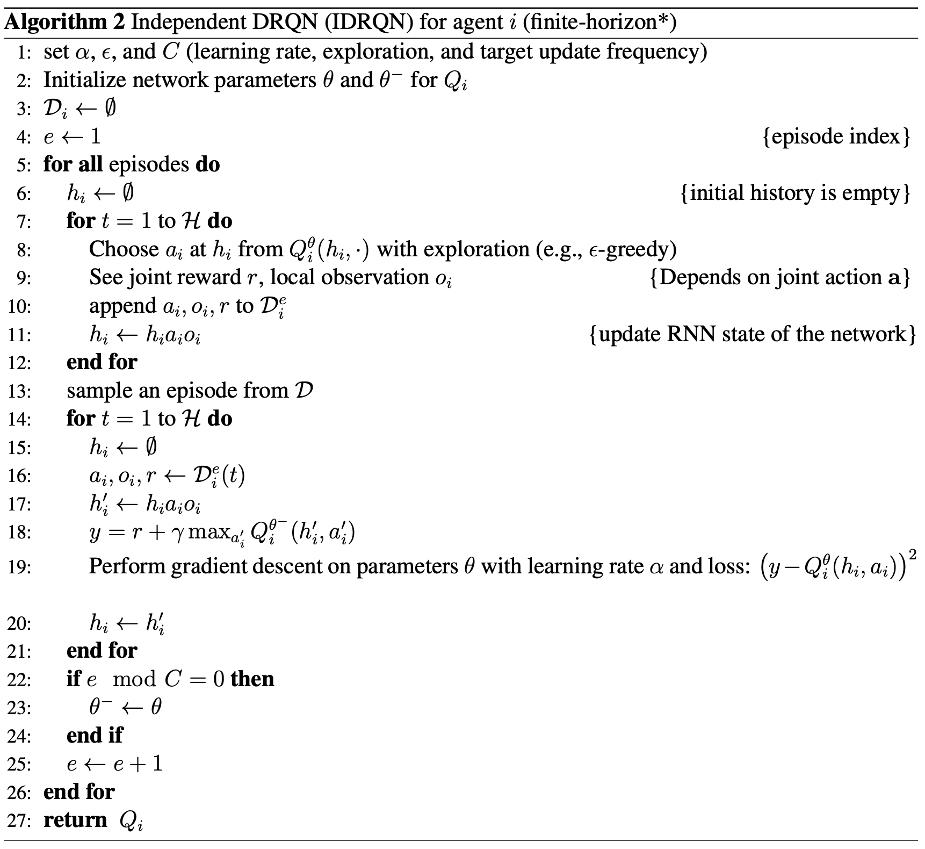
Extension to the deep case - IDRQN
Tampuu et al. – Plos one 17
Just DRQN applied to the multi-agent case
Still needs other agents to act
Based on other agents

Slide 32
Extension to the deep case - IDRQN
Tampuu et al. – Plos one 17
Just DRQN applied to the multi-agent case
Still needs other agents to act
Independent buffers cause poor performance (non-stationarity)
Based on other agents

Slide 33
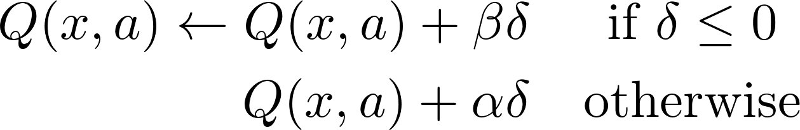
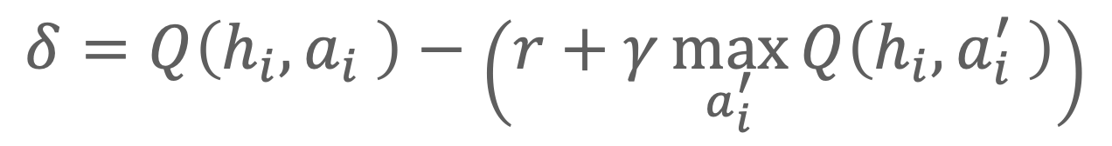
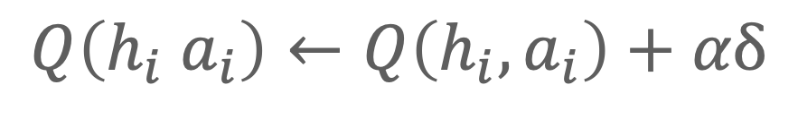
Decentralized MARL (Dec-HDRQN)
Omidshafiei, Pazis, Amato, How and Vian - ICML 17
Traditional Q-learning: estimate Q-value with (x can be state, observation or history)
Hysteresis (Matignon et al., IROS 07): two learning rates 𝜶 and 𝜷 (with 𝜷 < 𝜶)
Still use DRQN (Hausknecht and Stone, arXiv 15) if partially observable
For learning rate 𝛼
Helps with coordination
Helps with scalability
Helps with partial observability
Local history
$$Q\left(h_{i} a_{i}\right)←Q\left(h_{i}, a_{i}\right)+αδ$$
$$δ=Q\left(h_{i},a_{i} \right)−\left(r+γ\max_{a_{i}^{′}}{Q\left(h_{i},a_{i}^{′} \right)}\right)$$

Slide 34
Decentralized Hysteretic DQN (Dec-HDRQN)
Omidshafiei, Pazis, Amato, How and Vian - ICML 17
Dec-HDRQN algorithm overview
Use idea from previous slide to help with cooperation, scalability and partial observability
Each agent learns concurrently (not independently)
Use decentralized Concurrent Experience Replay Trajectories (CERTs) (synchronized buffers) to stabilize learning
Current decentralized methods (e.g., IPPO) also use some form of concurrent learning

Slide 35


Other deep decentralized methods
Several other extensions of tabular and single agent methods
Deep lenient Q-learning (Palmer et al. AAMAS 18)
Only for the fully observable case
Add leniency values to the replay buffer for
Likelihood Q-learning (Lyu et al. AAMAS 20)
Uses distributional RL to estimate when other agents are exploring and use that info to adjust learning rate

Slide 36
Decentralized Policy Gradient Methods
Decentralized REINFORCE, IAC, IPPO

Slide 37
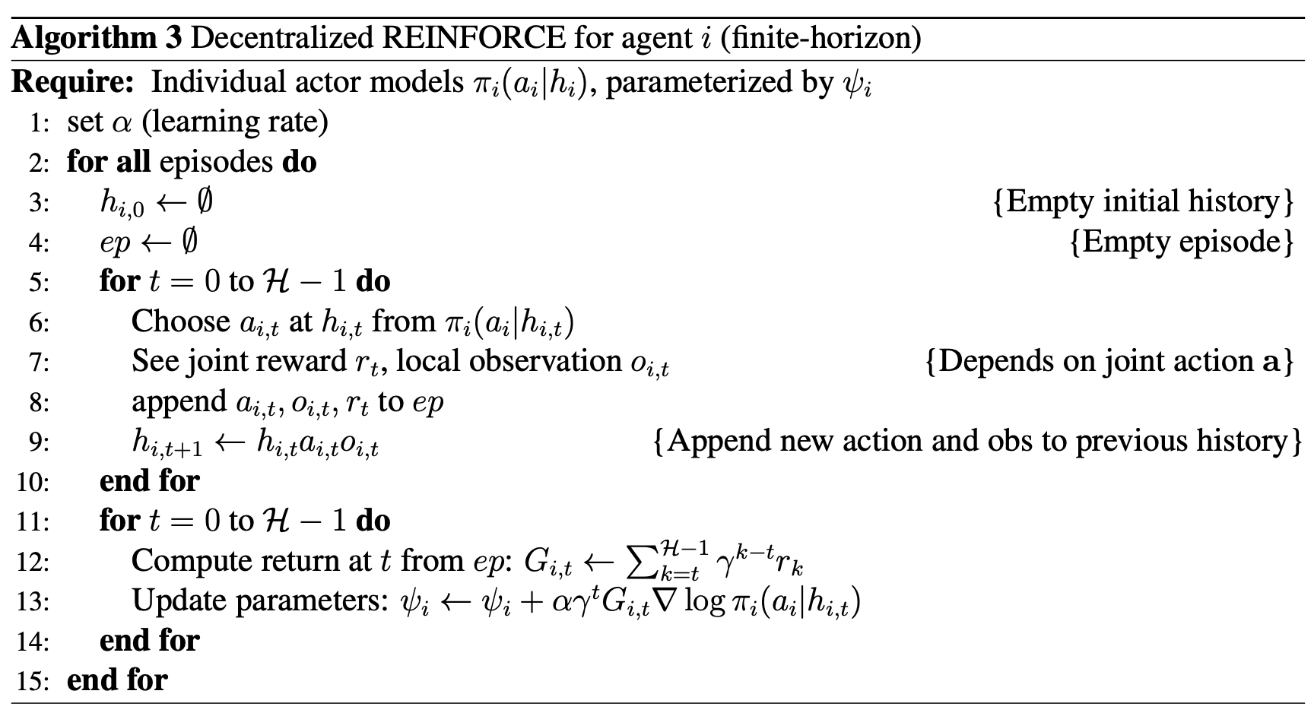
Decentralized REINFORCE
Peshkin et al. – UAI 00
Extends single agent REINFORCE (Williams 92)
Simple but has convergence guarantees!
joint gradient can be decomposed into decentralized gradients
I.e., this algorithm converges to the same values as a centralized algorithm (over decentralized policies)
Assumes concurrent learning
Policy but no value function
Based on other agents
Monte Carlo returns
Note: this version generalizes the original algorithm which was defined for finite-state controllers

Slide 38
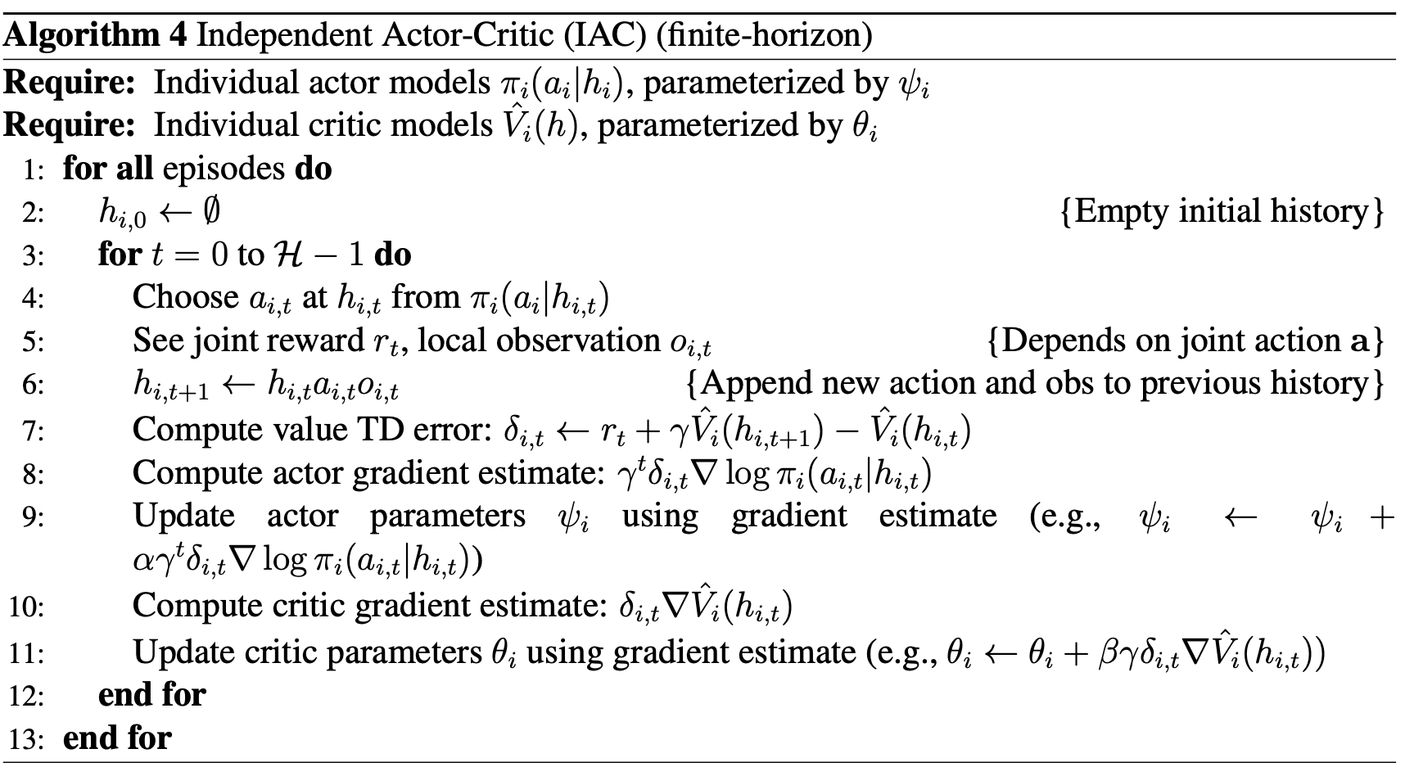
Independent actor critic (IAC)
Foerster et al. – AAAI 18
Policy and value model
Extends Decentralized REINFORCE to the Actor Critic case
On-policy error
Update both models

Slide 39
Other decentralized PG methods
Can extend any single-agent PG method to the multi-agent case
Independent PPO (IPPO) (de Witt et al. 20)
A version of IAC with PPO as the base RL method
Yu et al. (22) version uses parameter sharing (not DTE)
More about IPPO and MAPPO in the CTDE discussion
Not a very active area

Slide 40
Other topics
Parameter sharing
Agents share the same copy of policy and/or value networks
I consider this a form of CTDE (since it assumes centralized info)
Decentralized methods can easily use parameter sharing to potentially improve performance
Relationship with CTDE
Centralized PG equal to decentralized PG so maybe not that different?
Other forms of decentralization
Communication during execution using ‘networked’ agents, e.g. (Zhang et al. 18)

Slide 41
Centralized Training for Decentralized Execution (CTDE) MARL
Models and methods

Slide 42
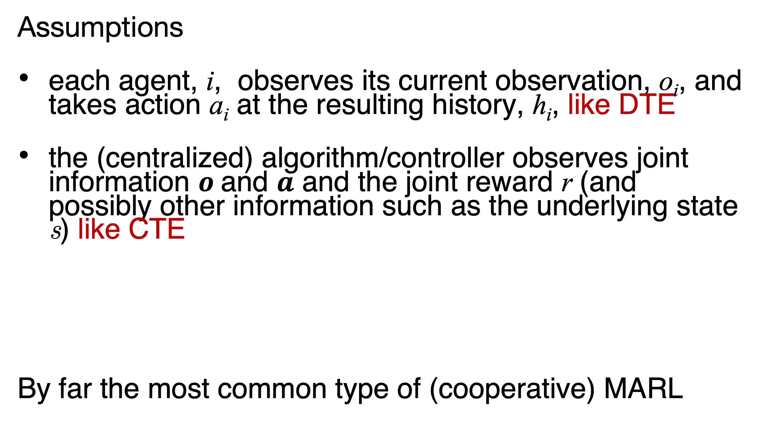
Centralized training for decentralized execution (CTDE)
Assumptions
each agent, i, observes its current observation, o_{i}, and takes action a_{i} at the resulting history, h_{i}, like DTE
the (centralized) algorithm/controller observes joint information $o$and $a$ and the joint reward r (and possibly other information such as the underlying state s) like CTE
By far the most common type of (cooperative) MARL
Actor₁
Centralized
Critic
Actor_{n}

Slide 43
Centralized training for decentralized execution (CTDE)
Train offline for online execution
Can use centralized info offline
Still need to execute in a decentralized manner
CTDE has become the dominant form of (cooperative) MARL
Many methods: MADDPG, NeurIPS-17; COMA AAAI-18; QMIX, ICML-18; QPLEX, ICML-21; MAPPO, NeurIPS DB-22
Actor₁
Centralized
Critic
Actor_{n}

Slide 44
CTDE Action-Value Methods
Value function factorization: VDN, QMIX, and QPLEX

Slide 45
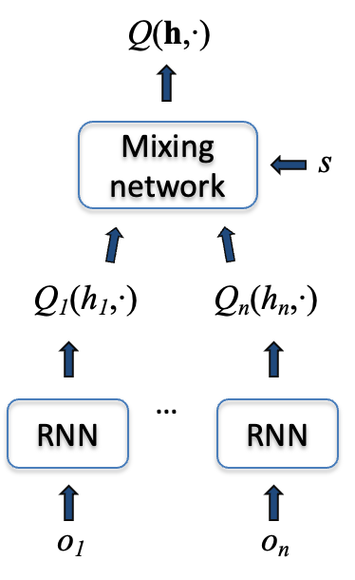
Value function factorization methods
Basic idea:
Learn individual Q-values per agent as well as a form of joint Q-function
During training, learn individual Q-values from joint one
During execution, each agent uses individual Q-values to select actions

Slide 46
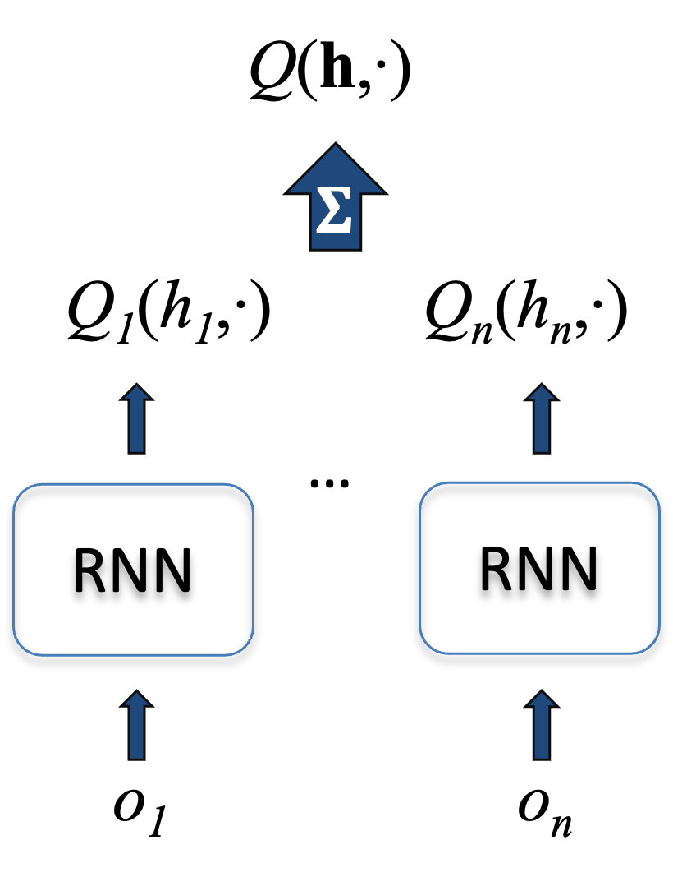
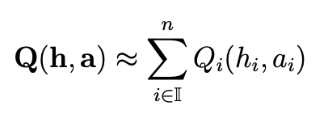
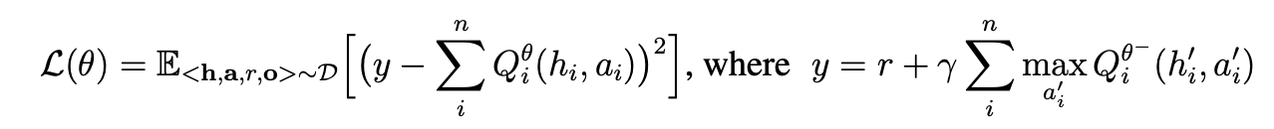
Value decomposition networks (VDN)
Sunehag et al. – arXiv 17
The first deep value function factorization/decomposition method
Represents joint Q-value as a sum of individual Q-values:
Trains solely based on (joint) RL loss
Simple, scalable, but limited joint Q-value representation
DRQN

Slide 47
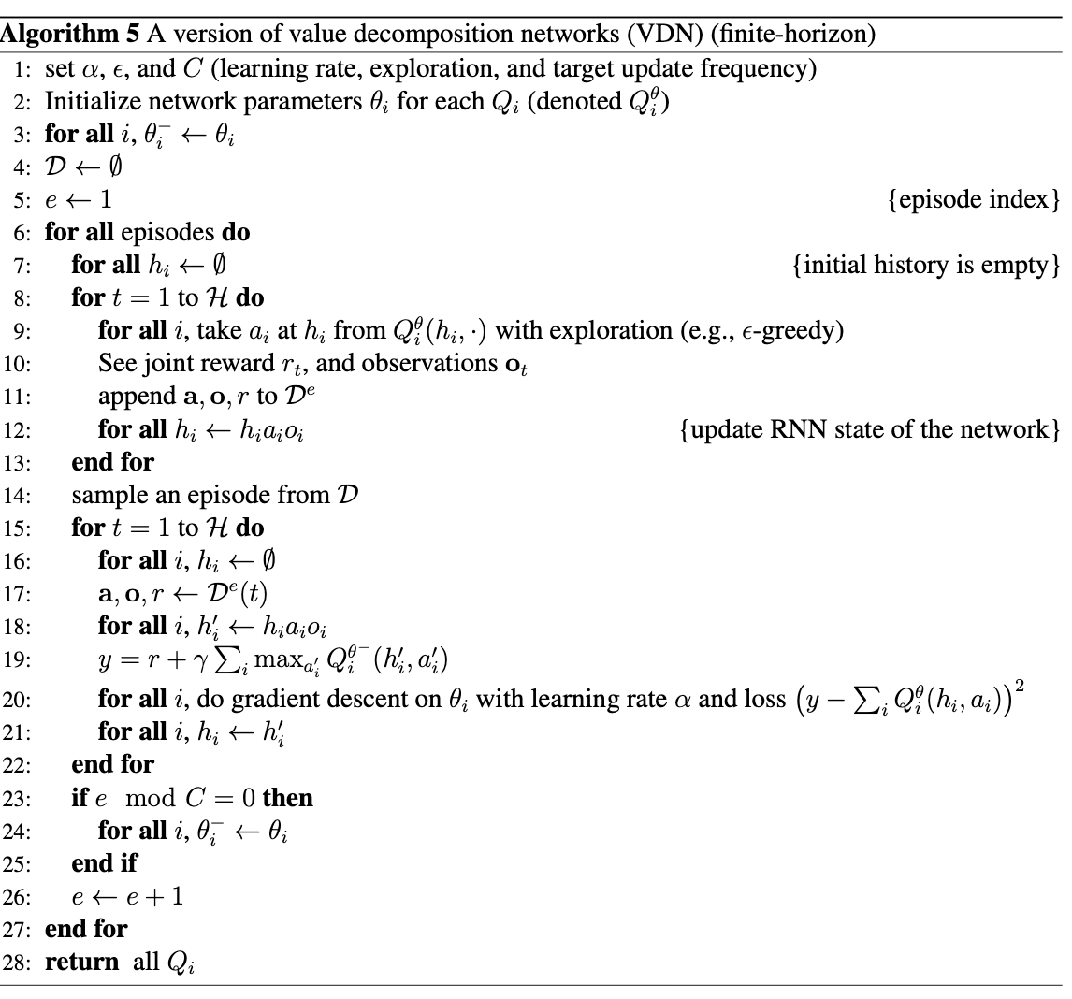
VDN algorithm
Only argmax over individual Q-functions
Target network
Learn from the joint Q-values

Slide 48



QMIX
Rashid et al. – ICML 18
Extends VDN to represent monotonic functions
(implemented with positive weights in mixer)
Also, use state as input to mixer (with hypernetwork)
Still argmax over indiv. Q-functions and train based on the joint loss
Can’t represent all Q-functions but still a state-of-the-art method
DRQN

Slide 49


Individual Global-Max (IGM)
Son et al.– ICML 19 (QTRAN)
Definition: Individual-Global-Max
For a joint action-value function Q(h,a) where h$=⟨h_{1},…,h_{n}⟩$ is a joint action-observation history, if there exist individual functions [Q_{i}] such that:
Then [Q_{i}] satisfy IGM for Q at h
This is the main principle value factorization/decomposition methods: the argmax of the joint value function is the same as the argmax of the individual Q-functions
VDN and QPLEX satisfy this (as do QTRAN, QPLEX, etc.)

Slide 50


QPLEX
Wang et al.– ICLR 21
Extends IGM to the advantage case
Definition: Advantage-based IGM
For joint and individual advantages:
A(h,a) = Q(h,a)-V(h) where V(h)$=\max_{a}\text{Q}\text{(}\text{h}\text{,}\text{a}\text{)}$ and A_{i}(h_{i},a_{i})= Q_{i}(h_{i},a_{i})-V_{i}(h_{i}) where V_{i}(h_{i})=$\max_{a_{i}}\text{Q}\text{i}\text{(}\text{h}\text{i}\text{,}\text{a}\text{i}\text{)}$
For a joint action-value function Q(h,a) where h$=⟨h_{1},…,h_{n}⟩$ is a joint action-observation history, if there exist individual functions [Q_{i}] such that:
Then [Q_{i}] satisfy IGM for Q at h
This is subtle but important! Non-standard advantage makes then 0 for optimal action and negative otherwise! Used a a constraint to represent the full IGM function class

Slide 51

QPLEX architecture
Wang et al.– ICLR 21
Architecture is a bit complicated but it performs well
Can sometimes outperform QMIX and is a state-of-the-art method
Other recent value factorization/decomposition methods but not clear they outperform QMIX and QPLEX
DRQN

Slide 52

State in value function factorization
Marchesini et al.,--AAMAS 25
Is it cheating/wrong to use state during training?
QMIX: Sound since state information gets marginalized out
QPLEX:
Sound since similar to QMIX
Less general with state (can’t represent all IGM functions)
Weighted QMIX: Probably not sound as uses separate state-conditioned weights
Note: The paper also introduces a new algorithm DualMIX which I don’t discuss here

Slide 53

State in value function factorization
Marchesini et al.,--AAMAS 25
Why is the state helpful?
Benefit of state unclear in theory but may be helpful in practice
Tried the methods with state (s), a random (r) value, or a 0 value
Other information can outperform state info!

Slide 54
CTDE Policy Gradient Methods
Centralized critics: MADDPG, COMA, and MAPPO

Slide 55

Actor critic with a centralized critic
Have an actor for each agent
Learn a ’centralized’ Q-function
Update each actor using this joint Q-value:
Update the joint Q-value using the joint info:

Slide 56

A basic centralized critic approach
A policy network for each agent
A joint value network
Joint error calculation
The gradient using
Loop over agents
Use joint Q to update agent policies

Slide 57
MADDPG
Lowe et al.—NeurIPS 17
Designed for competitive or cooperative problems
Off-policy (so uses reply buffer like DQN)
Continuous action, so uses a Deterministic PG (Silver et al., ICML-14)
Defined policies based on a single observation but should be:
Learn centralized critic from the reply buffer and using target network θ⁻
MADDPG is no longer widely used but the centralized critic have been adopted
Note: For the cooperative CTDE case we assume a single shared critic among agents, do not consider learning policy models of the other agents, and do not consider
ensembles of other agent policies to improve robustness.

Slide 58


Counterfactual Multi-Agent Policy Gradients (COMA)
Foerster et al.–AAAI 18
Centralized critic along with a counterfactual baseline to potentially help with variance and credit assignment
Calculate a per-agent advantage considering that difference between with the agent did and the expected Q-value from policy and fixing other agents:
Is implemented with agent ids to only require a single centralized critic network (rather than one per agent)
On-policy so the critic is updated as usual:
Policy network update uses A_{i} instead of Q:
COMA is also not widely used but very influential
Note: COMA originally used state instead of history in the advantage and Q-values but this is incorrect as I’ll discuss later.

Slide 59




MAPPO
Yu et al. -- NeurIPS DB&B 22
MAPPO is a form of a centralized critic method
Just use PPO as the base RL method
Actor loss:
Uses joint advantage:
Use GAE but can be computed from V as 𝛅=
Uses joint value function and local policy ratio:
Critic loss:
Can use other centralized info in the critic (more later)
Simple, but works well and some form of this often works best
Note: actual details in the paper are unclear so this is a more general version

Slide 60



IPPO
de Witt et al. –arXiv 20
Actor loss:
Uses local advantage:
Can also use GAE or other methods (e.g., n-step)
Ratio same as before:
The only difference is the use of A_{i} instead of A
Critic loss (with clipping):
Often performs similarly to MAPPO but sometimes lower

Slide 61
Contrasting Centralized and Decentralized Critics
in Multi-Agent Policy Gradient
Lyu, Xiao, Daley and Amato – AAMAS21 Best Paper Nomination
Centralized critic widely use but misunderstood
We show in theory:
Centralized Critic does not foster cooperation any better than Decentralized Critics
Both unbiased estimates of the decentralized policy
Centralized Critic exhibits more variance in policy gradient
In practice:
Centralized Critic – less bias, more variance
Decentralized Critics – more bias, less variance
Actor₁
Centralized
Critic
Actor_{n}
Notes:
[add animation]
Actor-Critic methods with a Centralized Critic has been very popular recently in multi-agent reinforcement learning
But we have found that there are common misconceptions in the current literature
So with this work we would like to correct those misconceptions
[click]
Through bias and variance proofs for Centralized and Decentralized Critics, we have two main theoretical takeaways:
First is that centralized critic does not meaningfully help with cooperation, although some might think they can.
The second is that the centralized critic exhibits more variance when is used for actor learning.
[click]
In practice, we see more variance with centralized critic and more bias with decentralized critic.
All this might come as a surprise for many people,
So let’s see how this all works out.

Slide 62



Multi-Agent Actor Critic
Decentralized and Centralized Critic
Decentralized actor and critic: pretend the other agents are part of the environment (independent per agent)
Decentralized actor and centralized critic: update critic based on centralized Q-value and then update each agent’s actor

Slide 63




Critic Centralization Cannot Solve Cooperation
Climb Game
Under uniform policy:
Decentralized $Q_{Alice}$:
Centralized $Q$:
Alice
Alice
$$a_{1}$$ | $$a_{2}$$ | $$a_{3}$$
-6.3 | -7.6 | 3.6
 | $$a_{1}$$ | $$a_{2}$$ | $$a_{3}$$
$$a_{1}$$ | 11 | -30 | 0
$$a_{2}$$ | -30 | 7 | 6
$$a_{3}$$ | 0 | 0 | 5
Bob
Alice
 | $$a_{1}$$ | $$a_{2}$$ | $$a_{3}$$
$$a_{1}$$ | 11 | -30 | 0
$$a_{2}$$ | -30 | 7 | 6
$$a_{3}$$ | 0 | 0 | 5
Return Values for Climb Game
Bob
Notes:
Let’s look at Climb Game, which is a matrix game that does not have state or observation dynamics,
And the reward shown in the table here only depend on the actions from our agents Alice and Bob.
In Climb Game, we’d like them to learn that action 1 is the best action, however, that is difficult for independent learners to discover this fact.
Because action1 is not appealing enough when your teammate is not already constantly taking action 1, and you risk getting that -30 penality.
Now, suppose they are initialized with uniform policies, [click]
from Alice’s perspective,
We would have the those return distributions, which is also what a critic ideally would tell us.
Notice that the centralized critic is able to learn all the values for each and every joint actions, but decentralized critic learns a marginalization of that.
Also, we can see that the centralized Q-table is easily to learn because the return value is deterministic for each joint action.
Not only that, it also directly tell us the optimal joint action is (a1, a1) at positive 11. That is great.
Intuitively, it is easy to just conclude, that the centralized critic is superior, because it learn with less noise and provide us with better solutions.
However, the story doesn’t end here. In the previous slide I said that both critics gives the same expected policy gradient, that means the centralized critic will not do better than a decentralized one.
To see why is the case, let’s actually write out the gradients.

Slide 64





Critic Centralization Cannot Solve Cooperation
Climb Game
Policy gradients for $a_{1}$:
$∇ log π\left(a_{1};θ\right) \left(−6.3\right) w.p. 1$
$∇ log π\left(a_{1};θ\right) \left(+11\right) w.p. \frac{1}{3}$
$∇ log π\left(a_{1};θ\right) \left(−30\right) w.p. \frac{1}{3}$
$∇ log π\left(a_{1};θ\right) (0) w.p. \frac{1}{3}$
when $π_{Bob}=$
Under uniform policy:
Decentralized $Q_{Alice}$:
Centralized $Q$:
Alice
$$a_{1}$$ | $$a_{2}$$ | $$a_{3}$$
-6.3 | -7.6 | 3.6
Alice
 | $$a_{1}$$ | $$a_{2}$$ | $$a_{3}$$
$$a_{1}$$ | 11 | -30 | 0
$$a_{2}$$ | -30 | 7 | 6
$$a_{3}$$ | 0 | 0 | 5
Bob
$$a_{1}$$ | $$a_{2}$$ | $$a_{3}$$
$$\frac{1}{3}$$ | $$\frac{1}{3}$$ | $$\frac{1}{3}$$
Notes:
We see that using centralized critic gives us more variances in our policy learning.
Because decentralized critic gives Alice a deterministic value with 0 variance, and three different values for centralized critic with some positive variance.
[click, click]
Notice that in this case, the variance occurs purely due to the fact that Bob is willing to take more than one action.
(If Bob’s policy have zero entropy, …)

Slide 65
Learning Value Functions
Joint*
Local*
* the return/value/action in the joint/local action-history space
Reward signal
Centralized Critic
Decentralized
Critic
Decentralized
Critic
Value
Actor
Actor
Actor
Actor
Action
Both estimating and updating decentralized policies
Notes:
This diagram shows whether the inputs and outputs of each component is joint or local.
We can see that the centralized critic on the left learn completely in the joint action-history space,
and the decentralized critics on the right receive signal from the joint action-history space but have to marginalize it down into the local action-history values.
[click]
The marginalizing over other agents’ histories and actions is carried out by both methods, but by different components.
On the left, the marginalization burden is implicitly on the actors when you have centralized critic. This give actor-learning more variance and therefore it is harder to learn, as we have seen in Climb Game.
On the right, the decentralized critic is more difficult to learn because its learning target have more variance due to the same logic.
So in actual training it would have more bias compared to the centralized critic.
We refer readers to more discussions on those trade-offs and also scalability in section 6 of the paper.
Ok, now we see both methods are somewhat equivalent in theory,
So, which one works better in practice?
Well,

Slide 66














Centralized and Decentralized Critic Performance
on StarCraft Multi-Agent Challenge (SMAC), Box Pushing, Particle environments, Target Capture, etc.
Notes:
Well, unsurprisingly, we find that they work mostly the same with very few exceptions.
One of those exception is [click] Dec-tiger, so let’s take a closer look.

Slide 67











Dec-tiger: requires stable policy
Decentralized
Critic
Centralized
Critic
Open left door
Open right door
Listen
Notes:
Now, there are some environments requires your policy to be very stable in order to get good results, those tasks can be very sensitive to policy changes.
And dec-tiger is one of those tricky tasks.
[click]
We have two doors that two agents can open, obviously they want to get the treasure, but treasure and the tiger are randomly initialized.
[click]
so there is a third action called “listen”, which gives the agent noisy information about where the tiger might be.
If they open the treasure door at the same time, they get more treasure, if they open the tiger door at the same time they get less punishment.
But if they individually open doors, they get less treasure or more punishment respectively.
So this is really encouraging them open a certain door at the same time.
Empirically, [click]
The decentralized critic can usually find an okay solution where they open the door after two or three times of listening. [click]
But the centralized critic converged to just opening a door simultaneously in the first time step.
This is because when you have high variance in your policy updates, it is harder for the agents to retain a stable policy, and that makes it harder to coordinate that simultaneous door opening.
In the end, the agents must resort to opening the door at the first timestep without gathering any information.
There are other result and analysis in the paper, if you want to read more on the effect of unstable policies.

Slide 68
Decentralized vs centralized critics
Theoretically equivalent
But that assumes learned critics
Decentralized critics can be harder to learn
When other agents change policies
Higher bias
Centralized critics can be harder to learn
Large domains (action, obs, agents)
Higher variance to marginalize out other agents

Slide 69

State-based Centralized Critics
State information is often available offline in a simulator
Implemented by pioneering Centralized Critic methods
COMA (Foerster et al. 2018), MADDPG (Lowe et al. 2017)
Followed by later methods
SQDDPG (Wang et al. 2020), LIIR (Du et al. 2019), LICA (Zhou et al. 2020),VDAC-mix (Su, Adams, and Beling 2021), DOP (Wang et al. 2021) and MACKRL (Schroeder de Witt et al. 2019)
Obvious Advantages of State-based Centralized Critic
Compact, Fully Observable
Obvious Disadvantages of History-based Centralized Critic
Complexity from (potentially long) time horizon
Complexity from combining observations (and actions) from multiple agents
Partially Observable
Notes:
State-based critics are used as the default method from the beginning when centralized critics were used for centralized training.
Mainly because it works really well on the benchmarks, which later we’ll see why.
But what is intuitively obvious is that learning state values are considerable easier.
[click]
The state is compact and fully observable by definition.
The observation histories, though, get longer over time, get larger with more agents, and is not fully observable.
So is there any reason not to use state-based critics?
To answer that question, let me go just a little deeper into how actor critic works.

Slide 70
A Deeper Understanding of State-Based Critics
in Multi-Agent Reinforcement Learning
Lyu, Baisero, Xiao and Amato – AAAI22
State-based critics in MARL are popular but misunderstood
We show in theory:
State-based critics may be biased compared to History-based Critics
State-based critics may produce higher variance
We show empirically:
Both critics work well in different domains
Common benchmarks lack partial observability
The state-history-based critic is robust to various domains
Notes:
Let me briefly go over the messages in this paper.
Firstly, we see in MARL that centralized critics have gained a lot of popularity thanks to the recent popularity of Centralized Training for Decentralized Execution paradigm.
More often than not, we encounter state-based centralized critics
However, we noticed that there are some misunderstandings around state-based centralized critics.
[click] In this paper, we show that depending on the environment and your policy, state-based critics can be biased, so you lose your convergence guarantees.
Also, it can have higher variance in its policy gradient.
In just a second I’ll give very simple examples to illustrate those theoretical results.
[click] On the empirical side, we find both state or history critics works well to a certain degree, and both showing their advantages in difference environments.
In the process, we also highlights a problem with our current popular and standard benchmarks, in that we often lack real partial-observability.
Finally, we found that the combination of state and history-based critic is quite robust across various domains.

Slide 71


Centralized critics
Centralized critic
Conditions on history of all agents (joint history $h$)
State-based centralized critic
Conditions on the world state $s$
Notes:
Actor Critic is appealing when you allow for a centralized training, [click] because you can use centralized critic to train those decentralized actors.
and afterwards, the critic can be discarded because it is not required for acting in the real environment.
[click] Very often recently, state based centralized critics have been used instead of the joint history based critic, because it is a lot more compact.
The actors have to act in a decentralized manner, so they are history based.
In this work, we look closely at the seemingly perfect state-based critic and clarify some of the misunderstandings around it.

Slide 72


Centralized critics
Centralized critic
Conditions on history of all agents (joint history $h$)
State-based centralized critic
Conditions on the world state $s$
History-state-based centralized critic
Conditions on the joint history $h$ and world state $s$
Notes:
Actor Critic is appealing when you allow for a centralized training, [click] because you can use centralized critic to train those decentralized actors.
and afterwards, the critic can be discarded because it is not required for acting in the real environment.
[click] Very often recently, state based centralized critics have been used instead of the joint history based critic, because it is a lot more compact.
The actors have to act in a decentralized manner, so they are history based.
In this work, we look closely at the seemingly perfect state-based critic and clarify some of the misunderstandings around it.

Slide 73




Bias Example - Noisy Beverage Domain
🍵
🍵❗️
🍵/☕❓
💁‍♂️
😌
😑
😑
🍵
🍵
💵
💁‍♂️
💁‍♂️
🍵❗️
😑
☕
25%
😑
🍵/☕❓
☕❗️
💁‍♂️
😑
75%
Notes:
Now we make the beverage domain more realistic.
[click] Our barista can now ask the customer what he wants, [click] and the customer can say either tea or coffee, [click] you then can serve the drink with that information.
Interestingly, the customer is erratic, [click] only disclosing his true preference say 75% percent of the time, so it may be the case that the agent has to ask multiple times until say hearing a consistent answer two or third time in a row just to make sure.
of course let’s say there is a small time penalty otherwise we might be asking for his preference forever.

Slide 74



History Values
Q(
,
) =
💵
Q(
,
) =
💵
Q(
,
) =
💵
Q(
,
) =
💵
Notes:
Let’s say we have a relatively good policy, which serves after hearing three consistent consecutive answers
if we look at Q values for the “asking” action, we would get those history values and state values.
[go though each one]

Slide 75


State Values
Q(
,
) =
…
Q(
,
) =
💵
= Q(
,
)
State value cannot represent the value of a particular history
Notes:
[click] Remember, the state values are weighted sum of state history values. For example, let’s look at the state of customer wanting tea, and let’s say the underlying state of those values on the right have this underlying state. [click] The state value is just then the weighted average of those values, weighted by the probability of each individual history, of course.
[click] Now, because we are not at advantage whether the customer wants tea or coffee, assuming our policy does not bias against either type of customer, the value of customer wanting coffee have the same overall value.
Now if you think about it, the strategy of making-sure means you are trying to decrease your uncertainty on the underlying state, effectively increasing your chance of getting that dollar. So if we get consist answers from our client, we ought to increase our value estimate and vise versa. Now if you think about learning this policy, it requires our our confident to be reflected in history values, so that the action of asking becomes appealing when we need to gather information. It is clear that the optimal policy cannot be learned from those constant state values.
So remember for policy updates, you go with the estimated value.
The history values tells you, oh if you are confident of the true customer preference, you are to expect a higher return.
The state value tells you that no matter what you hear from the customer, at any point in time, how sure or unsure you are, the value does not change. Imagine how hard it is to learn from that.
In other words, we see key distinction here is that the state values does not factor in the uncertainty, but, as you can see, being able to deal with uncertainty is kinda crucial in partially observable domains like serving tea or coffee.

Slide 76
State Values
Q(
,
) =
…
Q(
,
) =
💵
= Q(
,
)
Proofs in the paper
Notes:
[click] Remember, the state values are weighted sum of state history values. For example, let’s look at the state of customer wanting tea, and let’s say the underlying state of those values on the right have this underlying state. [click] The state value is just then the weighted average of those values, weighted by the probability of each individual history, of course.
[click] Now, because we are not at advantage whether the customer wants tea or coffee, assuming our policy does not bias against either type of customer, the value of customer wanting coffee have the same overall value.
Now if you think about it, the strategy of making-sure means you are trying to decrease your uncertainty on the underlying state, effectively increasing your chance of getting that dollar. So if we get consist answers from our client, we ought to increase our value estimate and vise versa. Now if you think about learning this policy, it requires our our confident to be reflected in history values, so that the action of asking becomes appealing when we need to gather information. It is clear that the optimal policy cannot be learned from those constant state values.
So remember for policy updates, you go with the estimated value.
The history values tells you, oh if you are confident of the true customer preference, you are to expect a higher return.
The state value tells you that no matter what you hear from the customer, at any point in time, how sure or unsure you are, the value does not change. Imagine how hard it is to learn from that.
In other words, we see key distinction here is that the state values does not factor in the uncertainty, but, as you can see, being able to deal with uncertainty is kinda crucial in partially observable domains like serving tea or coffee.

Slide 77


Experiments
Tested with advantage actor critic (A2C)
History critic
State critic
State-history critic
Used standard domains: small common domains, SMACv1 (Starcraft) and partially observable particle environments
Have additional experiments and base actor-critic methods in the paper
SMAC v1
Partially observable particle envs

Slide 78


Common small environments
Notes:
The state-based critic may have variance and bias problem we just talked about.
The history-based critic may encounter representation learning problems, because those histories may get complicated.
We found that the combining the information and learning state-history value directly may help some situations.

Slide 79

SMAC - StarCraft Multi-Agent Challenge
Notes:
SMAC results are mixed.

Slide 80




Partially Observable Particle Environments
Predator and Prey
Observation Radius = 0.8
Observation Radius = 1.6
Notes:
HC (orange) learns well but have difficulties -> representation learning issue
SC (blue) got better in larger radius -> less biased when less partially observable (maybe not include this point, too confusing)
SHC (green) works the best -> state helps with representation learning & history helps with bias problem
We have more experiments in the paper, where we also talk about the implications of reactive policies and its relationship with t

Slide 81
Takeaways
Benchmark problems
We need harder, more partially observable problems
Methods to use
Decentralized critics and (centralized) state-history-based often work the best
MAPPO paper had a similar result
Not really clear why
CTDE
What is the best way to perform centralized training for decentralized execution (that’s both principled and performs well)?

Slide 82
Other CTDE methods
Many other extensions and approaches:
E.g., FACMAC: Use a factored critic (doesn’t need IGM) (Peng et al., 2021)
Parameter Sharing
Alternating learning
(Banerjee et al., 2012, Su et al., 2024)
Sequential agent updates as in HATRPO and HAPPO (Kuba et al. 2022)
Other agent modeling, e.g., LOLA (Foerster et al. 2018a)

Slide 83
Other topics
Many other topics in (cooperative) MARL that we don’t have time to cover
Communication (Zhu et al., 2024)
Ad hoc teamwork (Mirsky et al., 2022),
Model-based methods (Wang et al., 2022)
Exploration, offline methods, model-based methods, hierarchical methods, role decomposition, multi-task approaches, etc.

Slide 84



Applications
(Bokade et al., 2023)
Video games (e.g.,AlphaStar (Vinyals et al., 2019)
Centralized MARL for a team
Warehouse robots (Krnjaic et al. 2024)
Hierarchical CTDE approach
Traffic signal control (e.g., survey by Wei et al. 2021)
Autonomous vehicle control (e.g., survey by Zhang et al. 2024)
Power systems, etc!

Slide 85

Multi-agent RL with macro-actions
Xiao, Hoffman, Xia and Amato – ICRA20
Notes:
In this experiment, two humans are working on their assembly tasks and requiring six objects in total to be found and delivered in the correct order at the right time: the measurement tool, clamp, electronic drill.
We can see that fetch behaves smartly such that finds the correct tool in the proper order and passes to the right tool to turtlebot who arrives at the table earlier, and the two turtlebots are also clever in such a way that separately serve the two humans rather than supply one human together that will make another human wait over there.

Slide 86



Benchmarks
Standard domains:
Multi-agent Particle Envs (MPE) (PyTorch and JAX)
Overcooked (PyTorch and JAX)
SMAC v1 and v2 (PyTorch and JAX)
Many many more inspired by applications

Slide 87





Environments and code
PettingZoo
Multi-agent version of gym
Interface and some environments
https://pettingzoo.farama.org/
JAXMARL
Efficient (JAX-based) baseline methods and environments
https://github.com/FLAIROx/JaxMARL/tree/main/jaxmarl/environments/smax
BenchMARL
PyTorch baseline methods and environments
https://github.com/facebookresearch/BenchMARL
Several more…

Slide 88


MARL and LLMs
RL is widely used for LLMs
MARL is not currently used for multi-agent LLMs (to best of my knowledge)
There is no reason it couldn’t be
Open questions
Use cases
Control scheme
MARLHF
Training
Benefits: specialization, robustness, scalability/performance
Disconnect between academia and industry
https://developer.nvidia.com/blog/introduction-to-llm-agents/
https://www.microsoft.com/en-us/research/project/autogen/

Slide 89
Conclusion
Cooperative multi-agent reinforcement learning is a very general setting that fits with lots of applications
A lot of work cooperative MARL
Centralized training and execution
Decentralized training and execution
Centralized training for decentralized execution (CTDE)
Academia and industry are working on improved methods to improve scalability and performance

Slide 90
Conclusion
Many open questions
MARL for LLM agents
Very scalable MARL
Optimal MARL
How to best do CTDE
Multiagent approaches to ML (e.g., GANs, decentralized methods)

Slide 91

Our resources
Dec-POMDP book
Background on models and planning methods
Book draft (An Initial Introduction to Cooperative Multi-Agent Reinforcement Learning): https://arxiv.org/abs/2405.06161
Let us know what you think and what should be changed/added for the final version!
Slides will be available
https://www.khoury.northeastern.edu/home/camato/tutorials.html

