Slide 1
Partially Observable RL
Chris Amato
Northeastern University with some slides from Rob Platt, Lawson Wong and U Alberta
Notes:
1

Slide 2
Announcements
Class website: https://www.khoury.northeastern.edu/home/camato/7170scheduleF25.html
  I’ll put slides there
Teams
  If you aren’t on it, let me know!

Slide 3
This week
Start reading my book draft
  An Initial Introduction to Cooperative Multi-Agent Reinforcement Learning
  https://arxiv.org/abs/2405.06161
  Read at least the first 2 chapters (they are short and easy) for Thursday (or today)
    Email me at least one suggestion for each chapter
  Read chapter 3 for Monday (or Thursday)
    Email me at least two suggestions for this chapter
  Read chapter 4 through 4.2 for Thursday or next Monday
    Email me at least two suggestions for these sections
Also send me paper ideas (one each)

Slide 4
Partially observable RL
Sometimes the environment includes state variables that are not visible to the agent
  the agent sees only observations, not state
  e.g., the object in the box, or in other rooms, velocities, even real positions as distinct from sensor readings
This makes the environment Non-Markov
Note red title slides from Andrea Baisero

Slide 5
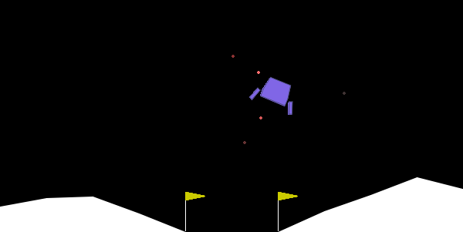
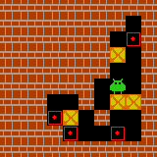

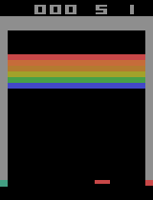

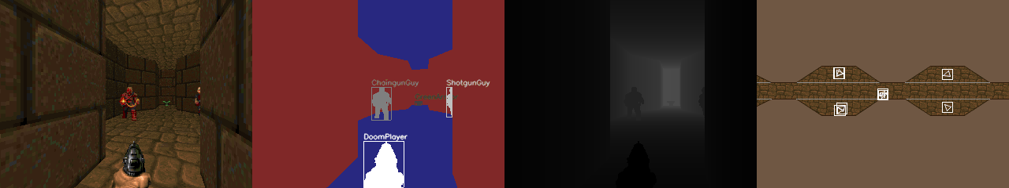
Examples of Full and Partial Observability
Informal definition: Some state information is hidden.
(a) Acrobot.
(b) Lunar Lander.
(c) Sokoban.
(d) Flappybird. (e) Breakout.
(f) ViZDoom.

Slide 6
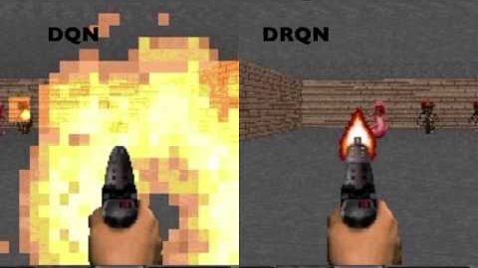
DQN with a recurrent layer (DRQN)

Slide 7
Implications of Partial Observability
What is partial observability?
Environment state is in some way hidden from agent
e.g., behind the agent, behind the corner, contents of a box, etc.
Agent sees indirect observations, not full state
  Sometimes filtered state
  Sometimes separate observation space altogether
Non-Markovian Pr(ot | ot−1, . . . , o1) ̸= Pr(ot | ot−1)
Is that such a big deal?
No, just use the same methods with available observation
Reactive policies π : O → ∆A

Slide 8
Implications of Partial Observability
What is partial observability?
Environment state is in some way hidden from agent
e.g., behind the agent, behind the corner, contents of a box, etc.
Agent sees indirect observations, not full state
  Sometimes filtered state
  Sometimes separate observation space altogether
Non-Markovian Pr(ot | ot−1, . . . , o1) ̸= Pr(ot | ot−1)
Is that such a big deal?
No, just use the same methods with available observation
YES! Significant theoretical & practical consequences!
Reactive policies π : O → ∆A are far from ideal!

Slide 9
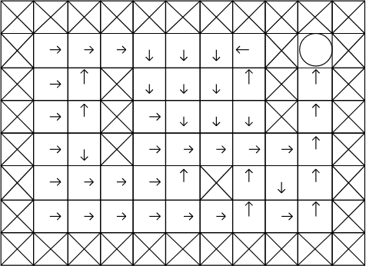
A (Somewhat) Positive Example: Sutton’s Gridworld
Observation: the directions the agent can move
Figure: Reactive solution to Sutton’s gridworld (Littman, 1994).
Keypoints: State aliasing
Suboptimality, reactive control as constrained control Still, we can guarantee goal

Slide 10
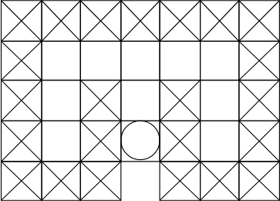
A Negative Example: McCallum’s Maze
Observation: the directions the agent can move
Figure: McCallum’s Maze (Littman, 1994).
Question: Can we guarantee goal?

Slide 11
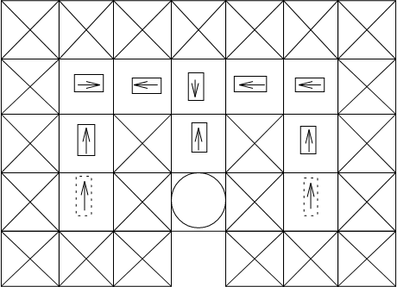
A Negative Example: McCallum’s Maze
Observation: the directions the agent can move
Figure: McCallum’s Maze (Littman, 1994).
Question: Can we guarantee goal?
Keypoints: Deterministic π fails from one direction (constrained policy) Stochastic π succeeds from both directions (still suboptimal) Optimal deterministic policy not guaranteed?

Slide 12
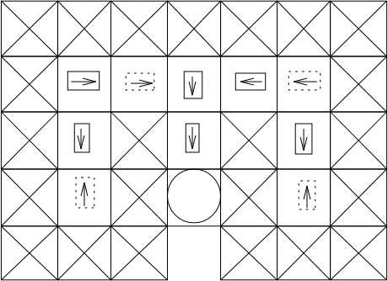
A Negative Example: McCallum’s Maze
Observation: the directions the agent can move
Figure: McCallum’s Maze (Littman, 1994).
Question: Can we guarantee goal?
Keypoints: Deterministic π fails from one direction (constrained policy) Stochastic π succeeds from both directions (still suboptimal) Optimal deterministic policy not guaranteed?
Resolution: Deterministic π w/ memory, guarantee goal from both directions!

Slide 13
Information Gathering & Memorization
Goal: Reach good exit, avoid bad exit
Observability:
Full observability of position
Partial observability of exits
FO Optimality: Just exit
PO Optimality: Backtrack, memorize, exit
Easy to execute Deviously hard to discover
Information Gathering:
Exit
Exit
Agent
Priest
Figure: Heaven/Hell Problem.
Broader than state estimation, about reaching desireable belief-states
Problem-dependent, e.g., info gathering actions/states/experiences, etc.
Commonly harmful upfront cost, hard to overcome
Memorization: History contains all the info, memorize what?
Memory as information extraction
Needle in haystack problem, key to extract and integrate right info
Remember too little, remember too much, remember wrong things

Slide 14
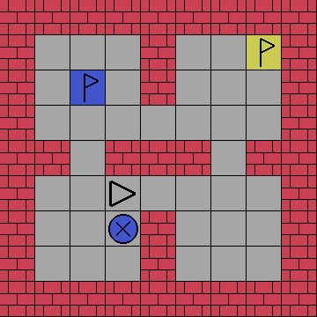

Information Gathering & Memorization
(b) Observation.
(a) State.
Figure: Memory-Four-Rooms-9x9, a procedurally generated navigation task which requires information-gathering and memorization. The agent must avoid the bad exit and reach the good exit, which is identifiable by the color of the beacon.

Slide 15
Full vs Partial Observability
Fully Observable Control
Access to full system state
π : S → ∆A
Solid theory, comparatively easy!
Strong assumption, not always possible!
Partially Observable Control
Access to partial/indirect observations derived from state
π : ? → ∆A
Better match to reality, common in real world problems
Extremely wide range of difficulties (technical vs significant PO)
  At best, about as difficult as full observability
  At worst, orders of magnitude more difficult, virtually impossible

Slide 16

Markov decision processes (MDPs)
Defined with tuple M = <S, A, P, R>
  S, discrete or continuous (Markovian) states
  A, discrete or continuous actions
  P, the state transition model:
  R, the reward model:
Generate policy 𝜋: S → A to maximize cumulative reward over finite or infinite time steps
a
Environment
s,r

Slide 17
POMDPs
Defined with tuple: M = <S, A, P, R, Ω, O>
  S,A,P,R, the same as the MDP
  Ω, discrete or continuous observations
  O, the observation model:
A policy is a mapping 𝜋: H → A or 𝜋: B → A
  Map obs histories (H) to distributions over states (belief states, B)
a
Environment
o,r

Slide 18
POMDPs
A policy is a mapping 𝜋: H → A or 𝜋: B → A
  Map obs histories (H) to distributions over states (belief states, B)
Solve (discrete) POMDP as continuous state “belief” MDP
Or directly evaluate histories: V^{𝜋}(h)
a
Environment
o,r

Slide 19
POMDPs
A policy is a mapping 𝜋: H → A or 𝜋: B → A
  Map obs histories (H) to distributions over states (belief states, B)
Solve (discrete) POMDP as continuous state “belief” MDP
Or directly evaluate histories: V^{𝜋}(h)
  Beliefs can be concise but hard to estimate, histories grow with horizon but maybe we can learn an abstraction
a
Environment
o,r

Slide 20
Computing belief states
Begin with some initial belief state b prior to any observations
Compute new belief state b′ based on current belief state b, action a, and observation o
b′(s′) = P(s′|o,a,b)
b′(s′) ∝ P(o|s′,a,b)P(s′|a,b)
b′(s′) ∝ O(o|s′,a)P(s′|a,b)
b′(s′) ∝ O(o|s′,a) ∑sP(s′|a,b,s)P(s|a,b)
b′(s′) ∝ O(o|s′,a) ∑sT(s′|s,a)b(s)

Slide 21
Computing belief states
Begin with some initial belief state b prior to any observations
Compute new belief state b′ based on current belief state b, action a, and observation o
b′(s′) = P(s′|o,a,b)
b′(s′) ∝ P(o|s′,a,b)P(s′|a,b)
b′(s′) ∝ O(o|s′,a)P(s′|a,b)
b′(s′) ∝ O(o|s′,a) ∑sP(s′|a,b,s)P(s|a,b)
b′(s′) ∝ O(o|s′,a) ∑sT(s′|s,a)b(s)
Kalman filter: exact update of the belief state for linear dynamical systems
Particle filter: approximate update for general systems

Slide 22


POMDP belief example
Prob
0
1

Slide 23
POMDP belief example
Prob
0
1

Slide 24
POMDP belief example
Prob
0
1

Slide 25
POMDP belief example
Prob
0
1

Slide 26
POMDP belief example
Prob
0
1

Slide 27
POMDP belief example
Prob
0
1

Slide 28
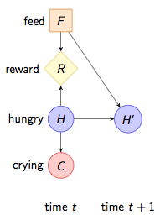
Crying Baby problem
Need to decide whether to feed baby given whether baby is crying
Crying is a noisy indication that the baby is hungry
Costs 5 to feed and 10 for hungry
Infinite horizon with discount γ

Slide 29
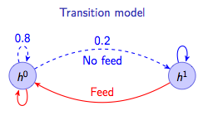
Crying baby Problem
P(c¹ | h⁰) = 0.1 (cry when not hungry)
P(c¹ | h¹) = 0.8 (cry when hungry)

Slide 30
Crying baby example
b=(h⁰,h¹)=(0.5, 0.5)
No feed, cry
b=(0.0928, 0.9072)
Feed, no cry
b=(1,0)
No feed, no cry
b=(0.9759, 0.0241)
No feed, no cry
b=(0.9701, 0.0299)
No feed, cry
b=(0.4624, 0.5376)
Observation model:
P(c¹ | h⁰) = 0.1 (cry when not hungry)
P(c¹ | h¹) = 0.8 (cry when hungry)

Slide 31
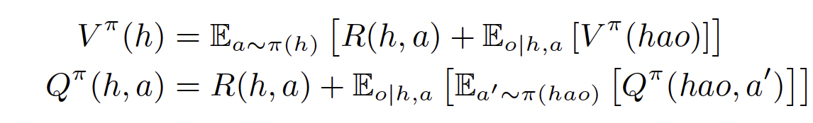
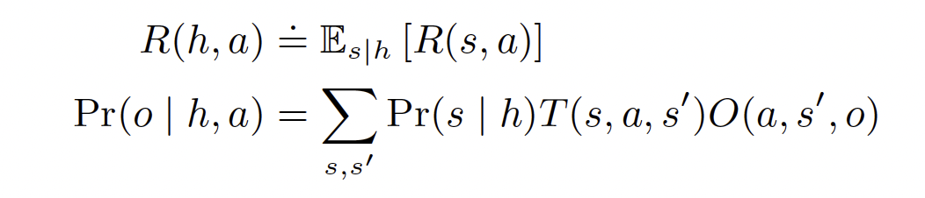
Histories
Notation:
.
∗
History Space H = O × (A × O)
e.g., h = (o0, a0, o1, . . . al−1, ol−1) history with length |h| = l
Concatenation notation hao = (*h, a, o)
History-based Control:
History policy π : H → ∆A
History values via Bellman equations
(3)
(4)
where
(5)
(6)

Slide 32
POMDP as belief MDP
POMDP is really an MDP where the states are belief states
B, the set of belief states, comprise the state space
  If there are n discrete states, then B ⊂ ℝ^{n}
A, the set of actions, remains the same
τ(b′|b,a) is the state transition function
  See DMU equation 6.5:
ρ(b,a),the immediate reward, is equal to ∑_{s} b(s)R(s,a)
Now in a continuous MDP (with some added structure)
There are extensions of dynamic programming to POMDPs, but we won’t discuss them

Slide 33
POMDP as belief MDP
POMDP is really an MDP where the states are belief states
B, the set of belief states, comprise the state space
  If there are n discrete states, then B ⊂ ℝ^{n}
A, the set of actions, remains the same
τ(b′|b,a) is the state transition function
  See DMU equation 6.5:
ρ(b,a),the immediate reward, is equal to ∑_{s} b(s)R(s,a)
Now in a continuous MDP (with some added structure)
There are extensions of dynamic programming to POMDPs, but we won’t discuss them
Practical Difficulties:
Continuous MDP even for discrete POMDPs
Requires model of environment
Estimating beliefs and belief updates is hard

Slide 34


POMDP as history MDP
Definition: History-MDP tuple
    State space
    Action space
    Transition function
    Reward function R(h,a) = E_{s|h}[R(s,a)]

Slide 35
POMDP as history MDP
Definition: History-MDP tuple
    State space
    Action space
    Transition function
    Reward function R(h,a) = E_{s|h}[R(s,a)]
Rejoice! MDP theory fully applies to POMDPs via history-MDPs!
No need to rederive all of MDP theory for history-MDPs
POMDPs just as easy as MDPs!
POMDPs just as “easy” as VERY HARD MDPs!
Practical Difficulties:
Exponential space size
Never encounter same history twice
Hard to generalize well
Do similar histories imply similar optimal actions?
Needle in a haystack problem

Slide 36
Online solution methods for POMDPs
The belief MDP is big
Online methods determine the optimal policy by planning from the current belief state
Many online methods use a depth-first tree-based search up to some horizon
The belief states reachable from the current state is typically small compared to the full belief space
Time complexity is exponential in the search depth
Heuristics and brand-and-bound techniques allow search space to be pruned

Slide 37
Forward Search

Slide 38
Monte Carlo evaluation
Use rollouts similar to the MDP case

Slide 39
Monte Carlo Tree search
Nodes represent
histories
Root sample
Get s’, r and o
Partially observable Monte Carlo planning (POMCP)

Slide 40
POMCP [Silver&Veness 2010 NIPS]
Still a state-of-the-art online planner for POMDPs
Monte Carlo Tree Search algorithm (a form of UCT)
  Lookahead search on tree of histories
  Nodes function as 'particle filters'
h₀ (now)
a₀
a_{k}
a₁
a₂
o₀
o₁
o₀
h₁ = h₀a₀o₀
h₁' = h₀a₀o₁
h₁'' = h₀a₂o₀

Slide 41
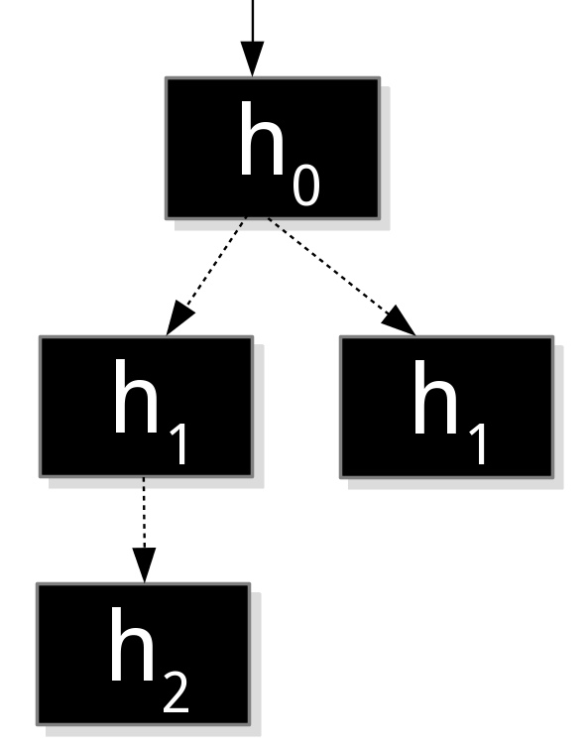
POMCP [Silver&Veness 2010 NIPS]
Same tree!
(but now in
more detail)
Still a state-of-the-art online planner for POMDPs
Monte Carlo Tree Search algorithm (a form of UCT)
  Lookahead search on tree of histories
  Nodes function as 'particle filters'
h₀ (now)
a₀
a_{k}
a₁
a₂
o₀
o₁
o₀
h₁ = h₀a₀o₀
h₁' = h₀a₀o₁
h₁'' = h₀a₂o₀

Slide 42
POMCP – example
{s_{a},s_{b},s_{c},s_{d}}
s_{d}
a₀
a₁
o₀
o₁
o₀
{s_{e}}
{s_{b}}
{s_{a}}

Slide 43
POMCP – example
{s_{a},s_{b},s_{c},s_{d},s_{d}}
s_{d}~b₀
a₀
a₁
o₀
o₁
o₀
{s_{e}}
{s_{b}}
{s_{a}}

Slide 44
POMCP – example
{s_{a},s_{b},s_{c},s_{d},s_{d}}
a₀
a₁
o₀
o₁
o₀
{s_{e}}
{s_{b}}
{s_{a},s_{f}}
s_{f}
a₀
o₁
{s_{b}}
s_{b}~T(.|s_{f},a₀)

Slide 45
POMCP – example
{s_{a},s_{b},s_{c},s_{d},s_{d}}
a₀
a₁
o₀
o₁
o₀
{s_{e}}
{s_{b}}
{s_{a},s_{f}}
a₀
o₁
{s_{b}}

Slide 46
POMCP – example
{s_{a},s_{b},s_{c},s_{d},s_{d}}
a₀
a₁
o₀
o₁
o₀
{s_{e}}
{s_{b}}
{s_{a},s_{f}}
a₀
How are the actions chosen in the tree?
  use stored statistics of the returns
  optimistically: chose action that has chance of being best one
o₁
{s_{b}}
upper
confidence
bound
mean return
exploration bonus

Slide 47
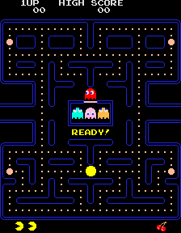
POMCP Summary
Successful:
  larger problems as before
  including Pac-man and Atari
but... requires simulator!

Slide 48
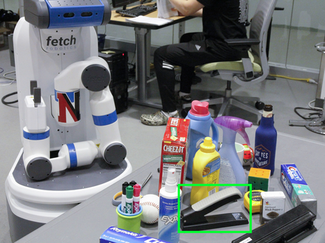
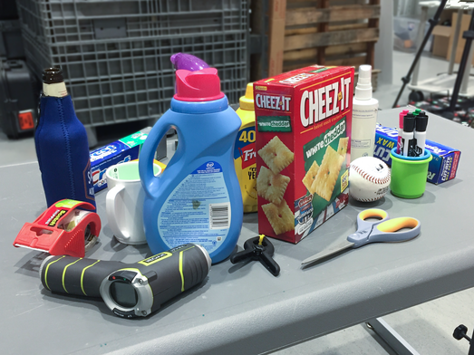
Example domain: target object search in clutter (ICRA-19)
Uncertainties (due to noisy perception and intricate occlusions):
► Locating each object
► Recognizing each object
► Manipulation outcome
Goal: the robot has to reason about the potential locations of the target object (stapler); move around and manipulate objects in an efficient manner to fetch the target under the uncertainties mentioned above.
Notes:
Searching for a specific object in a cluttered scene is a common task in our daily lives.

Slide 49
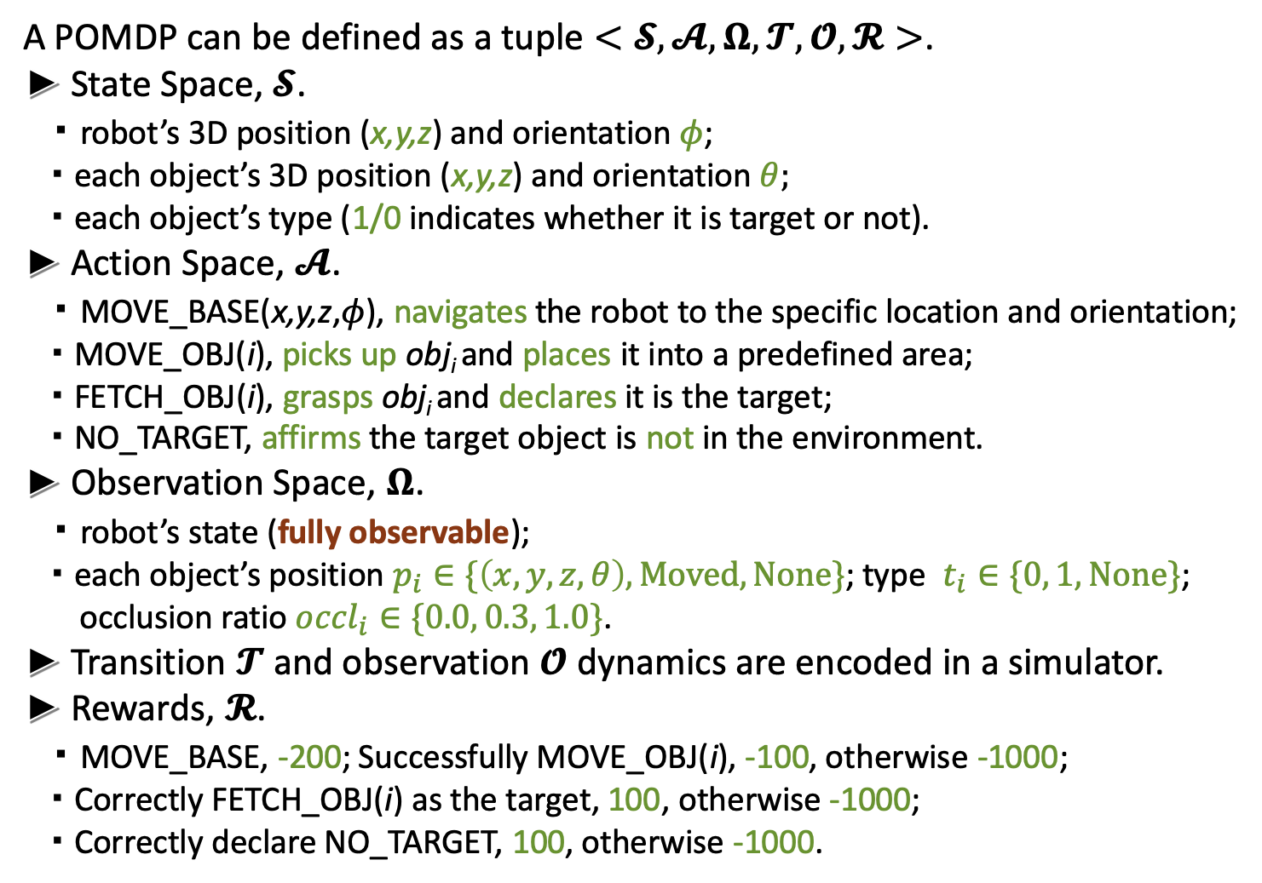
POMDP formulation
A POMDP can be defined as a tuple $<𝓢, 𝓐, Ω, 𝓣, 𝓞, 𝓡>$.
► State Space, $𝓢$.
・robot’s 3D position (x,y,z) and orientation $φ$;
・each object’s 3D position (x,y,z) and orientation $θ;$
・each object’s type (1/0 indicates whether it is target or not).
► Action Space, $𝓐$.
・MOVE_BASE(x,y,z,$φ$), navigates the robot to the specific location and orientation;
・MOVE_OBJ(i), picks up obj_{i} and places it into a predefined area;
・FETCH_OBJ(i), grasps obj_{i} and declares it is the target;
・NO_TARGET, affirms the target object is not in the environment.
► Observation Space, $Ω$.
・robot’s state (fully observable);
・each object’s position $p_{i}∈\{\left(x,y,z, θ\right),Moved, N\text{one}\text{\}}$; type $t_{i}∈\{0, 1, N\text{one}\text{\}}$;
occlusion ratio ${occl}_{i}∈\{0.0, 0.3, 1.0\}$.
► Transition $𝓣$ and observation $𝓞$ dynamics are encoded in a simulator.
► Rewards, $𝓡$.
・MOVE_BASE, -200; Successfully MOVE_OBJ(i), -100, otherwise -1000;
・Correctly FETCH_OBJ(i) as the target, 100, otherwise -1000;
・Correctly declare NO_TARGET, 100, otherwise -1000.
Notes:
In oder to solve this task and deal with the uncertainties mentioned in the previous slide, we model this problem as pomdp.

Slide 50
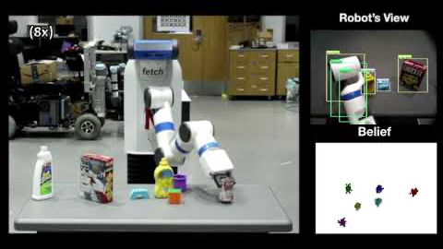
Target object search

Slide 51
Partially observable RL (PORL)
What about extending RL to the POMDP case?
Markov property rarely holds…
→ So PORL seems pretty important!
But… also difficult… let’s give it a try...

Slide 52
PORL example
your action: A1, A2, or A3?

Slide 53
PORL example
your action: A1, A2, or A3? → A3

Slide 54
PORL example
your action: A1, A2, or A3? → A3
returned: -100, O1

Slide 55
PORL example
your action: A1, A2, or A3? → A3
returned: -100, O1
your action: A1, A2, or A3?

Slide 56
PORL example
your action: A1, A2, or A3? → A3
returned: -100, O1
your action: A1, A2, or A3? → A1

Slide 57
PORL example
your action: A1, A2, or A3? → A3
returned: -100, O1
your action: A1, A2, or A3? → A1
returned: -1, O2

Slide 58
PORL example
your action: A1, A2, or A3? → A3
returned: -100, O1
your action: A1, A2, or A3? → A1
returned: -1, O2
your action: A1, A2, or A3?

Slide 59
PORL example
your action: A1, A2, or A3? → A3
returned: -100, O1
your action: A1, A2, or A3? → A1
returned: -1, O2
your action: A1, A2, or A3? → A1

Slide 60
PORL example
your action: A1, A2, or A3? → A3
returned: -100, O1
your action: A1, A2, or A3? → A1
returned: -1, O2
your action: A1, A2, or A3? → A1
returned: -1, O2

Slide 61
PORL example
your action: A1, A2, or A3? → A3
returned: -100, O1
your action: A1, A2, or A3? → A1
returned: -1, O2
your action: A1, A2, or A3? → A1
returned: -1, O2
your action: A1, A2, or A3?

Slide 62
PORL example
your action: A1, A2, or A3? → A3
returned: -100, O1
your action: A1, A2, or A3? → A1
returned: -1, O2
your action: A1, A2, or A3? → A1
returned: -1, O2
your action: A1, A2, or A3? → A2

Slide 63
PORL example
your action: A1, A2, or A3? → A3
returned: -100, O1
your action: A1, A2, or A3? → A1
returned: -1, O2
your action: A1, A2, or A3? → A1
returned: -1, O2
your action: A1, A2, or A3? → A2
returned: +10, O1

Slide 64
PORL example
your action: A1, A2, or A3? → A3
returned: -100, O1
your action: A1, A2, or A3? → A1
returned: -1, O2
your action: A1, A2, or A3? → A1
returned: -1, O2
your action: A1, A2, or A3? → A2
returned: +10, O1
your action: A1, A2, or A3?

Slide 65
PORL example
your action: A1, A2, or A3? → A3
returned: -100, O1
your action: A1, A2, or A3? → A1
returned: -1, O2
your action: A1, A2, or A3? → A1
returned: -1, O2
your action: A1, A2, or A3? → A2
returned: +10, O1
your action: A1, A2, or A3? → A2

Slide 66
PORL example
your action: A1, A2, or A3? → A3
returned: -100, O1
your action: A1, A2, or A3? → A1
returned: -1, O2
your action: A1, A2, or A3? → A1
returned: -1, O2
your action: A1, A2, or A3? → A2
returned: +10, O1
your action: A1, A2, or A3? → A2
returned: -100, O1

Slide 67
PORL example
your action: A1, A2, or A3? → A3
returned: -100, O1
your action: A1, A2, or A3? → A1
returned: -1, O2
your action: A1, A2, or A3? → A1
returned: -1, O2
your action: A1, A2, or A3? → A2
returned: +10, O1
your action: A1, A2, or A3? → A2
returned: -100, O1
Fun, eh?

Slide 68
PORL example
=OpenRight
=HearLeft
=Listen
=HearRight
=Listen
=HearRight
=OpenLeft
=HearLeft
=OpenLeft
=...
your action: A1, A2, or A3? → A3
returned: -100, O1
your action: A1, A2, or A3? → A1
returned: -1, O2
your action: A1, A2, or A3? → A1
returned: -1, O2
your action: A1, A2, or A3? → A2
returned: +10, O1
your action: A1, A2, or A3? → A2
returned: -100, O1

Slide 69
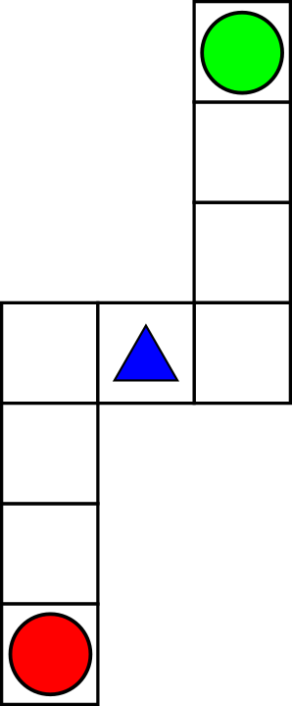
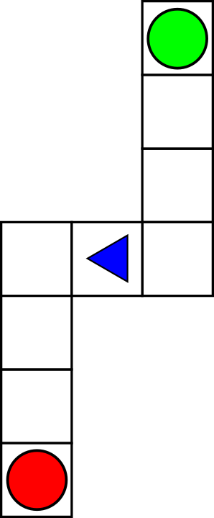
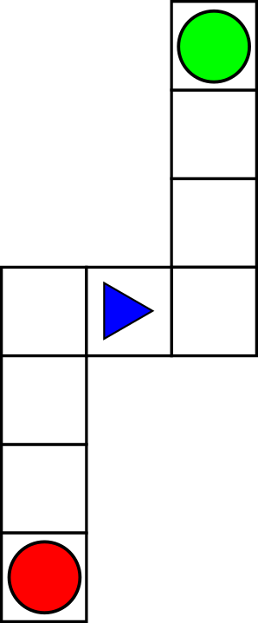
Histories - Why Actions?
Question: Agent chooses actions, they are not observations of state Do we actually need them?
Answer: Yes, actions may influence unobserved part of state
(a) Starting state. (b) Left turn. (c) Right turn.
Figure: Spiral problem where action-memory is necessary.
In Practice:
Highly dependent on problem and action semantics
  Generic case: Strictly necessary
  Special case: Plausibly unnecesaary and ignorable

Slide 70
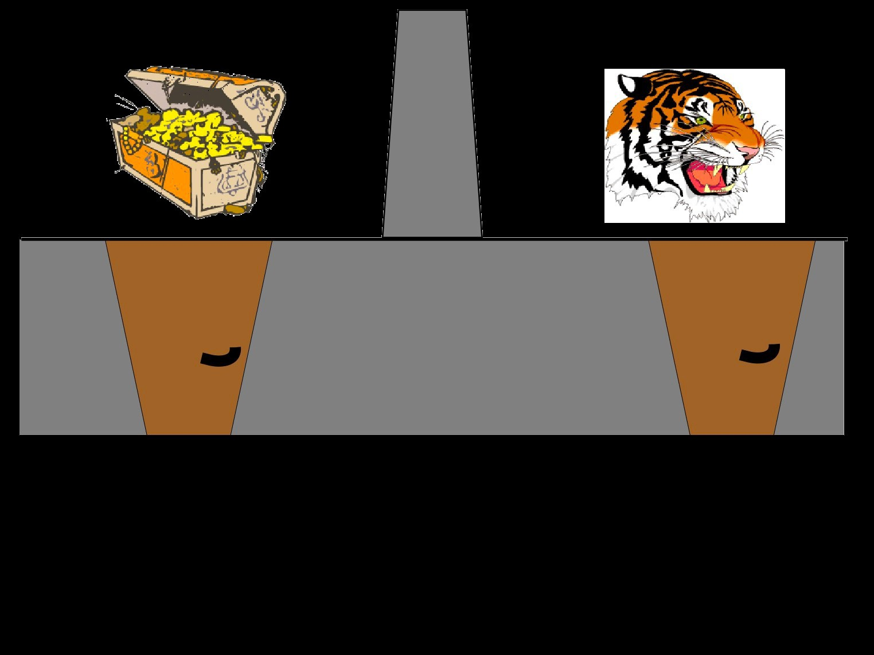
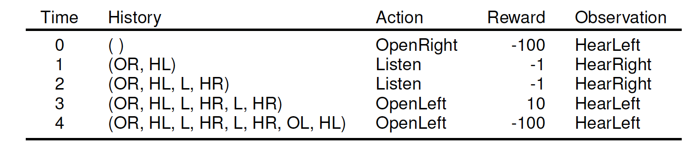
Agent POV Example
Figure: Tiger problem¹.
Table: Tiger Problem POV.
Keypoints:
Unlikely seeing same histories enough times to learn (despite tiny size)
• Hard to interpret long sequences despite semantics
¹ (Possibly recursive) image credit to Chris Amato’s PORL slides.

Slide 71
Beliefs
Belief: Distribution over states given observed history
Belief Space B = ∆S
Concatenation notation bao = (∗b, a, o)
POMDP initial belief p ∈ B, prior to any observation
.
Notation overload: b : H → ∆S, likelihood of s given observed history h
.
b(h, s) = Pr(s | h)
Belief-based Control:
Belief policy π : B → ∆A
Belief values via Bellman equations
V ^{π} (b) = E_{a∼π(b)} [R(b, a) + γ E_{o|b,a} [V ^{π} (bao)]]
(7)
(8)
Q^{π} (b, a) = R(b, a) + γ E_{o|b,a} [E_{a}′_{∼π(bao)} [Q^{π} (bao, a′)]]
R(b, a) = Es∼b [R(s, a)]
where
.
(9)
(10)
L
′ ′
Pr(o | b, a) = b(s)T (s, a, s )O(s , a, o)
s,s′

Slide 72
Belief Update
Rules: Just Bayes’ rule
po(s) ∝ p(s)O(s, o)
(11)
( !
L
′ ′ ′
bao(s ) ∝ b(s)T (s, a, s ) O(a, s , o)
(12)
s
In practice:
Discrete state space S ≡ {si}^{n}
i=1
=⇒ Tensor operations, exact recursive update
Continuous state space, linear dynamic system, e.g.
st+1 = Ftst + Btat + wt ot = Htst + vt
(13)
(14)
=⇒ Kalman filter, exact recursive update on µ = E [s | h] , Σ = C [s | h]
General system
=⇒ Particle filter {sk}^{K} , approximate sample-based update
k=1
Particles {sk}^{K} + rejection sampling → {s′ }^{K}
k=1 k k=1
Particles {sk, wk}^{K} + importance sampling → {s′ , w′ }^{K}
k=1 k k k=1

Slide 73
DRQN: A simple model-free approach
Deep Recurrent Q-Networks
Deep Q-Networks (DQN) (Mnih et al., Nature 15) uses a neural net for function approximation
DRQN (Hausknecht and Stone, arXiv 15) adds a recurrent layer for memory
Idea: don’t stack states (who knows how many you’ll need), but train a recurrent network to some abstraction of history

Slide 74
Deep Recurrent Q-Networks (DRQN) (Hausknecht and Stone, 2015)
Control Problem: Flickering Atari, frame obscured with p = 50%
Approach: Ditch frame stacking, employ RNNs!
Theoretical “infinite” memory!
Vanishing gradients problem
  LSTMs (Hochreiter and Schmidhuber, 1997)
  GRUs (Cho et al., 2014)
Keypoints:
Use RNN to combine all observation information over time, ϕ(h)
Combine RNN with any deep RL method, PO “solved”!
Limitations:
Training RNNs is slow and requires A LOT of data
Vanishing gradient still a problem for LSTMs and GRUs
RNNs may not easily learn good history representations just via RL

Slide 75
DRQN
Basic idea: Add a recurrent layer in your network
This is one example for Atari ->
Everything else (i.e., replay buffer, target network) is the same, but now train on sequences rather than single (o,a,o’,r) tuples

Slide 76
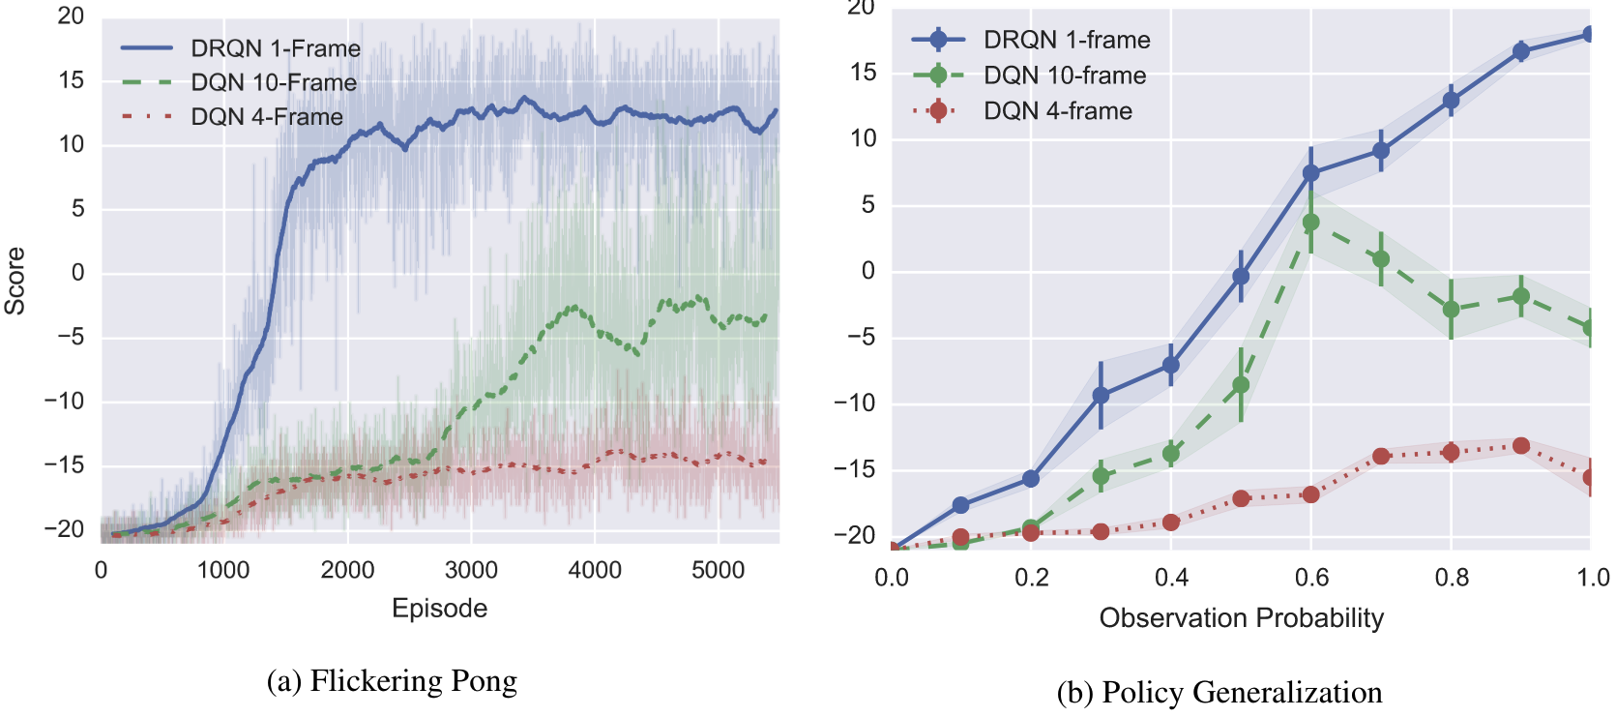
DRQN results
Stacking works fine in most Atari games, but not all
When there is more partial observability DRQN helps even more

Slide 77
DRQN
Can add recurrent layers to any deep RL method (e.g., RA3C, RPPO)
A simple idea that can often help deal with partial observability
But…
Training recurrent networks is slow
LSTMs/GRUs etc. may not be able to learn good history representations in this way

Slide 78
Deep RL for POMDPs
Helps scale to large state/observation spaces, but doesn’t solve other problems
  Sample efficiency/online learning
  Dealing with partial observability

Slide 79
Stateful PORL
Groundbreaking new idea: Let’s use state in PORL!
... ... Wait, what?
State available at training time:
Agent learning algorithm uses state to improve agent policy
Agent policy does not use state to select actions

Slide 80
Stateful PORL - Offline RL
Training with static dataset:
FO dataset D = {(si, ai, ri, s′ )}^{N}
i
i
PO dataset D = {(hi, ai, ri, oi, ri)}^{N}
i
PO+state dataset D = {(hi, si, ai, ri, s′, oi, ri)}^{N}
i
i
Training with dynamic simulator:
Exploit simulated state representation
Other practical advantages: Physical safety, training efficiency
Other practical concerns (sim-to-real):
  State completeness (e.g., missing variables)
  Observation realism (e.g., out-of-distribution issues)
  Dynamics accuracy (e.g., impossible transitions, collisions, clipping)
Multi-agent: Centralized Training for Decentralized Execution (CTDE)
Single-agent: Offline Training for Online Execution (OTOE)
Question: How to use state (correctly) to improve history-policy?

Slide 81
Stateful PORL - Asymmetric Actor-Critic
“Asymmetric Actor Critic for Image-Based Robot Learning” (Pinto et al., 2018)
Goal: Robot control from images
Topics:
Robotic manipulation: Pick-n-place, push, move, etc.
Vision based control: Third POV of workspace
Goal based control (with explicit goal representation)
Sim-to-real: Transfer from simulated training to real environment
Asymmetric training: Exploit (compact) simulator state for training
Asymmetric Training:
History policy constrained by problem definition
π : H → ∆A, where H ≡ history of images
State critic as training construct, not used during execution
V^{ˆ} : S → R, where S ≡ simulator internal state

Slide 82
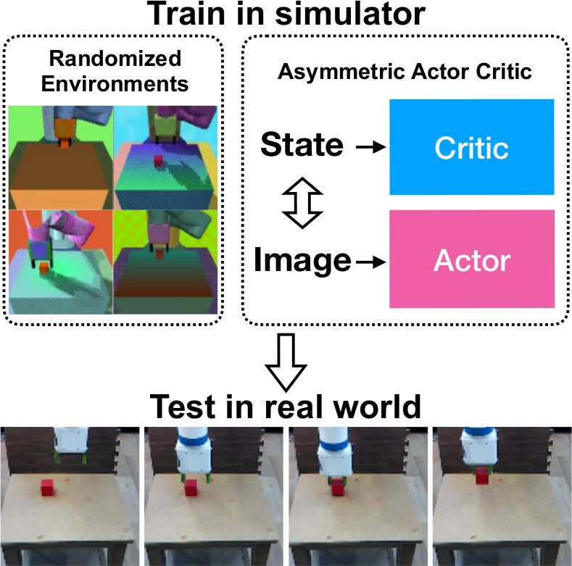
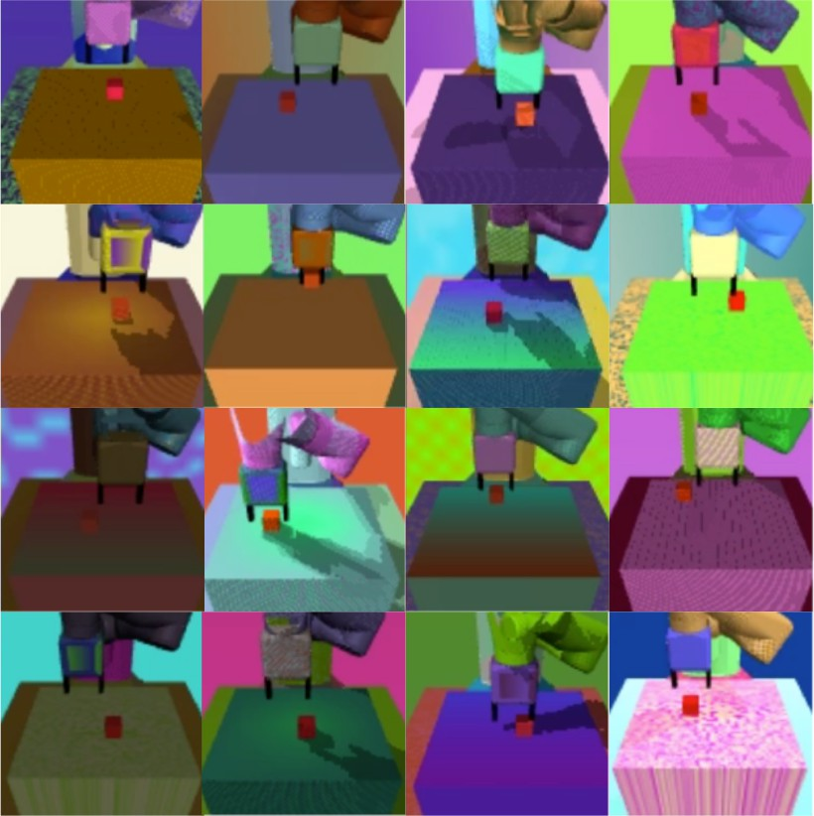
Stateful PORL - Asymmetric Actor-Critic
“Asymmetric Actor Critic for Image-Based Robot Learning” (Pinto et al., 2018)
(a) Asymmetric training framework⁵ .
(b) Randomized simulated environments⁵ .
⁵ (Pinto et al., 2018)

Slide 83
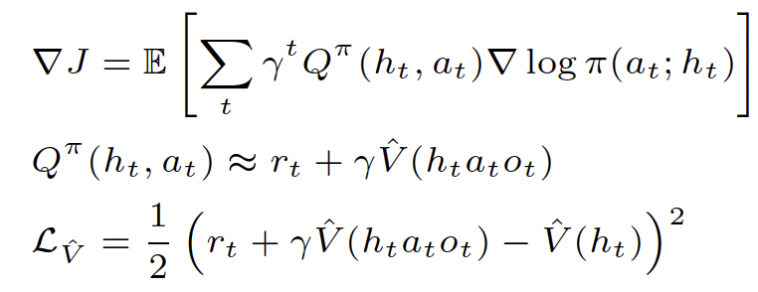
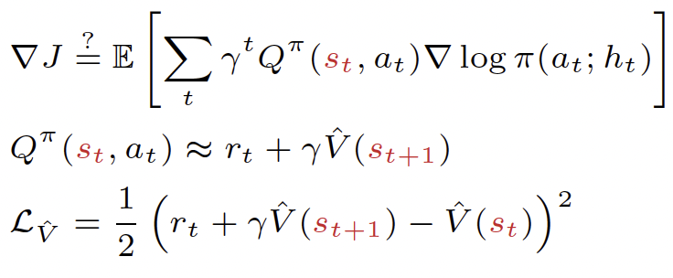
Stateful PORL - Asymmetric Actor-Critic
“Asymmetric Actor Critic for Image-Based Robot Learning” (Pinto et al., 2018)
(Symmetric) Actor-Critic:
Asymmetric Actor-Critic:
Question: Does the asymmetric ∇J =? equality hold?
Answer: Not in general!
Can work in practice (e.g., for reactive control, as in paper!)
But concerning theoretical issues re: partial observability

Slide 84




Bias Example – Noisy Beverage (from Xueguang Lyu)
🍵
🍵❗️
😑
🍵/☕❓
💁‍♂️
😌
😑
🍵
🍵
💵
💁‍♂️
💁‍♂️
🍵❗️
😑
☕
25%
😑
🍵/☕❓
☕❗️
💁‍♂️
😑
75%
Notes:
Now we make the beverage domain more realistic.
[click] Our barista can now ask the customer what he wants, [click] and the customer can say either tea or coffee, [click] you then can serve the drink with that information.
Interestingly, the customer is erratic, [click] only disclosing his true preference say 75% percent of the time, so it may be the case that the agent has to ask multiple times until say hearing a consistent answer two or third time in a row just to make sure.
of course let’s say there is a small time penalty otherwise we might be asking for his preference forever.

Slide 85
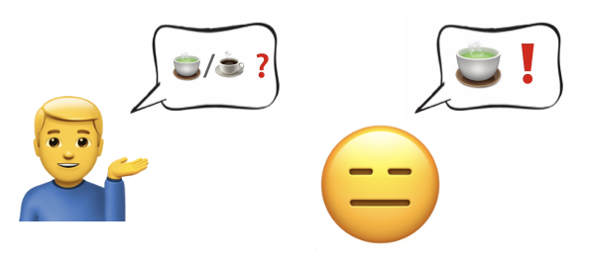

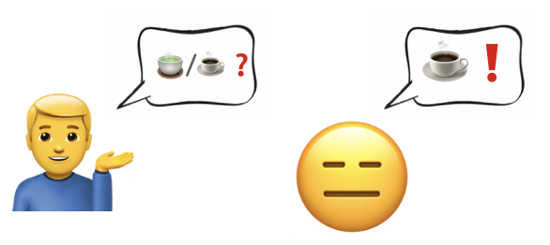
History values
Q(
,
) =
💵
Q(
,
) =
💵
Q(
,
) =
💵
Q(
,
) =
💵
Notes:
Let’s say we have a relatively good policy, which serves after hearing three consistent consecutive answers
if we look at Q values for the “asking” action, we would get those history values and state values.
[go though each one]

Slide 86
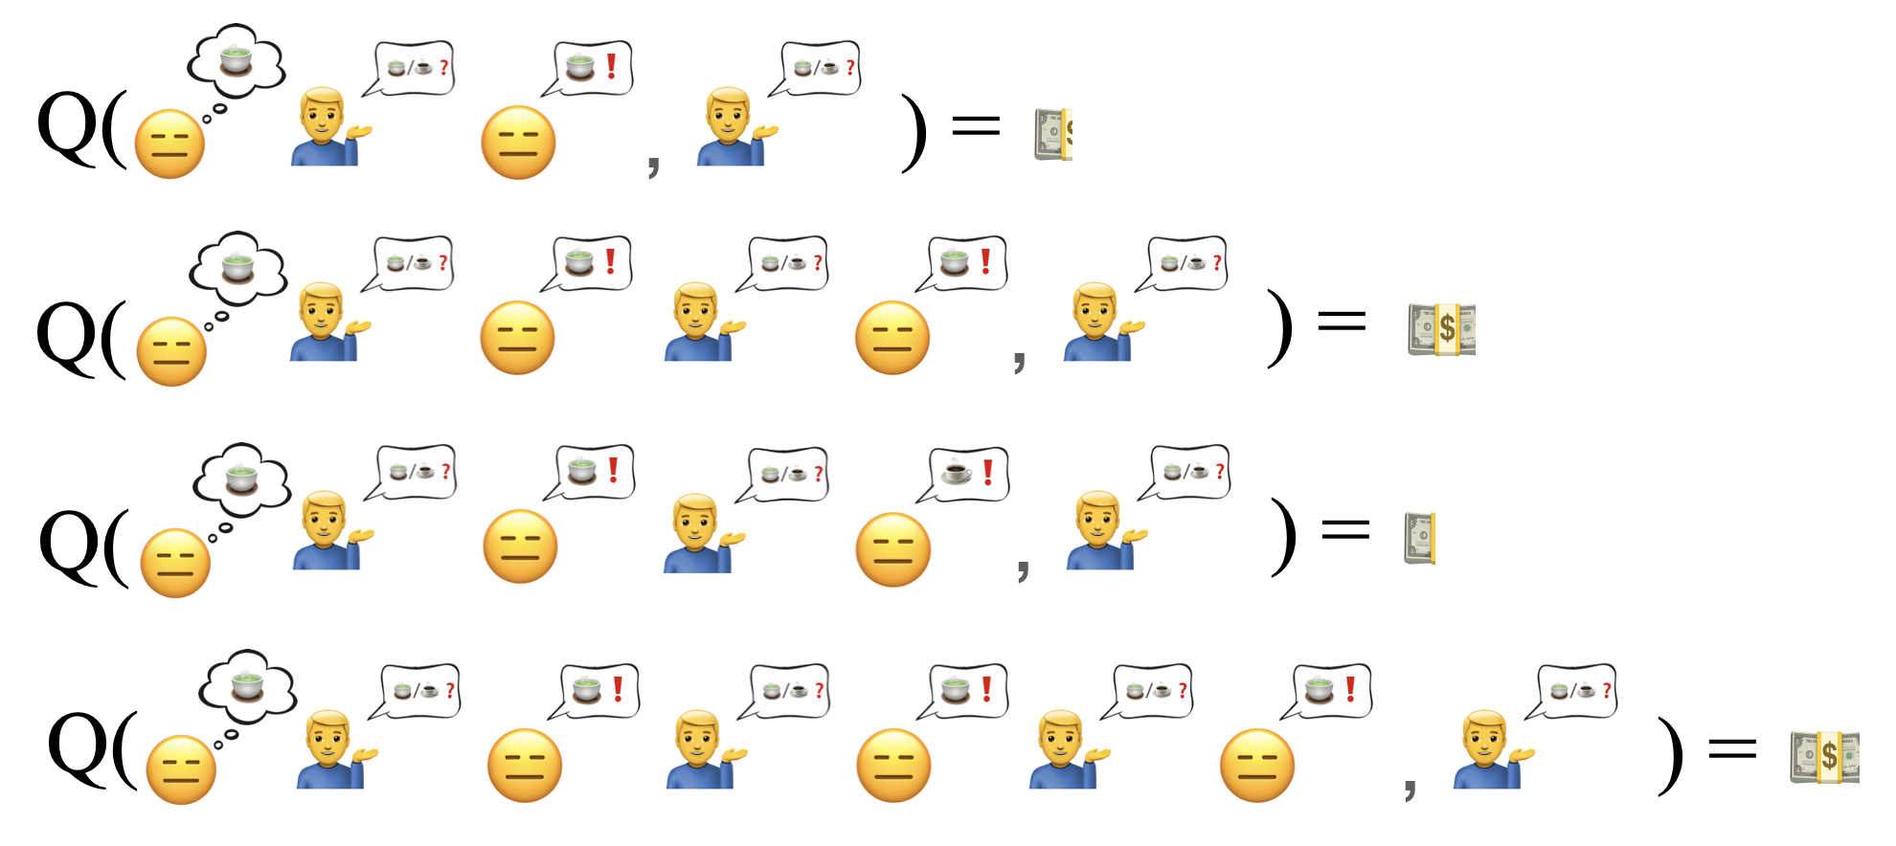

State values
Q(
,
) =
…
Q(
,
) =
💵
= Q(
,
)
State value cannot represent the value of a particular history
Notes:
[click] Remember, the state values are weighted sum of state history values. For example, let’s look at the state of customer wanting tea, and let’s say the underlying state of those values on the right have this underlying state. [click] The state value is just then the weighted average of those values, weighted by the probability of each individual history, of course.
[click] Now, because we are not at advantage whether the customer wants tea or coffee, assuming our policy does not bias against either type of customer, the value of customer wanting coffee have the same overall value.
Now if you think about it, the strategy of making-sure means you are trying to decrease your uncertainty on the underlying state, effectively increasing your chance of getting that dollar. So if we get consist answers from our client, we ought to increase our value estimate and vise versa. Now if you think about learning this policy, it requires our our confident to be reflected in history values, so that the action of asking becomes appealing when we need to gather information. It is clear that the optimal policy cannot be learned from those constant state values.
So remember for policy updates, you go with the estimated value.
The history values tells you, oh if you are confident of the true customer preference, you are to expect a higher return.
The state value tells you that no matter what you hear from the customer, at any point in time, how sure or unsure you are, the value does not change. Imagine how hard it is to learn from that.
In other words, we see key distinction here is that the state values does not factor in the uncertainty, but, as you can see, being able to deal with uncertainty is kinda crucial in partially observable domains like serving tea or coffee.

Slide 87
State values
Q(
,
) =
…
Q(
,
) =
💵
= Q(
,
)
Proofs in the paper
Notes:
[click] Remember, the state values are weighted sum of state history values. For example, let’s look at the state of customer wanting tea, and let’s say the underlying state of those values on the right have this underlying state. [click] The state value is just then the weighted average of those values, weighted by the probability of each individual history, of course.
[click] Now, because we are not at advantage whether the customer wants tea or coffee, assuming our policy does not bias against either type of customer, the value of customer wanting coffee have the same overall value.
Now if you think about it, the strategy of making-sure means you are trying to decrease your uncertainty on the underlying state, effectively increasing your chance of getting that dollar. So if we get consist answers from our client, we ought to increase our value estimate and vise versa. Now if you think about learning this policy, it requires our our confident to be reflected in history values, so that the action of asking becomes appealing when we need to gather information. It is clear that the optimal policy cannot be learned from those constant state values.
So remember for policy updates, you go with the estimated value.
The history values tells you, oh if you are confident of the true customer preference, you are to expect a higher return.
The state value tells you that no matter what you hear from the customer, at any point in time, how sure or unsure you are, the value does not change. Imagine how hard it is to learn from that.
In other words, we see key distinction here is that the state values does not factor in the uncertainty, but, as you can see, being able to deal with uncertainty is kinda crucial in partially observable domains like serving tea or coffee.

Slide 88
Stateful PORL - Theory of Stateful Values
Table: Theoretical properties of value functions.
“Unbiased Asymmetric Reinforcement Learning under Partial Observability” (Baisero and Amato, 2022)
Observations | Policy | Value | Well Defined | Unbiased
Generic o ∼ O(a, s) | History π(h) | V ^{π} (h) | ✓ | ✓
 |  | V ^{π} (s)
 |  | V ^{π} (s, o)
 |  | V ^{π} (h, s) | ✓ | ✓
 |  | V ^{π} (h, z) | ✓ | ✓
Generic o ∼ O(a, s) | Reactive π(o) | V ^{π} (h) | ✓ | ✓
 |  | V ^{π} (s)
 |  | V ^{π} (s, o) | ✓ | ✓
 |  | V ^{π} (h, s) | ✓ | ✓
 |  | V ^{π} (h, z) | ✓ | ✓
Reactive o ∼ O(s) | Reactive π(o) | V ^{π} (h) | ✓ | ✓
 |  | V ^{π} (s) | ✓
 |  | V ^{π} (s, o) | ✓ | ✓
 |  | V ^{π} (h, s) | ✓ | ✓
 |  | V ^{π} (h, z) | ✓ | ✓
Reactive o ∼ O(s), w/o aliasing | Reactive π(o) | V ^{π} (h) | ✓ | ✓
 |  | V ^{π} (s) | ✓ | ✓
 |  | V ^{π} (s, o) | ✓ | ✓
 |  | V ^{π} (h, s) | ✓ | ✓
 |  | V ^{π} (h, z) | ✓ | ✓

Slide 89
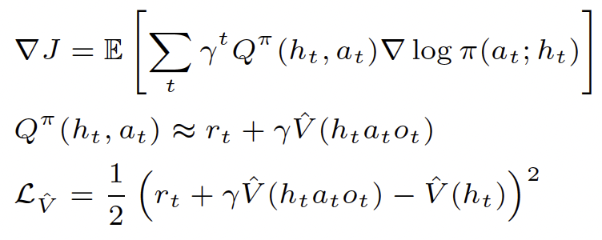
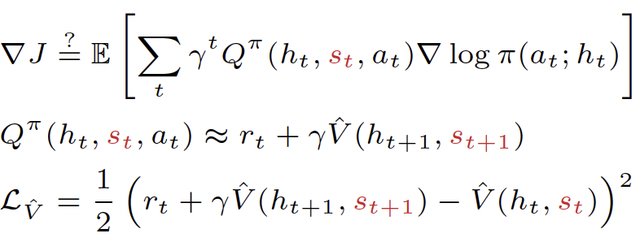
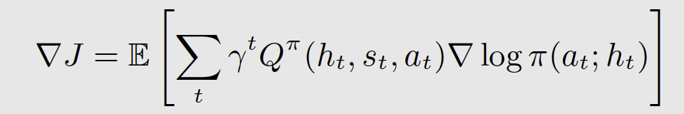
Stateful PORL - Unbiased Asymmetric Actor-Critic
“Unbiased Asymmetric Reinforcement Learning under Partial Observability” (Baisero and Amato, 2022)
(Symmetric) Actor-Critic: (Unbiased) Asymmetric Actor-Critic:
Question: Does the asymmetric ∇J =? equality hold?
Theorem (Stateful Policy Gradient)
(25)
Keypoints:
Applicable to generic non-reactive problems and policies
Small implementation change, huge empirical advantages

Slide 90
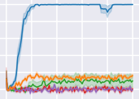
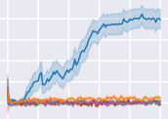
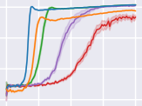
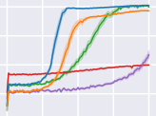
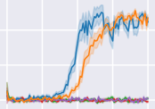
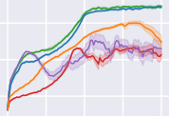
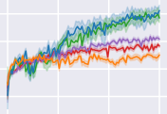
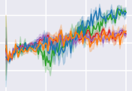
Stateful PORL - Unbiased Asymmetric Actor-Critic
“Unbiased Asymmetric Reinforcement Learning under Partial Observability” (Baisero and Amato, 2022)
A2C-asym-hs A2C-asym-s A2C A2C-react-2 A2C-react-4
1.0
0.8
0.6
0.8
0 0
0.6
−50
−50
0.4
0.4
−100
0.2
0.0
0.2
−100
0.0
−150
0 2 M 4 M 6 M 8 M 10 M 0 2 M 4 M 6 M 8 M 10 M
Timestep Timestep
(a) Heaven-Hell-3 (b) Heaven-Hell-4
−150
0
500 k 1 M 1.5 M 2 M
Timestep
0 500 k 1 M 1.5 M 2 M
Timestep
(c) Shopping-5
(d) Shopping-6
2
0
0.4
60
0
−2
0.2
40
−2
−4
−4
0.0
20
0 1 M 2 M 3 M 4 M 0 1 M 2 M 3 M 4 M
Timestep Timestep
(e) Car-Flag (f) Cleaner
0
2 M
Timestep
4 M
6 M 0
2 M
Timestep
4 M
6 M
(g) Memory-Four- Rooms-7x7
(h) Memory-Four- Rooms-9x9
Figure: Learning performance curves of episodic returns averaged over the last 100 episodes, with statistics computed over 20 independent runs. Shaded areas are centered around the empirical mean and show one standard error of the mean.

Slide 91
Next time
Multi-Agent RL!

