Slide 1
7170: Seminar on (Cooperative) Multi-Agent Reinforcement Learning Chris Amato Northeastern University
Notes:
1

Slide 2
Some logistics
Class webpage: https://www.ccs.neu.edu/home/camato/7170summaryF25.html
Will be updated
Office hours
Chris: Monday after class (~1:30-3pm) or by Appt. in ISEC 522
No TAs (just me)
Questions: email or Teams me

Slide 3
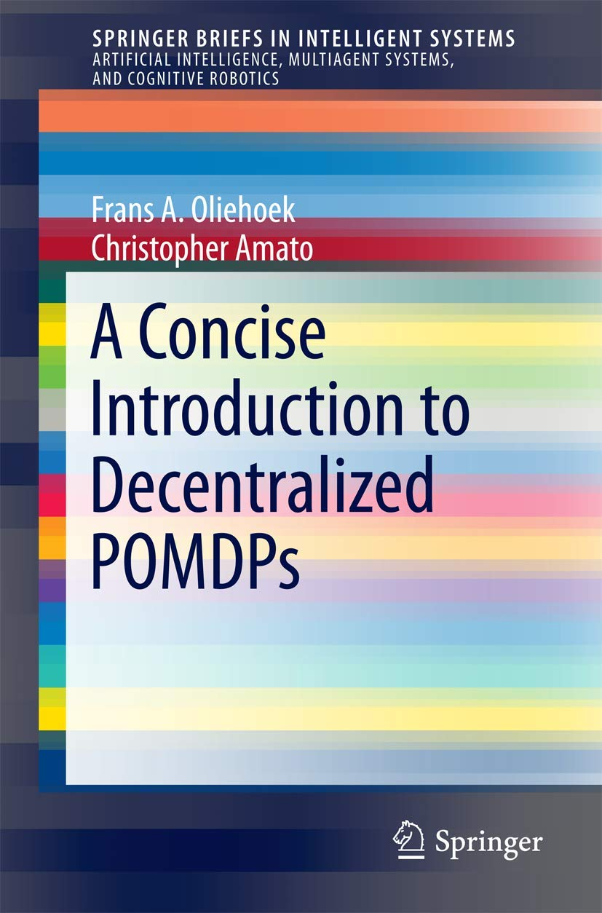
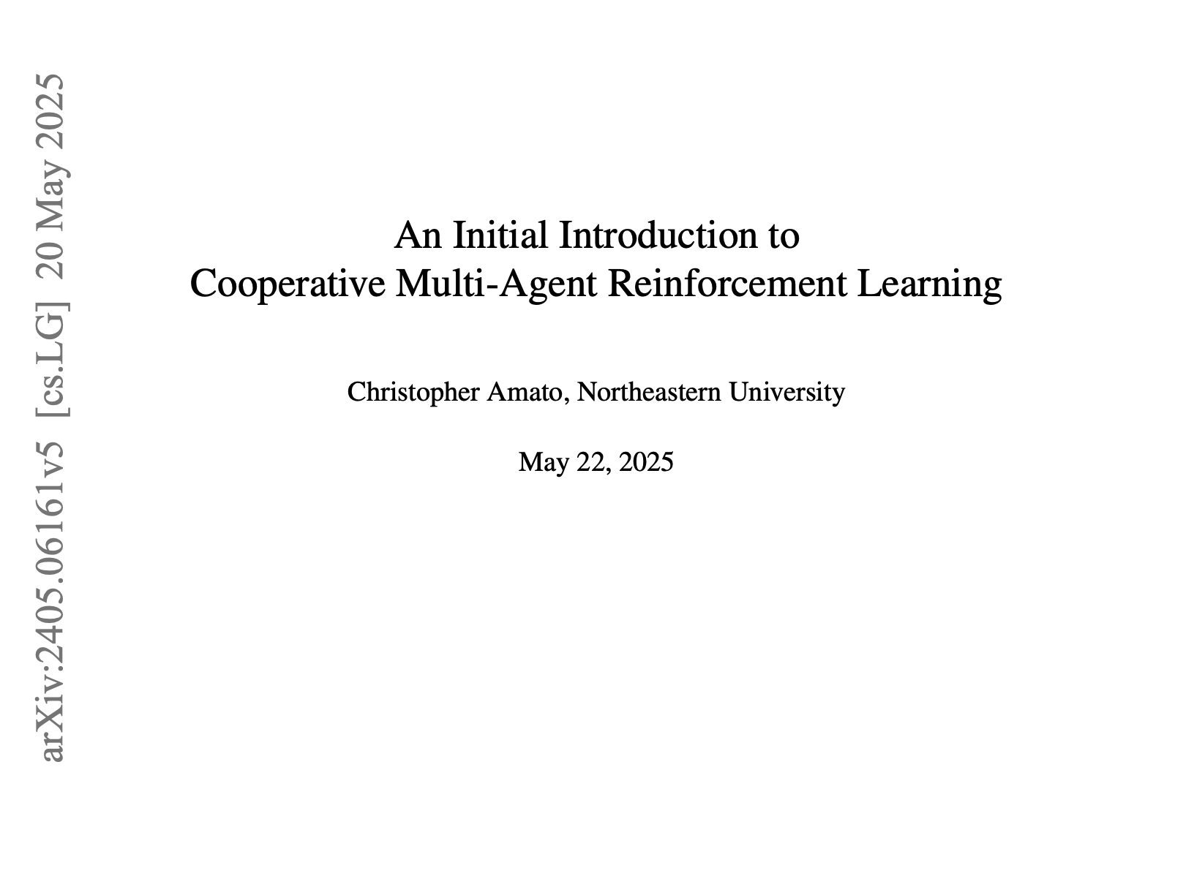
Books
Intro:
Reinforcement Learning: An Introduction (2nd edition), http://incompleteideas.net/book/the-book-2nd.html
The problem
https://www.khoury.northeastern.edu/home/camato/publications/OliehoekAmato16book.pdf
Book in progress
https://arxiv.org/abs/2405.06161
Extra
We’ll supplement with papers and other text for more advanced material

Slide 4
Overview
Class goal: Learning the principles and algorithms of (cooperative) multi-agent reinforcement learning (MARL)
Combination of lecture and reading papers (that you will present)
Geared for PhD students
Not coding focused

Slide 5
Grades
Participation in class
Paper presentations
Peer feedback on presentations
Pros/Cons summary for each paper
Final project (submission and presentation)

Slide 6
Class Project
Let’s do something useful for the community!
Benchmarking state-of-the-art MARL algorithms on new domains
Literature review of a subarea without a survey
Tutorial on some aspect of MARL
New environment that adds something that is currently missing
Will be on the website for the book!

Slide 7
Grading
Paper presentations: 50%
Paper summaries: 15%
Participation: 10%
Final project (presentation and paper): 25%

Slide 8
Background
Expected to have some RL background already
Should also have a strong math (probability, calculus, linear alg) background to keep up
Strong coding is needed for many projects

Slide 9
Possible schedule
November: Paper presentations (7 days)
Topics to be decided!
December: Projects
Project presentations 12/1-8
Project due 12/10
September: Lecture/Discussion
RL review (1 or 2 classes)
Partially observable RL
Basics of Decentralized MARL, Centralized MARL, and Centralized Training for Decentralized Execution (CTDE)
October: Paper presentations (8 days)
Exploration
Communication
New methods

Slide 10
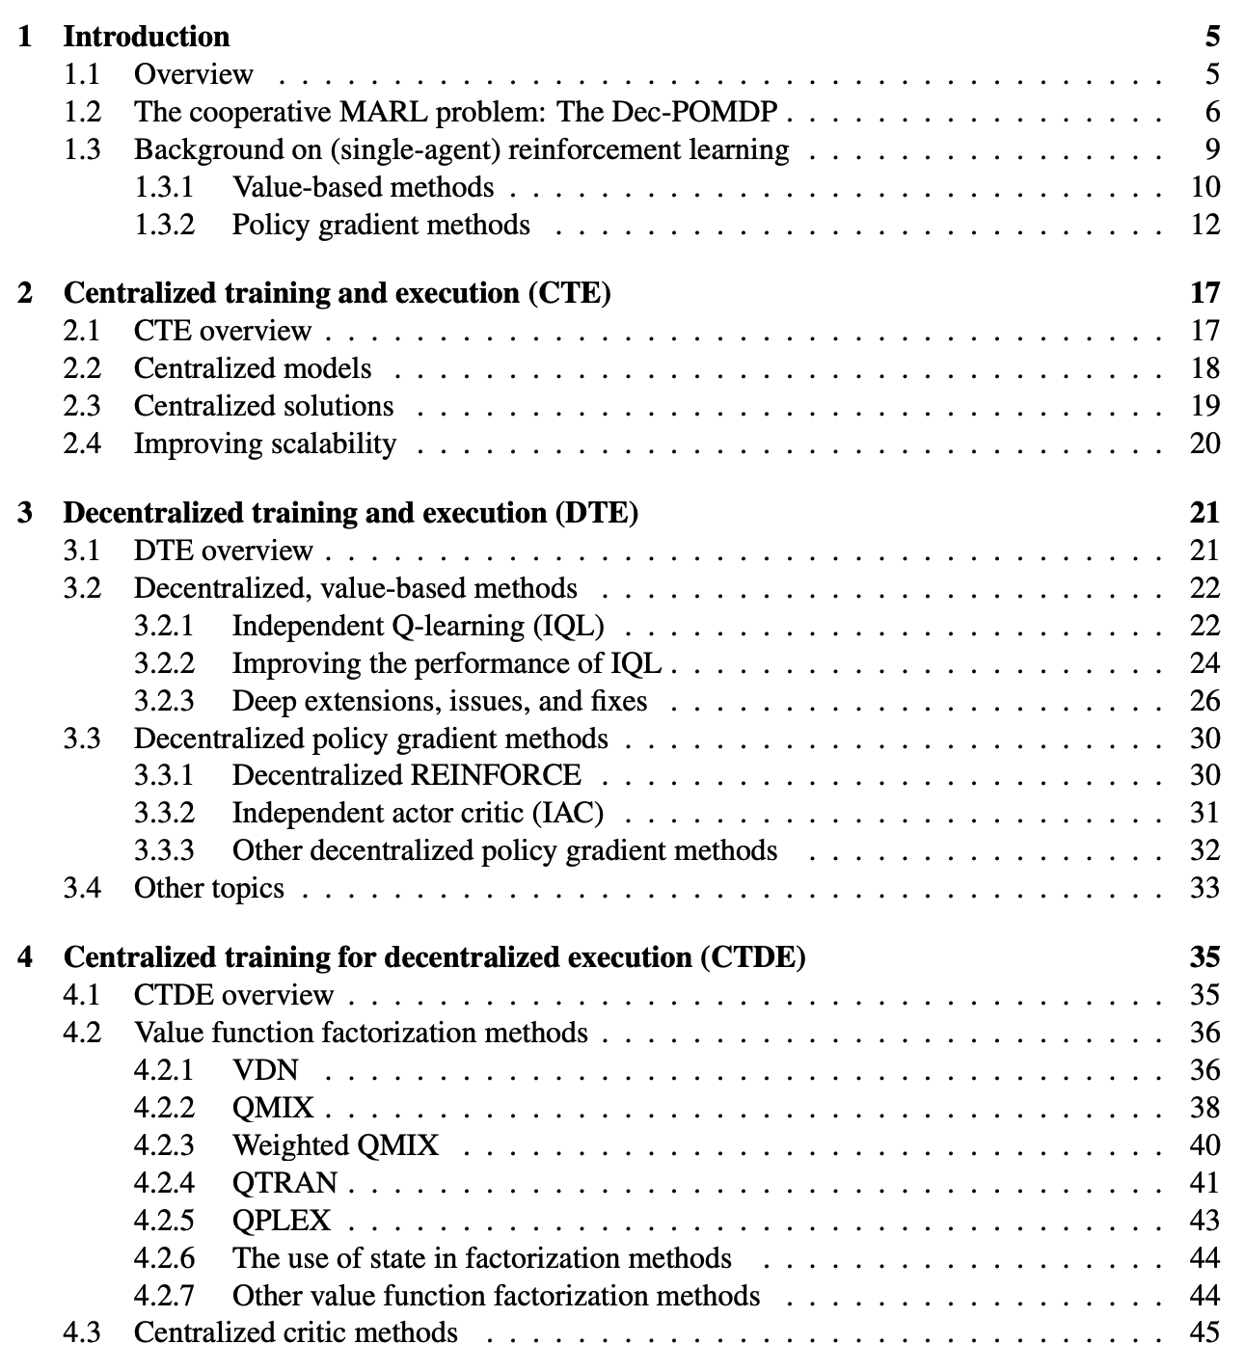
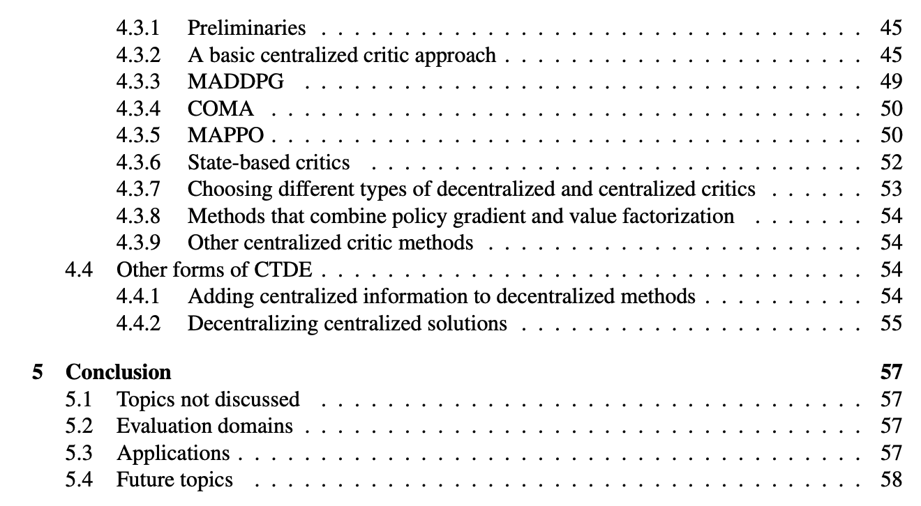
MARL book ToC

Slide 11
Plan
15 days of paper presentations
Maybe 2 per day (~50 minutes each)
30 slots people can sign up for (e.g., with 10 students this is 3 slots)
Everyone will have read the paper so short overview (~15 minutes) and then discussion of pros/cons (~35 minutes)
Organized per topic
I’ll make a list of possible papers but other suggestions are welcome

Slide 12
Paper reviews
For each paper, everyone will write a short review
Some guides for reviewing papers
https://homes.cs.washington.edu/~mernst/advice/meier-paper.review.html
https://eliassi.org/fong-sigcse.pdf
For this class just 1 paragraph each of:
Summary
Pros
Cons

Slide 13
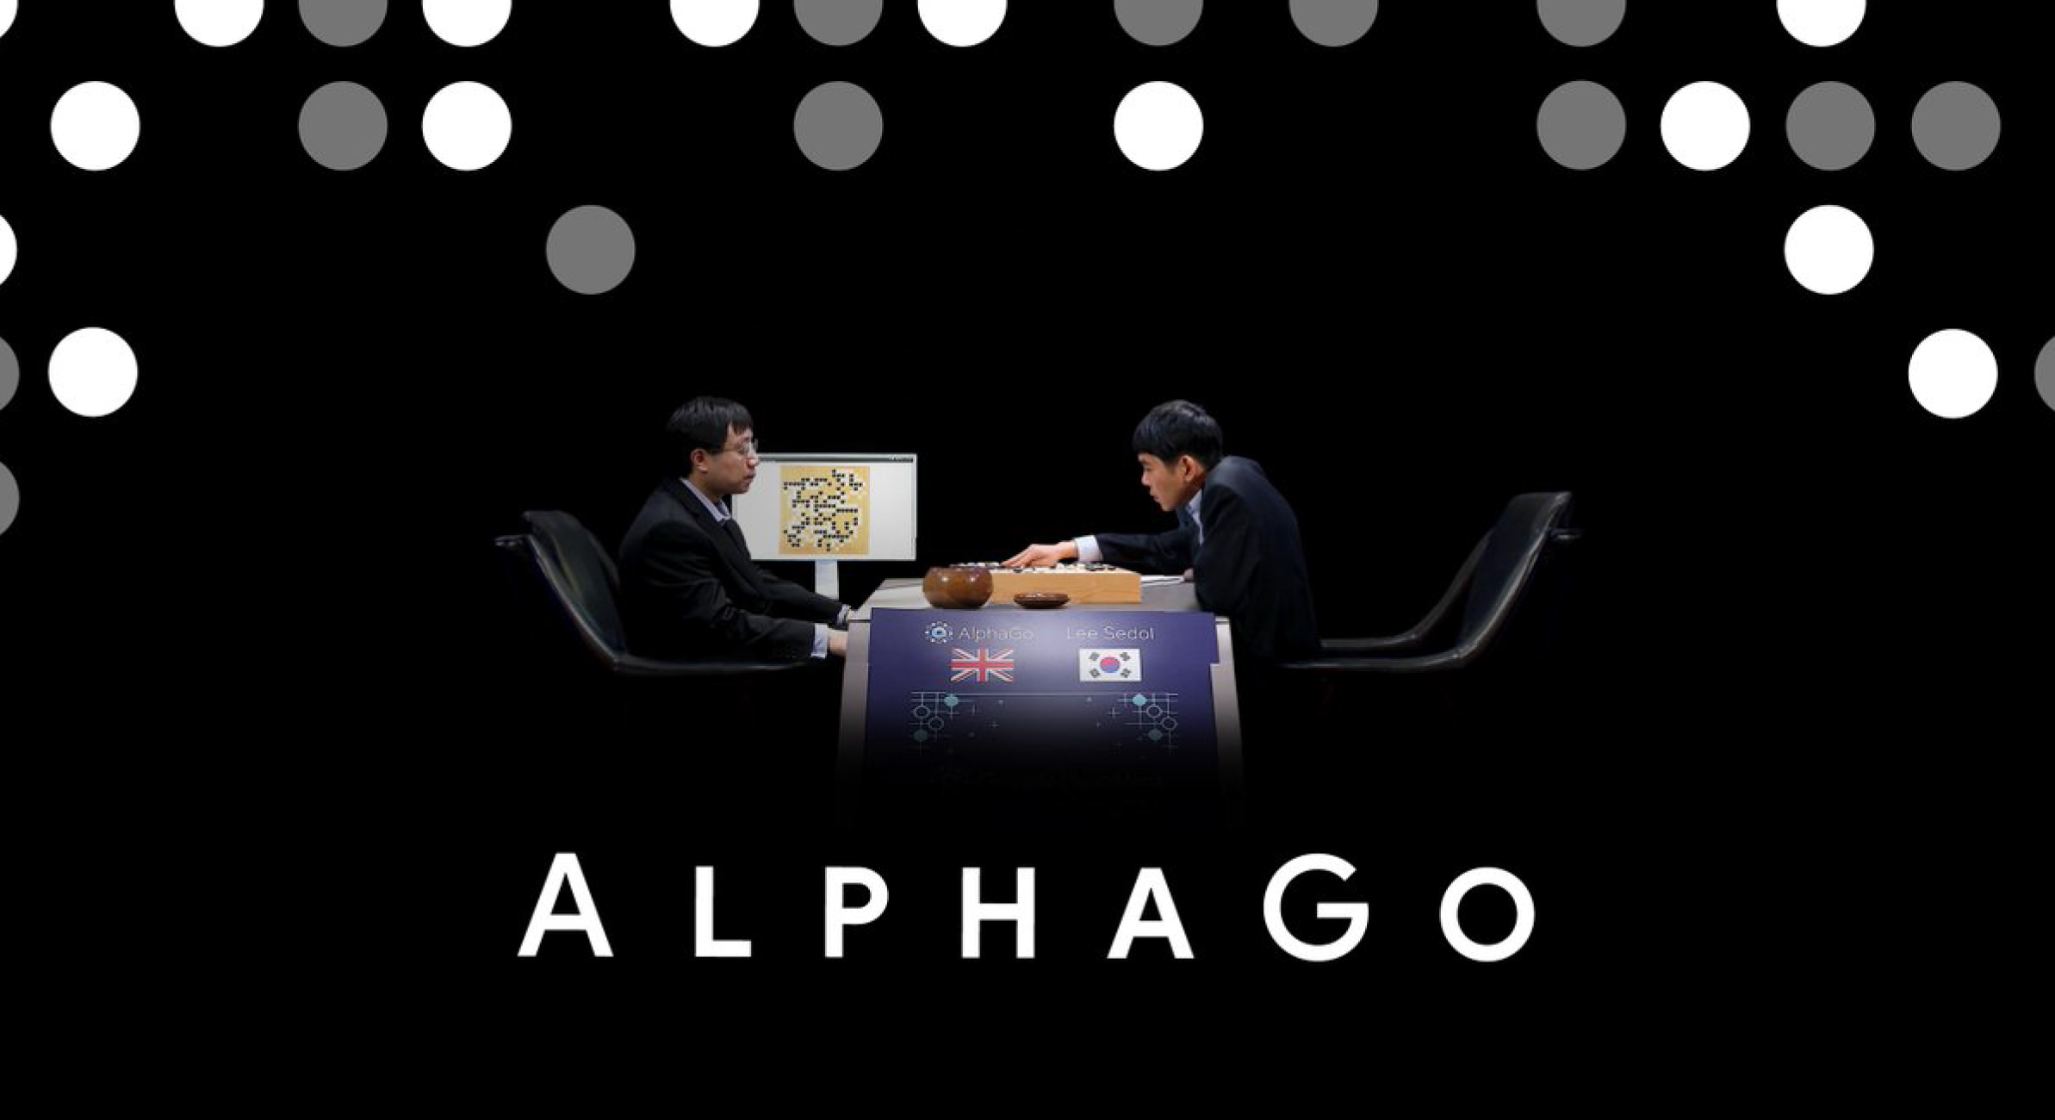
Excitement
https://www.youtube.com/watch?v=WXuK6gekU1Y

Slide 14
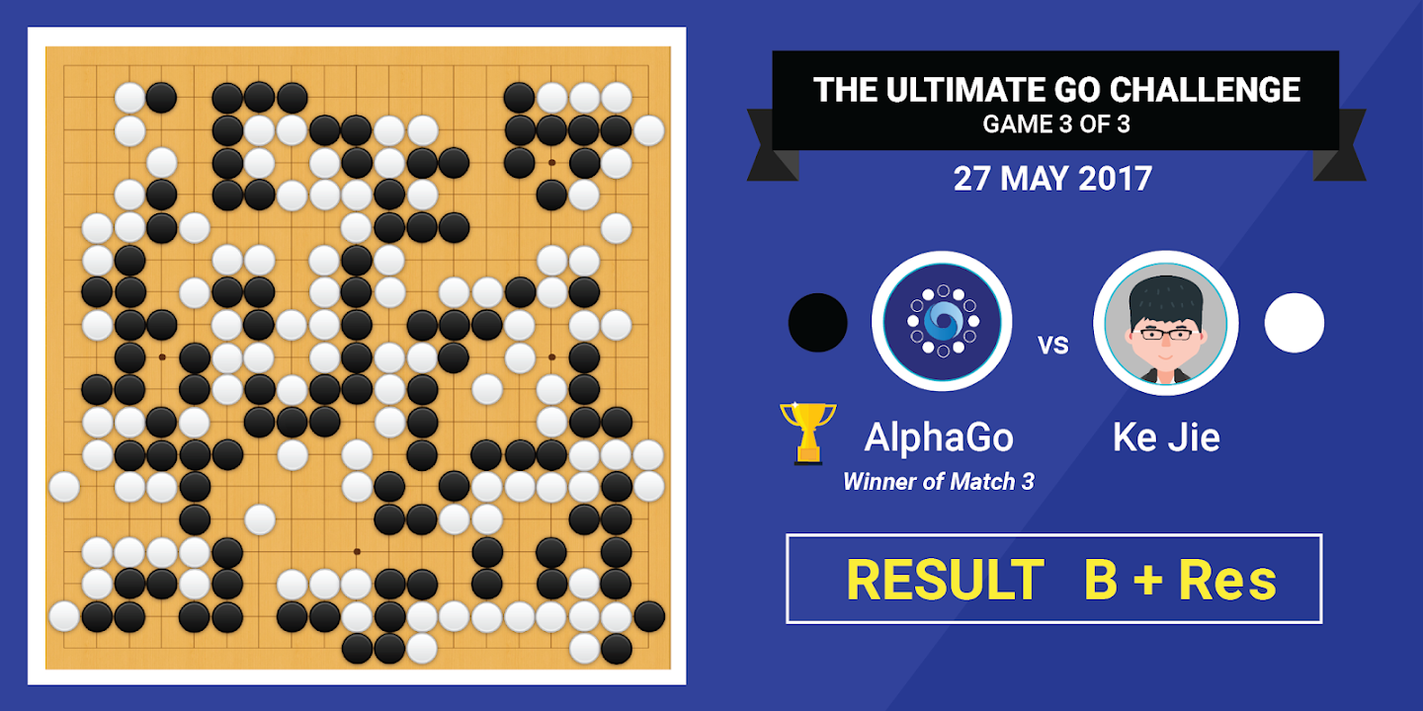
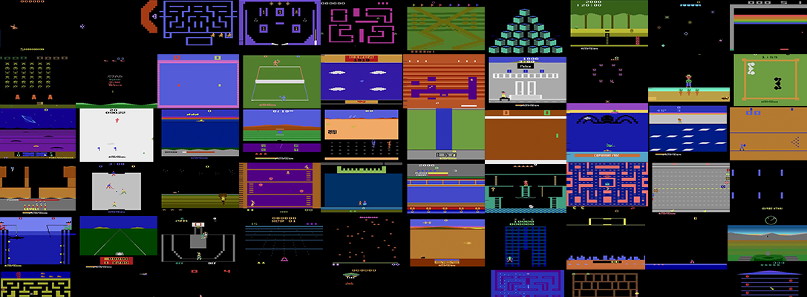
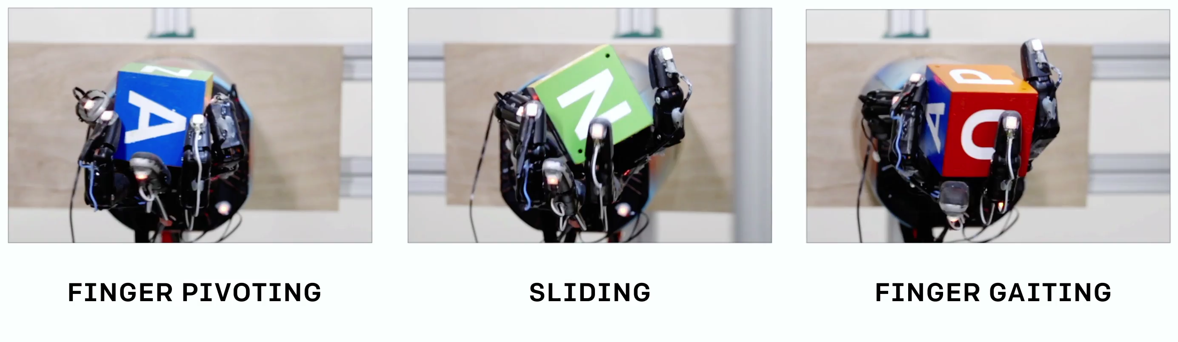
Reinforcement Learning Sucesses
Atari (Google DeepMind)
AlphaGo (Google DeepMind)
Google Nest
Robot manipulation (OpenAI)
AlphaStar (Google DeepMind)

Slide 15
More examples
Atari Breakout https://www.youtube.com/watch?v=TmPfTpjtdgg
Environments: OpenAI Gym
https://gym.openai.com/envs/
Learning locomotion in MuJoCo https://www.youtube.com/watch?v=SHLuf2ZBQSw
Learning to navigate in DeepMind Lab https://www.youtube.com/watch?v=M40rN7afngY
Cart-Pole swing-up on a real robot https://www.youtube.com/watch?v=XiigTGKZfks

Slide 16
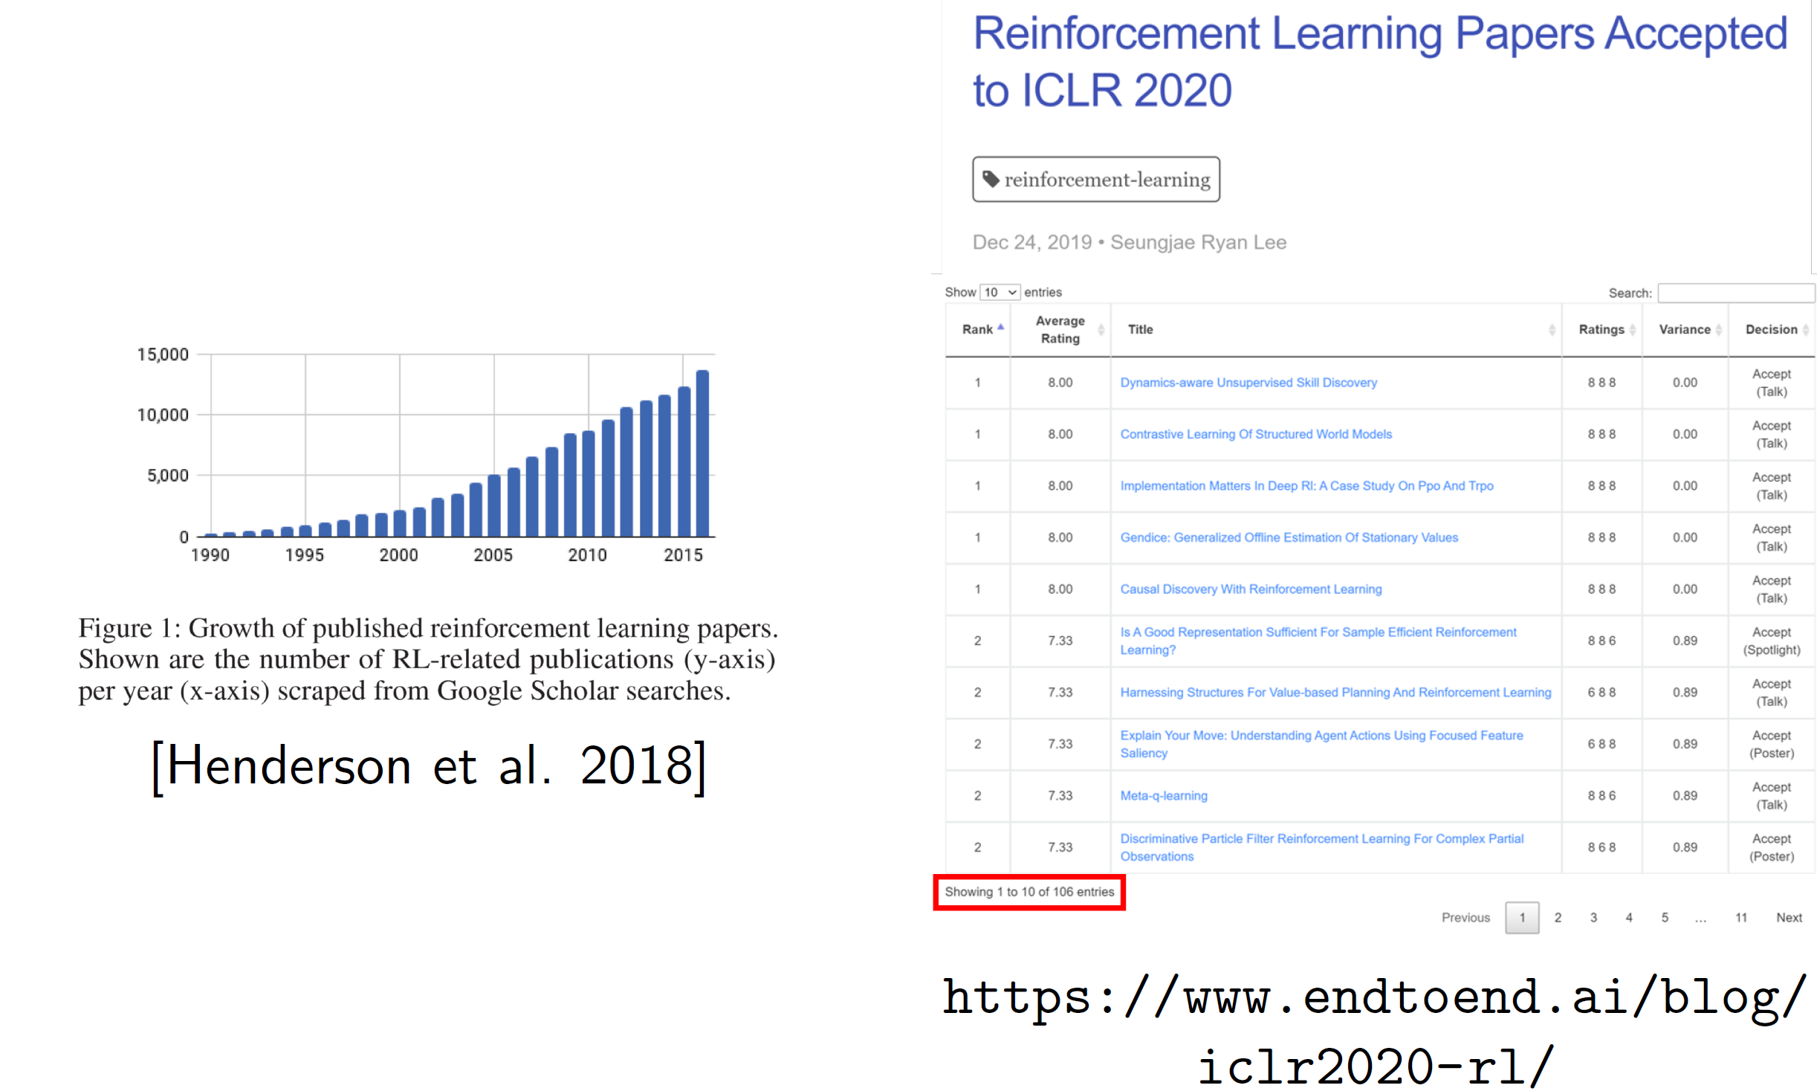
RL excitement
15% of papers

Slide 17
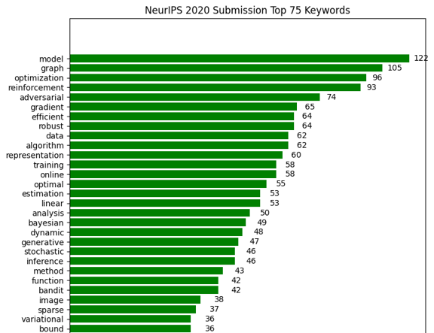
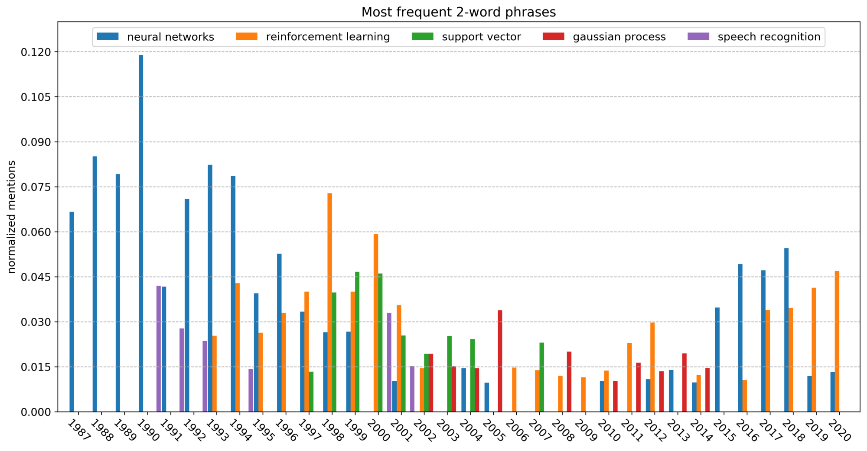
Excitement
Data from NeurIPS
…

Slide 18
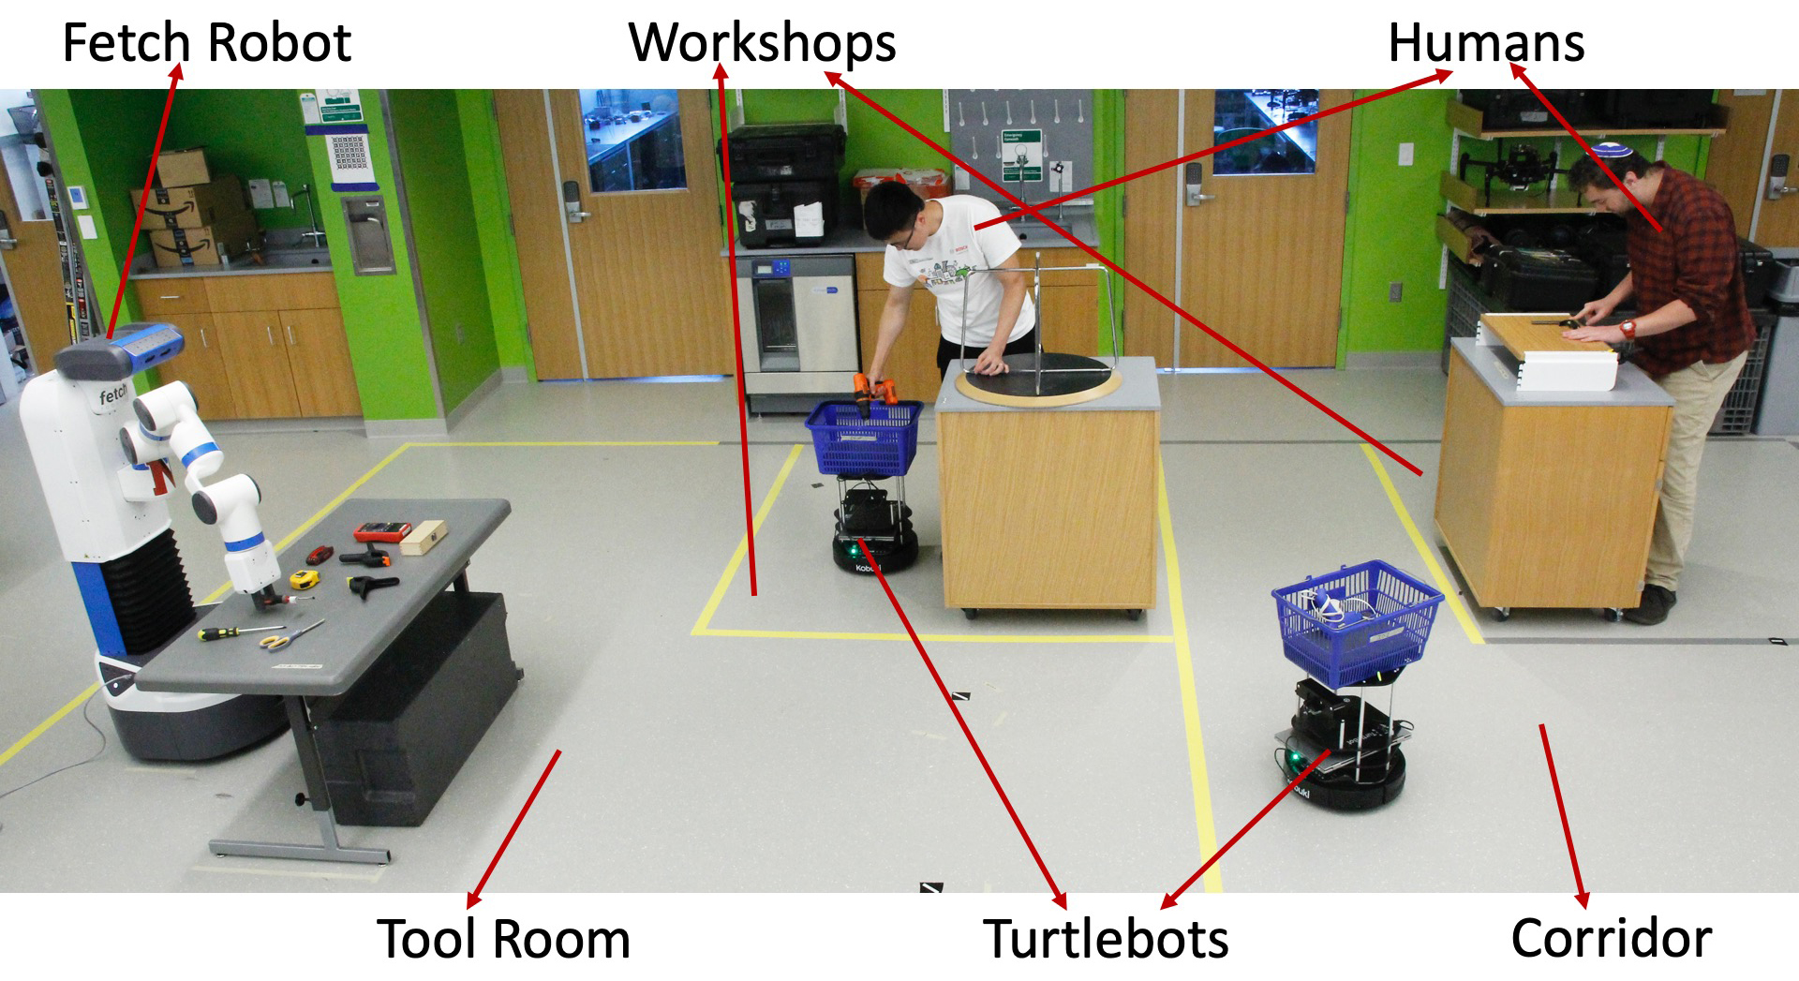
Reinforcement learning
Key characteristics:
Learning from (real-valued) feedback
Learning sequential decisions

Slide 19
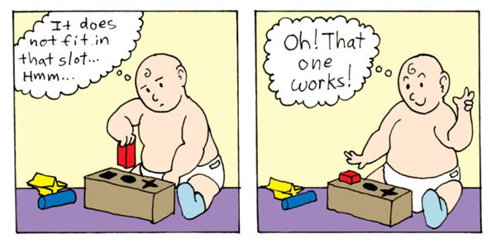
What is reinforcement learning?
RL is learning through trial-and-error without a model of the world
Like an idealized computational model of how humans learn
Notes:
19

Slide 20
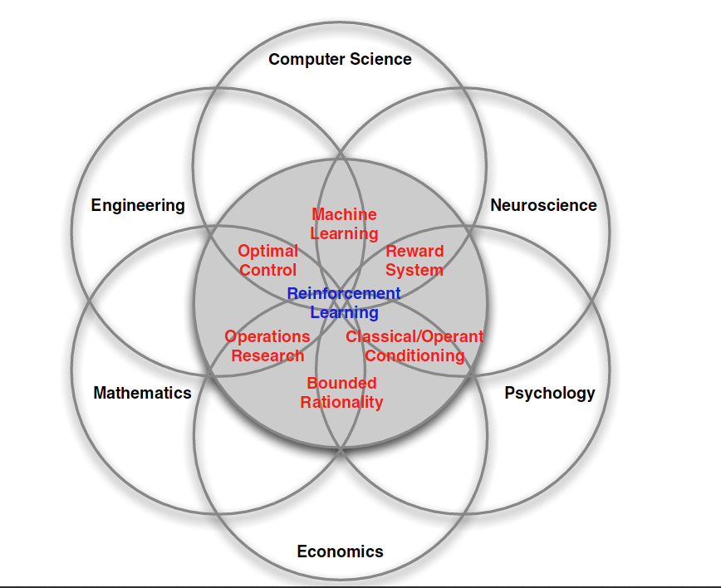
Where does RL live?
Notes:
20

Slide 21
The RL setting
Action
Agent
World
State
Reward
On a single time step, agent does the following:
1. observe some information (e.g., the state)
2. select an action to execute
3. take note of any reward
Goal of agent: select actions that maximize expected cumulative reward
Notes:
21

Slide 22
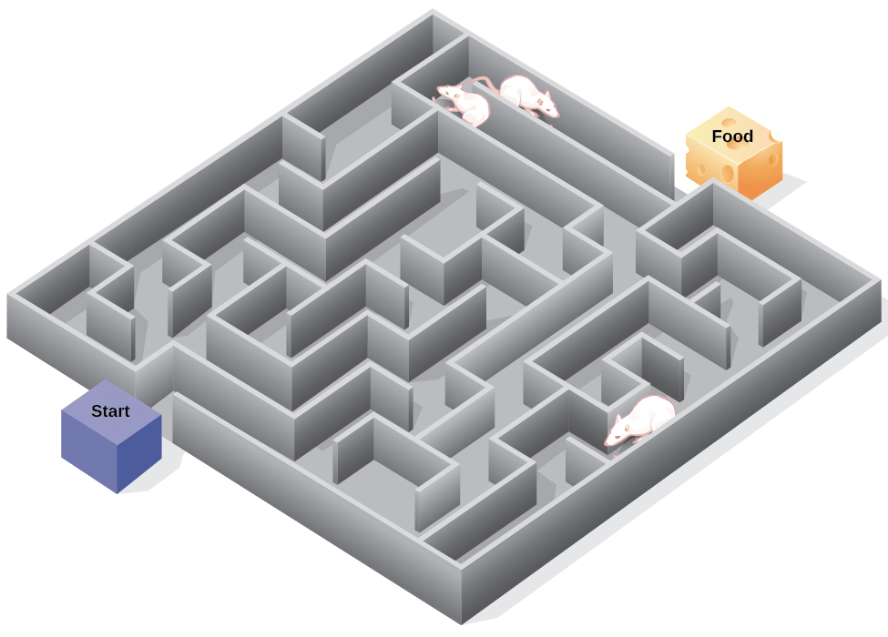
Example: rat in a maze
Move left/right/up/down
Agent
World
Observe position in maze
Reward = +1 if get cheese
Goal: maximize cheese eaten
Notes:
22

Slide 23
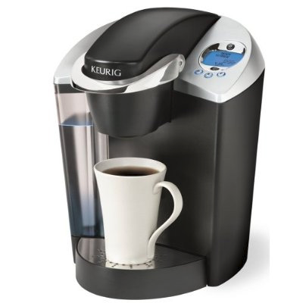
Example: robot makes coffee
Move robot joints
Agent
World
Observe camera image
Reward = +1 if coffee in cup
Goal: maximize coffee produced
Notes:
23

Slide 24
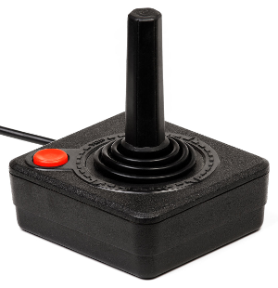
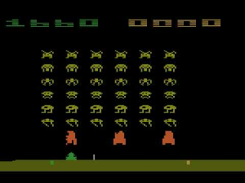
Example: agent plays pong
Joystick command
Agent
World
Observe
screen pixels
Reward = game score
Goal: maximize game score
Notes:
24

Slide 25
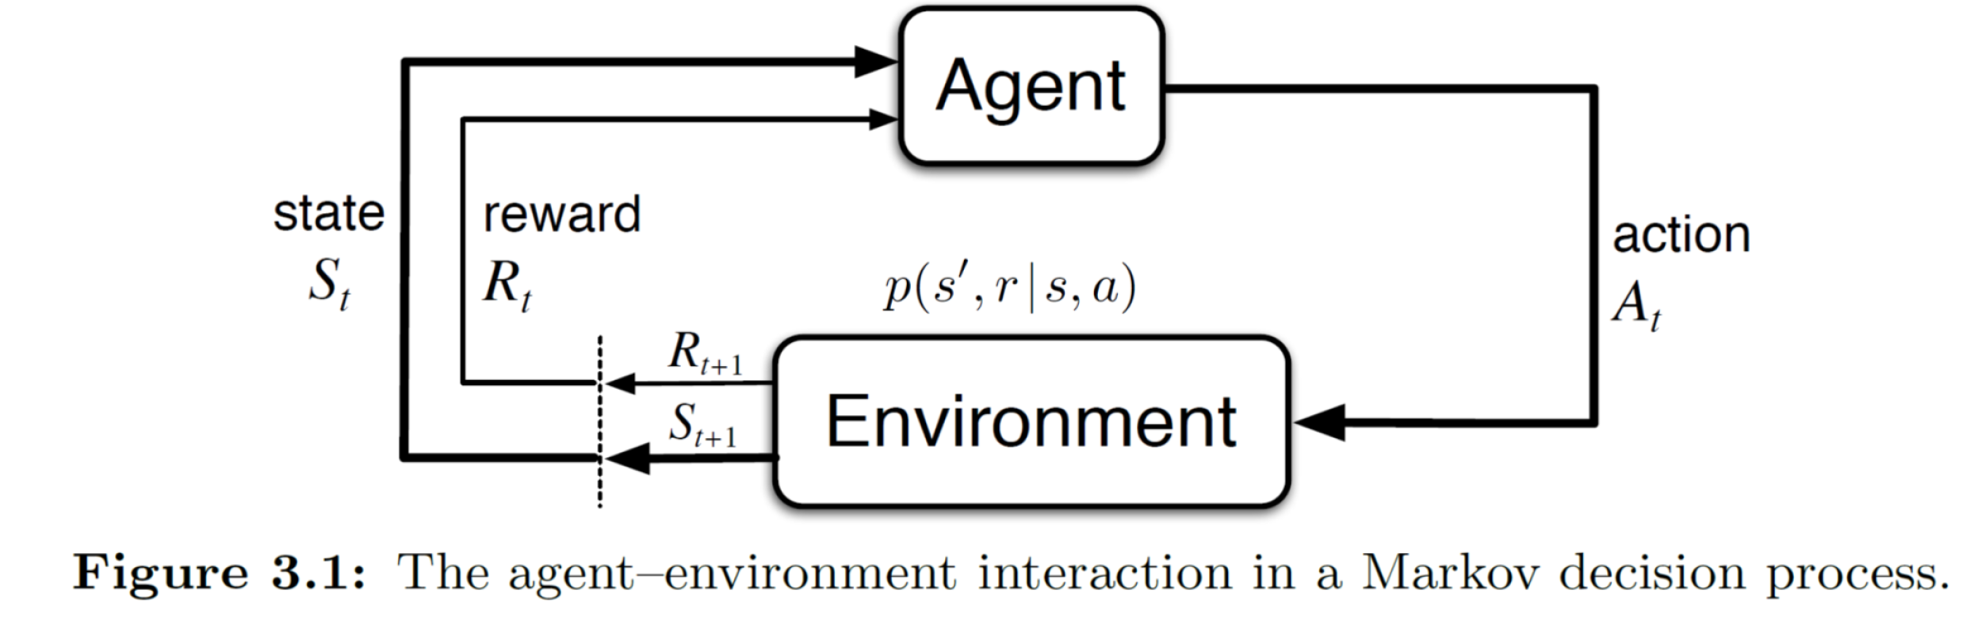
Technical intro to RL

Slide 26
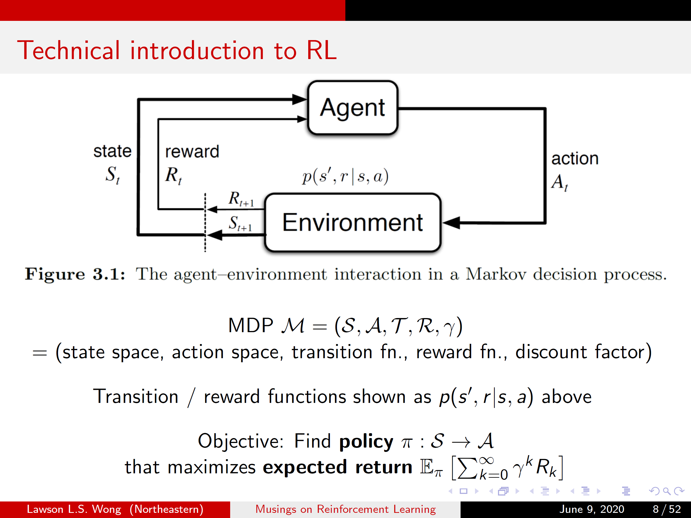
Technical intro to RL

Slide 27
Technical intro to RL

Slide 28
Technical intro to RL

Slide 29
Technical intro to RL

Slide 30
Major historical RL successes
Learned the world’s best player of Backgammon (Tesauro 1995)
Learned acrobatic helicopter autopilots (Ng, Abbeel, Coates et al 2006+)
Widely used in the placement and selection of advertisements and pages on the web (e.g., A-B tests)
Used to make strategic decisions in Jeopardy! (IBM’s Watson 2011)
Achieved human-level performance on Atari games from pixel-level visual input, in conjunction with deep learning (Google Deepmind 2015)
In all these cases, performance was better than could be obtained by any other method, and was obtained without human instruction
Nowadays (nearly?) every industry is trying to incorporate RL: from autonomous cars to AI assistants
Notes:
30

Slide 31
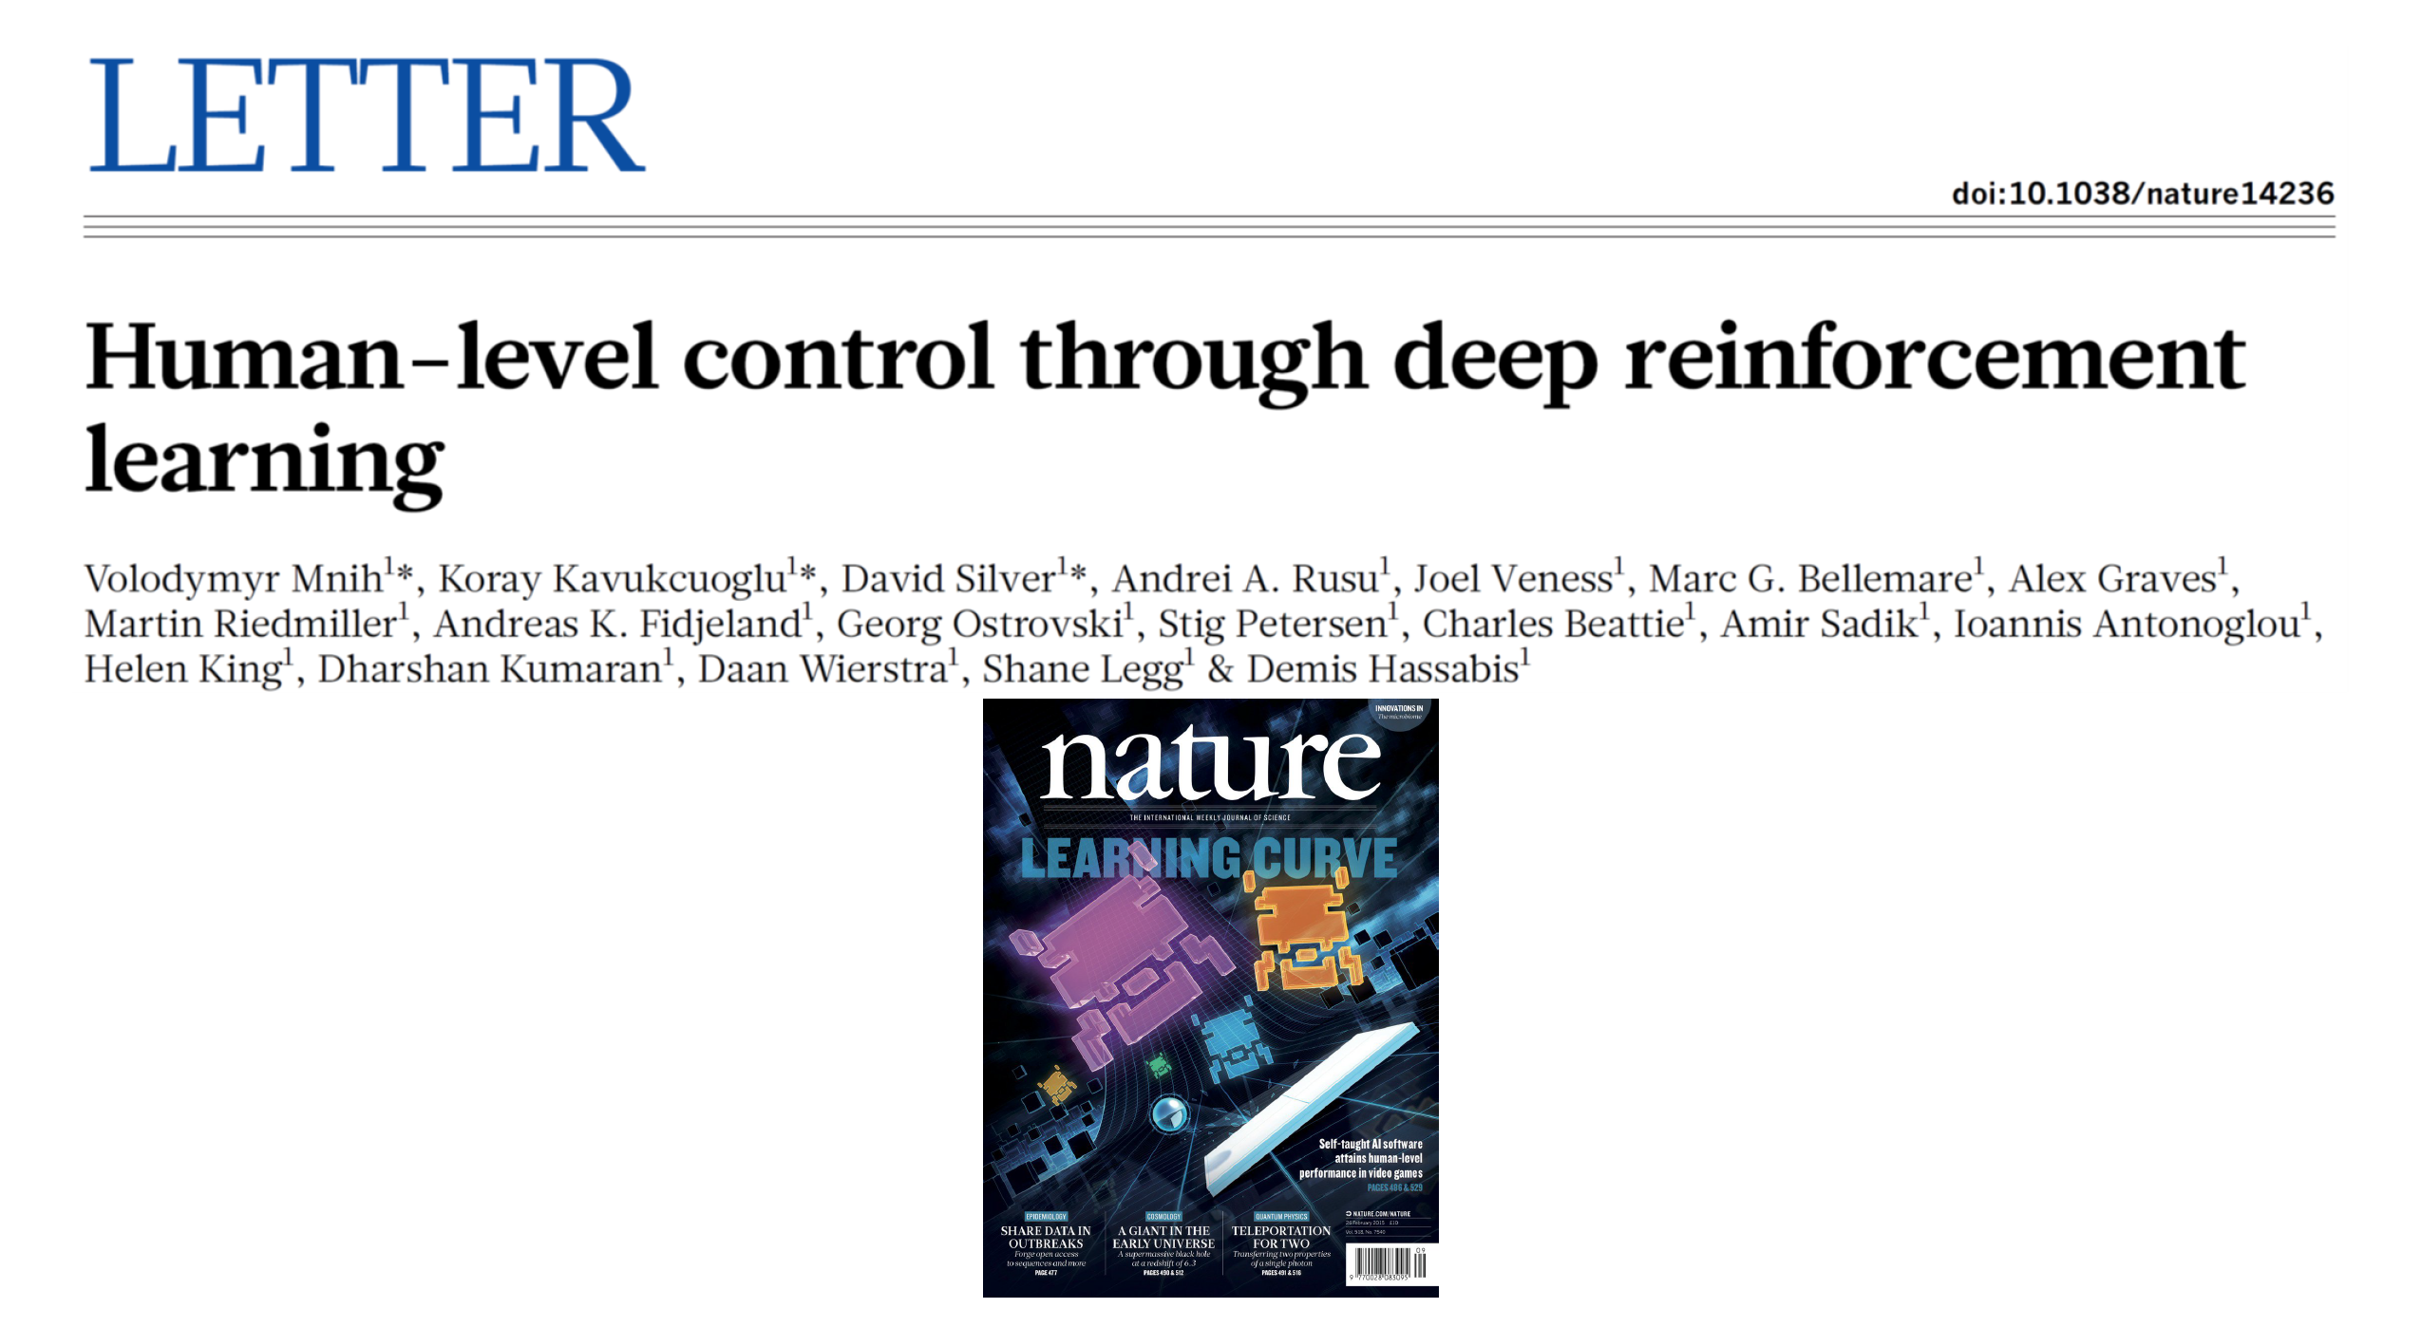
Deep Q-networks (DQN) (2015)

Slide 32
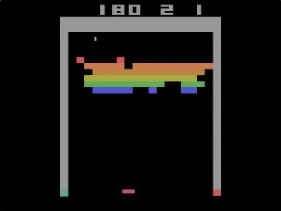
DQN on Breakout

Slide 33
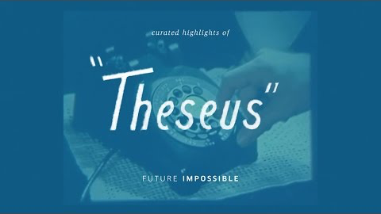
Rat in maze: Theseus (1950’s)

Slide 34
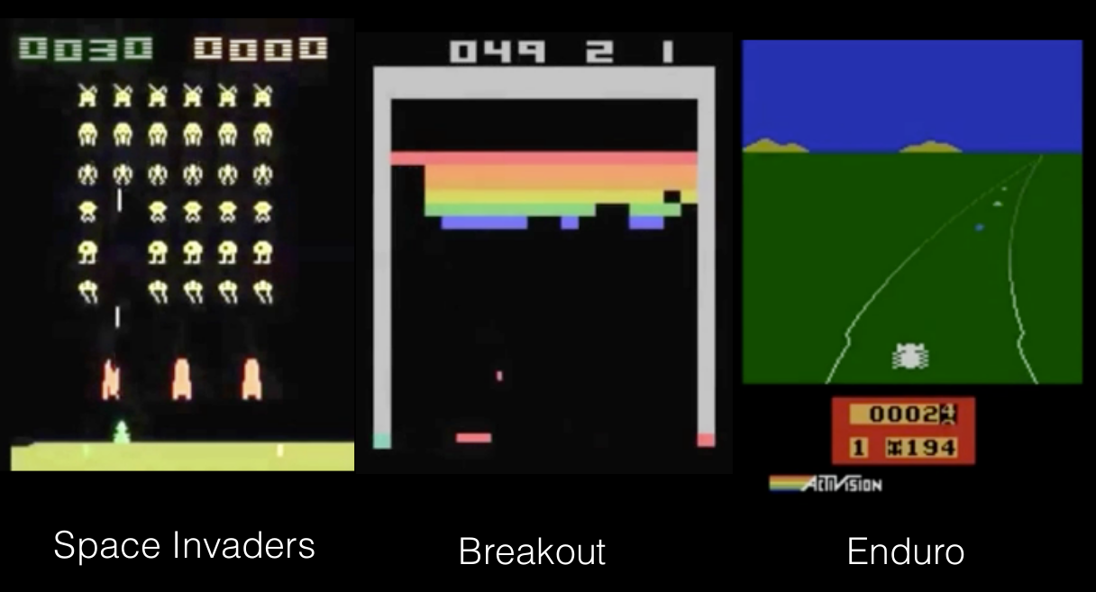
RL + deep learning on Atari games
Notes:
34

Slide 35
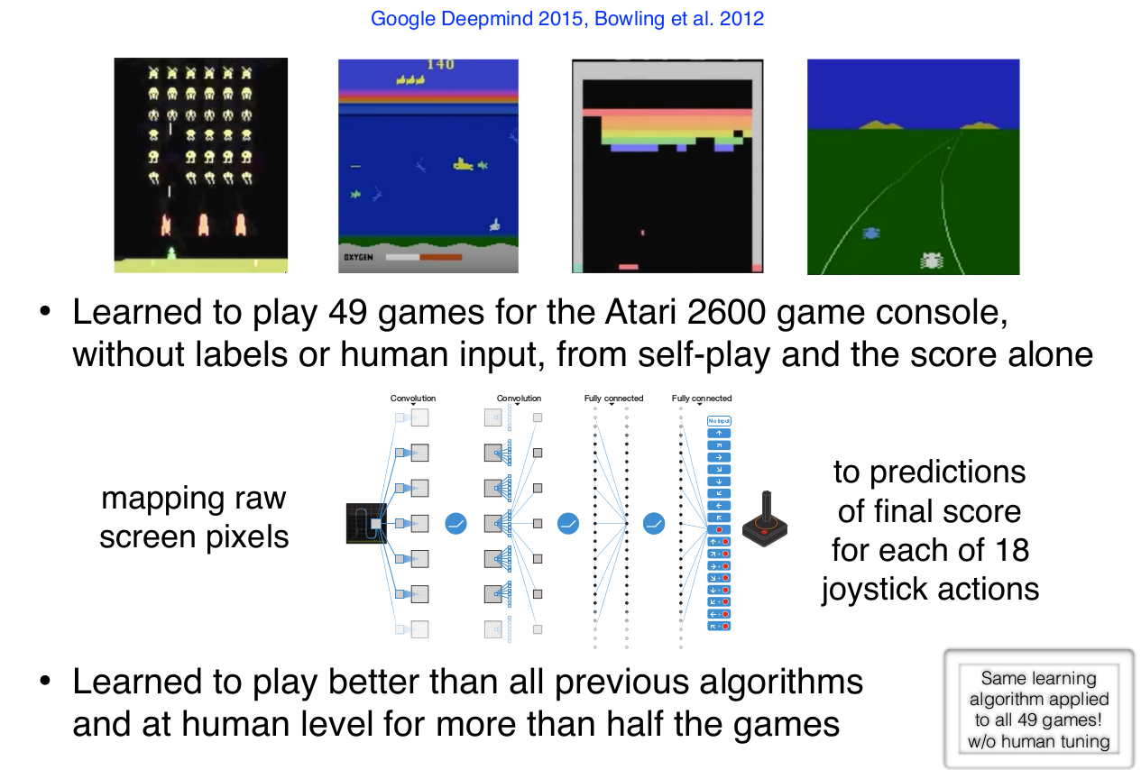
RL + deep learning on Atari games
Notes:
35

Slide 36
Note
Reinforcement learning is very general and has demonstrated promise
However, RL is a very challenging problem and is still very much a research field

Slide 37
Key challenges for RL
no model of the environment
agent only gets a scalar reward signal
delayed feedback
need to balance exploration of the world exploitation of learned knowledge
real world problems can be non-stationary

Slide 38
What about MARL?
What do you know already?

Slide 39
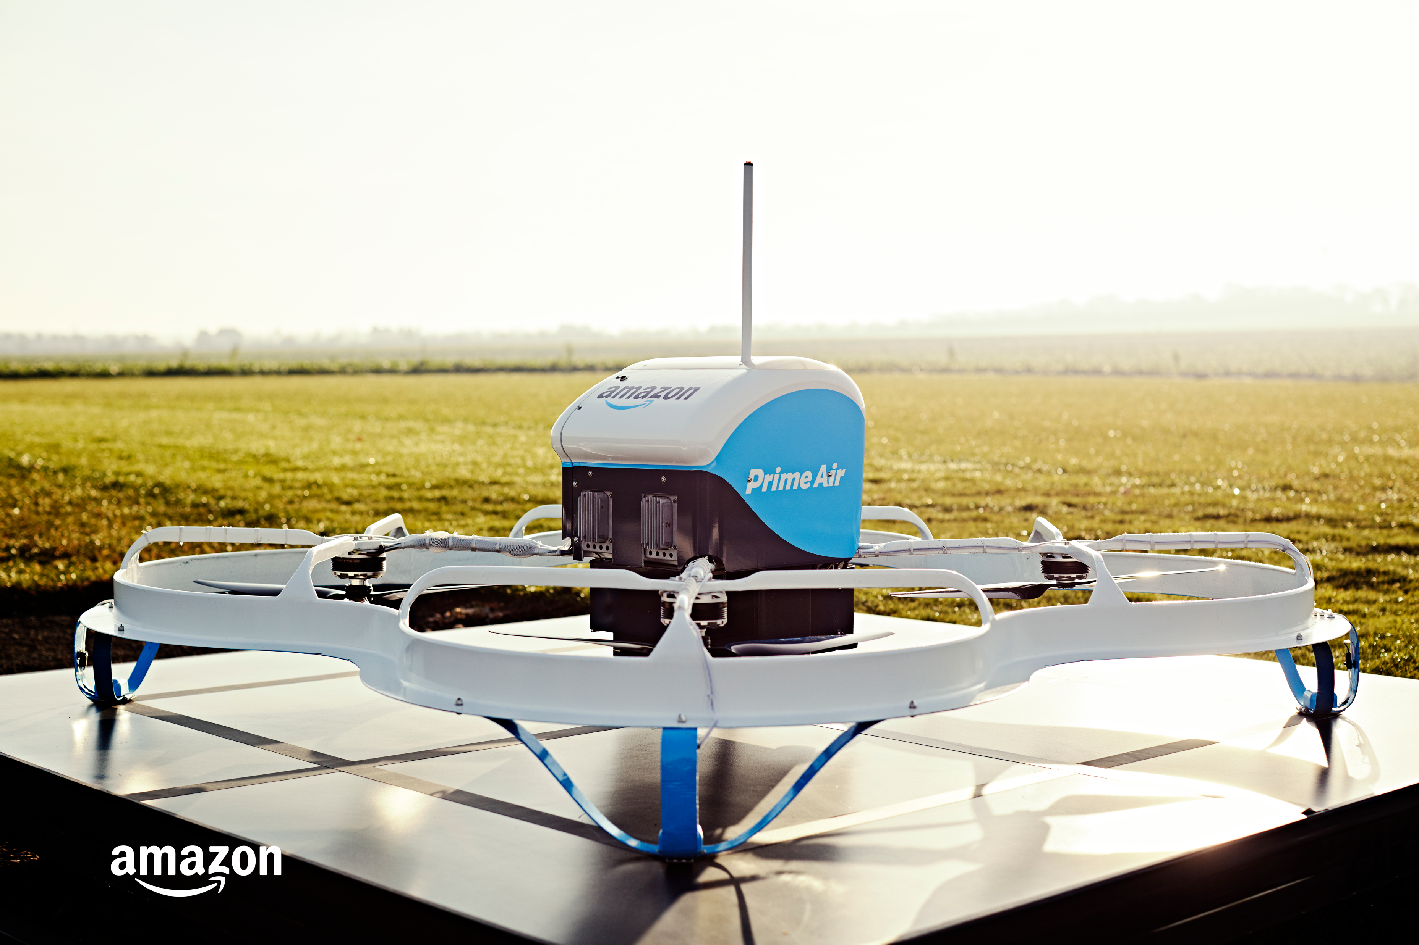
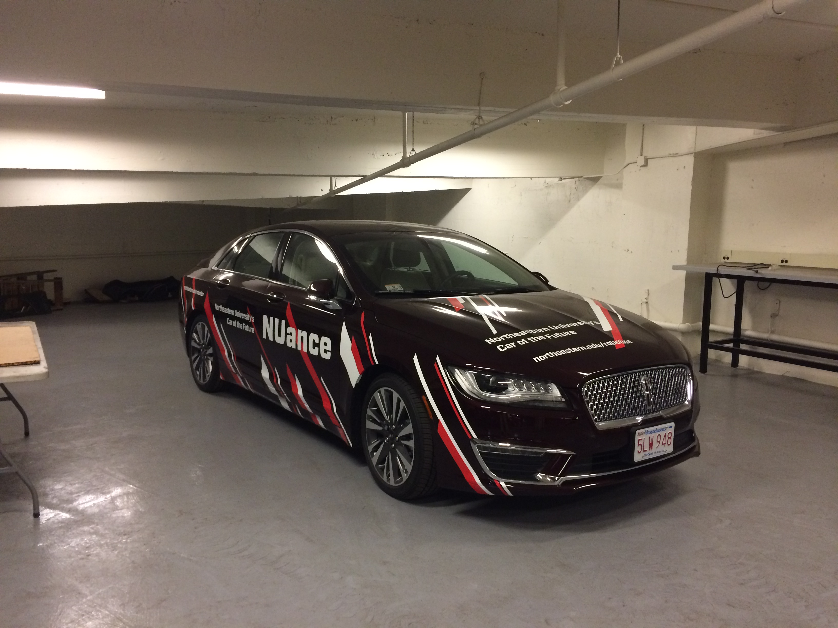



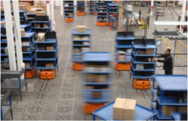
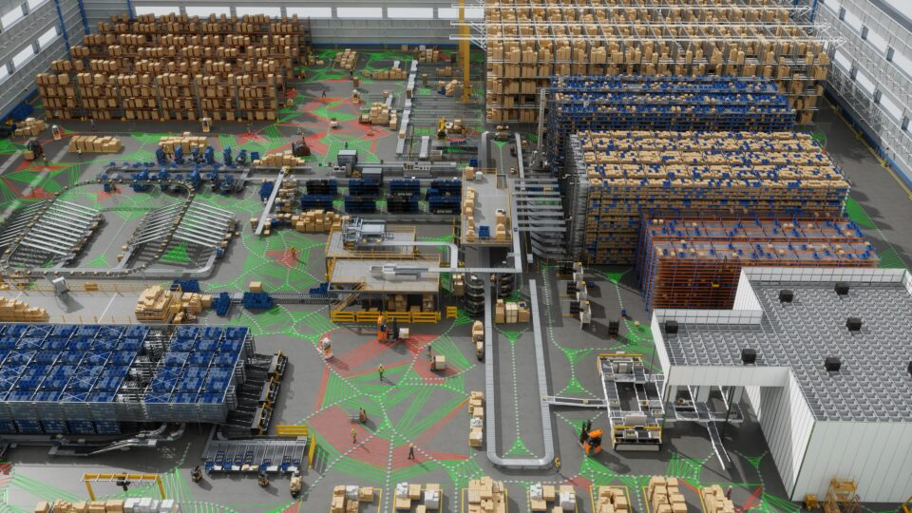
Multi-agent systems are (going to be) everywhere
Drone delivery
LLM agents
Autonomous cars
Amazon
Northeastern
Home robots
Warehouse robots
Factories
iRobot
Amazon
Accenture/nvidia
Useful for scalability, robustness, specialization, etc.
Notes:
Factories: (humans, robots, other agents) https://blogs.nvidia.com/blog/mega-omniverse-blueprint/

Slide 40
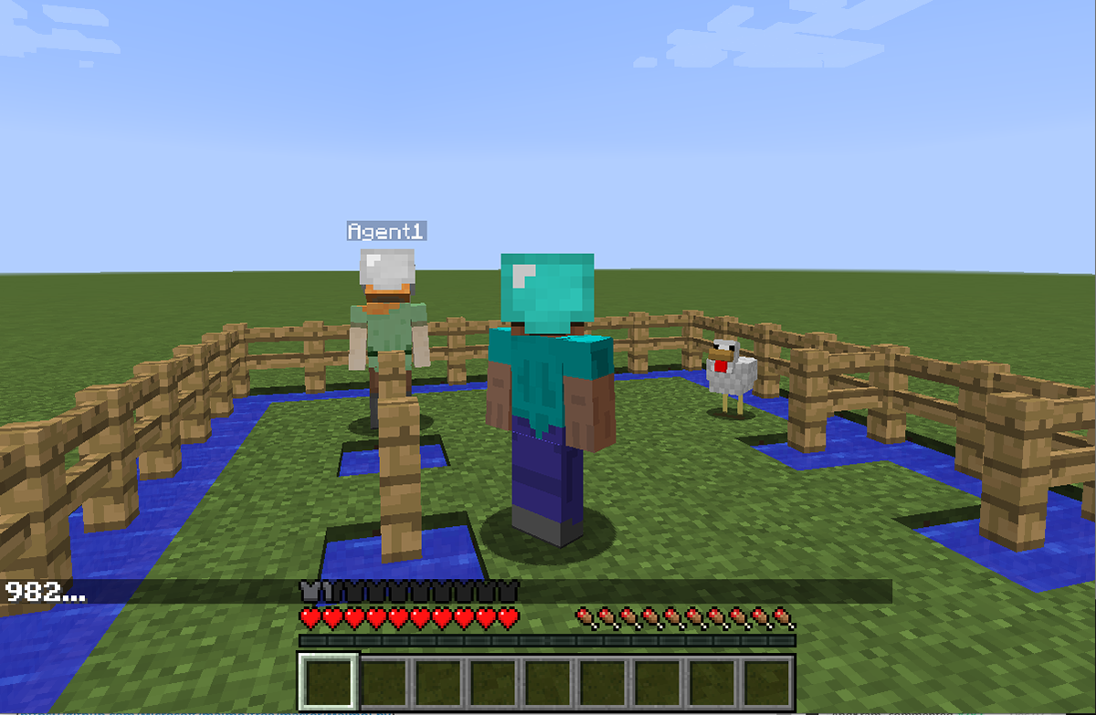
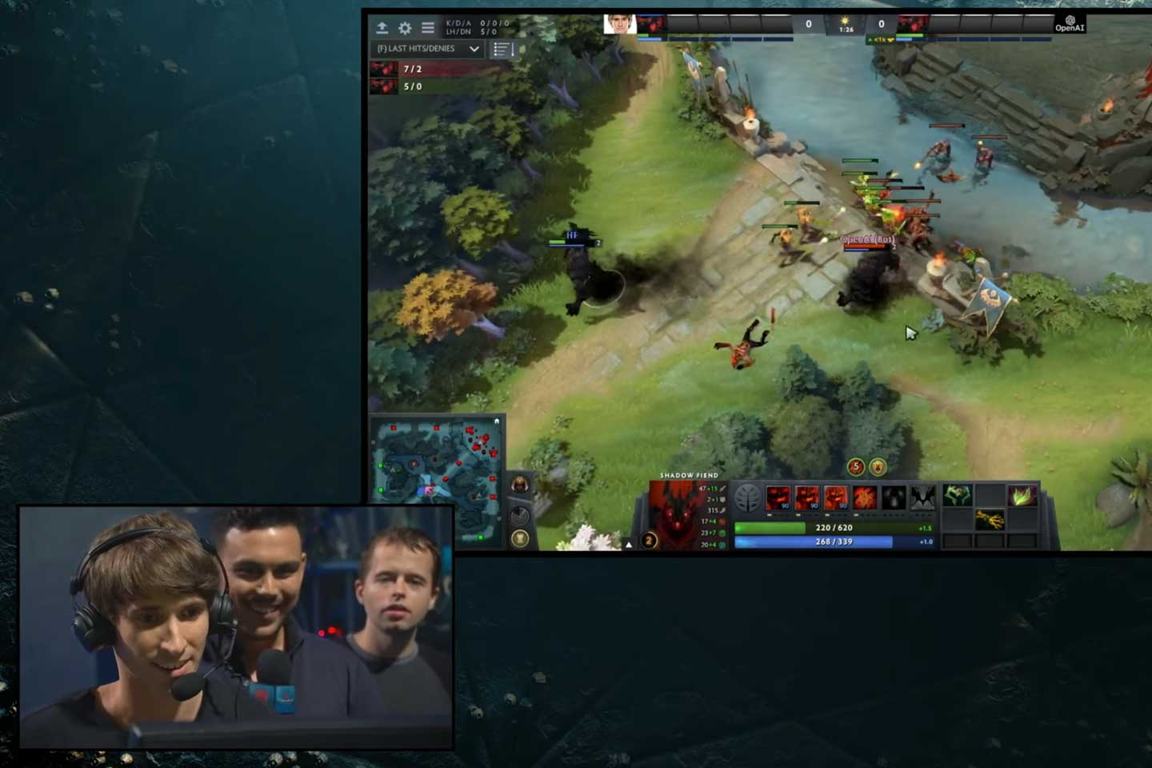
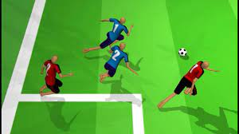
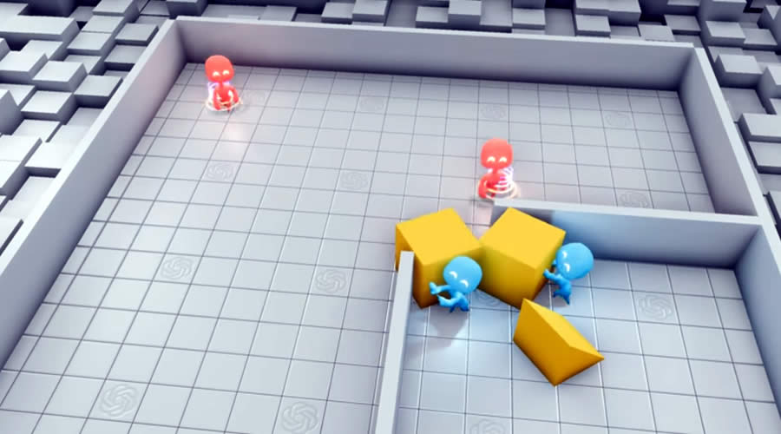
Multi-agent RL has had some successes
Project Malmo (Microsoft Research)
OpenAI Five Dota 2 (OpenAI)
Humanoid Soccer (Google DeepMind)
Emergent tool use (OpenAI)
AlphaStar (Google DeepMind)

Slide 41
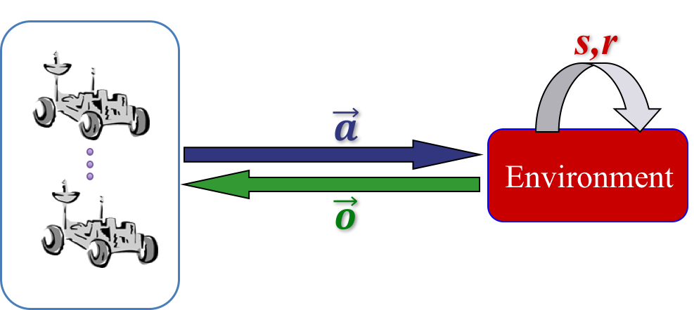
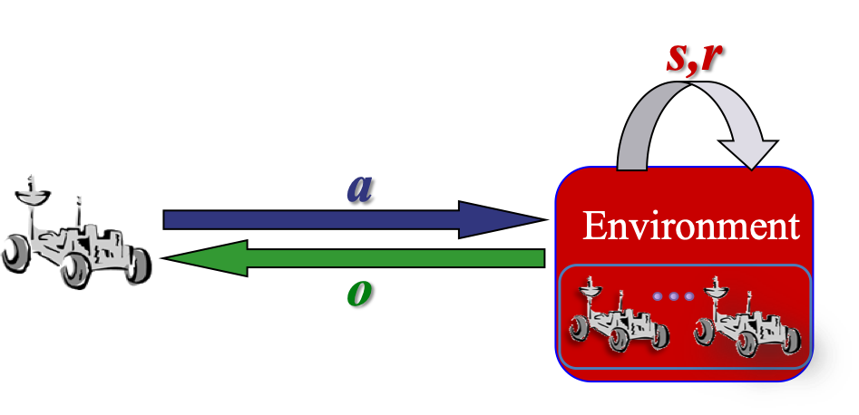
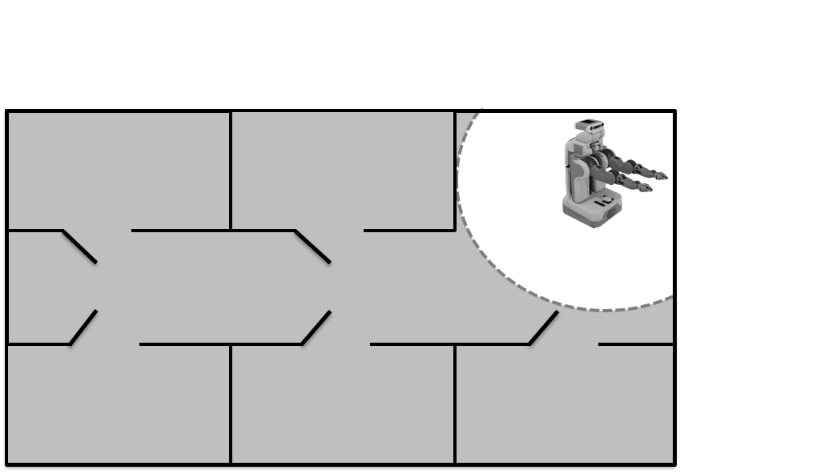
Multi-agent RL is hard
How can we apply RL here?
Centralized learning and control? Need fast, perfect communication (cooperative case)
Decentralized learning and control? Limited knowledge of other agents and environmental nonstationarity
Centralized training for decentralized execution? Use centralized information offline but still execute in a decentralized way
Almost always have partial observability

Slide 42
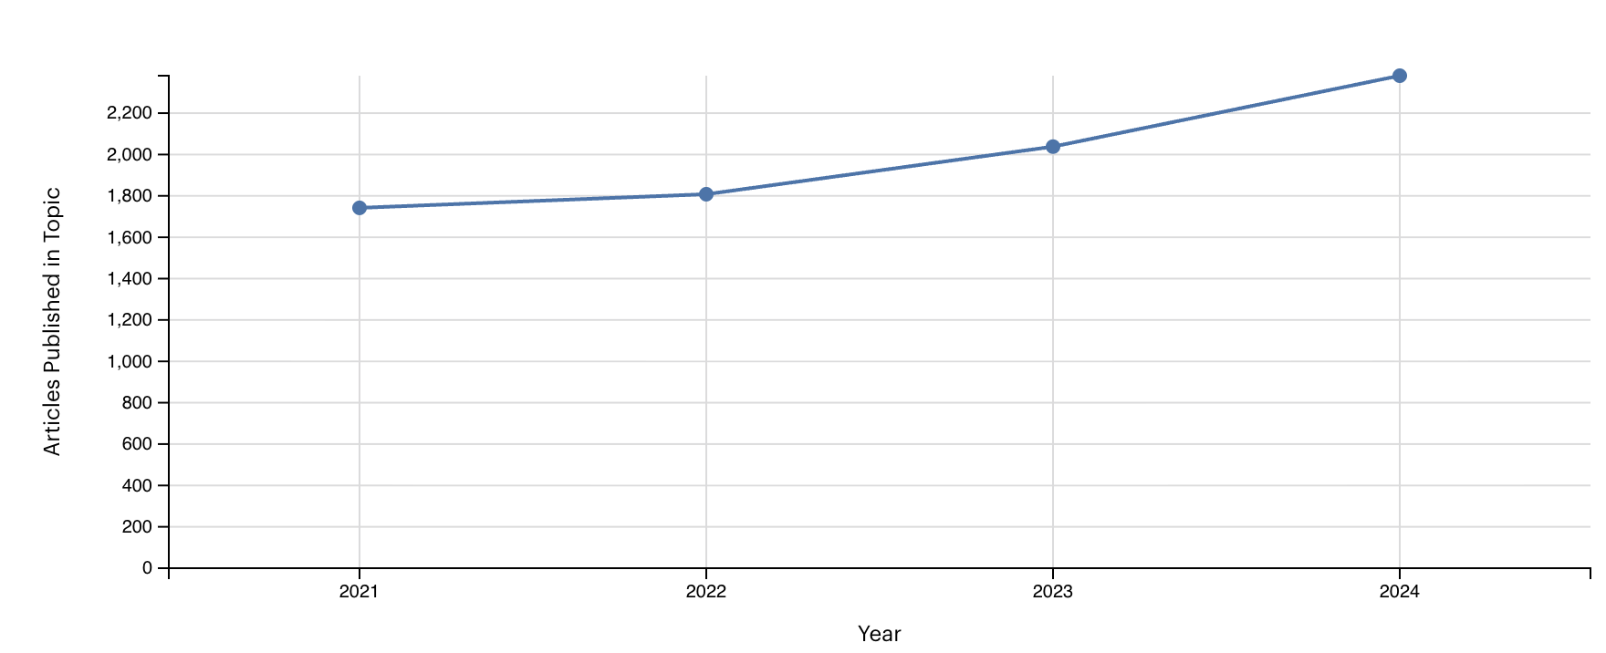
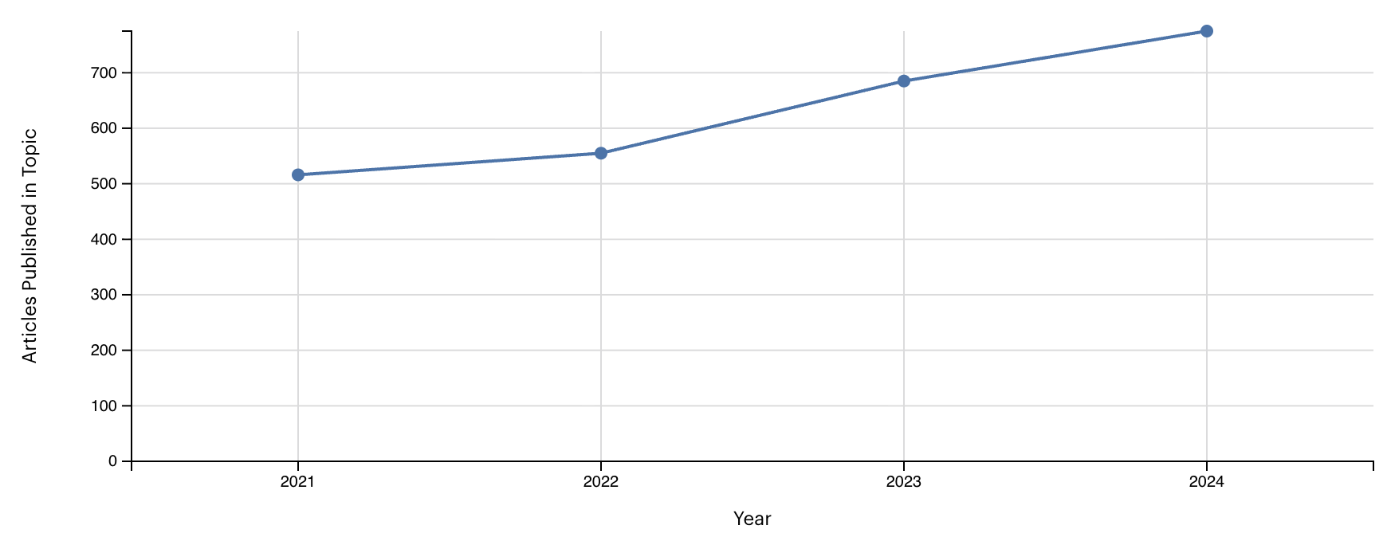
Multi-agent RL (MARL) excitement
A lot of publications in MARL (and RL)
Google scholar says 1,070 results so far this year with ”multi-agent reinforcement learning” in the title
RL overall
MARL
Nature: research intelligence¹
1
https://www.nature.com/research-intelligence/nri-topic-summaries/multi-agent-reinforcement-learning-micro-1393

Slide 43
Overview
Define the cooperative multi-agent RL (MARL) problem
Discuss the current state-of-the art for the different classes of solutions
Centralized training and execution
Decentralized training and execution: IQL, decentralized REINFORCE, deep extensions
CTDE: VDN, QMIX, QPLEX, MADDPG, MAPPO
Identify misconceptions/issues with current methods
Applications, code, other topics, and the future (LLMs?)

Slide 44
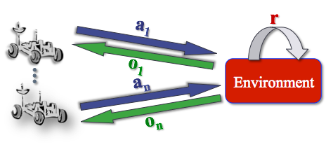
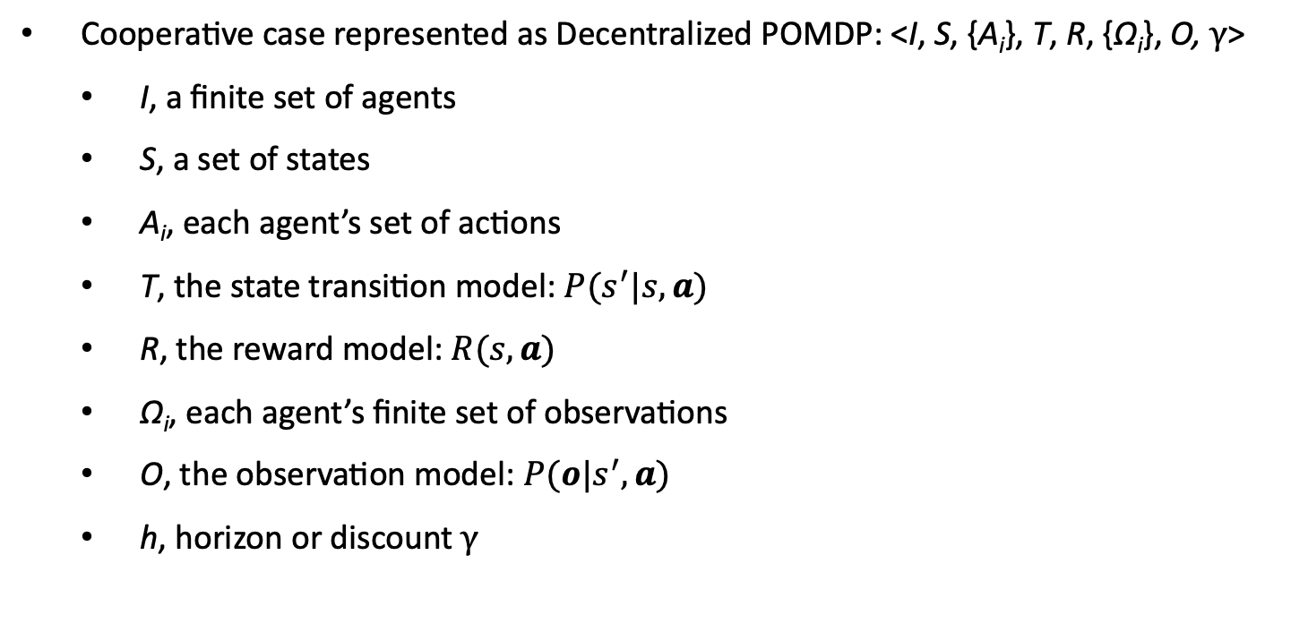
Cooperative MARL
Cooperative case represented as Decentralized POMDP: <I, S, {A_{i}}, T, R, {Ω_{i}}, O, γ>
I, a finite set of agents
S, a set of states
A_{i}, each agent’s set of actions
T, the state transition model: $P(s^{′}|s,a)$
R, the reward model: $R(s,a)$
Ω_{i}, each agent’s finite set of observations
O, the observation model: $P(o|s^{′},a)$
h, horizon or discount γ
Notes:
Much of the work here can also be applied to the POSG case

Slide 45
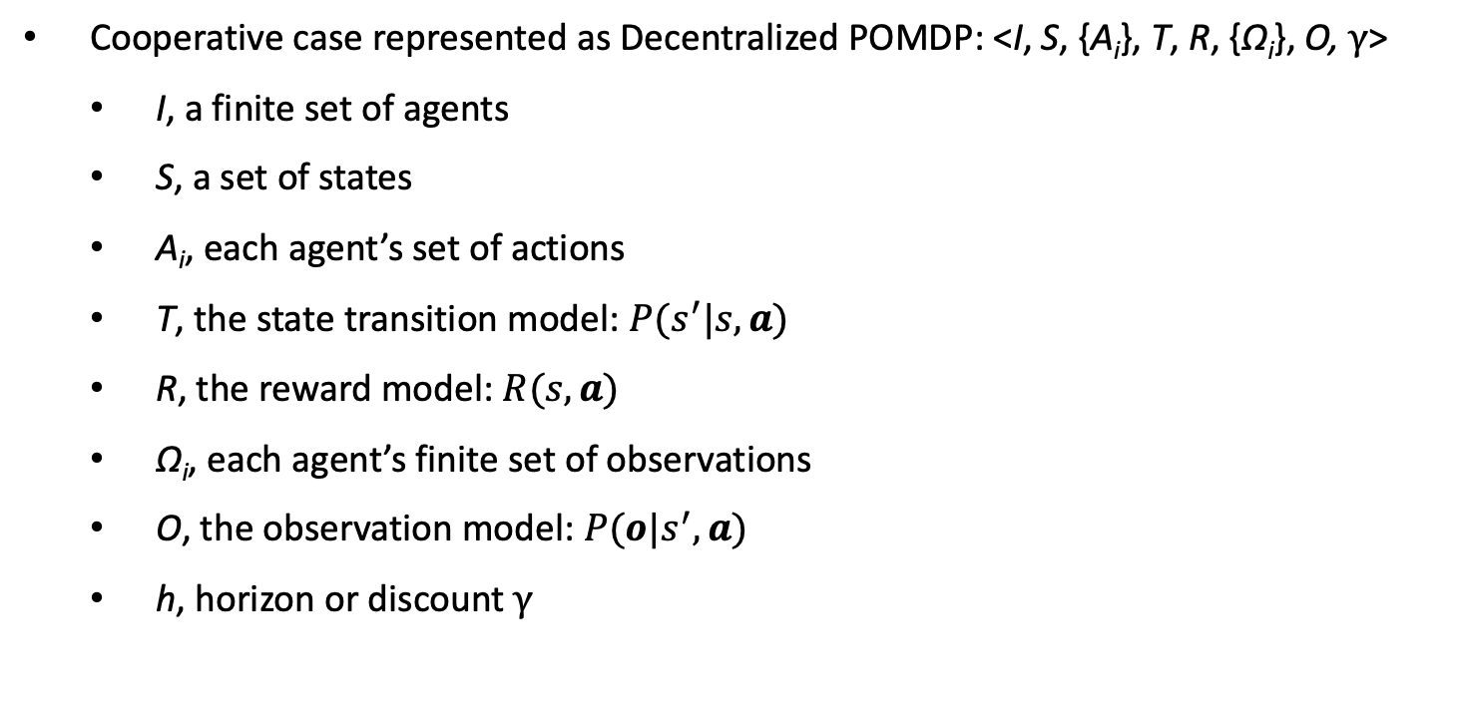
Cooperative MARL
Cooperative case represented as Decentralized POMDP: <I, S, {A_{i}}, T, R, {Ω_{i}}, O, γ>
I, a finite set of agents
S, a set of states
A_{i}, each agent’s set of actions
T, the state transition model: $P(s^{′}|s,a)$
R, the reward model: $R(s,a)$
Ω_{i}, each agent’s finite set of observations
O, the observation model: $P(o|s^{′},a)$
h, horizon or discount γ
Objective: Maximize the (discounted) sum of future (joint) rewards Cooperative
Notes:
Much of the work here can also be applied to the POSG case

Slide 46
Cooperative MARL
Cooperative case represented as Decentralized POMDP: <I, S, {A_{i}}, T, R, {Ω_{i}}, O, γ>
I, a finite set of agents
S, a set of states
A_{i}, each agent’s set of actions
T, the state transition model: $P(s^{′}|s,a)$
R, the reward model: $R(s,a)$
Ω_{i}, each agent’s finite set of observations
O, the observation model: $P(o|s^{′},a)$
h, horizon or discount γ
Objective: Maximize the (discounted) sum of future (joint) rewards
Calculate a set of optimal policies for each agent π_{i}*: H_{i} → A_{i} that maximize joint objective
Notes:
Much of the work here can also be applied to the POSG case

Slide 47
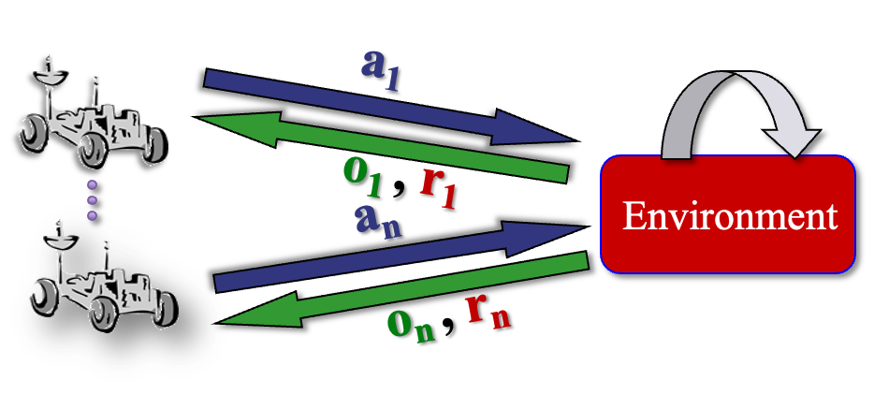
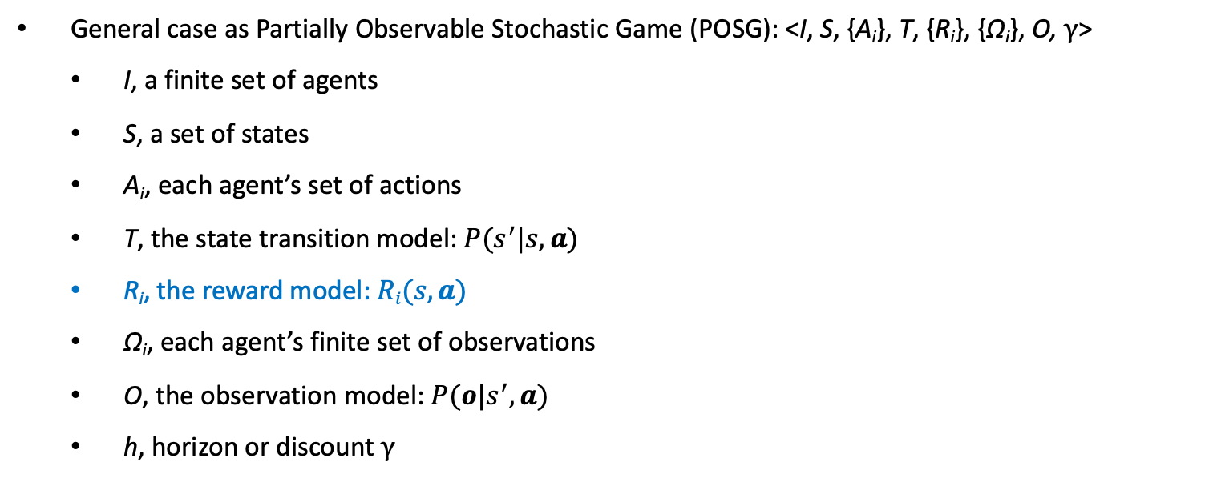
General MARL
General case as Partially Observable Stochastic Game (POSG): <I, S, {A_{i}}, T, {R_{i}}, {Ω_{i}}, O, γ>
I, a finite set of agents
S, a set of states
A_{i}, each agent’s set of actions
T, the state transition model: $P(s^{′}|s,a)$
R_{i}, the reward model: $Ri(s,a)$
Ω_{i}, each agent’s finite set of observations
O, the observation model: $P(o|s^{′},a)$
h, horizon or discount γ
Objective unclear: Some form of each agent maximizing the (discounted) sum of future individual rewards Mixed/competitive
Note: This class will focus on the cooperative case but we can talk about how cooperative methods extend to the general case and read some papers in this area
Notes:
Much of the work here can also be applied to the POSG case

Slide 48
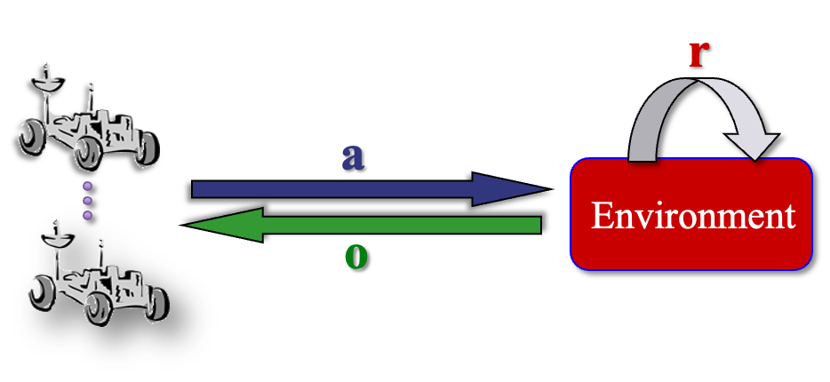
Centralized MARL
Assumptions:
a centralized controller chooses actions for each agent, a
each agent takes the chosen actions a = ⟨a₁,...,a_{n}⟩,
the centralized controller observes the resulting observations o = ⟨o₁,...,o_{n}⟩
the (centralized) algorithm/controller observes o (and a) and the joint reward r
Centralized
Actor
Centralized
Critic
Note: Not a Dec-POMDP (or POSG) anymore since execution is centralized

Slide 49

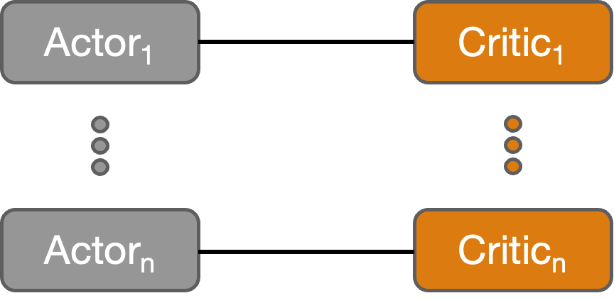
Decentralized MARL
Assumptions:
each agent, i, observes its current observation, o_{i}, and takes action a_{i} at the resulting history, h_{i},
the (decentralized) algorithm/controller sees the same information (o_{i} and a_{i} ) as well as the joint reward r.

Slide 50
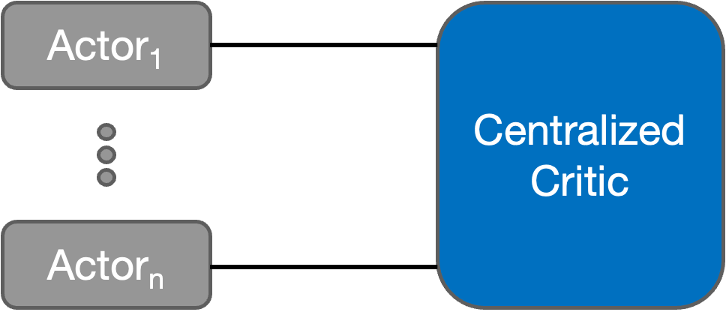
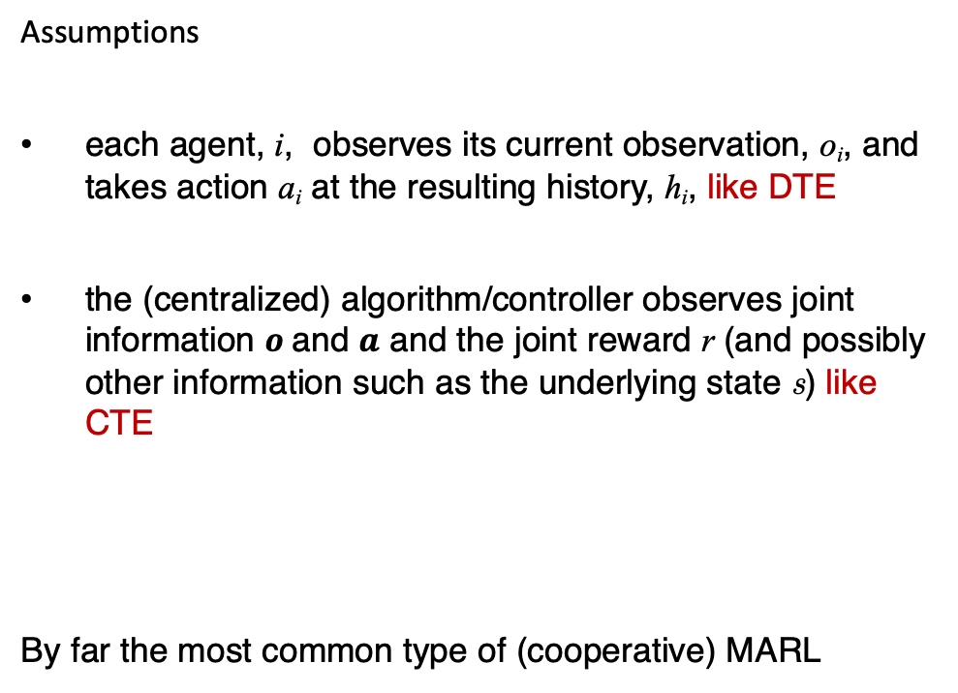
Centralized training for decentralized execution (CTDE)
Assumptions
each agent, i, observes its current observation, o_{i}, and takes action a_{i} at the resulting history, h_{i}, like DTE
the (centralized) algorithm/controller observes joint information $o$and $a$ and the joint reward r (and possibly other information such as the underlying state s) like CTE
By far the most common type of (cooperative) MARL

Slide 51
What are you most excited about learning?
MARL subareas
Exploration
Communication
Application areas
Evaluation (benchmarks and metrics)
Hierarchical methods
Model-based methods
Ad-hoc teamwork and zero-shot coordination
MARL with/for LLMs
What else?

Slide 52
Next time
RL review!

